Slide 1



Group -1: Capstone Project Review
SALES GROWTH ANALYSIS
Members -
Sowmiya E (4515)
Nithiksha R (4516)
Logesh P M (4517)
Mentor - Prathima R M (2768)

Slide 2

Business Context & Process Flow
1
This section outlines the business problem we aim to solve, the objectives, and the value it brings to the organization.
Data Preparation & Modeling
2
Here, we discuss the data preprocessing steps, including data cleaning and transformation, followed by Exploratory Data Analysis (EDA) to understand patterns, trends, and anomalies.
AGENDA
Model Evaluation & Selection
3
In this section, we evaluate the performance of various models using selected metrics. We’ll present results, compare model effectiveness, and explain the rationale behind choosing the best-fit model based on the project’s goals.
Dashboard Insights
4
This part showcases the dashboard created to visualize and interpret key insights. The dashboard ties directly to business questions, providing actionable insights and aiding in data-driven decision-making.
5
Key Findings & Unique Selling Proposition (USP)
we present the main insights and observations derived from the analysis, emphasizing the project’s unique value. We’ll highlight the project's USP, or what differentiates our approach from other solutions in the market.
6
Best Practices & Industry Standards
The final section discusses recommended best practices in data analysis and modeling, along with industry standards that ensure quality, consistency, and scalability. This serves as a guide for maintaining high standards in future projects.

Slide 3

PROJECT OVERVIEW
This project aims to categorize customers based on their purchase behavior in the food distribution industry. Additionally, we are forecasting sales growth. The ultimate objective is to implement effective incentive strategies that drive sales by placing customers into predefined Incentive buckets.
Business Goals:
Customer Segmentation : Classify customers into 5 segments - Sales Growth, Volume, Exclusive Band, Non-Standard, and New Customer incentives based on Average Sales.
Sales Growth Analysis: Utilize historical data to identify trends and forecast future sales.
Dashboard Development:Visualize through dashboard (Power BI) and we are driving insights.
Goals of the Model:
Drive Sales Growth: Encourage higher purchasing by assigning segmented incentives.
Improve Retention & Loyalty: Reward consistent buying behavior.
Enhance Customer Insights: Predict and cater to future purchasing trends.

Slide 4
DATA COLLECTION
Data Source:
Client’s Tool: A La Carte - automatically updates purchase data in excel and used for creating agreements.
Source : Snowflake - download data in .xlsm format
Dataset Description:
The dataset contains three tables:
EXISTING_CUSTOMERS
EXISTING_CUSTOMERS_VARIABLE_EXP
VARIABLE_SELLING

Slide 5
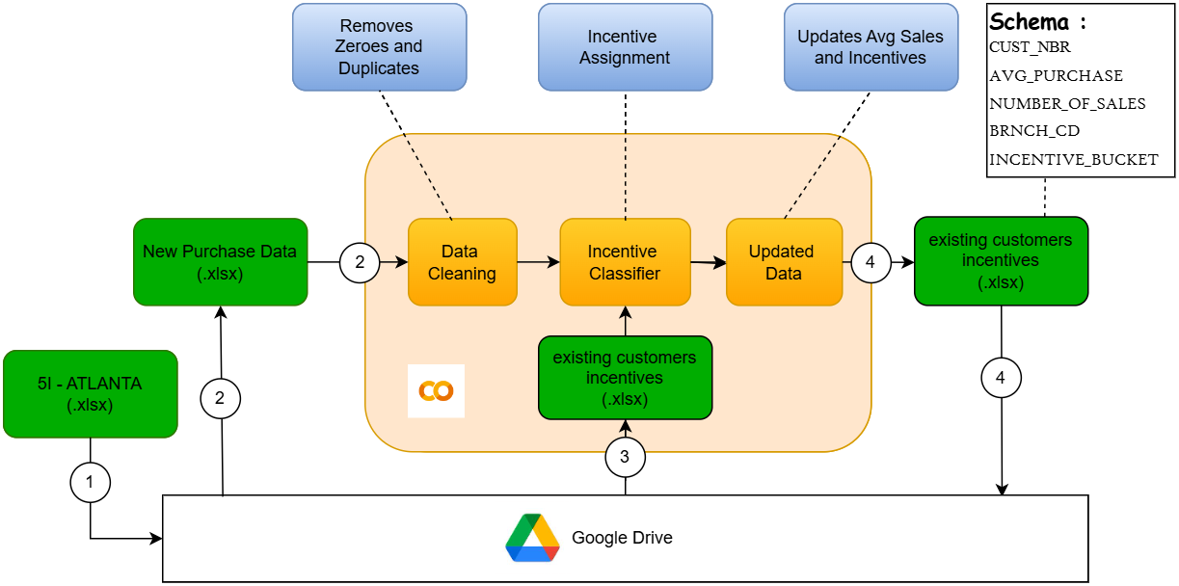
CUSTOMER SEGMENTATION MODEL

Slide 6
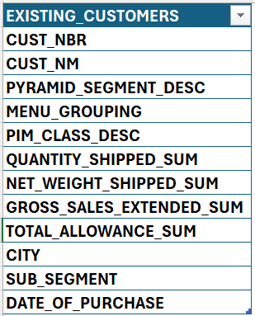
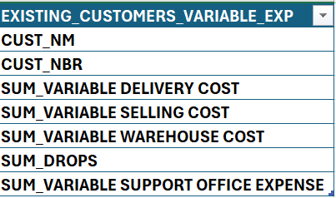
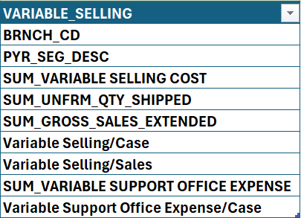
SCHEMA OF THE DATA
Input Constraints

Slide 7




DATA PREPROCESSING
No Missing Data: The training dataset was found to be free of null values and duplicates.
Data Quality Assurance: We have implemented a preprocessing step to automatically remove any null values or duplicates that might be present in new datasets that will be added, ensuring data integrity for our model.
NO DUPLICATES FOUND
NO NULL VALUES FOUND

Slide 8

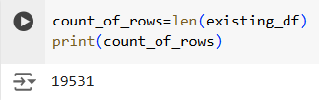
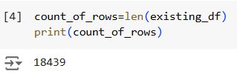


DATA PREPROCESSING
BEFORE
AFTER
Row count
Average sales
We removed rows with zero values, as these represent either canceled or incomplete purchases to ensure:
Excludes canceled or incomplete purchases, ensuring sales data accuracy.
Prevents skewed averages by removing non-revenue entries.
Enhances forecast accuracy by using only actual sales data.

Slide 9
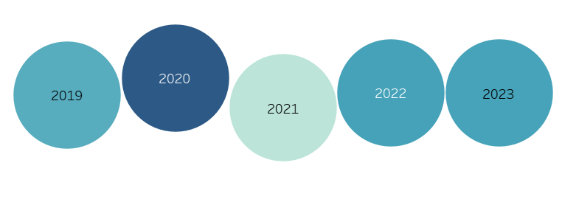
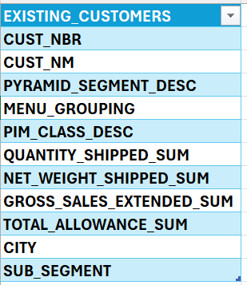
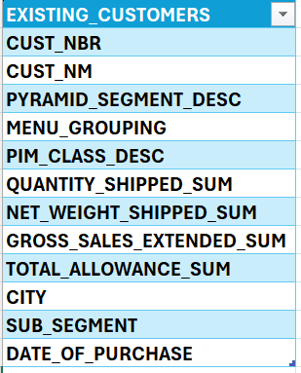
DATA PREPROCESSING
BEFORE
AFTER
The original dataset lacked a DATE_OF_PURCHASE column, making it difficult to analyze sales data over time. By adding this column and splitting the data into monthly intervals over the past 5 years, we can now leverage time series analysis to identify trends.

Slide 10
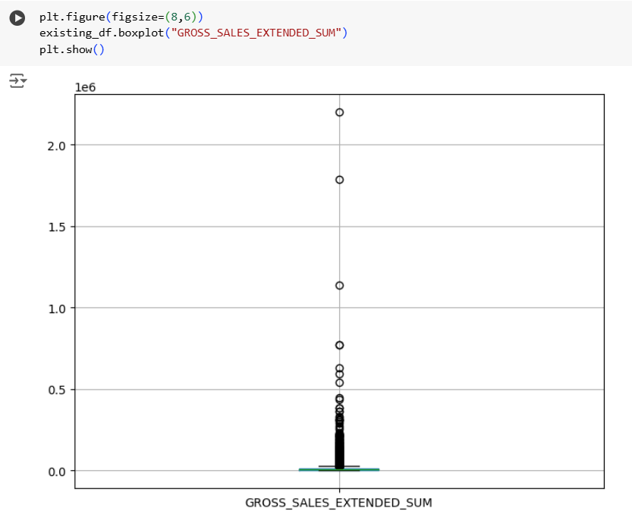
OUTLIERS
Retained outliers as they significantly contribute to overall revenue.
Sales spikes in outliers reveal peak demand patterns for inventory planning

Slide 11
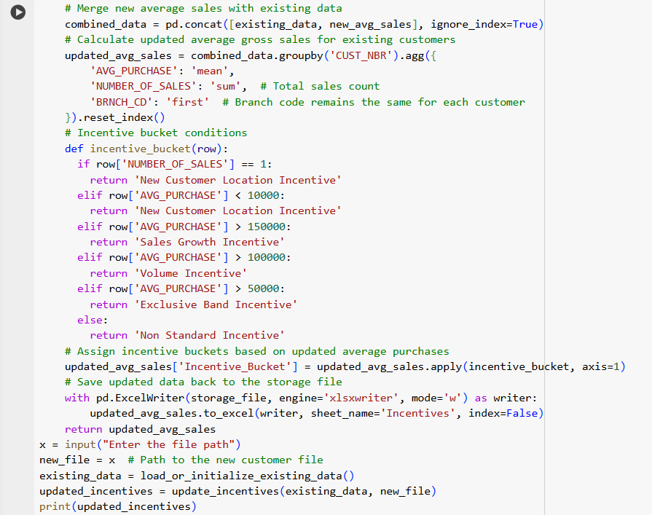
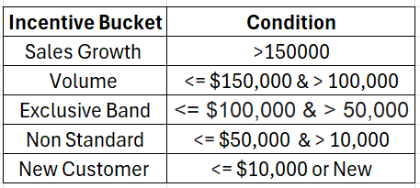
Customer Segmentation

Slide 12
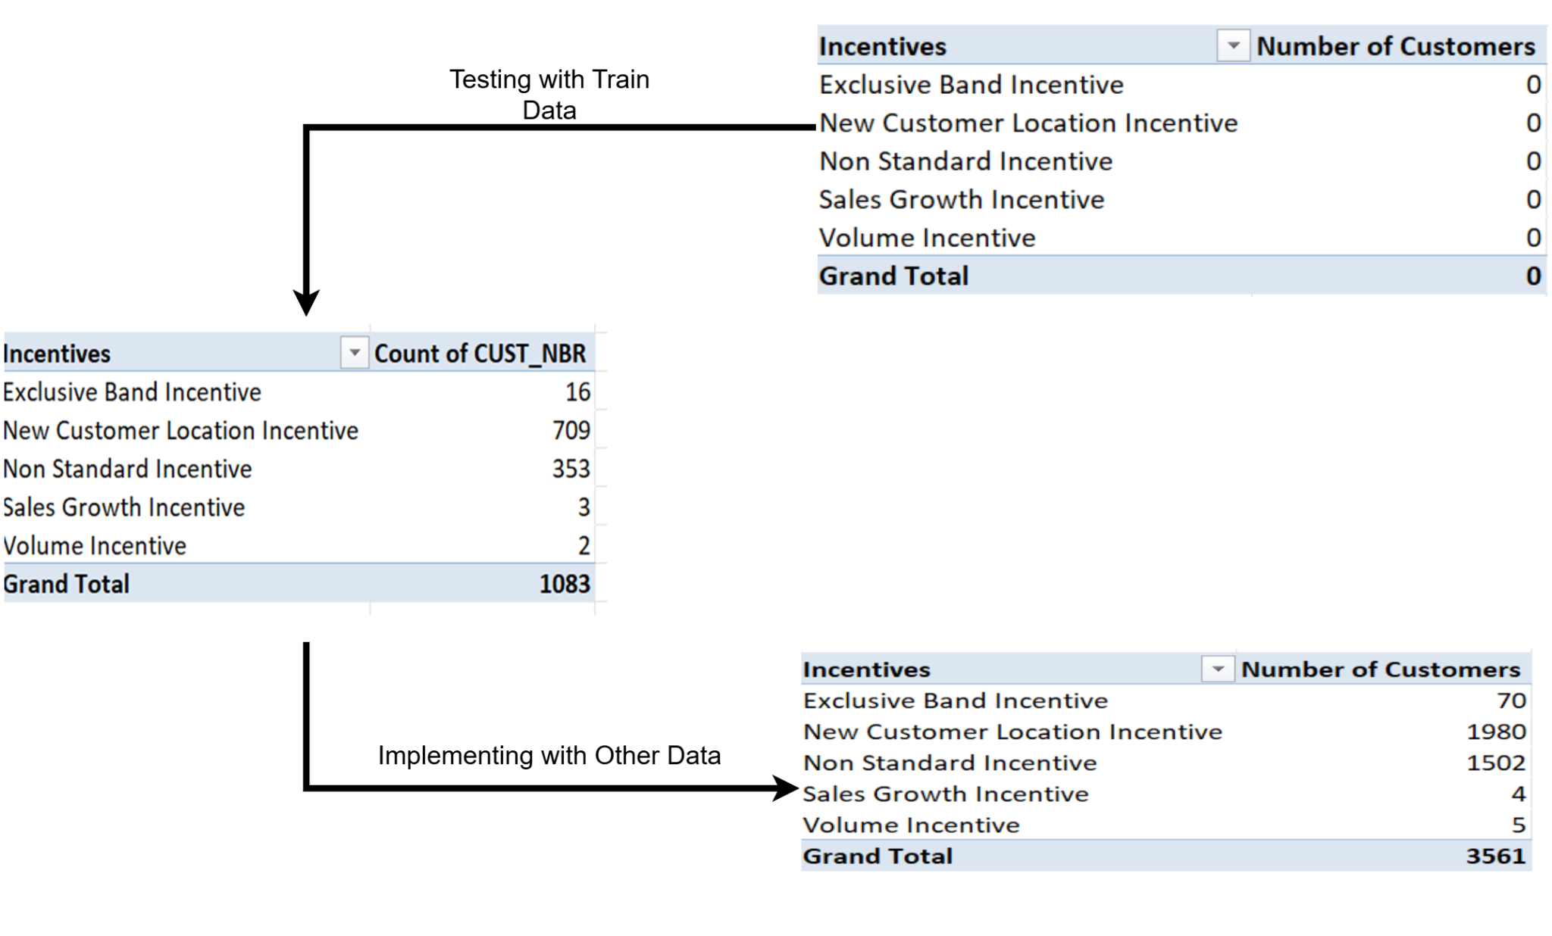
Customer Segmentation

Slide 13
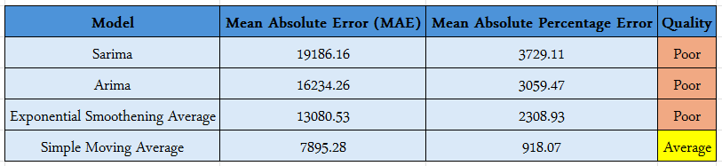

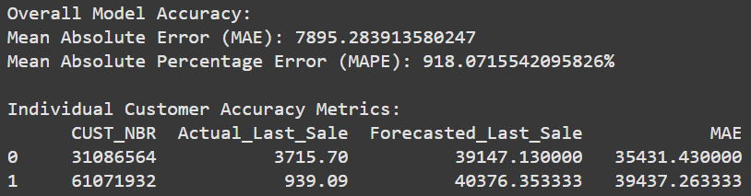
Forecasting - Why Simple Moving Average?

Slide 14
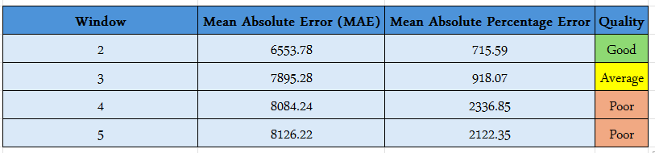
Simple Moving Average - Window Size
Increased noise: Amplifies fluctuations, making predictions less stable.
Reduced smoothing: Fails to smooth out irregular data
Overfitting risk: Overfit to recent data, losing generality.

Slide 15
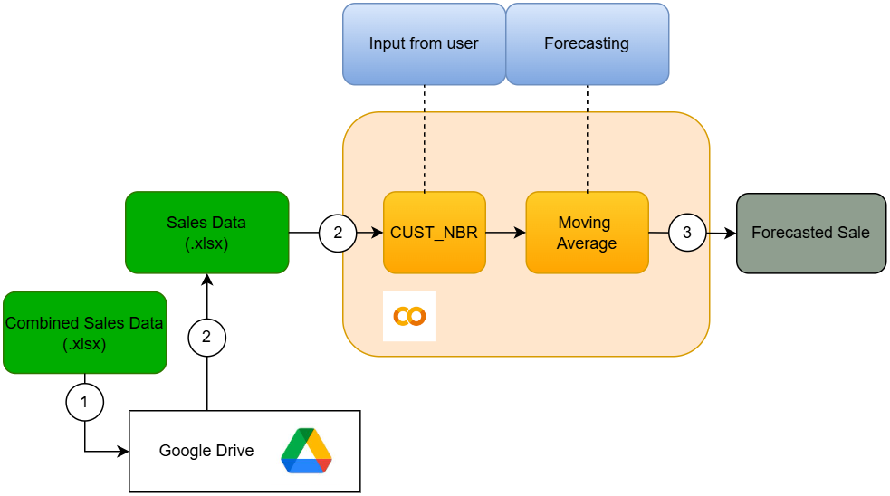
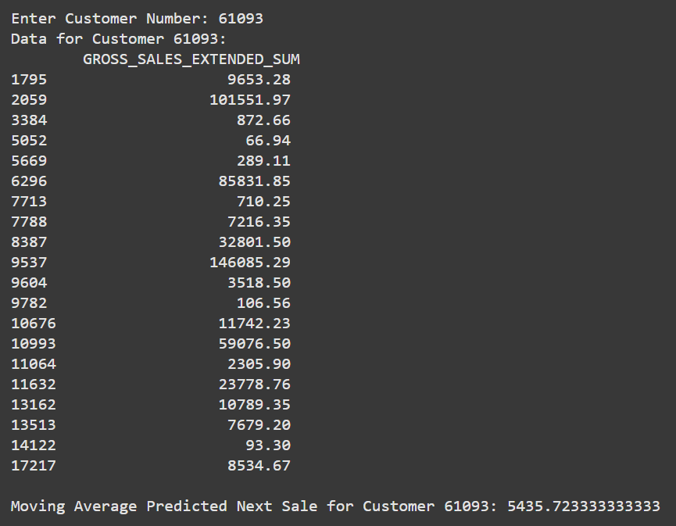
Simple Moving Average

Slide 16
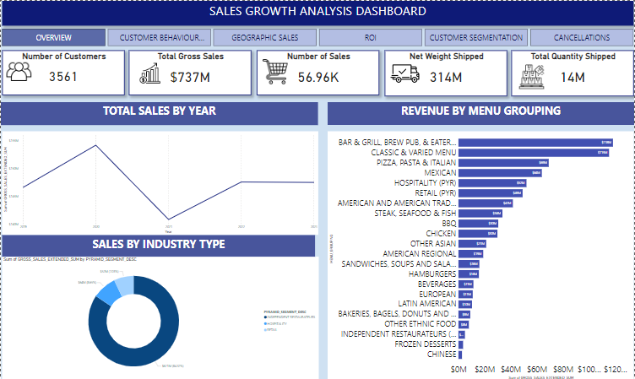

Slide 17
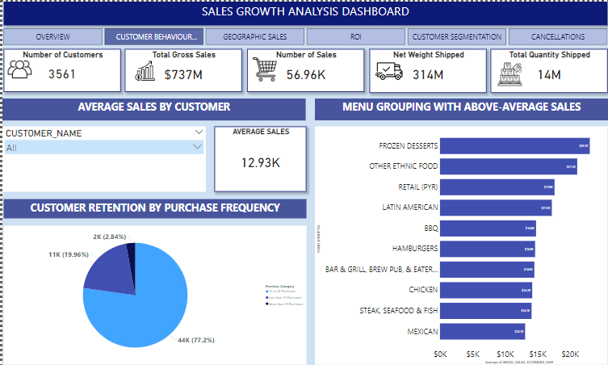

Slide 18
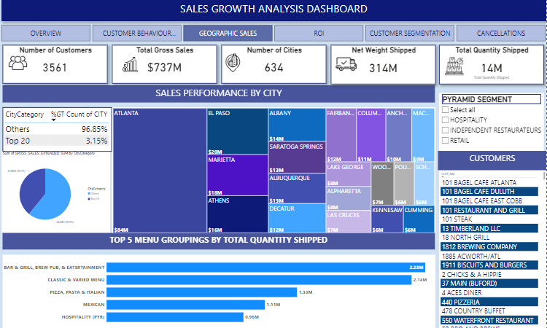

Slide 19
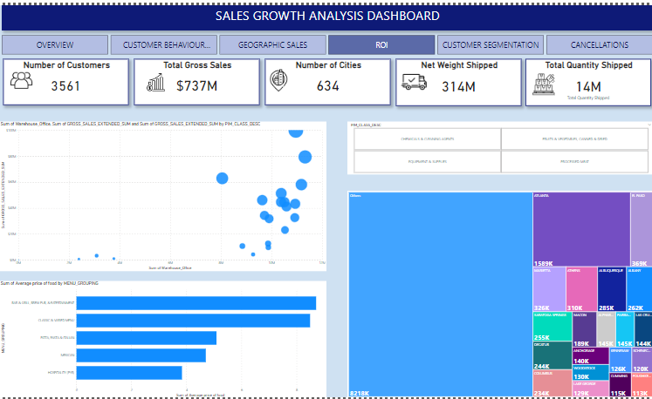

Slide 20
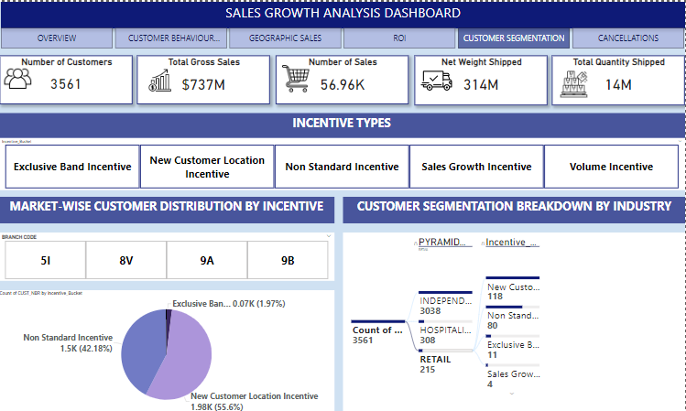

Slide 21
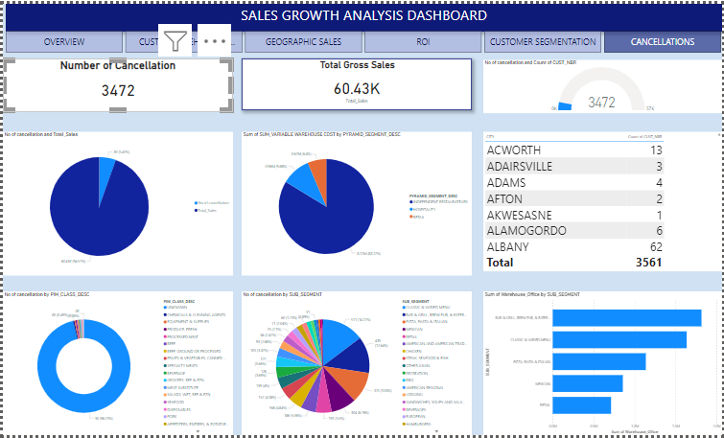

Slide 22
INSIGHTS
Overall Performance:
Strong Growth: Total gross sales of $737M reflect healthy business growth.
Large Customer Base: 3,561 customers present a solid base for potential expansion.
Customer Behavior Analysis:
High Average Sales: Average sales per customer are $12.93K, indicating high-value customers.
Frequent Purchasers: Retention data shows many customers make frequent purchases.
Return on Investment (ROI) Insights
Cost vs. Sales Analysis:
When plotting total management cost against gross sales across all pyramid categories, four pyramids stand out:
These pyramids incur higher management costs but yield lower gross sales.
Example: Total management cost for these pyramids can reach up to $10M, while gross sales remain under $20M.
Categories Identified: Meat, vegetables and fruits. These perishables are especially susceptible to waste due to short shelf lives, leading to higher management costs.
Recommended Actions:
Improved Storage Facilities: Install refrigeration in warehouses located in cities where sales of these perishable pyramids are high. This will reduce spoilage, extend product life, and potentially lower management costs.
Additional Measures: Consider further strategic actions, such as optimizing stock levels or implementing demand forecasting for these products in specific cities.

Slide 23
INSIGHTS
Top Performing Cities: A small percentage—just 3% of cities—generate 40% of the total gross sales. To support this, it's essential to ensure high-quality supply chain management with continuous improvements. We can then focus on identifying the top-performing menu groupings within each city and prioritize stocking those products to meet demand effectively.
Incentive Assignment: By categorizing customers into their respective incentive buckets, we can determine the number of customers within each category. Based on these buckets, targeted allowances can be provided to boost sales tailored to each incentive level.
Cancellation Rate Analysis
Cancellation Rate: Currently, 5% of total orders are cancelled.
Concentration of Cancellations: 50% of cancellations are concentrated in just five menu groups.
Management Cost: Higher management costs are associated with these menu groups, potentially due to wastage, storage, or handling complexities.
Action: By identifying cities with high cancellation rates, storage can be optimized, reducing excess and associated management costs.

Slide 24
Unique Selling Proposition
Incentive buckets are assigned to customers, with allowances provided to encourage additional purchases.
The incentive bucket classification model is user-friendly; simply upload the purchase file with the required parameters.
Data is automatically updated to the existing records, eliminating the need for manual intervention.
Sales forecasts are generated for each target customer, allowing products to be pre-stocked in advance.
An interactive dashboard is available to analyze sales and highlight areas for improvement based on insights.

Slide 25
ROLES AND RESPONSIBILITY
Team Contributions
Sowmiya: Led the initial data understanding and cleaning to ensure quality and accuracy, and identified key performance indicators (KPIs) to guide our analysis and created the initial dashboard draft.
Logesh: Researched suitable forecasting models, implemented the chosen model, and compared the effectiveness of multiple approaches and derived insights from dashboard.
Nithiksha: Developed the solution approach and outlined the plan for graphing and visualizations to represent data insights effectively and refined the dashboard to ensure clarity and usability.
Collaboration
Together, we created a comprehensive dashboard, discovered actionable insights, and developed a PDF and PowerPoint presentation to showcase our project findings.
Throughout the project, our mentor, Prathima RM, provided valuable guidance, helping us better understand the data and refine our approach.
Each team member contributed equally to data analysis and model selection, fostering a balanced, collaborative environment.

Slide 26
BEST PRACTICES
01
Data Quality and Governance
Ensuring high data quality is essential for accurate forecasting. We ensure the data is clean, consistent, and complete by manually performing validation checks and addressing any discrepancies.
02
Defined KPIs and Metrics
Use standardized KPIs (e.g., sales growth, customer segment growth) to drive consistency and align with business goals.
03
Model Selection and Validation
It’s essential to test multiple forecasting models and validate their performance. This ensures the selected model is the best fit for accurate and reliable predictions.
04
Effective Customer Segmentation
Regularly update customer segments and test incentive effectiveness to enhance targeting and growth.
05
Dashboard Design and Visualization
Build intuitive dashboards to visualize key insights, forecasting results, and trends, ensuring that stakeholders can easily interpret and act on the data.
06
Progress Monitoring and Documentation
Regularly track progress through milestones and document each phase, ensuring transparency, reproducibility, and effective collaboration within the team.

Slide 27

THANK YOU!!

