Slide 1
Executive Data Analysis
Strategic Insights & Recommendations

Slide 2
Executive Overview
This comprehensive dataset encompasses 1,000 observations across 18 dimensions. Key metrics under analysis include user_id, click_through_rate, conversion_rate. The dataset demonstrates exceptional quality with 100.0% completeness. Through rigorous analysis, we have identified key patterns, trends, and actionable insights that can drive strategic decision-making.
1,000
18 fields
8
Total Records
Data Points
Numeric Metrics

Slide 3
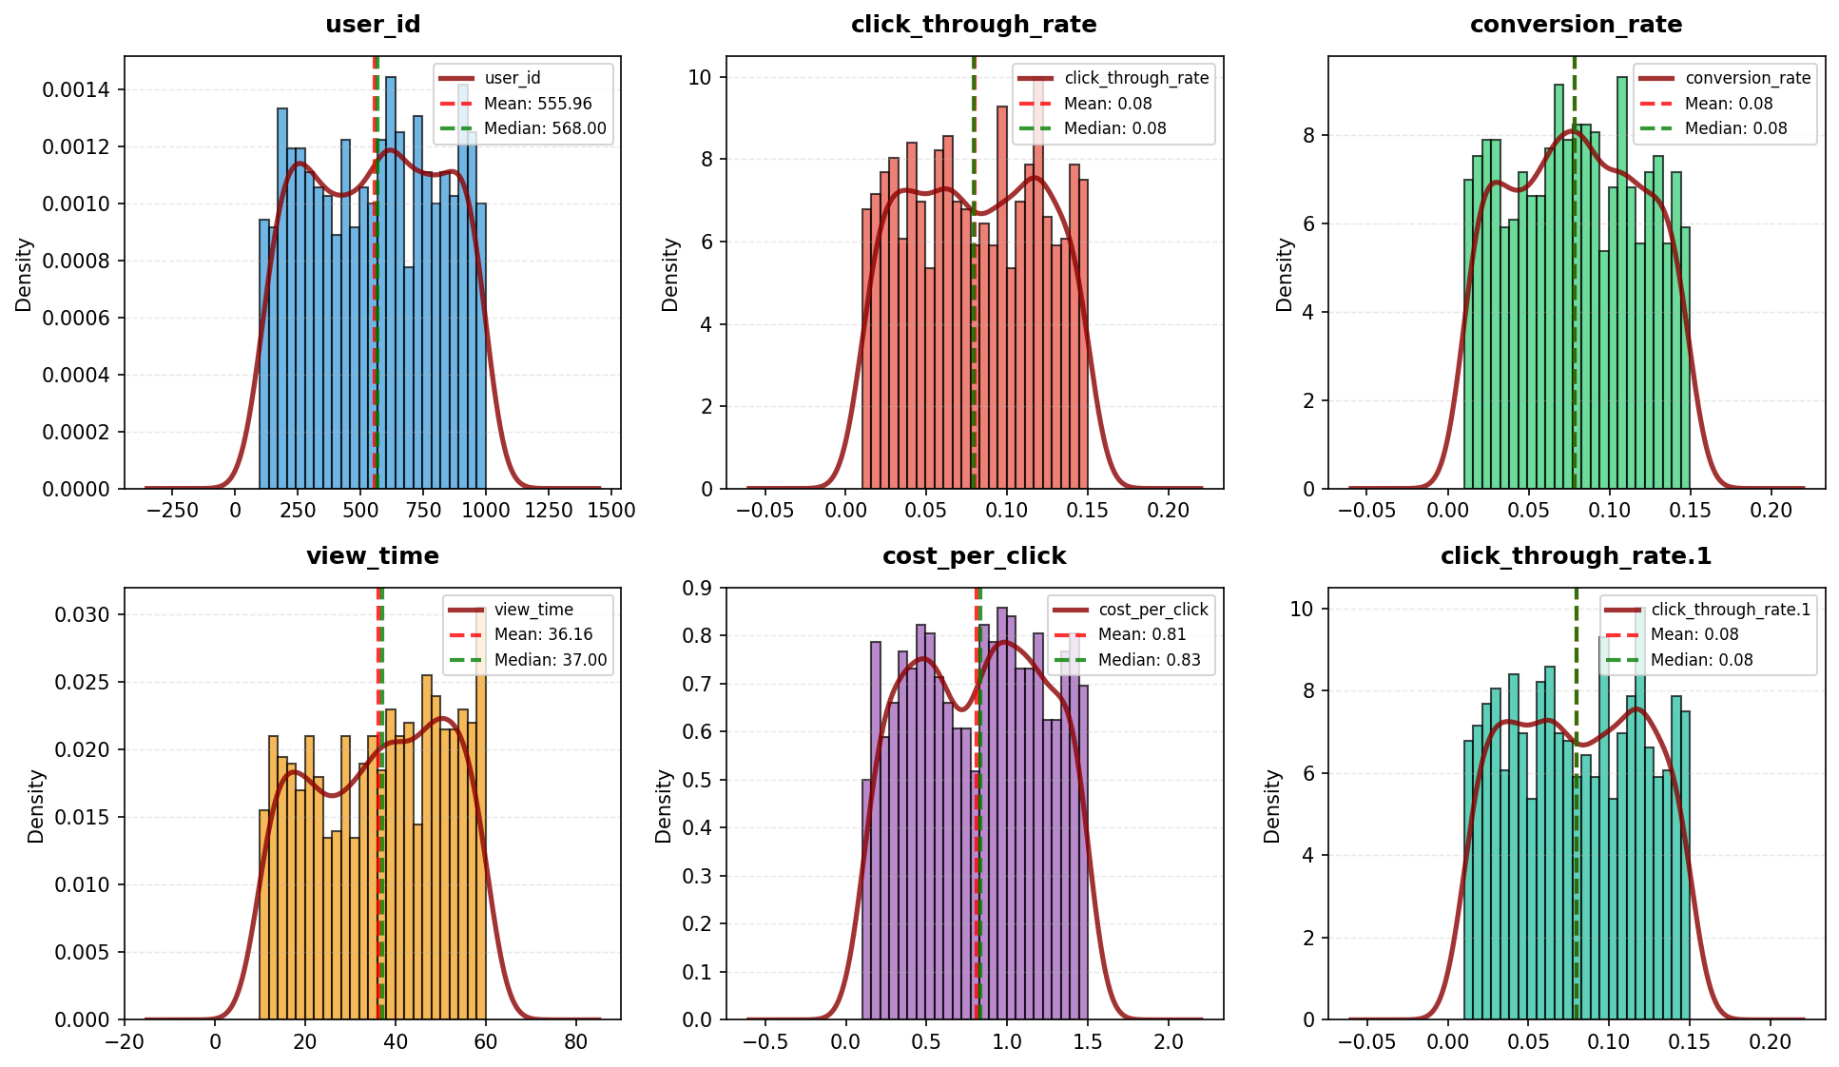
Quantitative Analysis

Slide 4
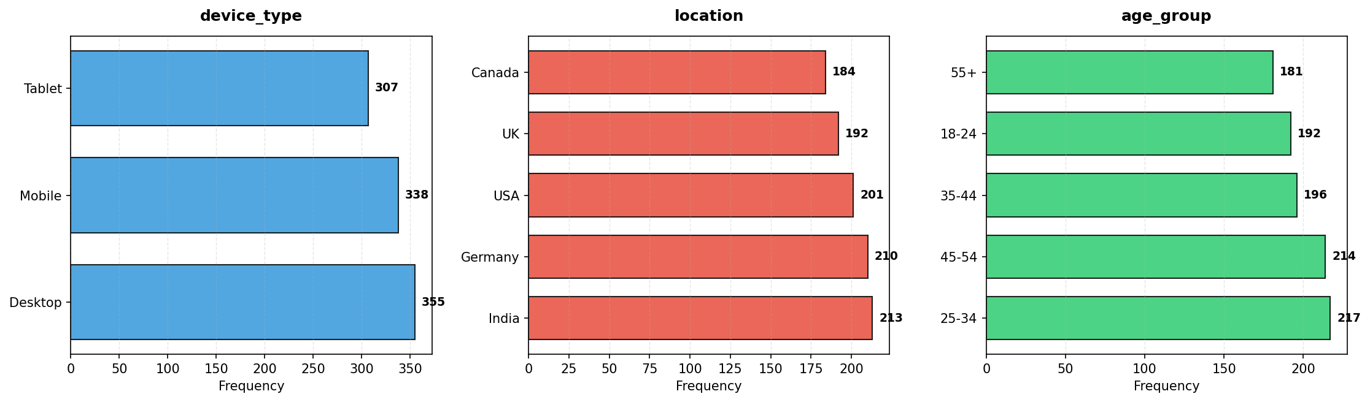
Categorical Distribution

Slide 5
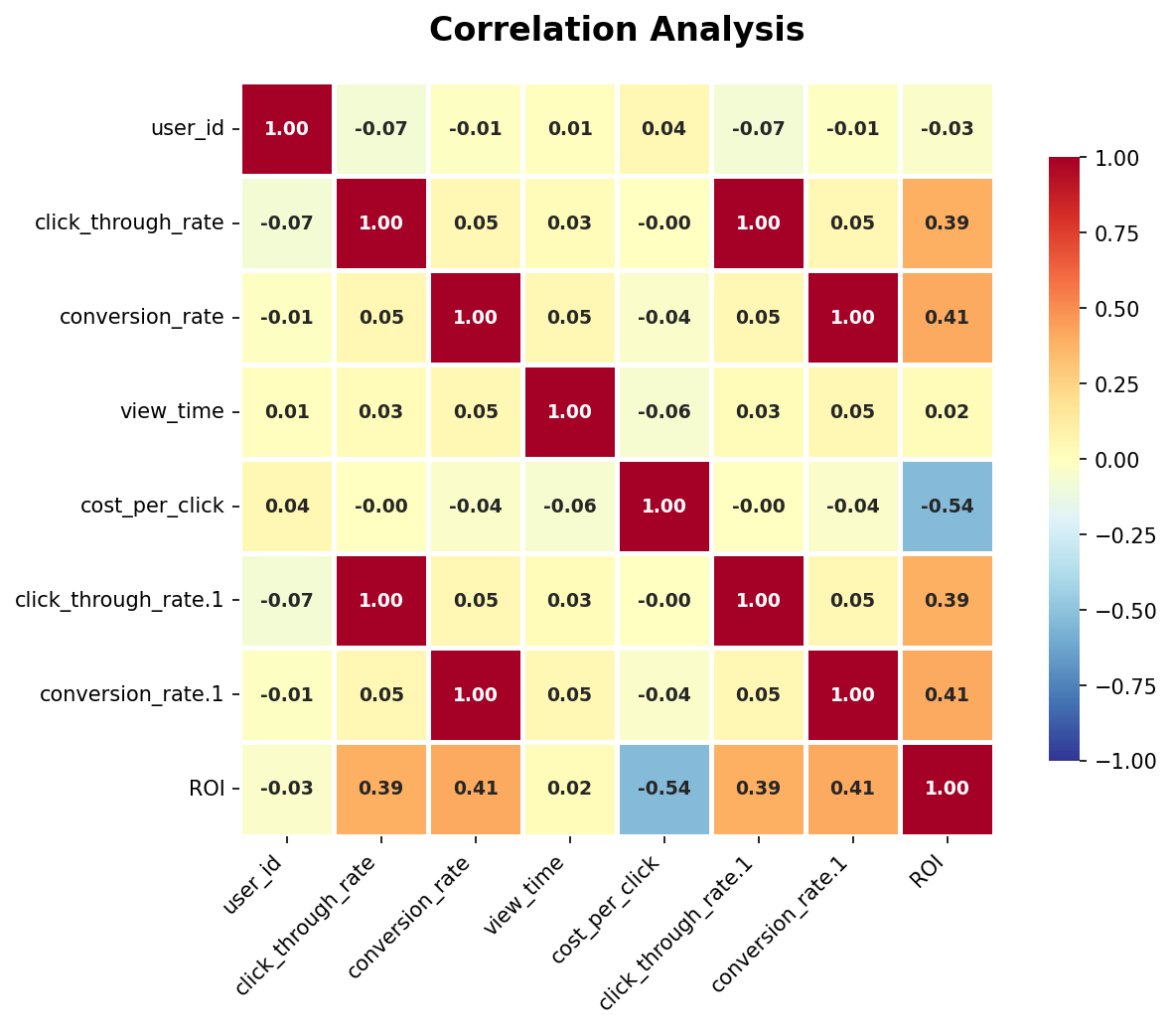
Correlation Matrix

Slide 6
Executive Data Analysis: Ad Campaign Performance
Client: C-suite Executive
Date: October 26, 2023
Subject: Deep Dive into Ad Campaign Performance Dataset
This analysis provides a comprehensive review of the provided ad campaign performance dataset, highlighting key statistical findings, notable patterns, potential anomalies, and critical business implications. Our objective is to furnish data-driven insights that inform strategic decision-making and optimize future ad investments.
• --

Slide 7
Key Statistical Findings
* User Engagement Breadth: The dataset captures 1,000 ad interactions, originating from 610 unique users. This indicates that a significant portion of users (approximately 39%) engaged with multiple ads or had multiple recorded interactions, suggesting either repeated exposure or sustained interest within the platform.
* Performance Stability in Core Metrics:
* Click-Through Rate (CTR): Mean CTR is 0.08, with a median of 0.08 and a low standard deviation of 0.04. This suggests a relatively consistent and stable click-through performance across the tracked ads. The range from 0.01 to 0.15 indicates some variability but generally clusters around the average.
* Conversion Rate (CR): Similar to CTR, the mean and median Conversion Rate are both 0.08, with a standard deviation of 0.04. This tight distribution implies a consistent conversion efficiency post-click, mirroring the CTR's stability.
* Highly Skewed Return on Investment (ROI):
* ROI exhibits a significantly right-skewed distribution. The mean ROI is 1.19, considerably higher than the median of 0.67. This discrepancy, coupled with a high standard deviation (1.54) and a maximum value of 11.57, strongly indicates that a small number of ad interactions or campaigns are generating exceptionally high returns, driving up the average.
* The 75th percentile (Q3) for ROI is 1.42, while the 25th percentile (Q1) is 0.3. This wide interquartile range further emphasizes the dispersed nature of ROI performance, with many ads generating modest or negative returns (median < 1.0) and a few yielding substantial profits.
* Engagement Dynamics: The most frequent engagement level observed is "Ignored" (27.2%), followed by "Liked" (25.7%), "Shared" (24.0%), and "Commented" (23.1%). This distribution suggests a significant baseline of user indifference.
* Ad Viewing Behavior: The average view time for ads is approximately 36 seconds (median 37 seconds), with a standard deviation of 14.8 seconds, indicating a moderate spread in how long users engage with content.
* Consistent Cost Per Click: The Cost Per Click (CPC) has a mean of 0.81 and a median of 0.84, with a standard deviation of 0.4. This indicates a relatively stable cost structure for clicks.
* Diverse Audience and Content Mix: Categorical variables such as `device_type`, `location`, `age_group`, `gender`, `content_type`, `ad_topic`, and `ad_target_audience` all show relatively even distributions across their unique values. This suggests a broad demographic reach and a diverse portfolio of ad creatives and topics.

Slide 8
Notable Patterns & Trends
* Performance Disparity: The dataset demonstrates a clear bimodal performance profile for ads: a large segment exhibiting moderate to low ROI (below 1.0, as indicated by the median) and a smaller, highly successful segment driving the overall average ROI significantly upwards. This "Pareto Principle" effect is crucial for strategic focus.
* High Correlation (Implied): The `numeric_summary` explicitly states "High correlation detected." Given the almost identical statistics and unique values for `click_through_rate` and `conversion_rate` (and their respective `.1` duplicates), it is highly probable that these metrics are strongly correlated with each other, and potentially with `ROI`. This suggests that ads effectively capturing clicks also tend to convert well.
* Baseline Indifference: The highest frequency of "Ignored" engagement highlights a foundational challenge in capturing user attention. While "Liked," "Shared," and "Commented" collectively represent significant positive engagement, the initial hurdle of overcoming indifference is substantial.
* Diverse Market Penetration: The even distribution across geographical locations (India, Germany, USA, UK, Canada), device types (Desktop, Mobile, Tablet), age groups, and genders indicates successful broad market penetration. This diversity offers opportunities for segment-specific optimization.
* Ad Content and Targeting Strategy: The wide variety and even distribution of `ad_topic` and `ad_target_audience` suggest a diversified strategy for ad content and targeting, which aligns with broad market penetration.

Slide 9
Anomalies & Outliers
* Significant ROI Outliers: The maximum ROI of 11.57 is a stark outlier compared to the Q3 value of 1.42. These extreme high-performing ads warrant immediate, in-depth investigation to understand their unique characteristics.
* Data Duplication: The presence of `click_through_rate.1` and `conversion_rate.1` columns, which are exact duplicates of `click_through_rate` and `conversion_rate` respectively (same data types, counts, statistics, unique values), is a significant data quality anomaly. This redundancy inflates column count and, more importantly, could lead to erroneous interpretation of correlation analyses if not properly managed (e.g., falsely indicating perfect self-correlation).

Slide 10
Business Implications
* Strategic Focus on High-Performing Assets: The skewed ROI distribution means that merely improving average performance across all ads will be less impactful than identifying and scaling the characteristics of the top-performing (high ROI) ads. Replicating the success of these outliers is key to disproportionately boosting overall profitability.
* Addressing Engagement Gaps: A high "Ignored" rate implies either a mismatch in targeting, unengaging creative, or saturation. Failing to capture initial attention directly impacts downstream metrics like CTR and conversion, leading to wasted ad spend.
* Data Integrity as a Foundation: The presence of duplicate columns underscores a need for robust data governance. Unreliable or redundant data can undermine confidence in analytics and lead to flawed strategic decisions.
* Optimizing the Conversion Funnel: The observed high correlation between CTR and Conversion Rate (implied) suggests that if users click, they are relatively likely to convert. This indicates that the primary bottleneck may lie in generating the initial click and capturing attention rather than in the post-click user experience.
* Market Segmentation Opportunity: The diverse and evenly distributed categorical features suggest that a one-size-fits-all strategy might be suboptimal. There's a strong opportunity to develop tailored ad strategies for specific devices, locations, age groups, genders, and target audiences to maximize their respective ROIs.

Slide 11
Strategic Recommendations

