Slide 1
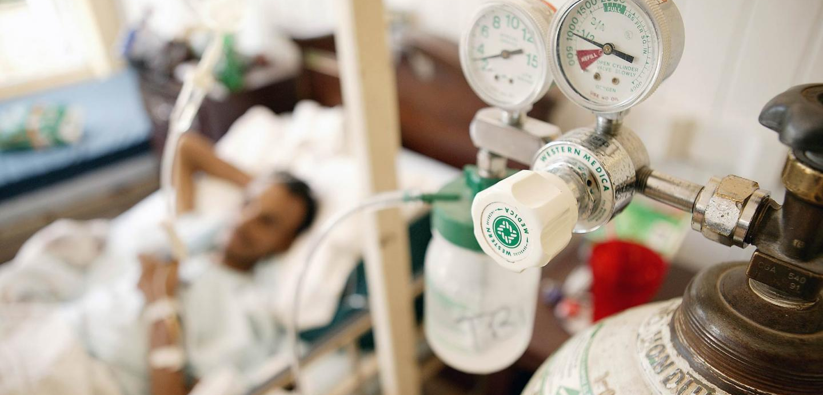

DAMG 6210 Data Management and Database Design
GROUP – 9 PROJECT TOPIC: OXYGEN RENTAL SYSTEM
Group Members:
Namratha Gonuguntla (001565081)
Nitin Dornipadu (002197358)
Rajesh Kaireddy (002198556)
Sai Kumar Ganga (002191288)

Slide 2
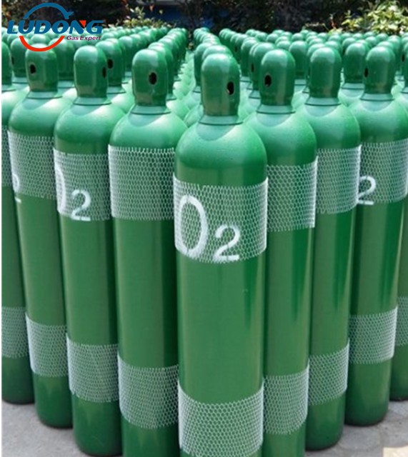
Problem Statement:
To provide a platform where people can connect to the nearest oxygen suppliers for oxygen cylinders in emergency.
Objectives:
Maintain (Insert, Update, delete) data of Oxygen plant locations and Customers.
Maintain the Booking History (Unique transaction ID, Customer ID, plant ID, quantity) to visualize and generate a report on demand of oxygen across county.
Security: Providing them a login-logout option based on Authorization role for security purposes.
Maintain Data Integrity and Avoid Data Redundancy.

Slide 3
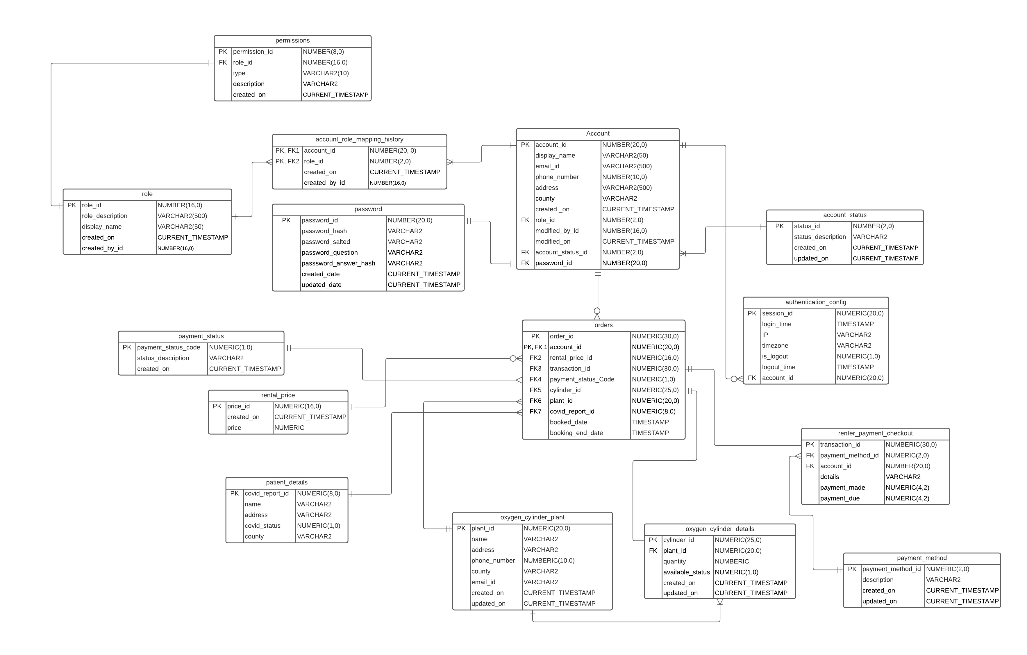
Entity-Relationship Diagram

Slide 4
Contents
DDL (Create Procedures)
DML (Insert, Insert Data – Packages and Procedures)
Exception Handling
Functions (Password)
Triggers
Views
Reports
ERD
Test cases
Justification

