Slide 1
ParaBank
Automation Framework
Selenium Automation Testing Project
Submitted By:
Guglavath Nithin
Organization: Wipro SDET Program
Technology Stack:
Selenium WebDriver
Java
Maven
TestNG
Eclipse IDE

Slide 2
Presentation Agenda
01
Project Introduction
08
Utilities
02
Problem Statement
09
Test Cases
03
Project Objective
10
Results
04
Technologies Used
11
Challenges
05
Framework Architecture
12
Future Enhancements
06
Project Workflow
13
Conclusion
07
Automated Modules

Slide 3
Project Overview
🏦 Introduction
🎯 Purpose
ParaBank is a web-based banking application used for performing core banking operations.
Automate banking functionalities using Selenium WebDriver and TestNG to achieve reliable, repeatable and fast test execution.
👤 Customer Registration
🔐 Login
💸 Fund Transfer
Selenium
+
TestNG
💳 Bill Payment
📊 Account Management

Slide 4
Problem Statement
⚠ Existing Challenges
✅ Proposed Solution
Manual Testing is:
Develop an automation framework that validates banking functionalities automatically — delivering speed, accuracy and repeatability.
⏰ Time Consuming
🔁 Repetitive
❌ Error Prone
🤖 Automated Regression Suite
🔍 Difficult for Regression Testing
✋ Zero Manual Intervention
👥 Resource Intensive
📈 Consistent & Reliable Results
⚡ Faster Test Cycles

Slide 5
Project Objective
Automate the following banking functionalities:
👤
🔐
💸
💳
User Registration
Login
Transfer Funds
Bill Payment
Benefits
⚡ Faster Execution
🎯 Increased Accuracy
🛡 Reduced Human Errors
♻ Reusable Scripts

Slide 6
Assignment Requirements
🌐 Website:
https://parabank.parasoft.com/parabank/register.htm
Automation Steps
⚡ Constraint
1
Register a new user via the registration form
Generate a unique username for every test execution run.
2
Submit the registration form with valid data
3
Verify registration success message
Logout from the application
user_" + System.currentTimeMillis()
4
5
Login using the newly registered credentials
Ensures unique username on every execution via timestamp.
6
Verify successful login to Accounts Overview

Slide 7
Technologies Used
☕
🔬
📦
Java
Selenium WebDriver
Maven
Programming Language
Web Automation
Dependency Management
✅
🌑
🌐
TestNG
Eclipse IDE
Chrome Browser
Test Execution
Development Environment
Execution Platform

Slide 8
Framework Type
Hybrid Framework
Components
Benefits
📄 Page Object Model (POM)
♻
🔧
Separates locators from test logic
Reusability
Maintainability
🛠 Utility Classes
Write once, use across all tests
Update in one place, fix everywhere
ConfigReader, ScreenshotUtil, BaseTest
📈
📖
✅ TestNG Framework
Scalability
Readability
Annotations, grouping & execution control
Add new modules without rewrites
Clean test code, easy to review

Slide 9
Project Architecture
📁 ParaBankAutomation/
Structure Benefits
├── 📂 base/
📁
Organized Code
├── 📂 pages/
Each layer has a single responsibility — clean separation between pages, tests and utilities.
├── 📂 testcases/
├── 📂 utilities/
🔧
Easy Maintenance
├── ⚙ config.properties
Changes to locators or flows affect only the relevant page class, not test scripts.
├── 🧪 testng.xml
├── 📦 pom.xml
🧩
Modular Design
New modules can be added independently without disrupting existing test cases.

Slide 10
Page Object Model (POM)
Design Pattern: Each web page is represented as a class with locators and methods, keeping test code clean and maintainable.
Pages Package – Classes
🏆 Advantages
RegisterPage.java
fillForm(), submit(), verifySuccess()
♻ Reusable Locators
LoginPage.java
enterCredentials(), clickLogin(), verify()
🔧 Better Maintainability
✂ Reduced Code Duplication
TransferFundsPage.java
selectAccounts(), enterAmount(), submit()
✨ Clean Test Classes
BillPayPage.java
enterPayee(), setAmount(), sendPayment()
🐛 Easier Debugging

Slide 11
Slide 11 – Project Workflow
Project Workflow
1
2
3
4
▶
▶
▶
🌐
🏦
📝
🔐
Launch
Browser
Open
ParaBank
Register
User
Login
▼
5
6
7
8
▶
▶
▶
💸
📄
🚪
❌
Transfer
Funds
Bill
Payment
Logout
Close
Browser
End-to-End Automated Test Execution Flow

Slide 12
Slide 12 – Registration Module
Registration Module
🛠 Activities
✅ Validation
1
Open Registration Page
✔ Registration Successful
Welcome message displayed with username
2
Enter User Details
Generate Dynamic Username
✔ Logout Link Displayed
3
Confirms user is logged in after registration
4
Submit Form
String user = "nithin" +
System.currentTimeMillis();

Slide 13
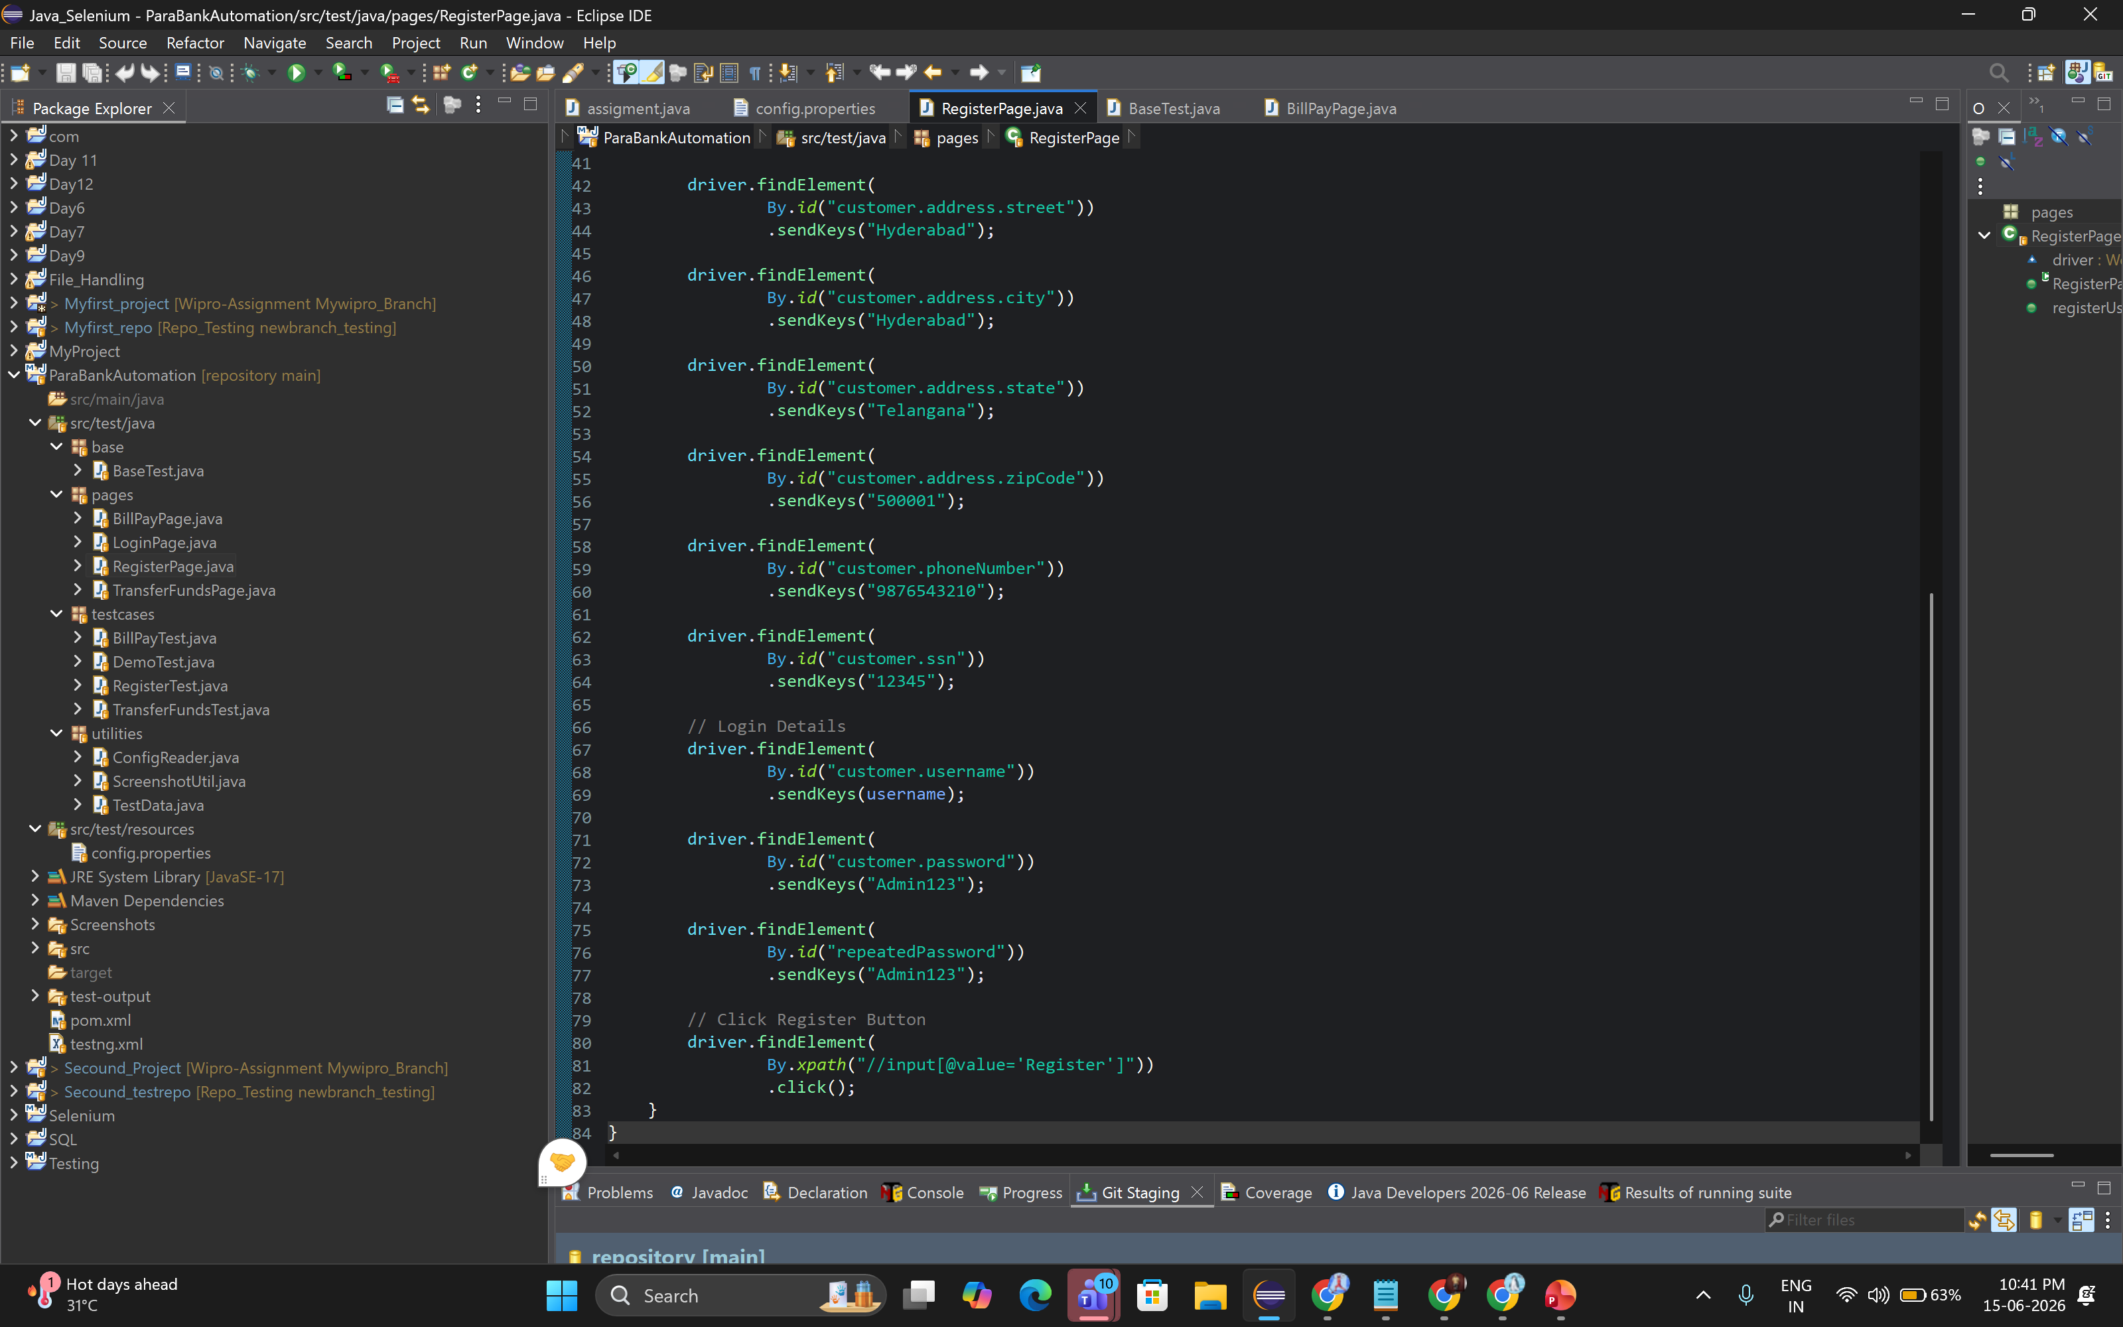
RegisterPage.java

Slide 14
Slide 13 – Login Module
Login Module
Login Automation
👤 Enter Username
1
ACTION
Type the dynamically registered username into the login field
🔑 Enter Password
2
ACTION
Enter the password used during registration
🖱 Click Login
3
ACTION
Submit the login form by clicking the Login button
✅ Validation
Verify: "Accounts Overview" page is displayed successfully after login.

Slide 15
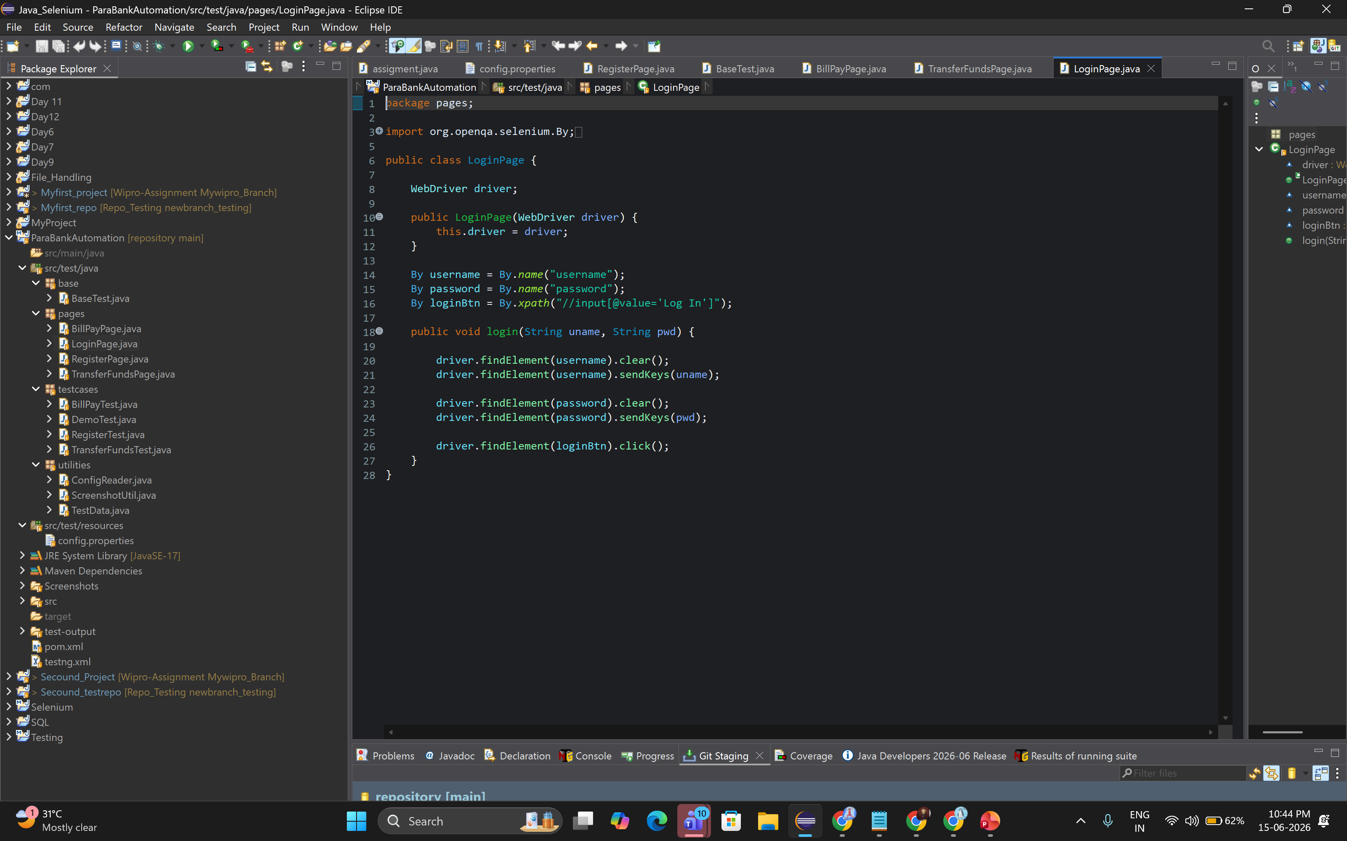
LoginPage.java

Slide 16
Slide 14 – Transfer Funds Module
Transfer Funds Module
Transfer Funds Automation
Steps
✅ Expected Result
1
Login
Transfer should complete successfully.
2
Open Transfer Funds
✔ Confirmation message shown
3
Enter Amount
✔ Amount deducted from source
4
Submit Transfer
✔ Destination account credited
transfer.enterAmount("100"); transfer.selectFromAccount(); transfer.clickTransfer();
Assert.assertTrue(transfer.isTransferSuccessful());

Slide 17
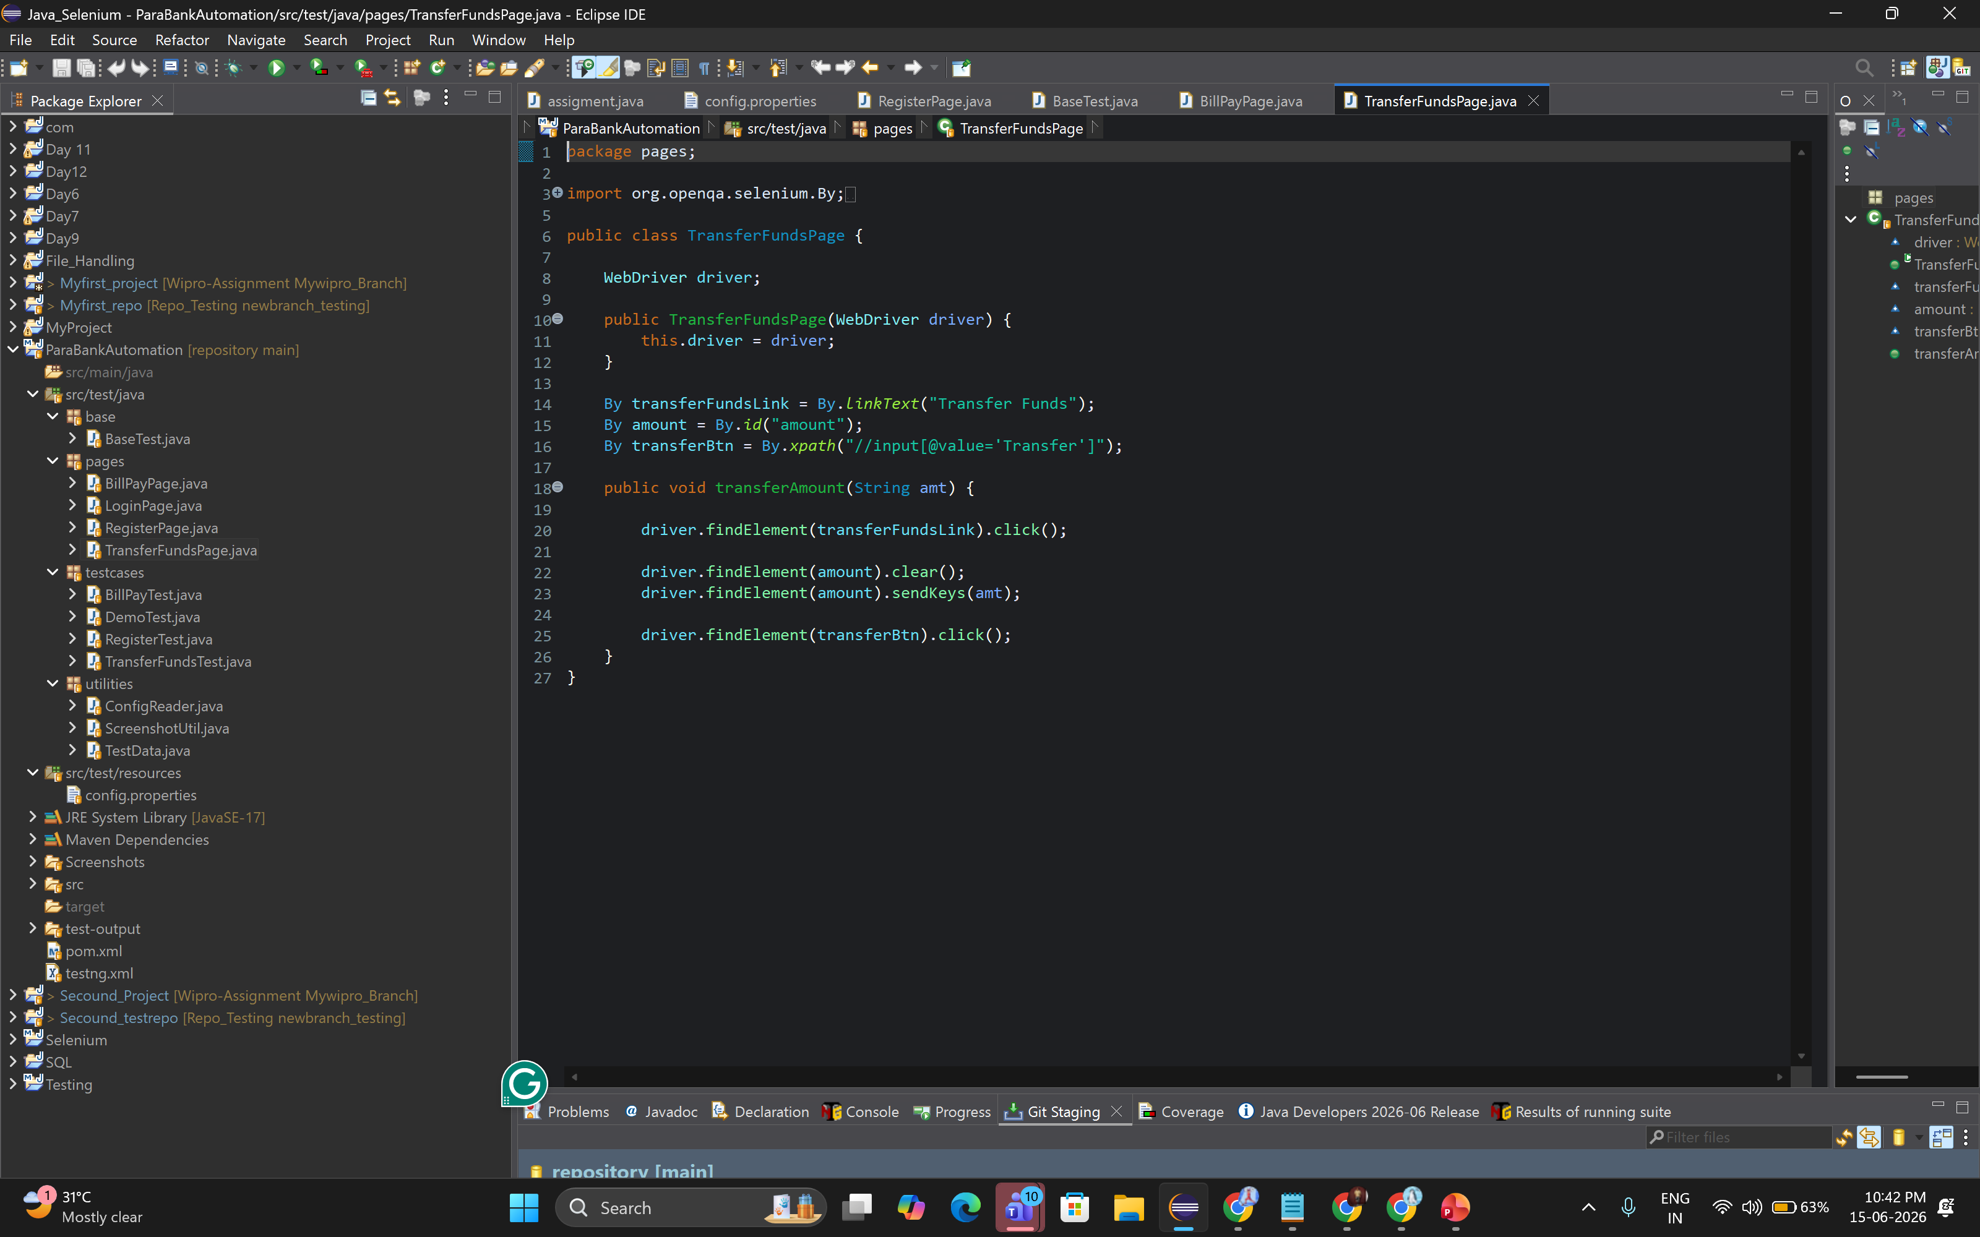
TransferFundsPage.java

Slide 18
Slide 15 – Bill Payment Module
Bill Payment Module
Bill Pay Automation
Steps
✅ Expected Result
1
Login
Bill payment completed successfully.
2
Open Bill Pay
✔ Payment success message shown
3
Enter Payee Details
✔ Transaction visible in history
4
Submit Payment
✔ Account balance updated
billPay.enterPayeeName(name); billPay.enterAccount(accNo); billPay.enterAmount("50");
billPay.clickSendPayment(); Assert.assertTrue(billPay.isPaymentComplete());

Slide 19
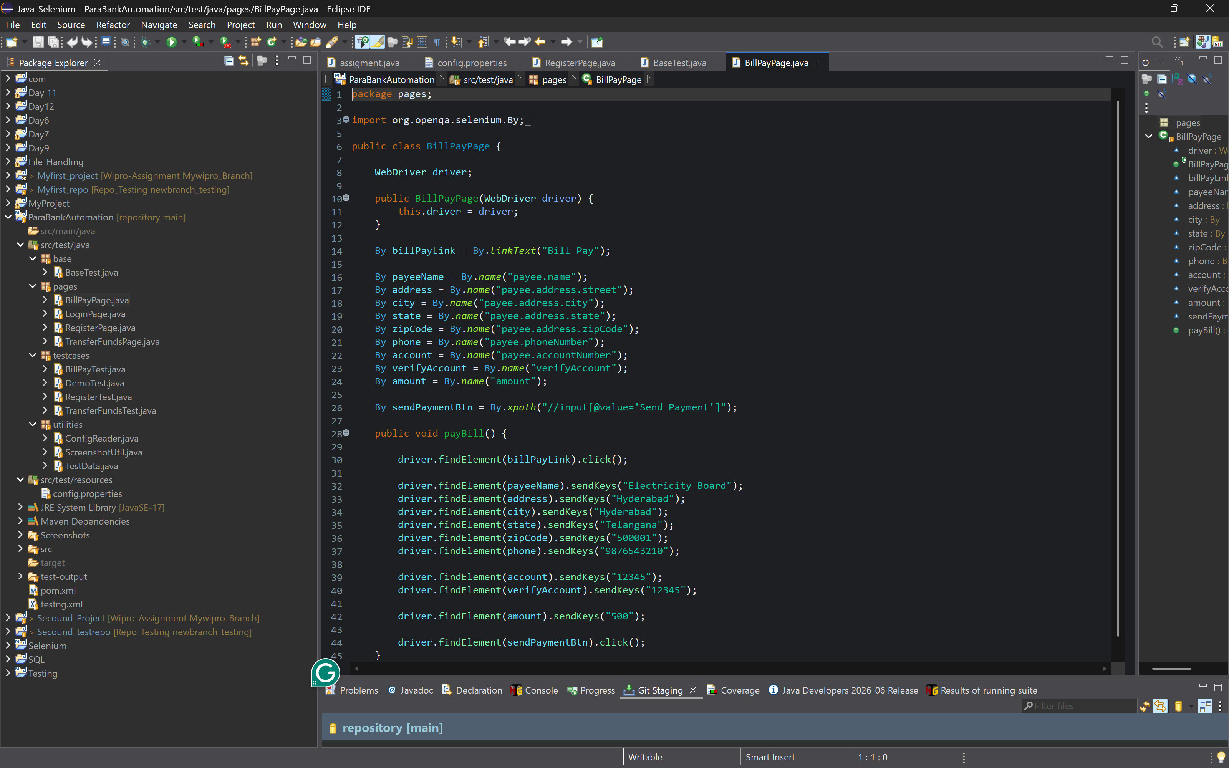
BillPage.java

Slide 20
Slide 16 –
Utilities Implemented
⚙️ ConfigReader Utility
Reads configuration values from config.properties file — test data is never hardcoded in test classes.
Reads:
url=https://parabank.parasoft.com/parabank
username=Nithinnayak08
password=Admin123
📸 Screenshot Utility
Captures full-page screenshots during execution and on failure for defect analysis.
Reads:
captureScreenshot(driver, testName)
Saves to /screenshots folder

Slide 21
Slide 17 – Dynamic Username Handling
Dynamic Username Handling
⚠ Challenge
ParaBank does not allow duplicate usernames — re-running the same test with the same username causes registration failure.
💡 Solution
public static String generateUsername(String prefix) {
return prefix + System.currentTimeMillis();
}
// Usage in RegisterPage test:
String username = TestDataGenerator.generateUsername(“nithin");
// Output: nithin1780980138851
Example Output:
✅ Ensures successful execution every time — zero conflicts between runs.
nithin1780980138851

Slide 22
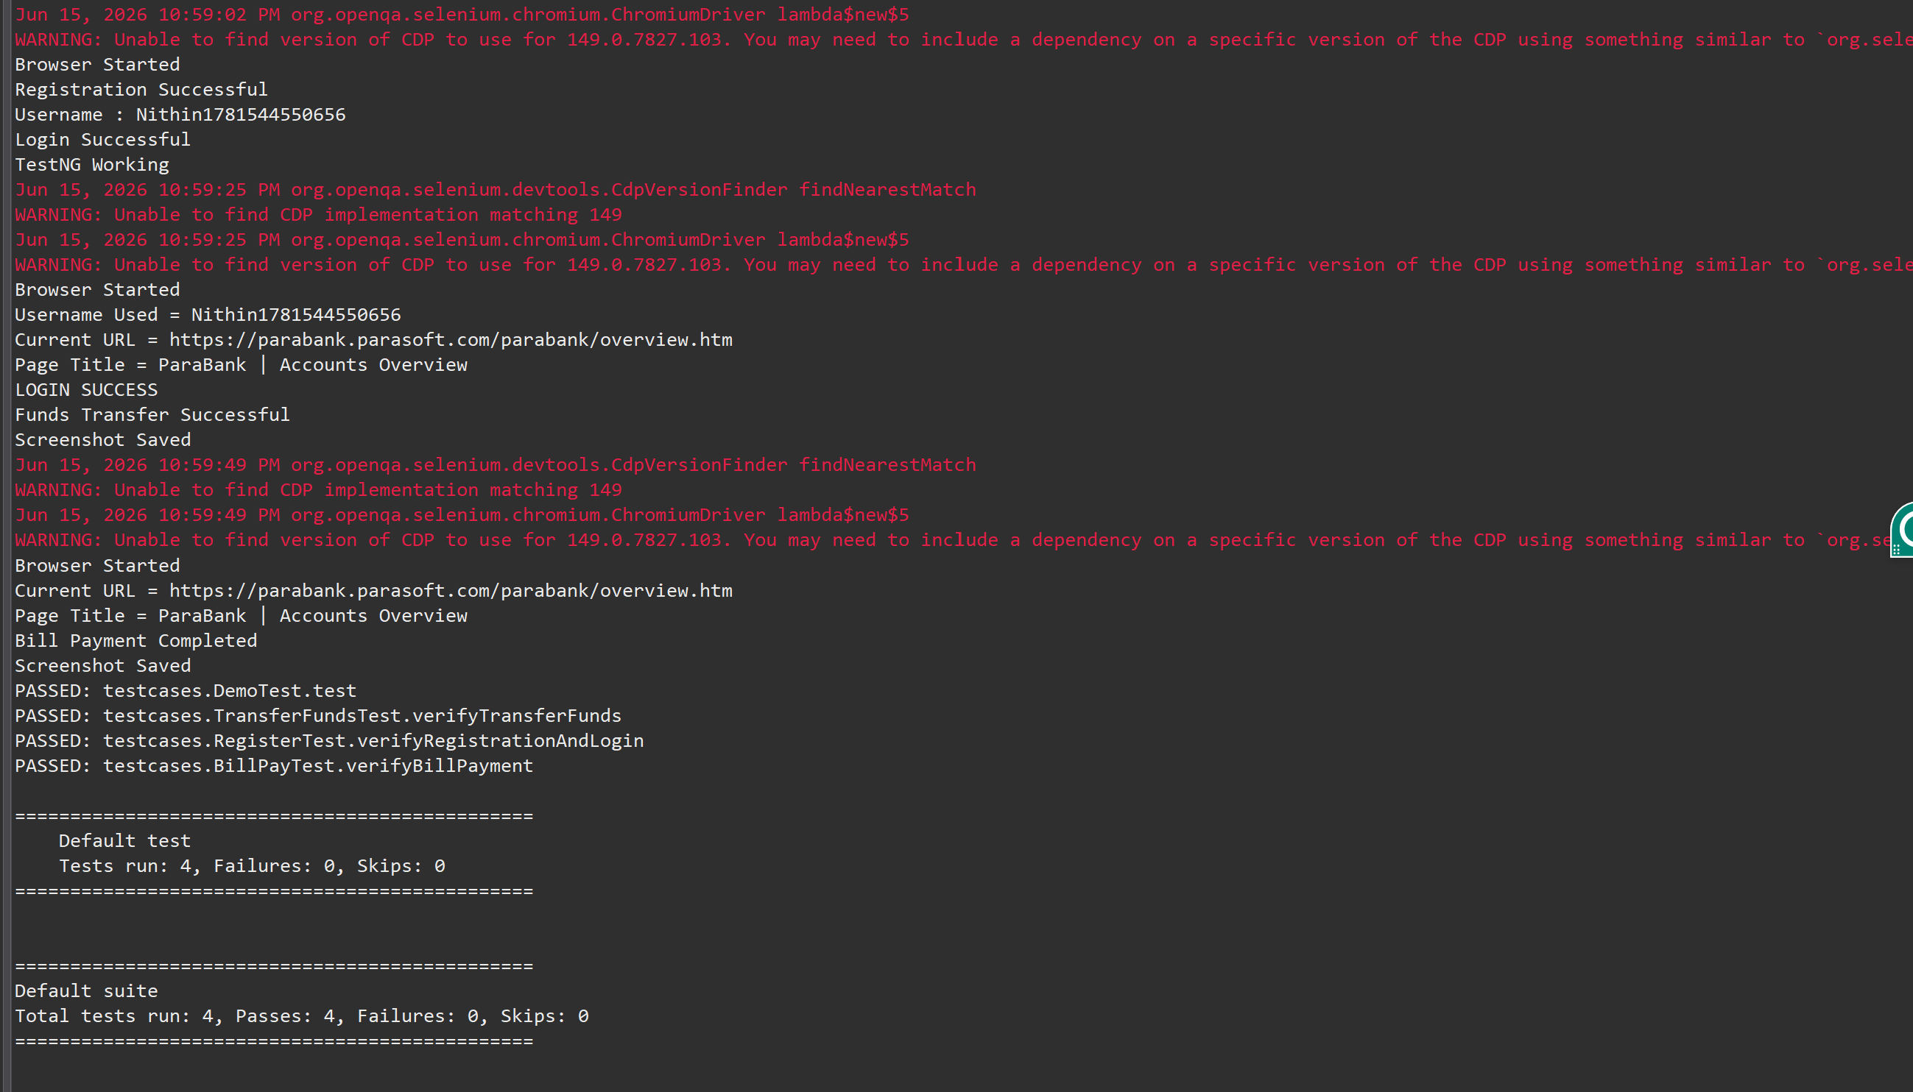
CONSOLE OUTPUT

Slide 23
Slide 18 –
Test Execution Results
4
4
0
0
Tests Run
Passed ✔
Failed ✘
Skipped
Test Case | Module | Status
Registration Test | User Registration | ✔ PASS
Login Test | Login & Logout | ✔ PASS
Transfer Funds Test | Transfer Funds | ✔ PASS
Bill Payment Test | Bill Payment | ✔ PASS
🎉 All 4 test cases PASSED — 100% Pass Rate | Tests Run: 4 | Pass: 4 | Fail: 0 | Skip: 0

Slide 24
Slide 19 – Challenges & Solutions
Challenges & Solutions
⚠ Dynamic Username Generation
→
✔ Solved using TestDataGenerator utility with System.currentTimeMillis()
⚠ Login Failures
→
✔ Handled using shared test data passed via BaseTest static variable
⚠ Synchronization Issues
→
✔ Implemented Explicit Waits (WebDriverWait + ExpectedConditions)
⚠ Element Identification Issues
→
✔ Used robust CSS and ID locators, organized in POM page classes
⚠ Screenshot Capture
→
✔ Implemented ScreenshotUtil with TakesScreenshot interface

Slide 25
Slide 20 – Conclusion & Future Enhancements
Conclusion & Future Enhancements
Successfully Automated:
Future Enhancements:
✔
User Registration
📊 Extent Reports
✔
Login
🔁 Jenkins Integration
✔
Transfer Funds
📋 Data Driven Testing
✔
Bill Payment
⚡ Parallel Execution
Technologies Used:
🔧 CI/CD Pipeline
Selenium WebDriver · Java · Maven · TestNG · Page Object Model
Thank You | Questions & Answers | Presented By Nithin Princy

