Slide 1

A New approach for de bruijn graph construction in genome assembly
Nithin sylesh
Am.en.u4aie19044

Slide 2
Genome assembly
Genome assembly is the computational process of deciphering the sequence composition of the genetic material (DNA) within the cell of an organism, using numerous short sequences called reads derived from different portions of the target DNA as input. The term genome is a collective reference to all the DNA molecules in the cell of an organism. Sequencing generally refers to the experimental (wetlab) process of determining the sequence composition of biomolecules such as DNA, RNA, and protein. In the context of genome assembly, however, the term is more commonly used to refer to the experimental process of generating reads from the set of chromosomes that constitutes the genome of an organism.

Slide 3
De bruijn graph
In graph theory, an n-dimensional De Bruijn graph of m symbols is a directed graph representing overlaps between sequences of symbols. It has m^{n} vertices, consisting of all possible length-n sequences of the given symbols; the same symbol may appear multiple times in a sequence.

Slide 4
Properties
If n = 1 then the conditions for any two vertices forming an edge holds vacuously and hence all the vertices are connected forming m^2 edges
Each vertex has m incoming and m outgoing edges
Each n dimensional de bruijn grah is the line digraph of the n-1 dimensional de bruijn graph with same set of symbols
Each de bruijn graph is eulerian and Hamiltonian, the eulerian and Hamiltonian cycles are de bruijn cycles

Slide 5
Analysis
Individual short reads are aligned to reference
Genotypes overlap each position
Reads must be arranged relative to each other to reconstruct longer sequences

Slide 6
Read Alignment
The first step in analysis of short read data is to align each read to genome
This process now takes no more than a few hours per million reads
Analyzing these data without a reference genome would require much longer reads or result in very fragmented assemblies
Effective read
The first step in analysis of short read data is to align each read to genome
This requirement effectively reduces coverage

Slide 7
Mapping Quality
Measures the confidence in an alignment, which depends on:
– Size and repeat structure of the genome
–Sequence content and quality of the read
– Number of alternate alignments with few mismatches
The mapping quality is usually also measured on a “Phred” scale
Cleaning
De Bruijn graphs are typically “cleaned” before analysis
Cleaning involves removing portions of the graph that have very low coverage

Slide 8
Steps
Take all (k-1)-mers from the set of k-mers, e.g. ATG, TGC-> AT, TG, GC. We should have gone past the size of k-mer reads.
Construct a multi-graph with nodes being k-1-mers; draw an edge between two k-1 mers only if the two k-1 mers are taken from the same read.
Graph constructed this way is guaranteed to have a Eulerian trail, follow the trail and connect the nodes to form our original sequence. The graph similar to this will appear.

Slide 9
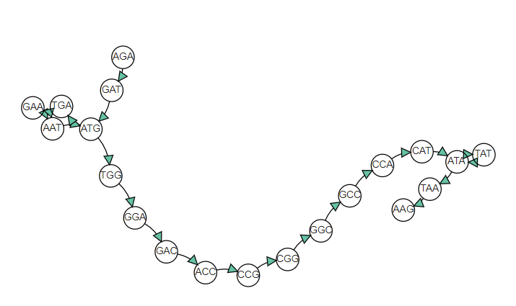
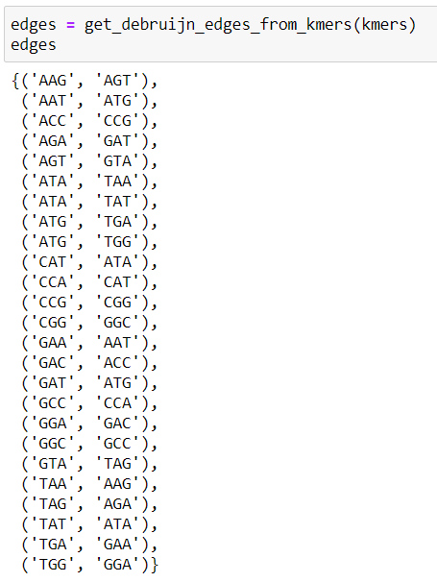
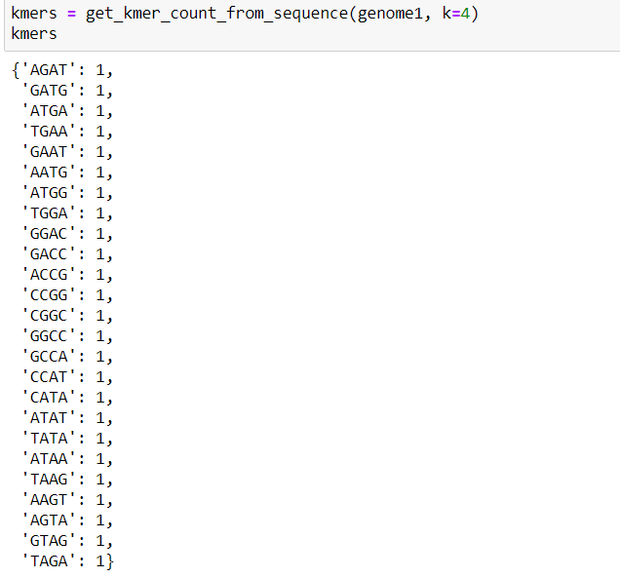
Output

Slide 10
Challenges
There are many challenges in implementing genome assembly. One of the major challenges is dealing with erroneous reads. Whatever the sequencing technology that is been used, the reads will not be 100% accurate. To overcome this sequencing the same section of DNA a number of times over can be used. The number of times a section got sequenced is called coverage. More the coverage, more the confidence level would be. So having higher coverage results in lots and lots of short reads of the DNA sequence. These short reads are mixed up like small pieces of a puzzle. They should be organized together and put them in the correct order to assemble the genome sequence. So assembling the short reads to get to the original genome is an uphill task.

Slide 11
Summary
Assembly based algorithms currently reach about 80% of the genome
These algorithms can handle different variant types more conveniently than mapping based approaches

Slide 12
References
Iqbal, Caccamo, Turner, Flicek and McVean (2012) Nature Genetics 44:226-232
Lander and Waterman (1988) Genomics 2:231-239
M. V. M. Silva, M. T. de Holanda, E. H. Haeusler, E. M. de Armas, and S. Lifschitz, “VelvetH-DB: Persistłncia de Dados no Processo de Montagem de Fragmentos de Sequłncias Biolgicas,” in Proceedings Satellite Events of the 32nd Brazilian Symposium on Databases. Databases Meet Bioinformatics Workshop, pp. 334–341, 2017
D. R. Zerbino and E. Birney, “Velvet: Algorithms for de novo short read assembly using de Bruijn graphs,” Genome Research, vol. 18, no. 5, pp. 821–829, 2008.

