Slide 1
PLANT DISEASE DETECTION
OUR TEAM
Ritika R Prasad AM.EN.U4AIE19053
Lakshmi G pillai AM.EN.U4AIE19074
Vysakh Nair AM.EN.U4AIE19072
Nithin Sylesh AM.EN.U4AIE19044

Slide 2
TABLE OF CONTENTS
Problem & Motivation
Methodology and Relevance
References and Links
01
03
05
Literature Review
Result and Conclusion
Targeted Conference
02
04
06

Slide 3
PROBLEMS
MOTIVATION
Crop growth and yield are essential aspects that influence the field of agriculture as well as farmer economically, socially, and in every possible way.
It is necessary to have close monitoring at various stages of crop growth to identify the diseases at right time.
In this aspect, automatic recognition and classification of various diseases of a specific crop are necessary for accurate identification. This thought gave inspiration for the present proposed framework.
The problem that we intend to solve in our project is Plan Disease Detection.Plant diseases detection is a very important research content in the field of machine vision. It is a technology that uses machine vision equipment to acquire images to judge whether there are diseases and pests in the collected plant images

Slide 4
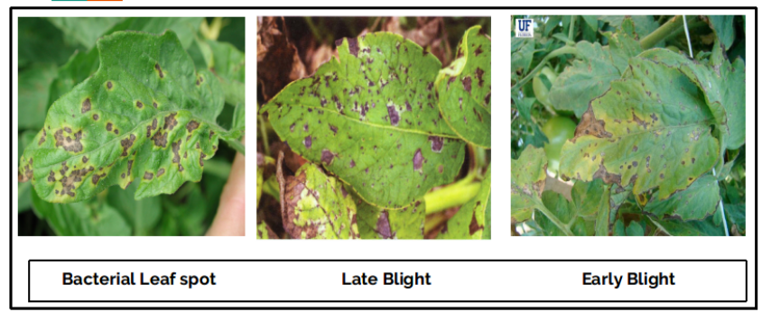
DATASET
DESCRIPTION
The PlantVillage dataset is created to bring efficient solutions in order to detect 38 different plant diseases. It contains 54,303 healthy and unhealthy images of plant leaves It was created with six different augmentation techniques for creating more diverse datasets with different background conditions.
Original paper URL: https://arxiv.org/abs/1511.08060
Dataset URL: https://data.mendeley.com/datasets/tywbtsjrjv/1

Slide 5
02
LITERATURE REVIEW

Slide 6
Leaf Disease Detection Using Deep Learning
Disease detection using an automated technology and methodology is effective and beneficial since it reduces the amount of time and effort required to monitor a large crop. We can detect the symptoms of plant illnesses in the early stages, when they first develop on the leaves of the plants. Plants are sampled for allied diseases in order to identify them. It expresses the competence of the provided algorithm to identify and classify tomato leaf illnesses by estimating the lesser attempts of the superlative outcome that are created. Convolutional algorithms can be used to improve the accuracy of the identification rate in the classification process.
.T. S. M, S. K. S, S. M. S and P. R. Devi, "Leaf Disease Detection Using Deep Learning," 2021 Second International Conference on Electronics and Sustainable Communication Systems (ICESC), 2021, pp. 1797-1804, doi: 10.1109/ICESC51422.2021.9532909.

Slide 7
Image-Based Detection of Plant Diseases: From Classical Machine Learning to Deep Learning Journey
Scientists have been researching methods to treat common diseases that affect humans and plants for many years. In this work, they examined how machine learning in general and deep learning in particular have aided in the identification of plant diseases. If illnesses are not adequately identified, they have an impact on crop productivity and can lead to long-term problems like global warming and even famine. Multiple investigations on plant disease automation and identification using various machine learning algorithms are summarised in the proposed study. The proposed publication also demonstrates that a variety of CV approaches are well-accepted in this domain, indicating that there is a large area of research to be investigated in the near future.
Rehan Ullah Khan ,1 Khalil Khan ,2 Waleed Albattah ,1 and Ali Mustafa Qamar
https://doi.org/10.1155/2021/5541859

Slide 8
Plant Disease Detection using Deep Learning
This paper proposes a deep learning-based model named plant disease detector. Using images of plants' leaves, the model can detect a variety of ailments. Plant disease detection model is developed using neural network. First, augmentation is used to increase the sample size of a dataset. Later, with several convolution and pooling layers, a Convolution Neural Network (CNN) is utilised. This method is built on a basic categorization process that takes advantage of CNN's feature extraction capabilities. Finally, the model employs fully connected layers for prediction. On publicly available datasets, the system obtained a testing accuracy of 98 percent. CNN is extremely ideal for automatic detection and diagnosis of plants, based on its accuracy. This technique can be implemented with mini-drones to identify diseases in farmed regions in real time. Furthermore, new real-world photographs of leaves can be added to the dataset to enhance accuracy on real-world images of leaves and categorise more plant and disease categories.
Chohan M, Khan A, Chohan R, Katpar SH, Mahar MS. Plant disease detection using deep learning. International Journal of Recent Technology and Engineering. 2020;9(1):909-14.

Slide 9
Solving Current Limitations of Deep Learning Based Approaches for Plant Disease Detection
This paper presents and discusses the current limitations and shortcomings of existing plant disease detection models. A new dataset containing 79,265 images was also introduced, with the goal of becoming the largest dataset containing leaf images. Images were captured in a variety of weather conditions, at various angles, and during daylight hours, with an inconsistent background to simulate practical situations. Traditional augmentation methods and state-of-the-art style generative adversarial networks were used to increase the number of images in the dataset. Several experiments were carried out to evaluate the impact of training in a controlled environment and application in real-world situations to accurately identify plant diseases in a complex background and under various conditions, including the detection of multiple diseases in a single leaf.
Arsenovic, Marko, Mirjana Karanovic, Srdjan Sladojevic, Andras Anderla, and Darko Stefanovic. 2019. "Solving Current Limitations of Deep Learning Based Approaches for Plant Disease Detection" Symmetry 11, no. 7: 939. https://doi.org/10.3390/sym11070939

Slide 10
03
METHODOLOGY

Slide 11
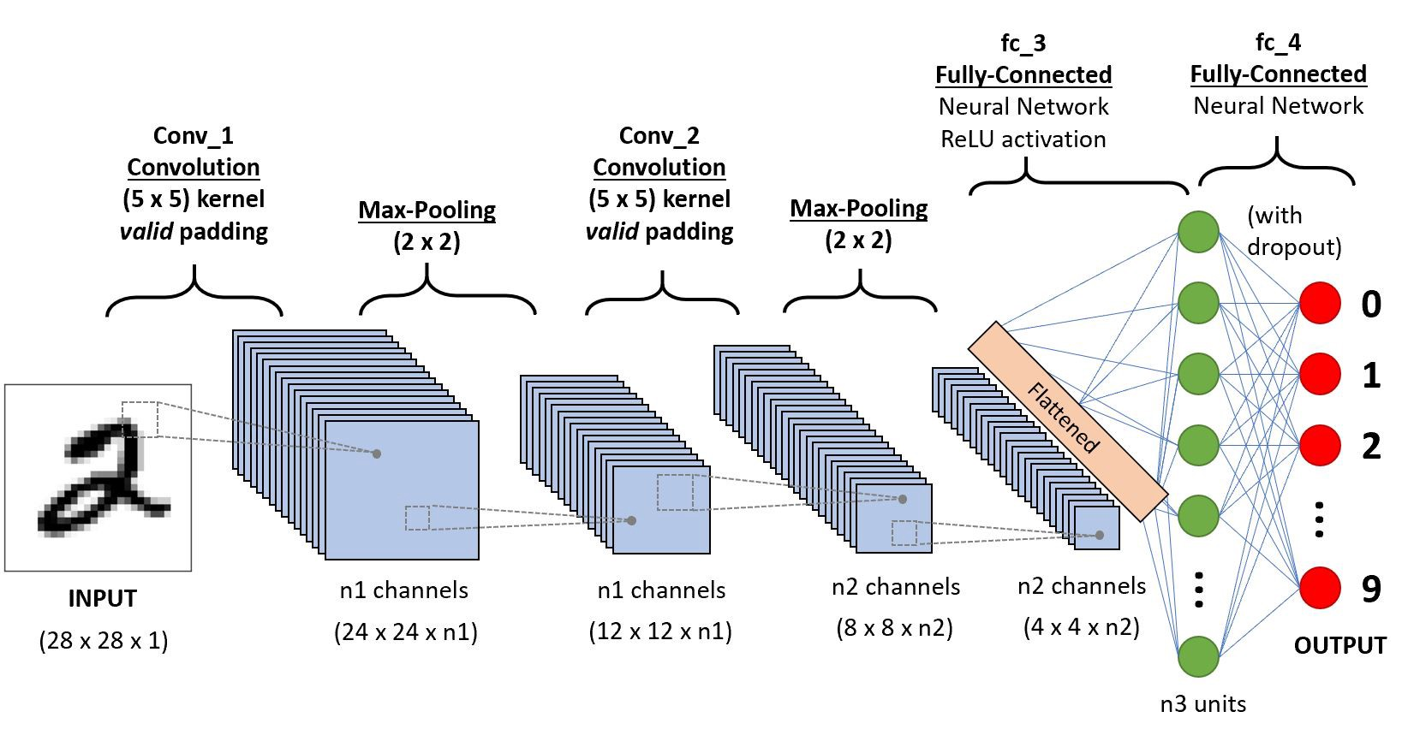
CNN
STRUCTURE

Slide 12
CNN ARCHITECTURE
USED

Slide 13
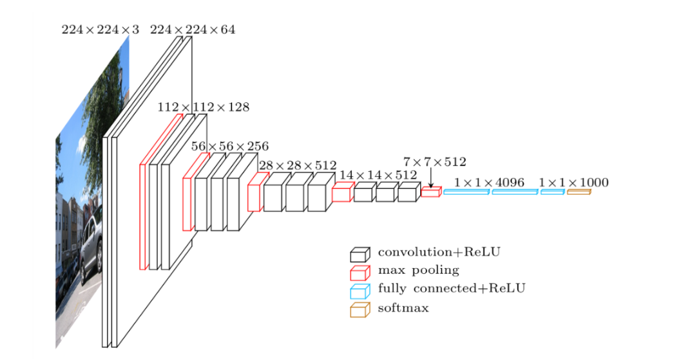
Vgg-16

Slide 14
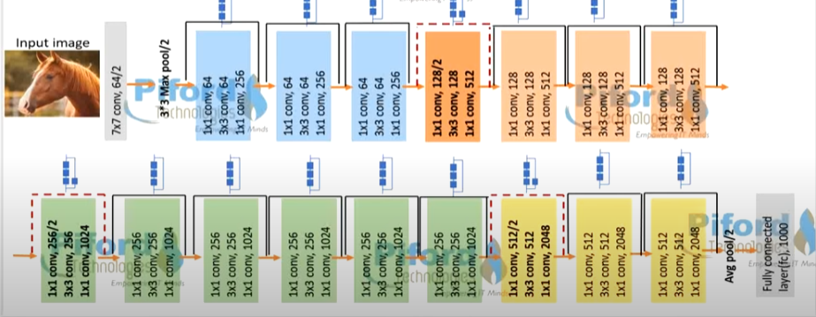
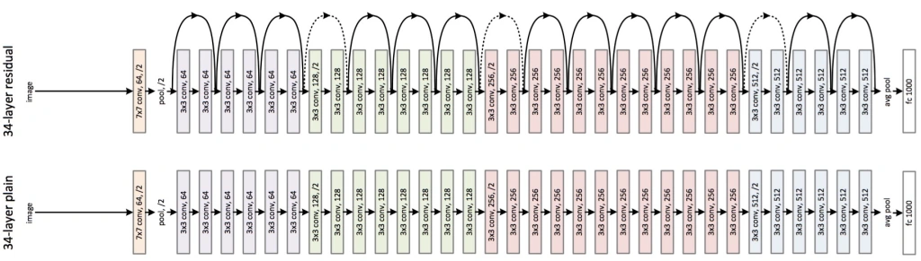
RESNET

Slide 15
04
RESULT and
CONCLUSION

Slide 16
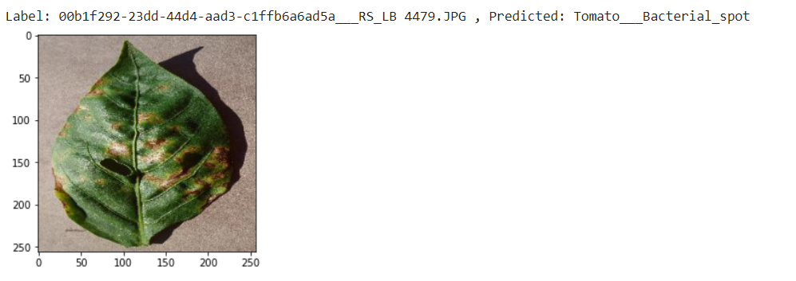
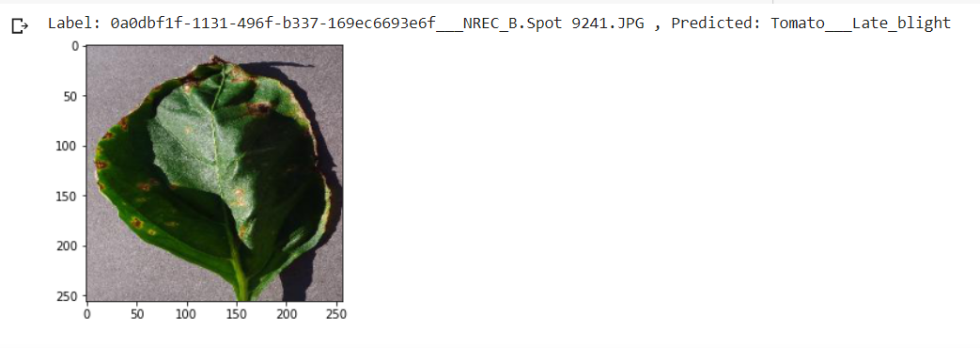
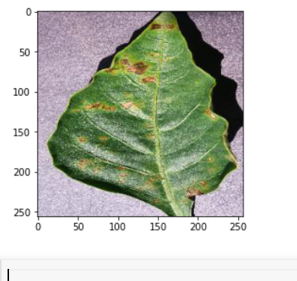
RESULT
VGG-16
RESNET-18

Slide 18
CONCLUSION
Compared with traditional image processing methods, which deal with plant diseases detection tasks in several steps and links, plant diseases detection methods based on deep learning unify them into end-to-end feature extraction, which has a broad development prospects and great potential. Although plant diseases detection technology is developing rapidly, it has been moving from academic research to agricultural application, there is still a certain distance from the mature application in the real natural environment, and there are still some problems to be solved.
In this paper the Deep Learning algorithm i.e. Convolutional Neural Network is used to with a goal to detect the diseases in the crops. The model is basically tested on some types of plant species with some types of plant diseases. The model was made using Tensorflow As an extension to the project the number of classes of plants and its diseases will be increased .Also the model will be further improved by increasing the parameters for training and test.

Slide 19
REFERENCES
T. S. M, S. K. S, S. M. S and P. R. Devi, "Leaf Disease Detection Using Deep Learning," 2021 Second International Conference on Electronics and Sustainable Communication Systems (ICESC), 2021, pp. 1797-1804, doi: 10.1109/ICESC51422.2021.9532909.
Chohan M, Khan A, Chohan R, Katpar SH, Mahar MS. Plant disease detection using deep learning. International Journal of Recent Technology and Engineering. 2020;9(1):909-14.
Chohan M, Khan A, Chohan R, Katpar SH, Mahar MS. Plant disease detection using deep learning. International Journal of Recent Technology and Engineering. 2020;9(1):909-14.
Sardogan, M., Tuncer, A., and Ozen, Y.: Plant Leaf Disease Detection and Classification Based on CNN with the LVQ Algorithm. In: 3rd Int. Conf. Comput. Sci. Eng. (2018) 382– 385
Wallelign, S., Polceanu, M., and Buche, C.: Soybean plant disease identification using a convolutional neural network. In: Proc. 31st Int. Florida Artif. Intell. Res. Soc. Conf. FLAIRS 2018 (2018), 146–151
Sladojevic, S., Arsenovic, M., Anderla, A., Culibrk, D., and Stefanovic, D.: Deep Neural Networks Based Recognition of Plant Diseases by Leaf Image Classification. Comput. Intell. Neurosci. 2016(2016)
Barbedo, J. G. A.: Factors influencing the use of deep learning for plant disease recognition. Biosyst. Eng., 172 (2018) 84–91

Slide 20
THANKS!

