Slide 1
TEXT TO IMAGE USING STACK GAN

Slide 2
TEAM-MEMBERS
NITHIN SYLESH | AM.EN.U4AIE19044
RITIKA R PRASAD | AM.EN.U4AIE19053
VYSAKH S NAIR | AM.EN.U4AIE19072
LAKSHMI G PILLAI | AM.EN.U4AIE19074

Slide 3
TABLE OF CONTENTS
1.INTRODUCTION 2.LITERATURE REVIEW
3.DATASET 4. SYSTEM ARCHITECTURE
5.METHODOLOGY 6.RESULTS

Slide 4
INTRODUCTION
Text to Photo-realistic Image Synthesis with Stacked Generative Adversarial Networks
Synthesizing high-quality images from text descriptions is a challenging problem in computer vision and has many practical applications
Samples generated by existing text-to-image approaches can roughly reflect the meaning of the given descriptions, but they fail to contain necessary details and vivid object parts.

Slide 5
Literature Review

Slide 6
StackGAN: Text to Photo-realistic Image Synthesis with Stacked Generative Adversarial Networks
In this paper, Han Zhang , Tao Xu2 proposed stacked Generative Adversarial Networks (StackGAN) to generate photo-realistic images conditioned on text descriptions. The Stage-I GAN sketches the primitive shape and basic colors of the object based on the given text description, yielding Stage-I low resolution images. The Stage-II GAN takes Stage-I results and text descriptions as inputs, and generates high resolution images with photo realistic details.

Slide 7
Text to Image Generation with Semantic-Spatial Aware GAN
In this paper, they proposed a novel framework of Semantic-Spatial Aware GAN for T2I generation. It has one generator-discriminator pair and is trained end-to-end. The core module of SSA-GAN is a Semantic Spatial Aware Convolution Network (SSACN) block which operates Semantic-Spatial Condition Batch Normalization by predicting mask maps based on the current generated image features, and learning the affine parameters from the encoded text vector. The SSACN block deepens the text image fusion through the image generation process, and guarantees the text-image consistency.

Slide 8
Generative Adversarial Text to Image Synthesis
In this work they developed a simple and effective model for generating images based on detailed visual descriptions.They demonstrated that the model is capable of synthesizing many plausible visual interpretations of a given text caption. Their manifold interpolation regularizer for conditional GAN achieved substantially improved text to image syn-thesis on CUB. They showed disentangling of style and content, and bird pose and background transfer from query images onto text descriptions. Finally they demonstrated the generalizability of their approach to generating images with multiple objects and variable backgrounds with their `results on MS-COCO dataset.

Slide 9
Text to Image Generation with Segmentation Attention
In this paper, they propose SegAttnGAN for text-to-image synthesis tasks, which uses segmentation attention to constrain the GAN training and successfully generates better quality images compared to other state-of-art methods. With the segmentation masks from datasets as input, our SegAttnGAN achieves the highest Inception Scores on both CUB and Oxford-102 datasets. When the masks are generated via our self-attention generator, our self-attention SegAttnGAN also generates results with better visual realism compared to other state-of-art method

Slide 10
The Caltech-UCSD Birds-200-2011 (CUB-200-2011) dataset is the most widely-used dataset for fine-grained visual categorization task.
DATASET
Contains 11,788 images of 200 subcategories belonging to birds, 5,994 for training and 5,794 for testing.
The extended version roughly doubles the number of images per category and adds new part localization annotations
All images are annotated with bounding boxes, part locations, and attribute labels.

Slide 11
SYSTEM ARCHITECTURE

Slide 12
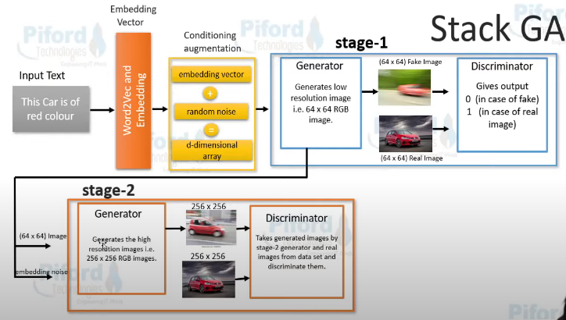

Slide 13
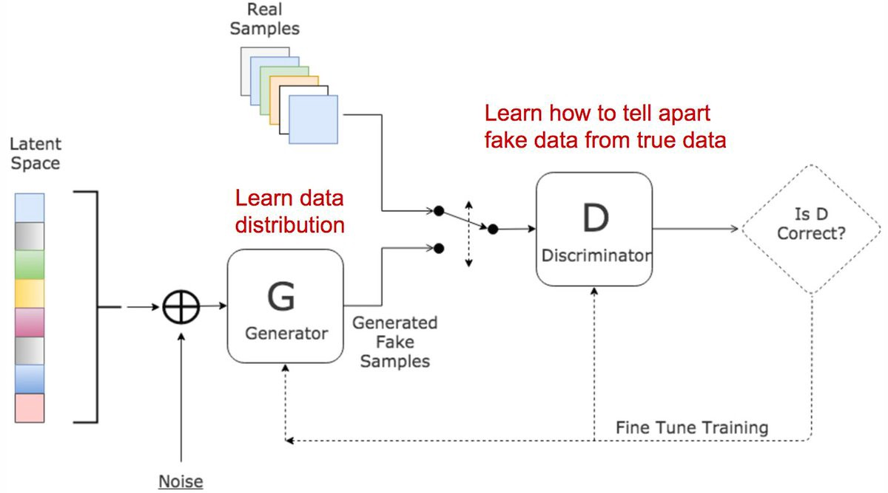

Slide 14
METHODOLOGY

Slide 15
Embedding
Converts the input variable length text into a fixed length vector. we will be using a pre-trained character level embedding.
Conditioning Augmentation
Generator and the Discriminator are conditioned on auxiliary data such as a class label during training.
Stage I Generator
Generates low resolution (64*64) images.
Stage I
Discriminator
The discriminator in a GAN is simply a classifier
Stage I I Generator
Generates high resolution (256*256) images.
Stage II
Discriminator
Distinguish real data from the data created by the generator.

Slide 16
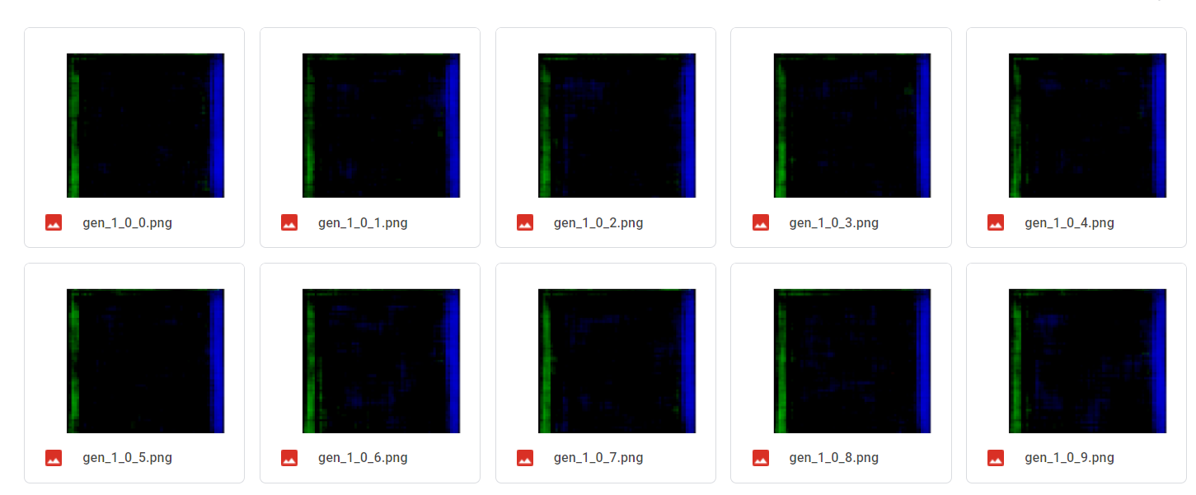
RESULTS

Slide 17
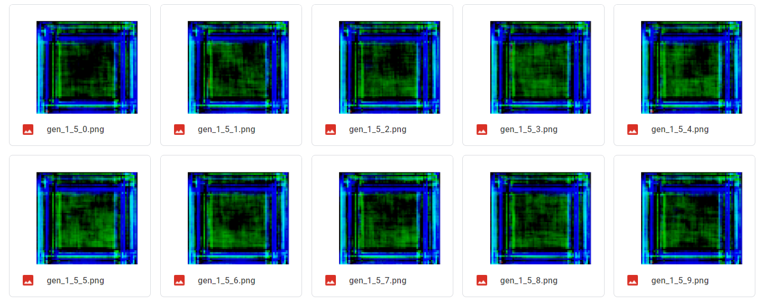

Slide 18
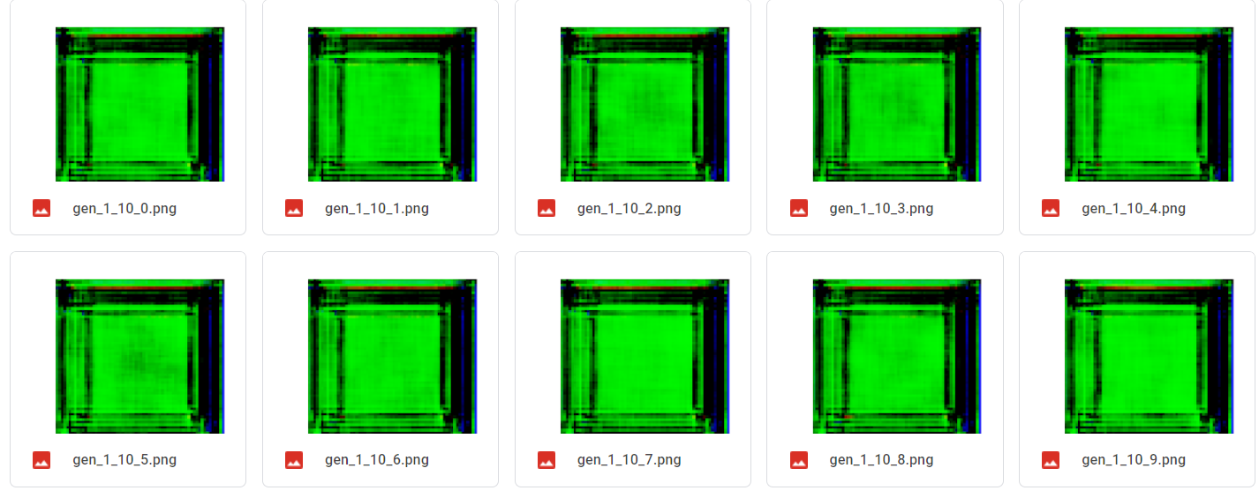

Slide 19
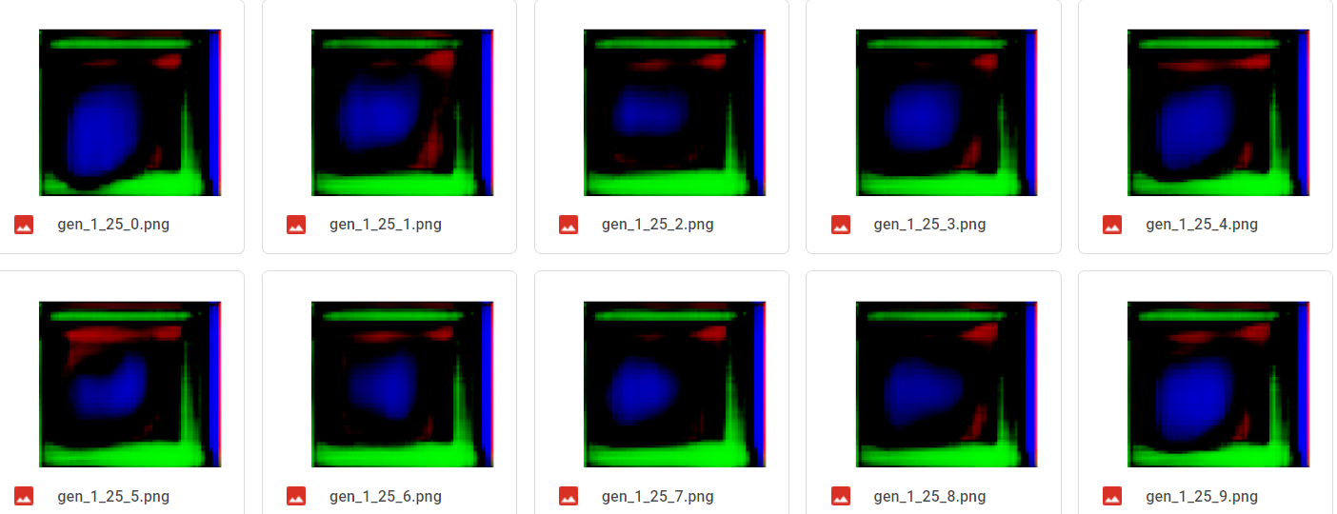

Slide 20
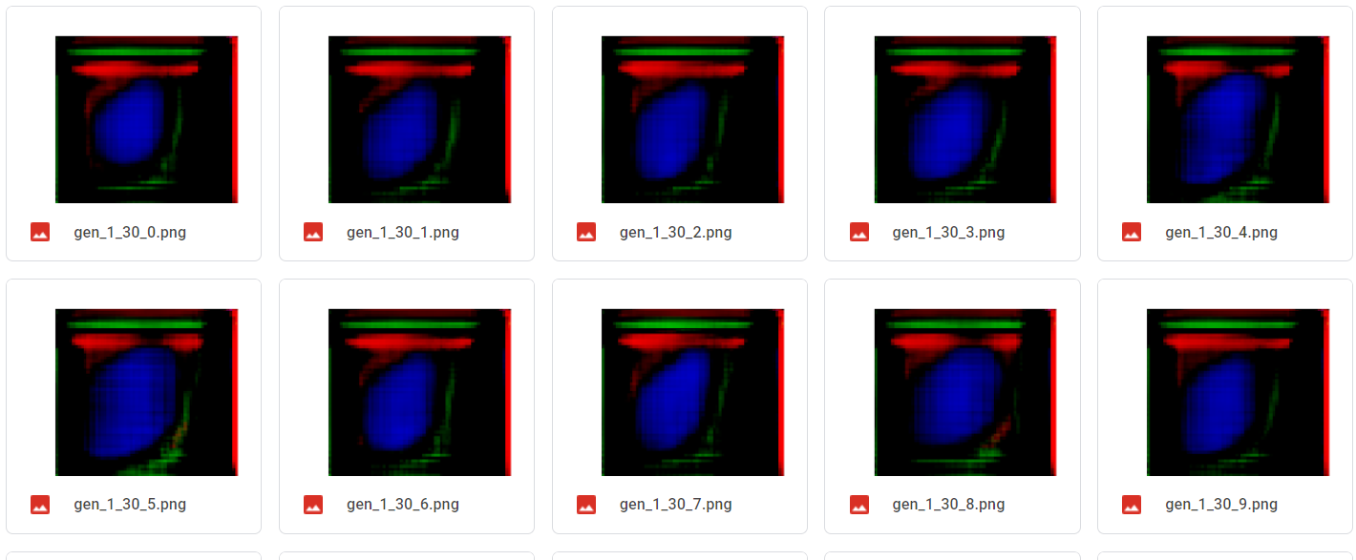

Slide 21
