Slide 1

Project Title - Seasonal Agriculture Performance Analysis
Student Name - TIPPARABOINA NITHIN
College Name- ACE ENGINEERING COLLEGE
AICTE STU ID : STU6a68ce16048521785253398

Slide 2

PROBLEM STATEMENT
Agricultural performance varies across seasons due to differences in environmental conditions, farming practices, resource availability and market conditions. However, raw agricultural data does not clearly show these differences or the patterns behind them. This project analyzes the agricultural dataset to identify seasonal variations, trends, relationships and factors affecting agricultural performance.

Slide 3
Project Description
This project analyzes agricultural data from 4,000 farm records to understand how crop performance changes across different seasons, crops, irrigation methods and states. The analysis uses Python, Pandas and Matplotlib to clean the data, explore patterns, compare agricultural performance and study relationships between environmental and farming factors. The project focuses on crop yield, production, profit, water usage, water efficiency and disease/pest risk to provide useful data-driven insights for better agricultural planning and resource management

Slide 4

WHO ARE THE END USERS?
Farmers – to understand crop performance, irrigation and profitability.
Agricultural planners – to support seasonal and crop planning.
Agricultural decision-makers – to compare yield, profit and resource usage.
Researchers & analysts – to study agricultural trends and relationships.
Agriculture organizations – to support better resource management and planning.

Slide 5

Technology Used
Python – Data analysis and processing
Pandas – Data cleaning and analysis
Matplotlib – Data visualization
Jupyter Notebook – Project development and documentation
VS Code – Coding and project development
GitHub – Project storage and submission

Slide 6
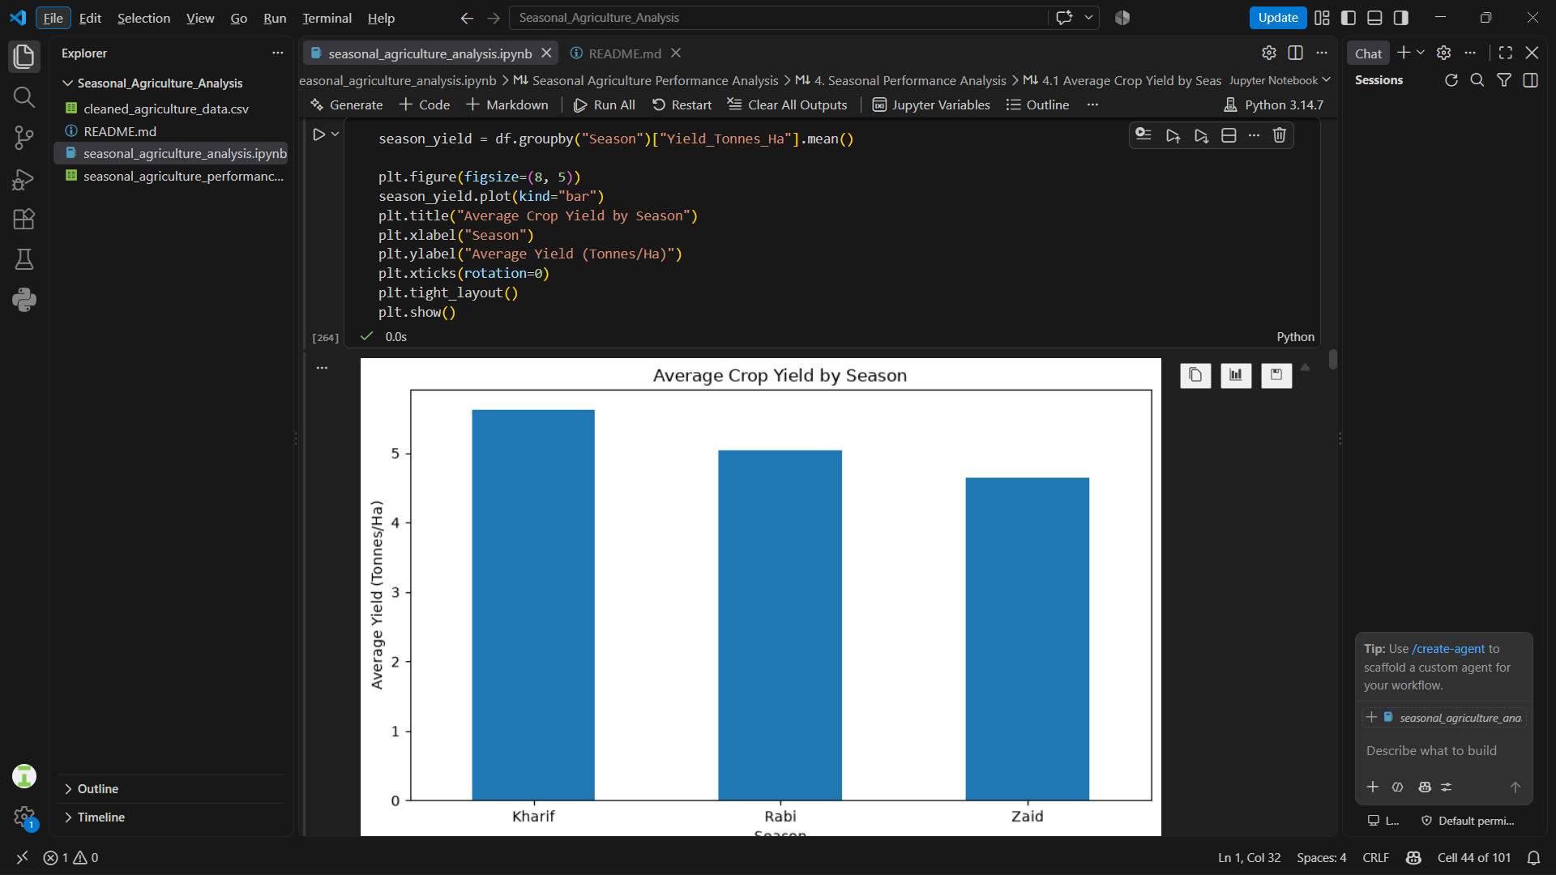
RESULTS - Seasonal Performance

Slide 7
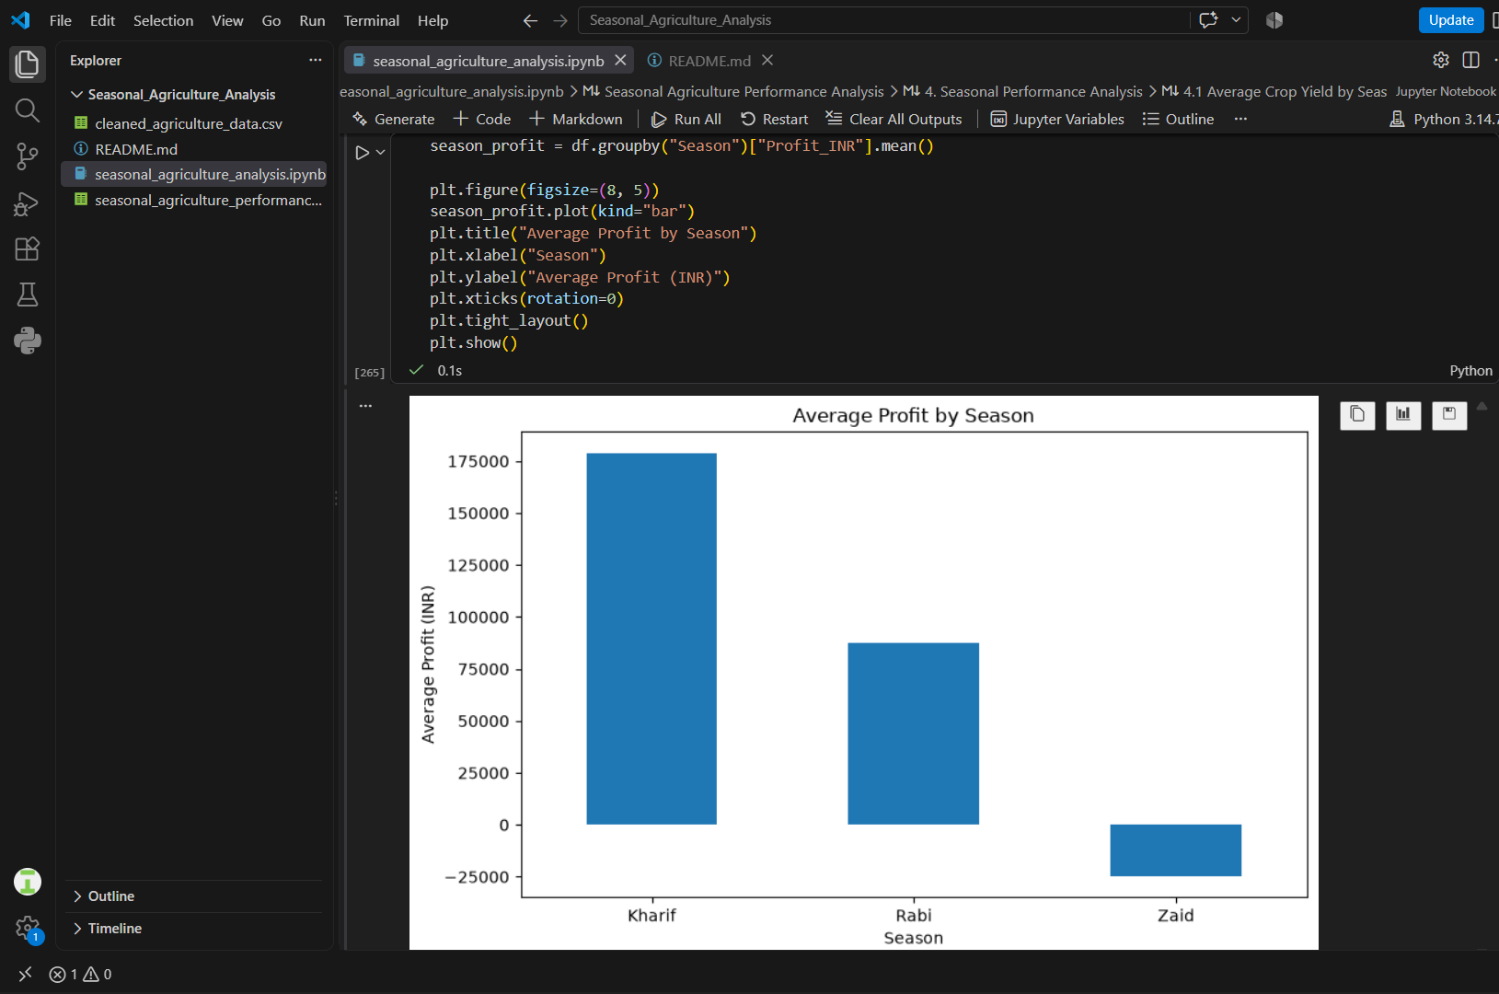

Slide 8
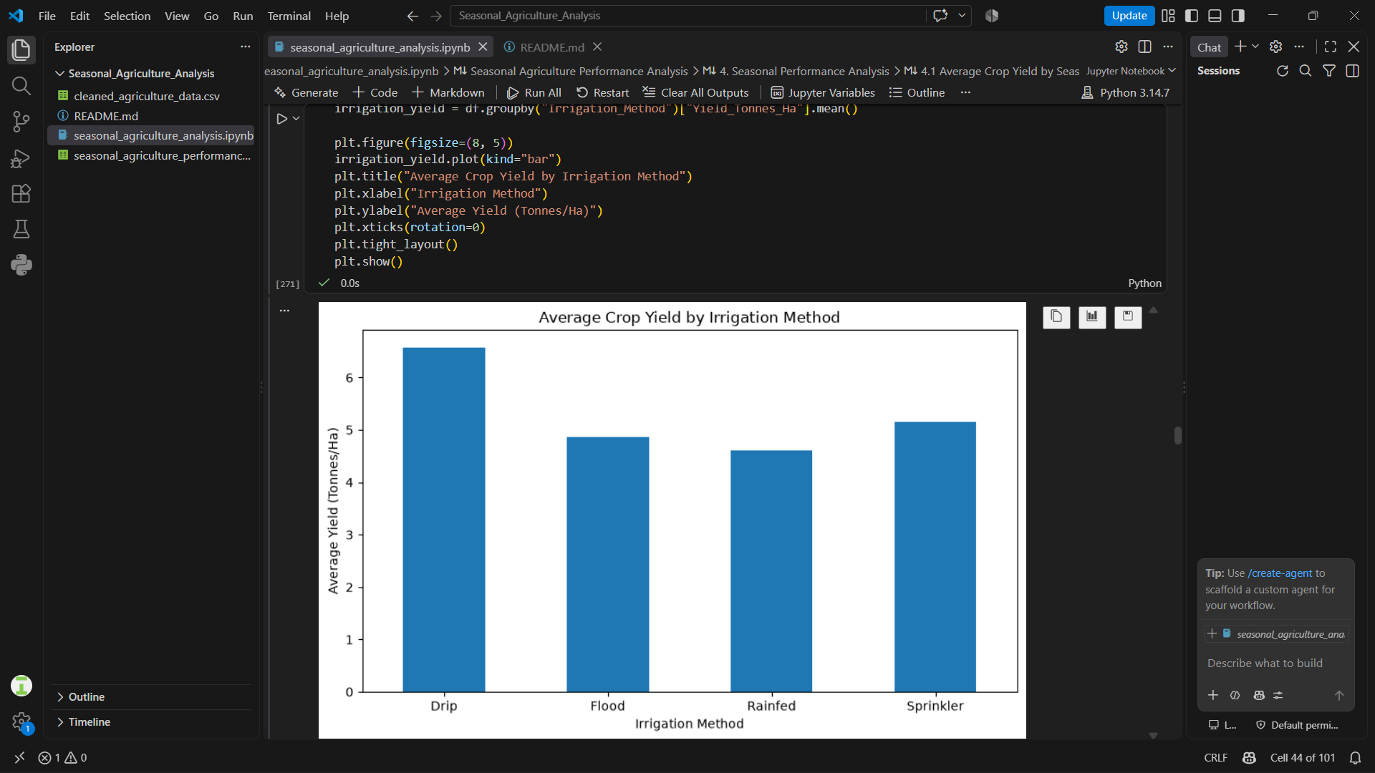
RESULTS - Irrigation Performance

Slide 9
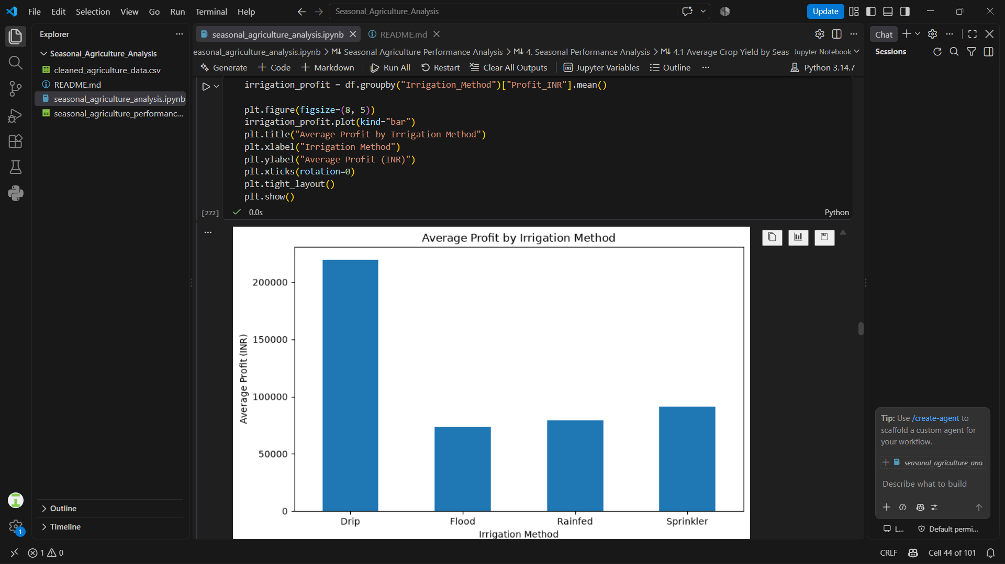

Slide 10
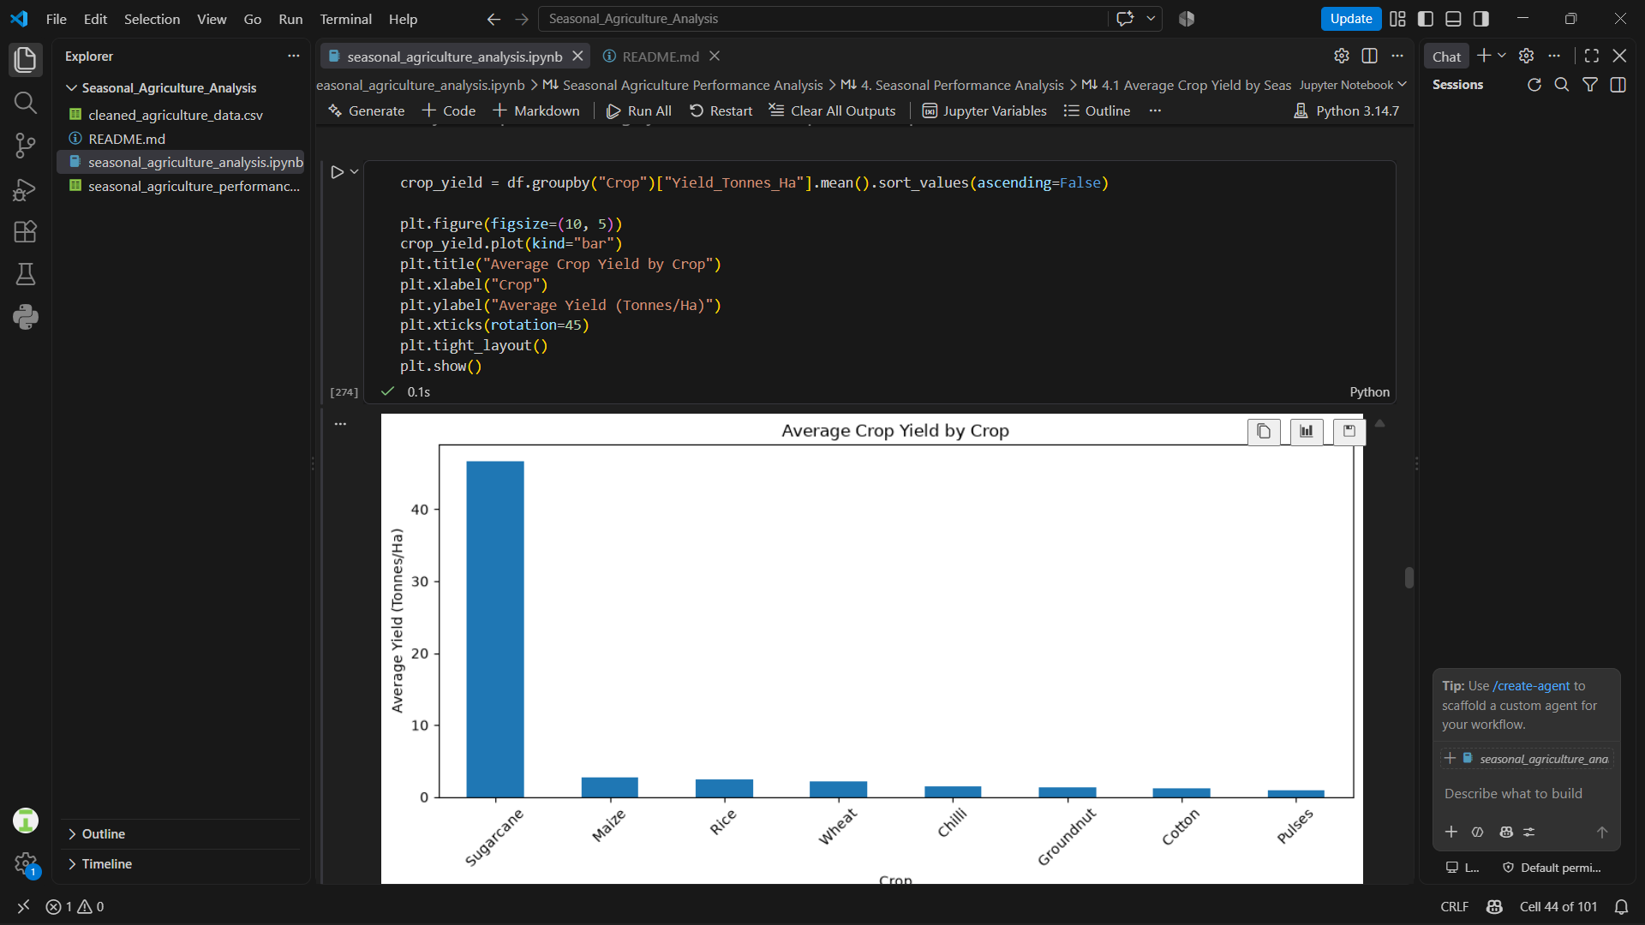
RESULTS - Crop Performance

Slide 11
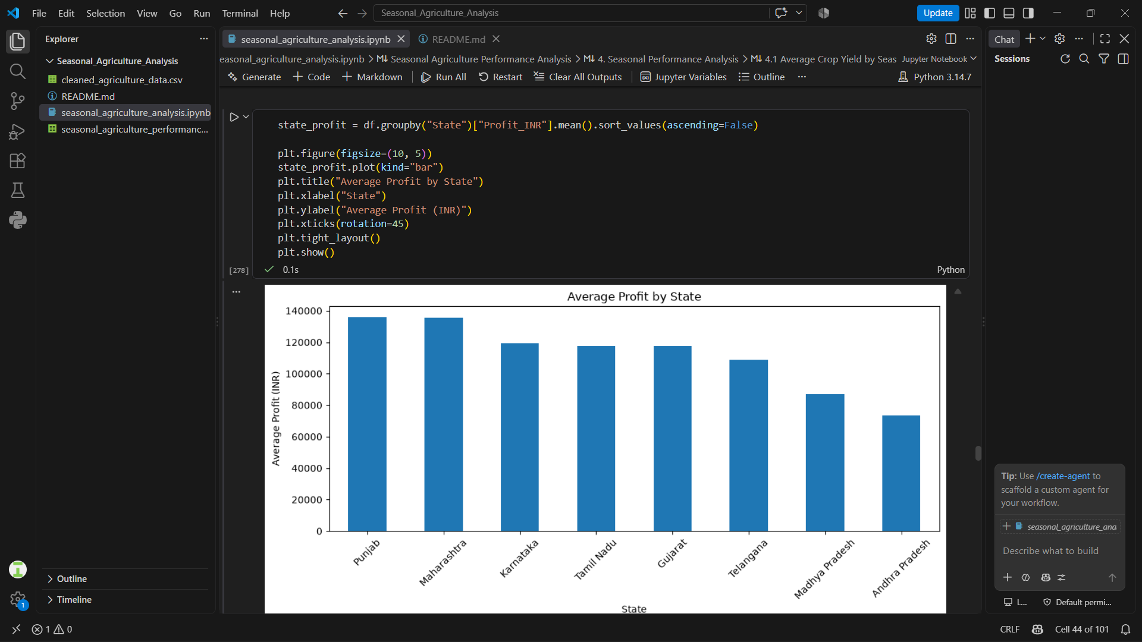
RESULTS - Geographical Performance

Slide 12
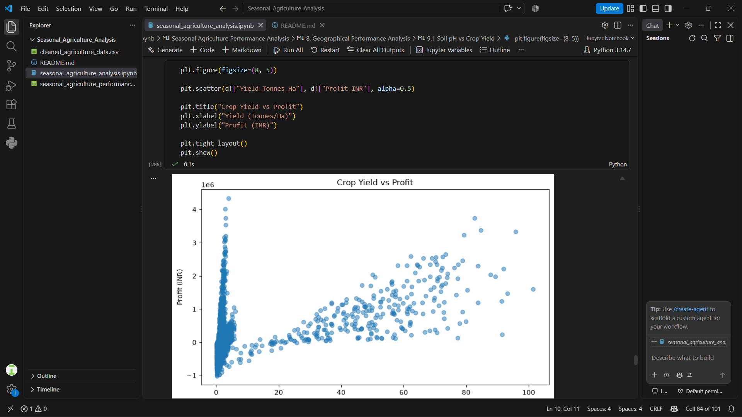
RESULTS - Important Relationships

Slide 13
Future scope
Develop a prediction model to forecast crop yield and profitability.
Use machine learning to identify the factors that most influence agricultural performance.
Include real-time weather and rainfall data for better seasonal analysis.
Develop a crop recommendation system based on soil, climate and resource conditions.
Improve water management by recommending efficient irrigation practices.
Expand the analysis using larger and more diverse agricultural datasets.
Build an interactive dashboard for farmers and agricultural decision-makers.

Slide 14
GitHub Link
https://github.com/nithin-tipparaboina/Seasonal_Agriculture_Analysis.git

Slide 15
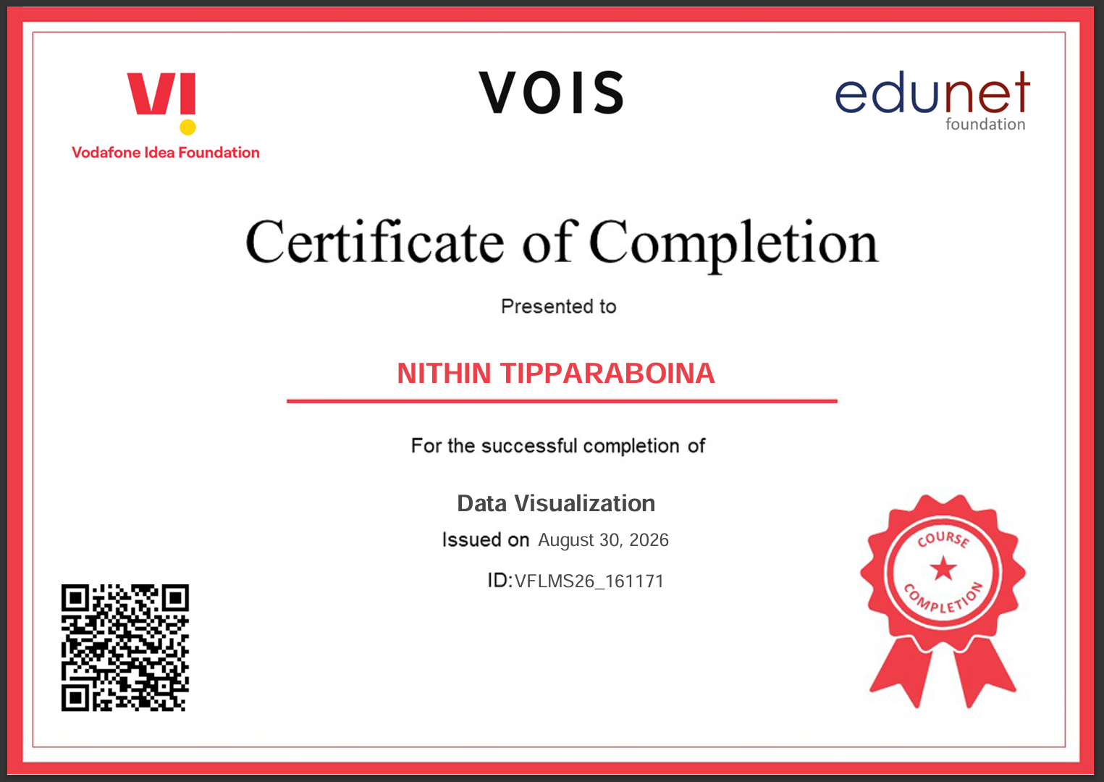
VOIS Course completion certificate - Course name- Data Visualization

Slide 16
Thank you
.
.

