Slide 1


TEEGALA KRISHNA REDDY ENGINEERING COLLEGE
Department of Computer Science & Engineering
HEAD OF THE DEPARTMENT PROJECT CO-ORDINATOR
Dr. CH. V. PHANI KRISHNA Mrs. P. SWETHA
Professor Assistant professor

Slide 2
Semantic Segmentation using
Deep Learning
U-Net Architecture
INTERNAL GUIDE
Dr.A.PRANAYANATH REDDY
Associate Professor
NAME OF THE STUDENTS
D. Nithin (21R91A0556)
A.Manoj (21 R91A0507)
C. Nitin kumar (21R91A0554)

Slide 3
CONTENTS
ABSTRACT
EXISTING SYSTEM
PROPOSED SYSTEM
SYSTEM REQUIREMENTS
SYSTEM ARCHITECTURE
MODULES
UML DIAGRAMS
REFERENCES

Slide 4
ABSTRACT:
Semantic segmentation is crucial in computer vision for tasks like autonomous driving, medical imaging, and augmented reality, involving pixel-wise classification to determine the semantic meaning of each pixel. The U-Net architecture, with its encoder-decoder framework, symmetrical design, and skip connections, excels in capturing precise object localization and contextual information, making it ideal for high-resolution tasks like medical image analysis. This study applies U-Net to a diverse person dataset, tackling challenges such as occlusions and complex backgrounds to enhance human activity recognition, crowd analysis, and video surveillance.

Slide 5
EXISTING SYSTEM:
Before U-Net, traditional CNNs like LeNet and AlexNet focused on image classification, while Fully Convolutional Networks (FCNs) adapted CNNs for pixel-wise predictions. Encoder-decoder frameworks like SegNet and DeconvNet emerged for segmentation, while object detection advanced with RCNN, Fast RCNN, and Faster RCNN. DeepLab enhanced multi-scale contextual information with dilated convolutions, building on early feature extraction techniques like SIFT and SURF before deep learning's rise.
Drawback or Limitations:
U-Net was developed to address the limitations of earlier technologies: traditional CNNs lacked pixel-wise segmentation accuracy, FCNs and encoder-decoder frameworks lost spatial information during downsampling, and models like RCNN were too complex and slow for real-time use. DeepLab also struggled with capturing fine details. U-Net’s symmetric encoder-decoder structure with skip connections preserved spatial information, enabling precise pixel-wise segmentation.

Slide 6
PROPOSED SYSTEM:
U-Net is a powerful architecture for image segmentation, featuring a symmetrical encoder-decoder structure with skip connections that preserve high-resolution spatial features and combine them with contextual information from deeper layers. This enables precise and detailed segmentation, making U-Net ideal for tasks requiring fine-grained object localization, such as medical imaging. Its efficiency and versatility have also made it popular for segmentation tasks in autonomous driving and satellite imagery analysis.
ADVANTAGES:
U-Net excels in image segmentation by combining high-resolution encoder features with upsampled decoder features through skip connections, enabling precise localization and efficient handling of high-resolution images. Its symmetrical architecture captures both local and global context, making it versatile and accurate across various applications.

Slide 7
SYSTEM REQUIREMENTS:
Hardware Requirements :
RAM: 8GB minimum, 16GB+ recommended
Storage: 256GB+ SSD
CPU: Intel Core i5 or higher
Software Requirements:
OS: Windows 10/11, macOS, or Linux
Programming Language: Python 3.x
Deep Learning Framework: TensorFlow
Libraries:
Image Processing: Pillow
Visualization: Matplotlib
ML Utilities: Scikit-learn
IDE/Tools:
Development: VS Code
GUI: Streamlit
3. Datasets:
Images & Segmentation Masks: Custom or Public datasets

Slide 8
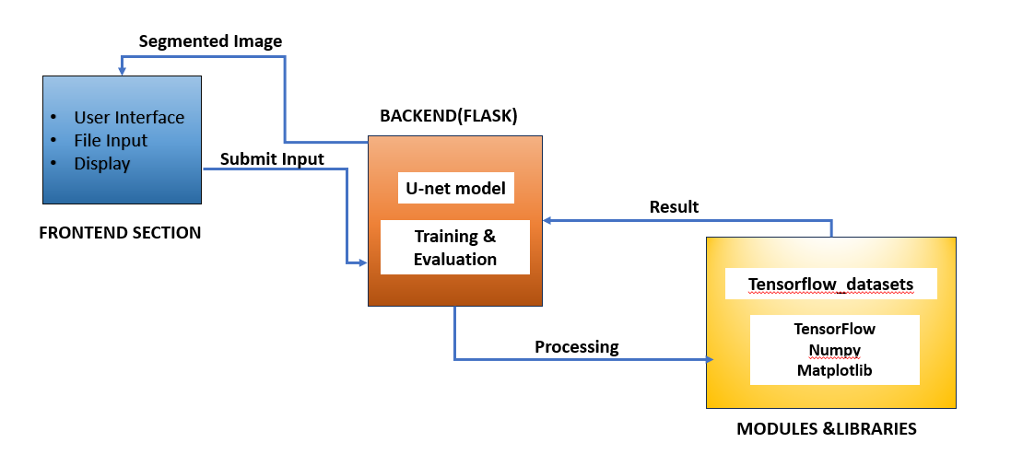
SYSTEM ARCHITECTURE:

Slide 9
MODULES:
Data Preparation Processing Module
Model Architecture Module
Training Evaluation Module
User Interface Inference Module

Slide 10
1.Data Preparation Processing Module
Handles image loading, resizing, and normalization.
Prepares data for training by augmenting and standardizing image dimensions.
Ensures proper preprocessing for feeding into the U-Net model.

Slide 11
2.Model Architecture Module
Constructs the U-Net architecture using MobileNetV2 as the base for feature extraction.
Adds up-sampling layers to reconstruct the segmentation mask at the original image size.
Ensures multi-scale feature extraction and mask prediction.

Slide 12
3. Training Evaluation Module
Trains the U-Net model using a predefined loss function, optimizer, and evaluation metrics
Saves the trained model and uses it for generating segmentation masks on new images.
Runs predictions, applying post-processing to produce output masks.

Slide 13
4.User Interface Inference Module
Provides a simple web interface using Streamlit to upload images and display segmentation results.
Allows users to interact with the trained model and visualize segmented images.
Ensures a seamless user experience for uploading and viewing results.

Slide 14
UML DIAGRAMS:
Use case diagram
Class diagram
Activity diagram
Sequence diagram
Component diagram

Slide 15
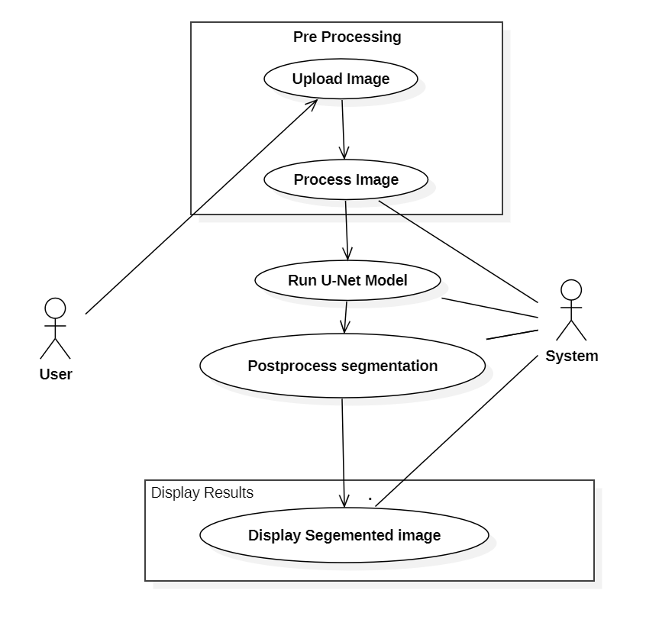
Use case diagram:

Slide 16
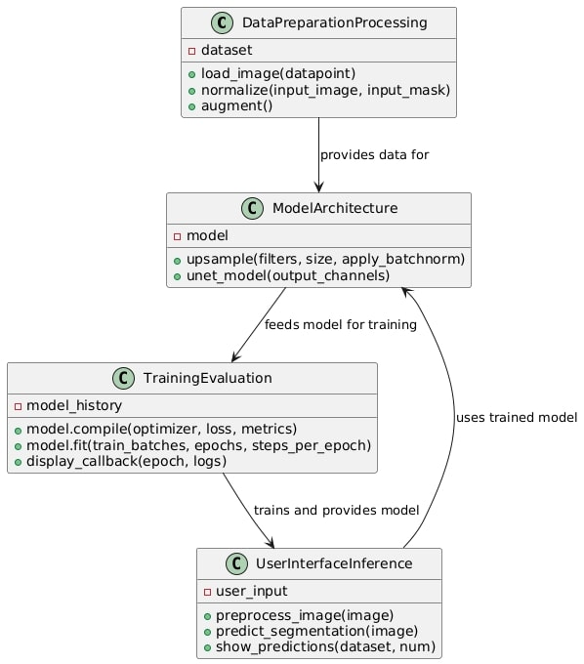
Class diagram:

Slide 17
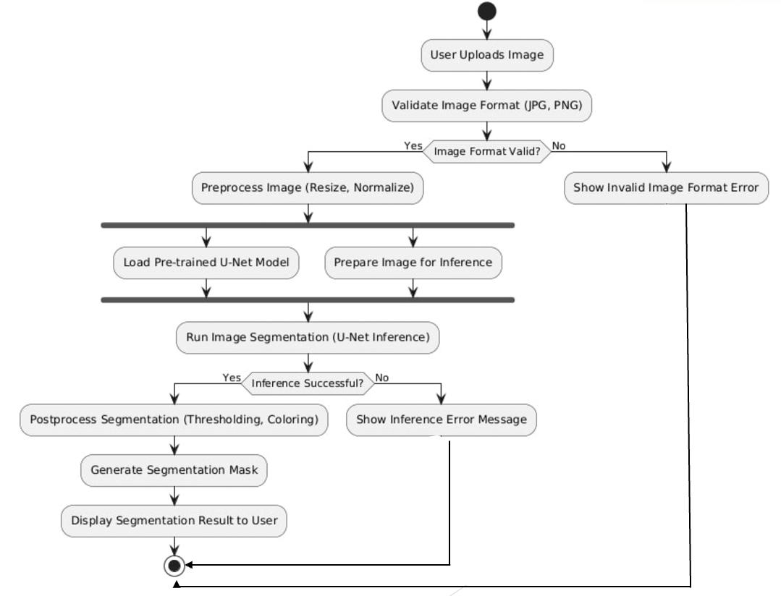
Activity diagram:

Slide 18
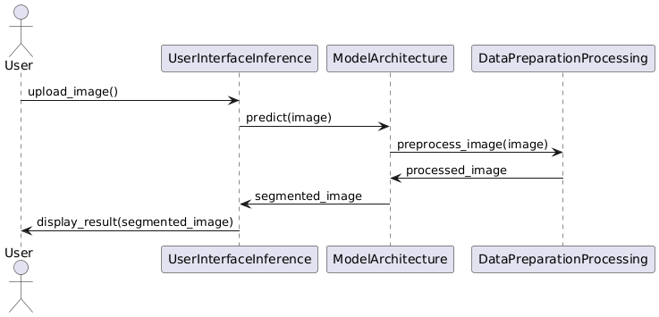
Sequence diagram:

Slide 19
Component diagram:

Slide 20
REFERENCES:
[1] C. M. Bishop. Pattern recognition and machine learning, page 229. Springer-Verlag New York, 2006. 6
[2] D. C. Ciresan, A. Giusti, L. M. Gambardella, and J. Schmidhuber. Deep neural networks segment neuronal membranes in electron microscopy images. In NIPS, pages 2852–2860, 2012. 1, 2, 4, 7
[3] J. Donahue, Y. Jia, O. Vinyals, J. Hoffman, N. Zhang, E. Tzeng, and T. Darrell. DeCAF: A deep convolutional activation feature for generic visual recognition. In ICML, 2014. 1, 2
[4] D. Eigen, D. Krishnan, and R. Fergus. Restoring an image taken through a window covered with dirt or rain. In Computer Vision (ICCV), 2013 IEEE International Conference on, pages 633–640. IEEE, 2013. 2
[5] D. Eigen, C. Puhrsch, and R. Fergus. Depth map prediction from a single image using a multi-scale deep network. arXiv preprint arXiv:1406.2283, 2014. 2

Slide 21
THANK YOU

