Slide 1



Plant Disease Detection System for Sustainable Agriculture

Slide 2

Learning Objectives
Plant Disease Detection using Deep Learning
1.Understand the Role of AI in Sustainable Agriculture:
Recognize how early and accurate plant disease detection contributes to reducing pesticide use, improving
yield, and promoting sustainable farming practice
2. Explore Image-Based Plant Disease Identification:
Learn how visual symptoms of plant diseases can be used to identify affected crops using image classification techniques.
3.Develop Competency in Deep Learning and CNNs:
Understand the working of Convolutional Neural Networks (CNNs) and their suitability for image classification problems.
Build and train deep learning models for detecting and classifying various plant diseases.
4.Handle Agricultural Image Datasets:
Acquire skills in collecting, cleaning, and augmenting plant leaf image datasets.
Learn preprocessing steps such as resizing, normalization, and augmentation to improve model generalization.
5.Evaluate and Interpret Model Performance:
Use accuracy, confusion matrix, precision, recall, and F1-score to evaluate classification results.
Understand overfitting and implement strategies to mitigate it (e.g., dropout, data augmentation, early stopping).
GOAL
Source :
www.freepik.com/

Slide 3
Tools and Technology used
Machine Learning & Deep Learning
TensorFlow / Keras – For building, training, and evaluating deep learning models (CNNs).
OpenCV – For image processing and manipulation (if used).
Scikit-learn – For performance metrics and model evaluation.
Image Handling
Pillow (PIL) – For loading and manipulating plant disease images.
Matplotlib / Seaborn – For visualizing images, training performance, and results.
Data & Preprocessing
NumPy / Pandas – For data manipulation, statistics, and array handling.
ImageDataGenerator (Keras) – For real-time image augmentation to reduce overfitting.
Model Optimization
Callbacks (EarlyStopping, ReduceLROnPlateau) – For improving training efficiency and preventing overfitting
Evaluation Tools
Confusion Matrix, Accuracy, Precision, Recall, F1-Score – For assessing the model’s performance
Development Environment
Jupyter Notebook / Google Colab – For interactive development, experimentation, and visualizing outputs.

Slide 4
Methodology
Problem Definition
Identify the need for an automated system to detect plant diseases early to promote sustainable agriculture.
Define the objective: classify images of plant leaves into healthy or disease categories using deep learning.
Data Collection
Use a publicly available dataset (e.g., PlantVillage) containing labeled images of healthy and diseased plant leaves.
Ensure the dataset includes diverse plant types and disease classes.
Data Preprocessing
Image Resizing: Standardize image dimensions to match model input requirements.
Normalization: Scale pixel values to a range of [0, 1] for better training performance.
Data Augmentation: Apply techniques like rotation, flipping, zooming, and shifting to increase dataset variability and reduce overfitting.
Model Building
Model Selection: Use a Convolutional Neural Network (CNN) architecture, or apply transfer learning with pre-trained models like VGG16, ResNet50, or MobileNet.
Architecture Design: Include convolutional layers, pooling layers, dropout layers, and dense layers.
Activation Functions: Use ReLU in hidden layers and softmax in the output layer for multi-class classification.
Model Training
Split the dataset into training, validation, and test sets.
Use categorical cross-entropy loss and an optimizer like Adam or SGD.
Monitor training and validation accuracy and loss across epochs.

Slide 5
Problem Statement:
In modern agriculture, early detection and treatment of plant diseases are critical to ensuring healthy crop yields and reducing economic losses. However, traditional methods of identifying plant diseases rely heavily on manual inspection by experts, which is time-consuming, subjective, and often inaccessible to farmers in rural areas.
With the increasing availability of image data and advances in artificial intelligence, there is a growing opportunity to develop an automated, efficient, and accurate system for plant disease diagnosis.
This project aims to design and implement a deep learning-based image classification system that can accurately detect and classify plant diseases from leaf images. The goal is to provide a scalable, affordable, and accessible solution that supports sustainable agriculture by enabling farmers to take timely action against diseases, thereby reducing crop loss and pesticide overuse.

Slide 6
Solution:
To address the challenges of manual and delayed plant disease identification, this project proposes an automated image-based plant disease detection system using deep learning techniques, specifically Convolutional Neural Networks (CNNs).
Key Aspects of the Solution:
Image Classification using Deep Learning:
Utilize CNNs to learn distinguishing features of plant leaves affected by various diseases.
The model is trained to classify leaf images into healthy or specific disease categories with high accuracy.
Data-Driven Approach:
Use a labeled dataset of plant leaf images (e.g., PlantVillage dataset) covering multiple crops and diseases.
Apply data augmentation to increase model robustness and handle variability in real-world images.
Model Architecture and Optimization:
Build a custom CNN or leverage transfer learning using pre-trained models like VGG16, ResNet50, or MobileNet for better accuracy and efficiency.
Apply dropout, early stopping, and learning rate scheduling to prevent overfitting and improve generalization.
Performance Evaluation:
Evaluate the model using metrics such as accuracy, precision, recall, F1-score, and confusion matrix.
Validate the system’s performance on unseen test data to ensure reliability.

Slide 7
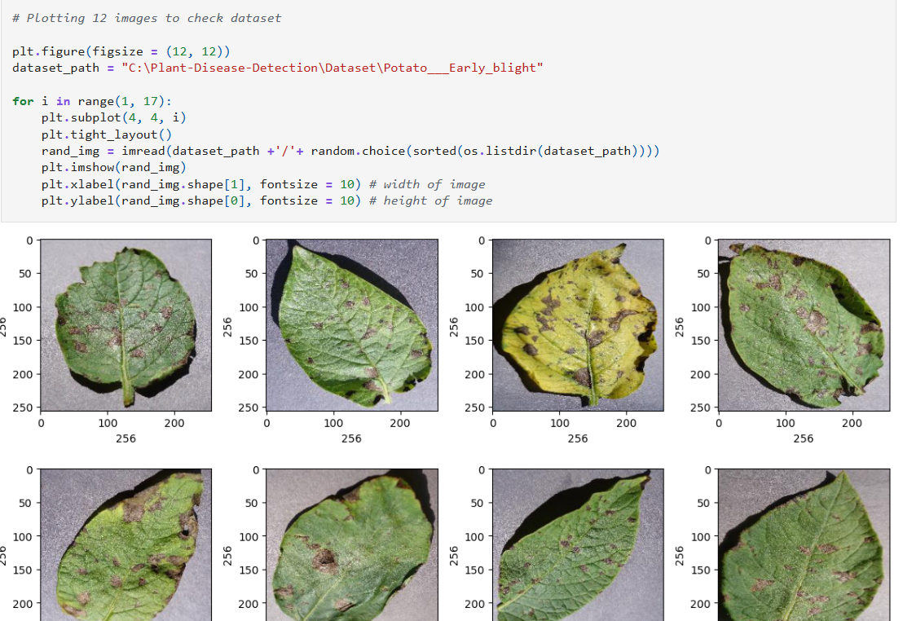
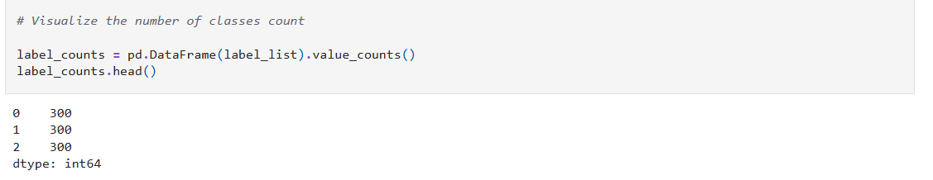
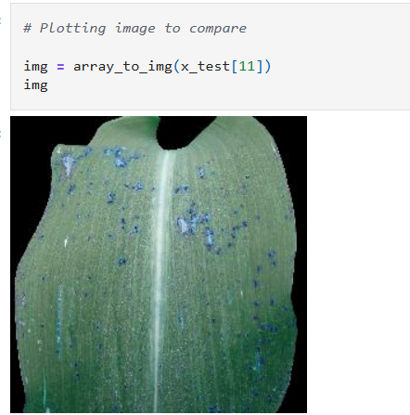

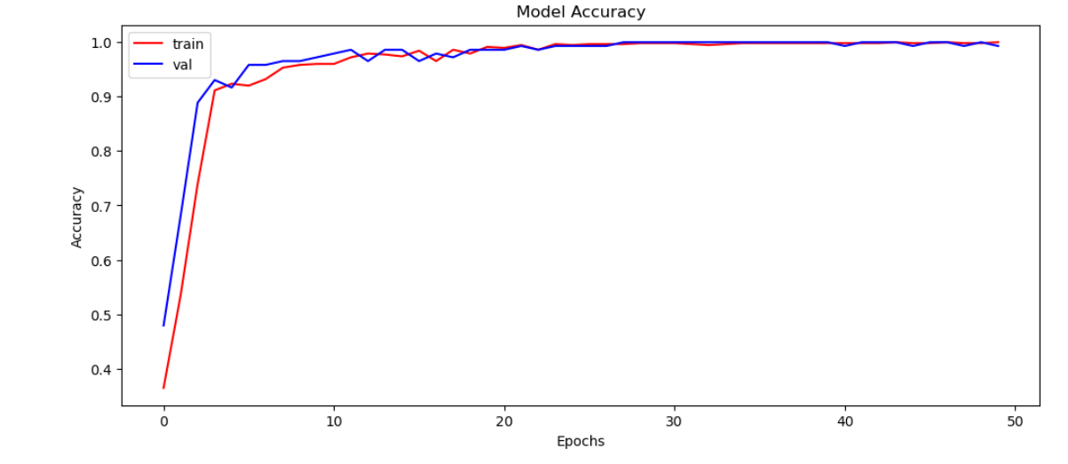
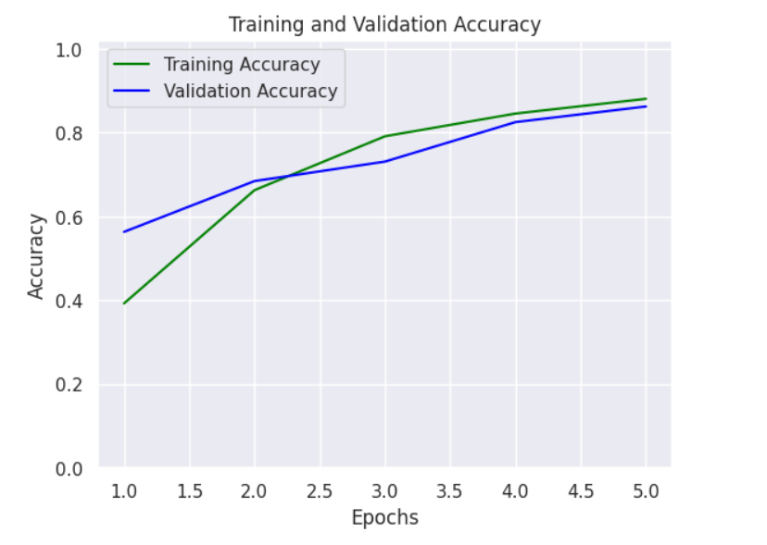
Screenshot of Output:

Slide 8
Conclusion:
The Plant Disease Detection System developed using deep learning techniques provides an effective and efficient solution for the early identification of plant diseases through leaf image classification. By leveraging Convolutional Neural Networks (CNNs), the system is capable of accurately classifying multiple plant diseases, which is essential for timely intervention and sustainable farming.
This project demonstrates the potential of artificial intelligence to:
Assist farmers in identifying diseases quickly and accurately without expert intervention.
Minimize crop losses and optimize pesticide usage, contributing to environmentally sustainable agriculture.
Enable the development of scalable and accessible tools such as mobile apps or web-based platforms that can be used even in remote rural areas.
With further enhancements, such as real-time image capture, multilingual interfaces, and integration with agricultural advisory systems, this model can become a powerful tool for promoting smart and sustainable farming practices.

