Slide 1

AED INFO 5100 NextStep System
GROUP NO: 46
Team Members
Nithin Yash Menezes
Samruddhi Sawant
Snehal Shinde

Slide 2
The Problem
What is the problem?
Many orphans lack access to proper care, including health, nutrition, and education. The workload on existing caregivers and supervisors is overwhelming, leading to inefficiencies in delivering services.
Who has this problem?
Organizations and government agencies involved in orphan care face this challenge due to a lack of sufficient workforce and resources, exacerbated by budget constraints.
How can the problem be resolved?
By streamlining operations through digital tools, the workload of caregivers and supervisors can be reduced. This will increase productivity, cover more areas, and ensure effective service delivery. The system also helps management track demands and efficiently allocate resources.

Slide 3
ORGANIZATIONS and SCOPE
The three basic organizations who are involved in management of the entire process are:
Welfare Organization
Field Level (FLO)
Health Organization
Supervisor.
Education Organization
Supervisor
Distributor
Teacher
Sector Level (SLO)
Block Level (BLO)
District Level (DLO)
Distributor
Teacher

Slide 4
Roles
Welfare Roles
Admin Role: Manages overall welfare enterprise and resource allocation.
BLO Role: Oversees block-level welfare operations and fund utilization.
FLO Role: Provides field-level welfare services and collects data.
Education Roles
Admin Role: Supervises educational programs and resource distribution.
Supervisor Role: Coordinates with teachers and distributors for effective education delivery.
Health Roles
Admin Role: Manages hospital operations and staff.
Doctor Role: Handles medical diagnosis and treatment for orphans.
Lab Assistant Role: Supports diagnostic needs and health reports

Slide 5
Functionalities of Organizations
Organizational Hierarchy and Responsibilities
Field Level (FLO)
Provides direct care and organizes welfare programs for orphans.
Refers critical issues to external organizations or higher authorities.
Reports to the supervisor with updates on programs.
Sector Level (SLO)
Supervises 40-60 field workers in orphan care.
Tracks the welfare and needs of orphans, assigning tasks accordingly.
Prepares and submits sector-level reports to the central MIS system.
Block Level (BLO)
Coordinates with external organizations for orphan welfare support.
Manages funds and tracks block-level statistics on orphan care initiatives.
Recruits staff and ensures efficient implementation of orphan care programs.
District Level (DLO)
Oversees district-level orphan care operations and budgeting.
Approves the establishment of new care centers and disbursement of salaries.
Submits proposals and statistics on orphan care to the Directorate.
WELFARE ORGANIZATIONS

Slide 6
Hospital organization
Doctor
Receives work requests from BLO.
Assigns tasks to Lab Assistants and Nurses.
Provides care to patients and oversees subordinates.
Lab Assistant
Conducts lab tests as per doctors' instructions.
Notifies the doctor upon task completion.
Nurse
Provides patient care and assists doctors.
Completes assigned tasks and updates doctors.
Offers support for various health issues.

Slide 7
Education organization
Supervisor
Processes requests from BLO.
Assigns tasks to Distributors or Teachers based on requirements.
Distributor
Distributes food and books to underprivileged children.
Requests funds through the Supervisor to BLO.
Teacher
Provides education to poor children and women.
Executes tasks assigned by the Supervisor.

Slide 8
SERIVES PROVIDED BY THESE Organizations and there target group
Services | Target Group
Nutritional Support | Orphans below 6 years, Adolescents
Health Check-ups | Orphans of all age groups
Educational Support | Orphans aged 3-18 years
Skill Development | Adolescents aged 12-18 years
Psychological Counseling | Orphans of all age groups
Referral Services | Orphans requiring special care

Slide 9

Scope of work
Organization Workflow in Orphan Care
Each organization has a dashboard to monitor sub-organization performance and statistics.
Every individual in the organization has a work queue for handling special requests and dedicated tasks.
Organizations conduct surveys of their lower levels and analyze reports to create comprehensive action plans.
Access Control: Each level can view details and reports of the levels under their jurisdiction

Slide 10
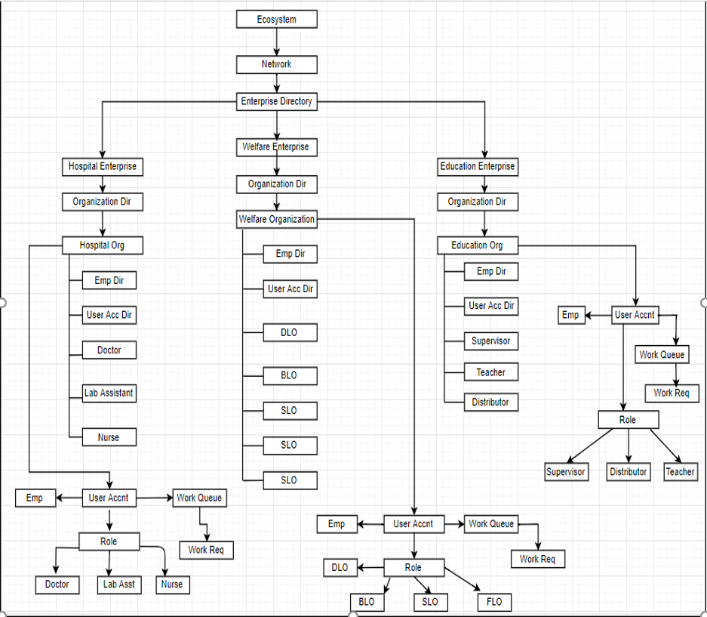
The ECOSYSTEM ARCHITECTURE

Slide 11
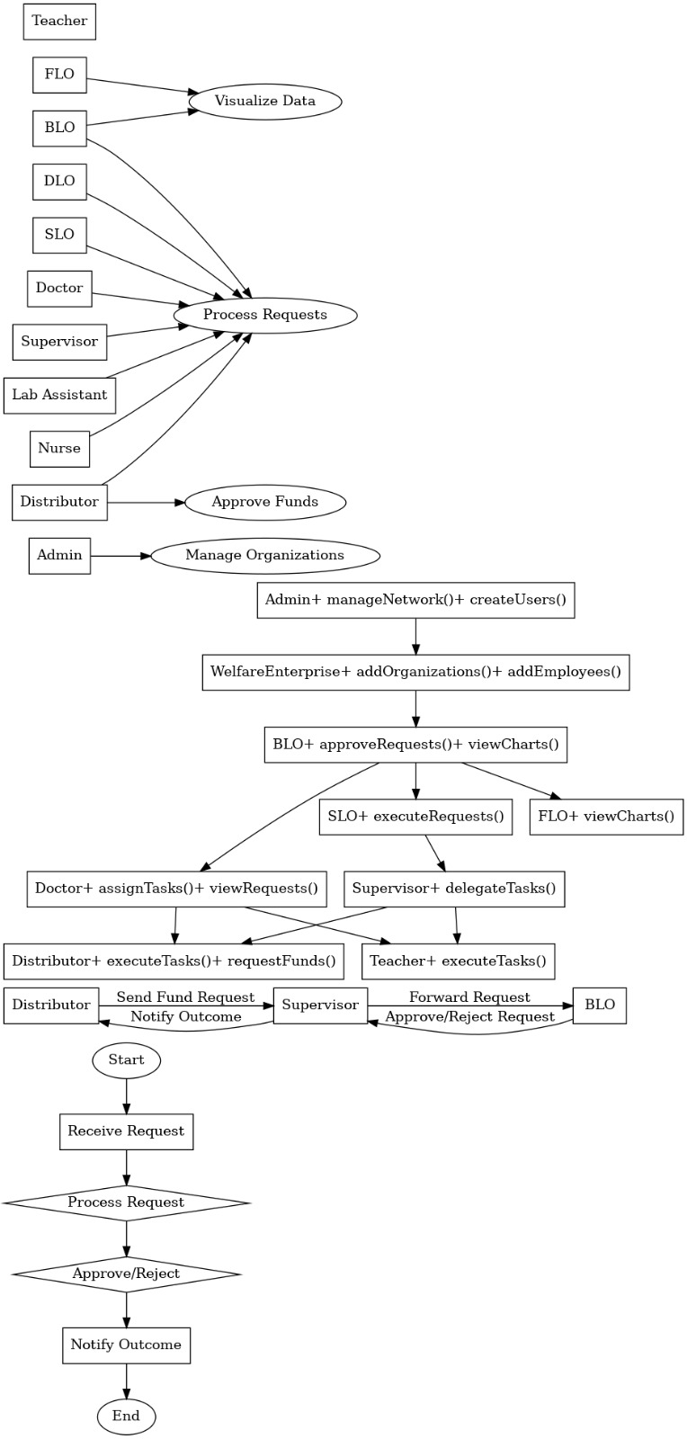
UML

Slide 12
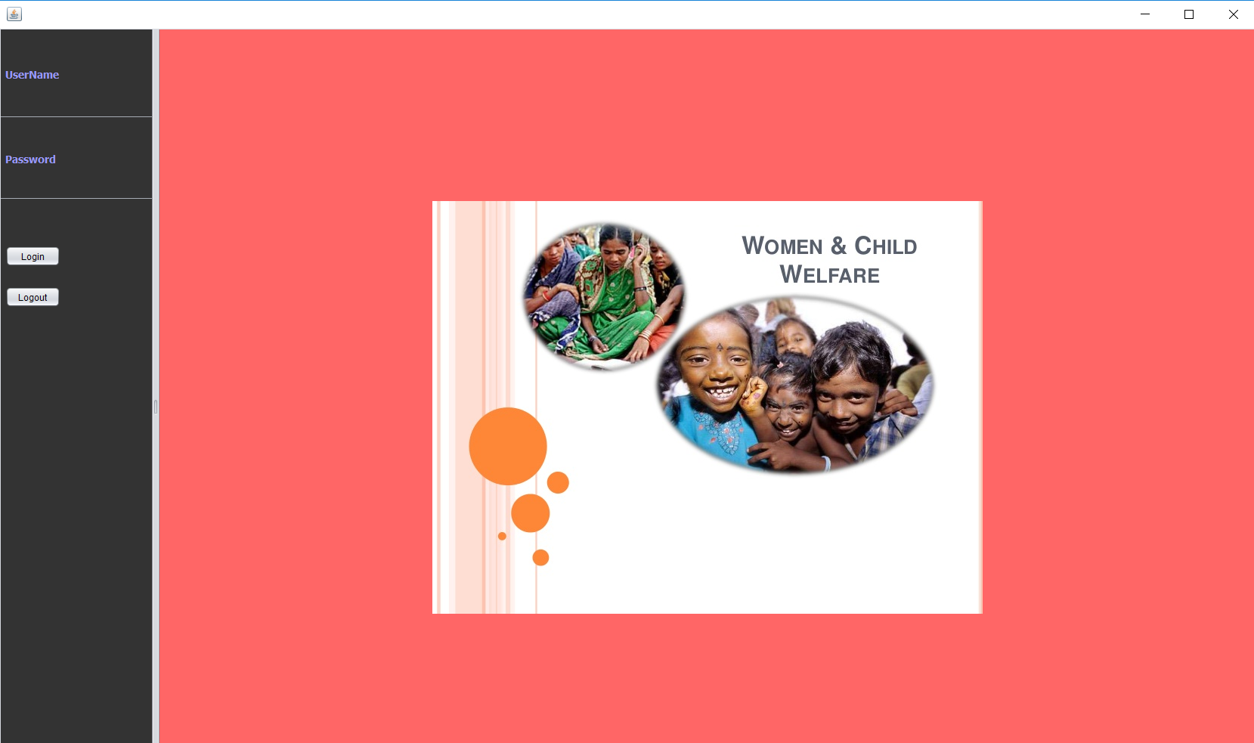
So we have developed this application to streamline the entire process.

Slide 13
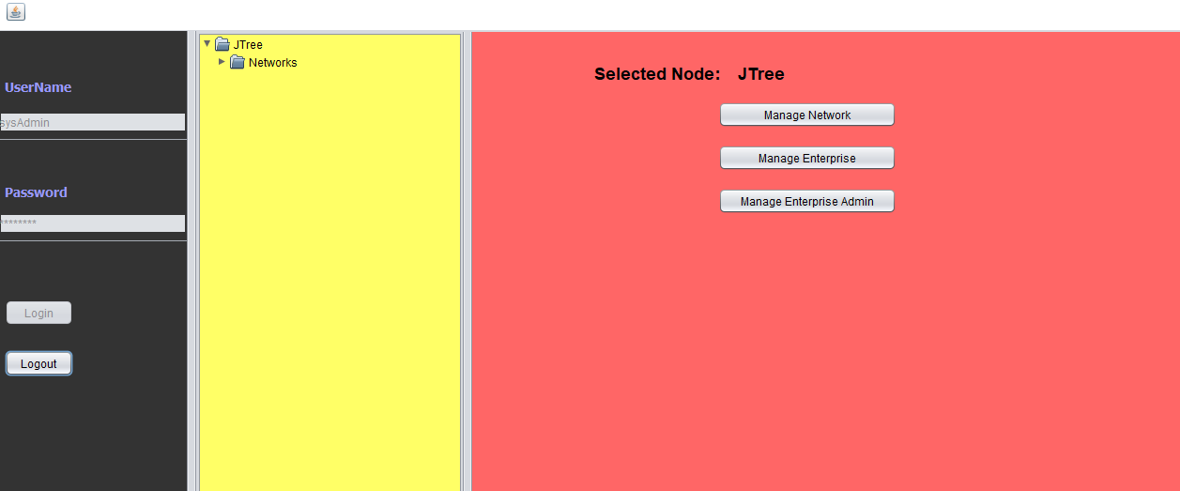
Admin can manage network, enterprise and create enterprise admin

Slide 14
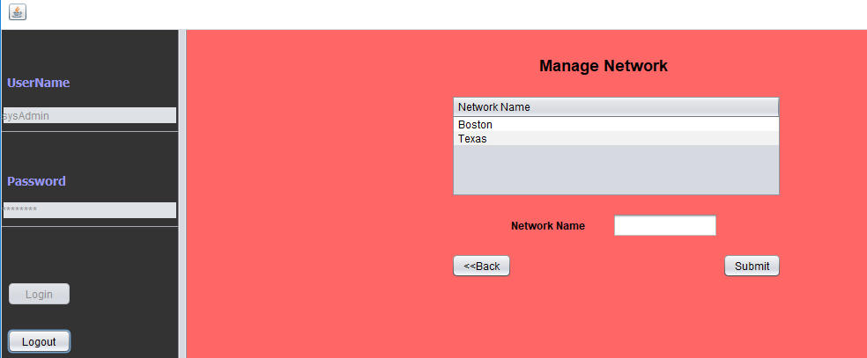
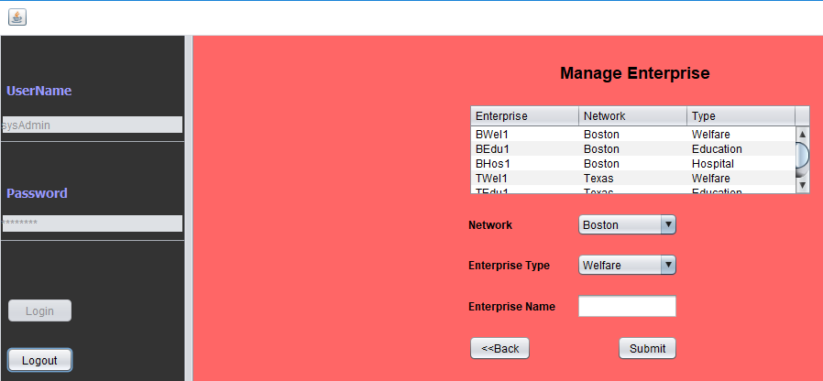
Admin can add network, enterprise and create users

Slide 15
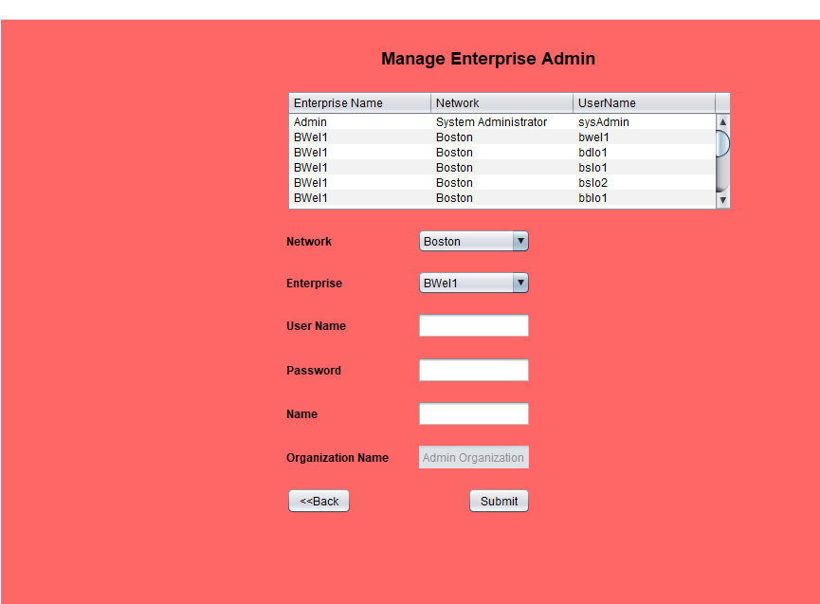

Slide 16
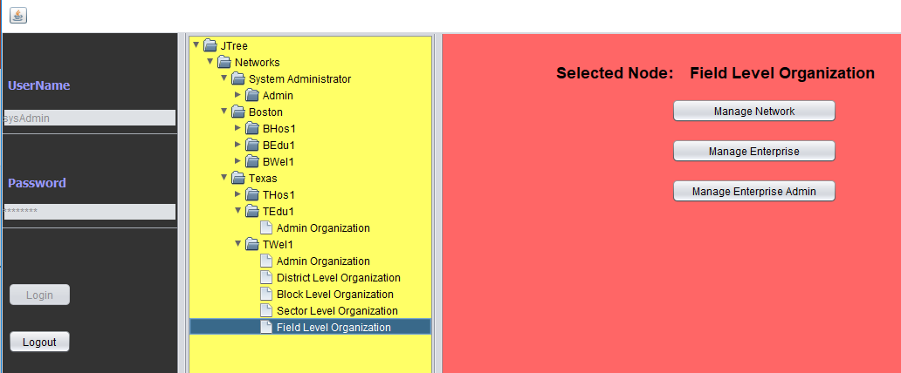
We have implemented JTree feature in the application to track overall network, enterprise and organizations has been created.

Slide 17
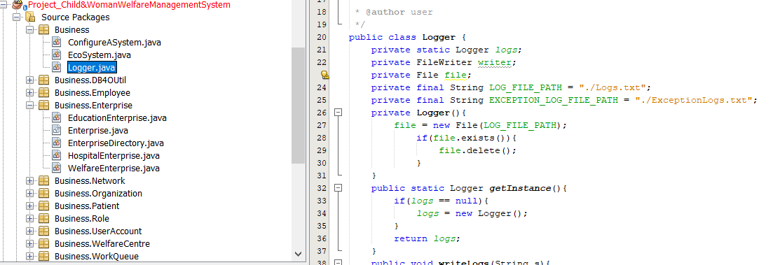
Added logger class to track what actually happening in the system such as User logging and activities and also catch exceptions in the log file.

Slide 18
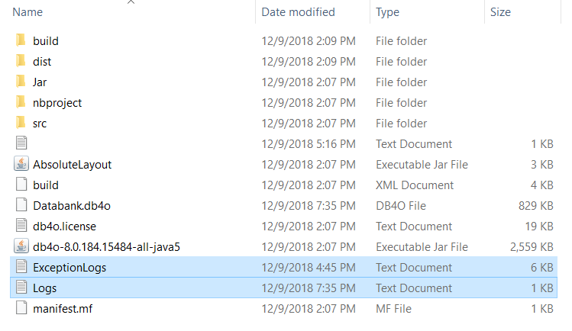
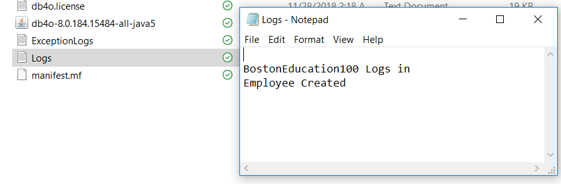
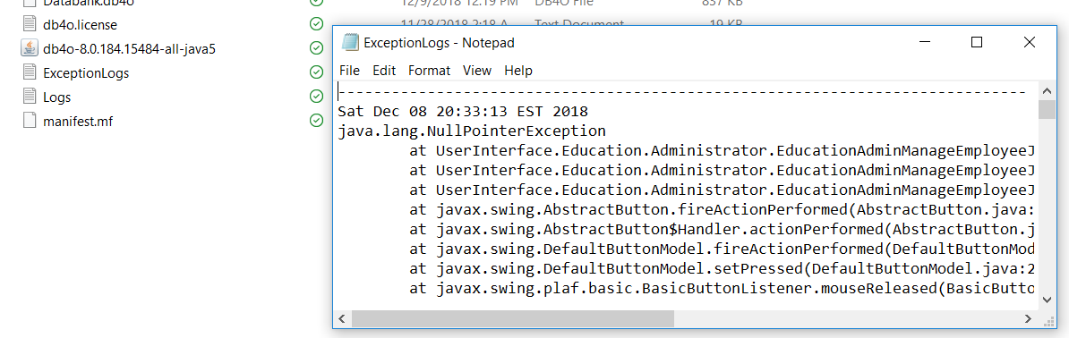
Log files in the system

Slide 19
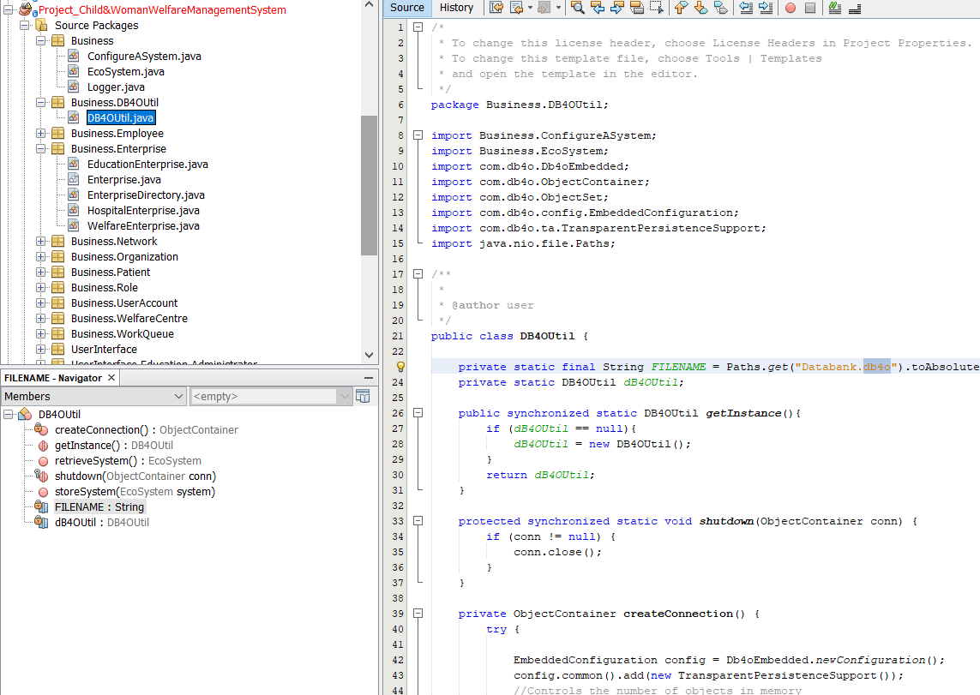
We have used db4o to store data created or used for the application.

Slide 20
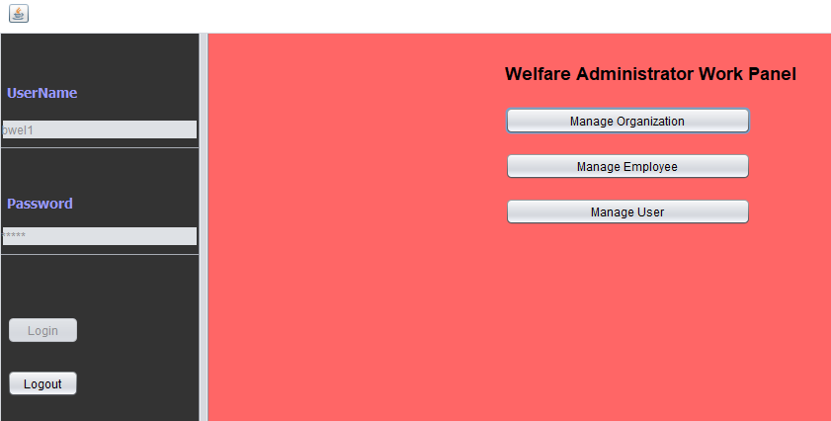
Welfare Enterprise
Welfare Admin Work Area

Slide 21
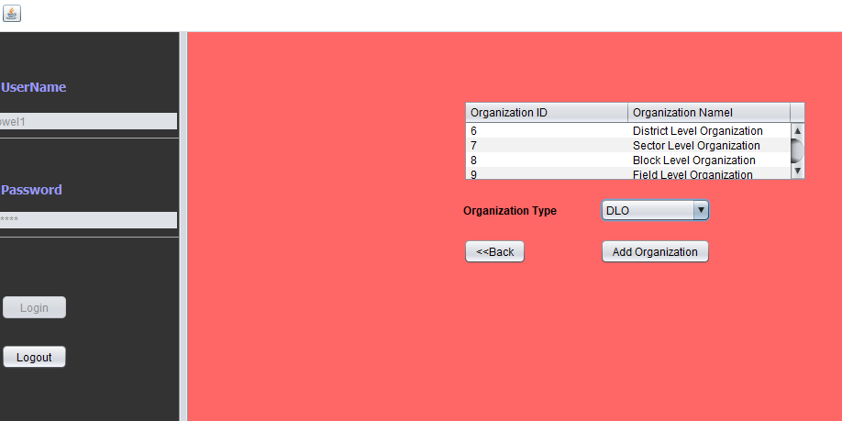
Welfare can add organizations such as BLO, DLO, SLO and FLO

Slide 22
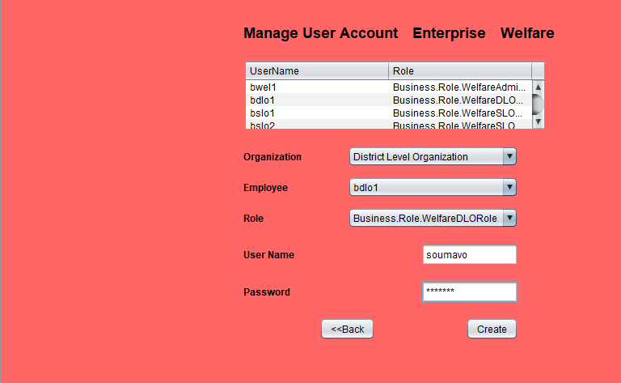
Welfare Admin can add employees and create their Username and Passwords

Slide 23
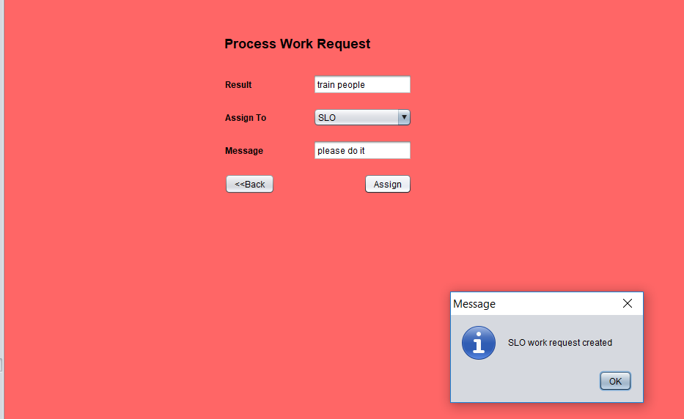
DLO can send request to SLO for executing certain task, which shows flow of request between organization.

Slide 24
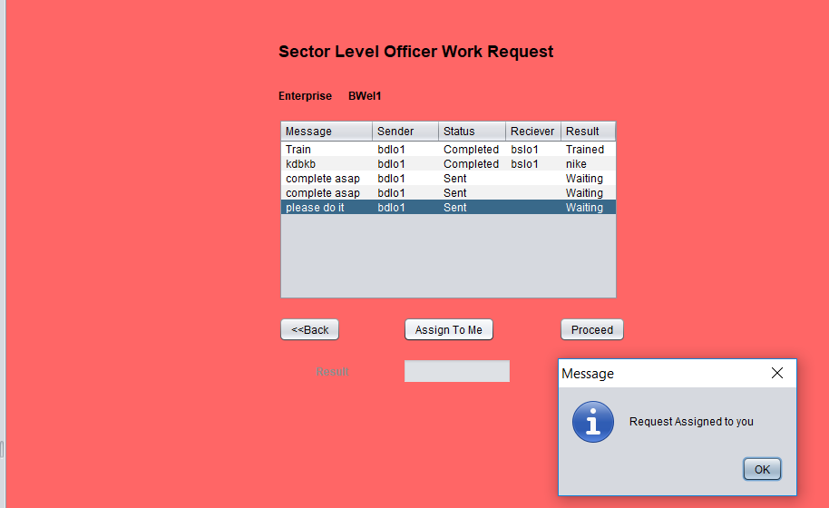
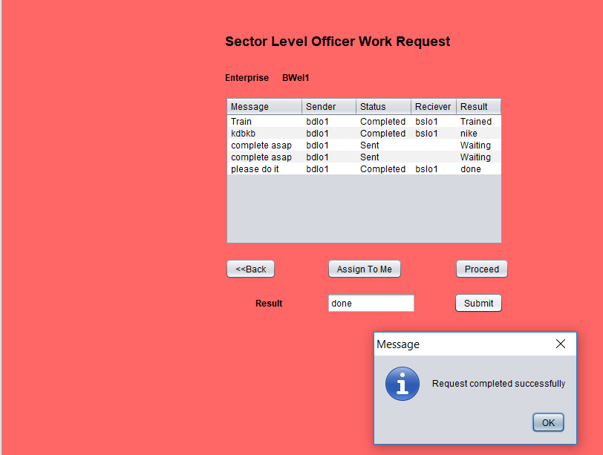
SLO process the same request which DLO sends.

Slide 25
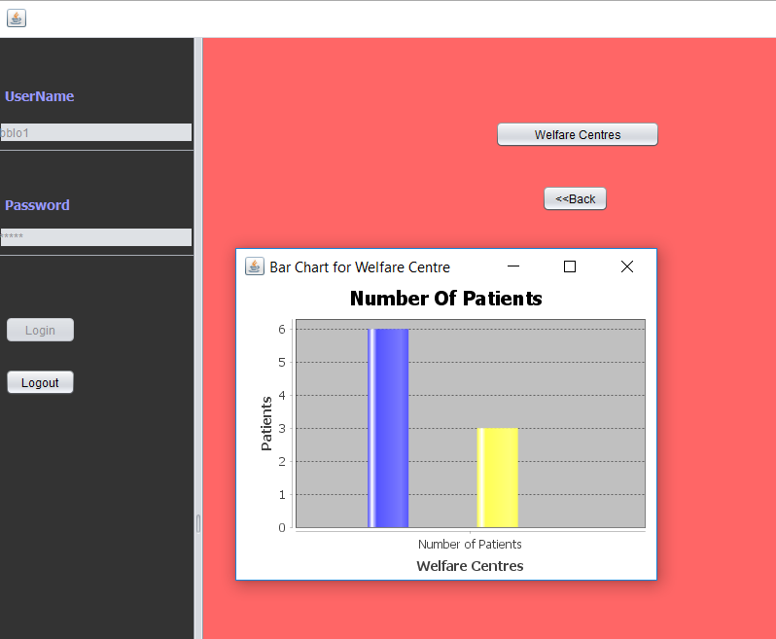
BLO can also see charts to check the status

Slide 26
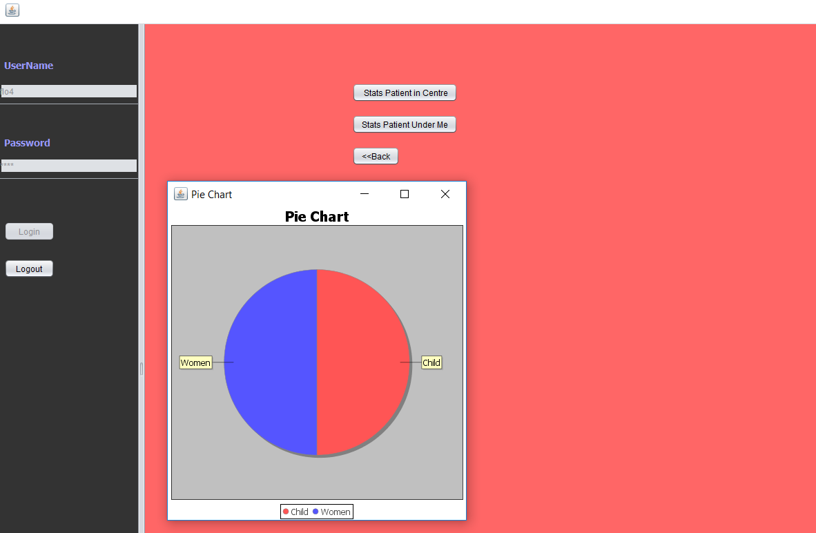
A FLO can also see charts for data visualization

Slide 27
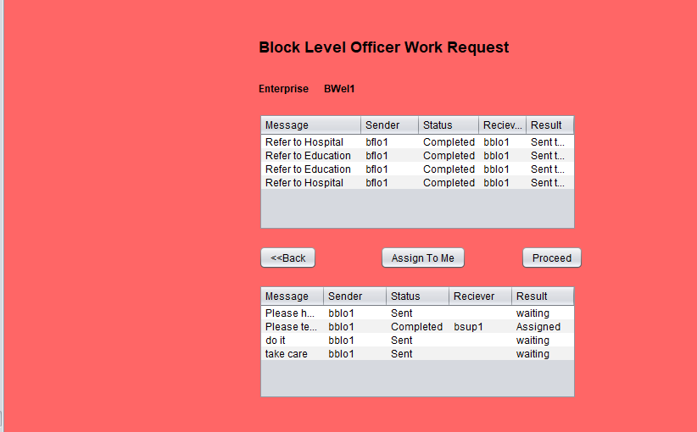
BLO can send request to Education or health department based on requirement which shows navigation of
request between enterprise, i.e from Welfare to Education or Welfare to health.

Slide 28
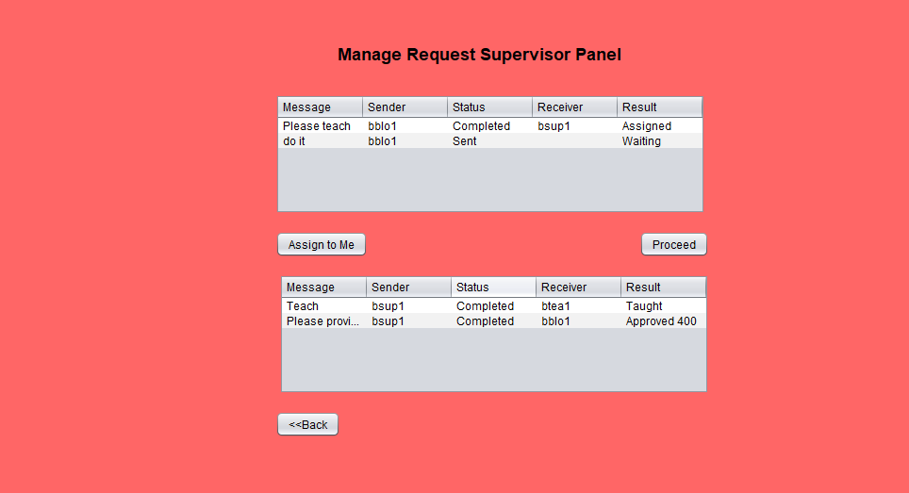
Supervisor gets the request from BLO with a message and task to execute. Supervisor belongs to Education
enterprise

Slide 29
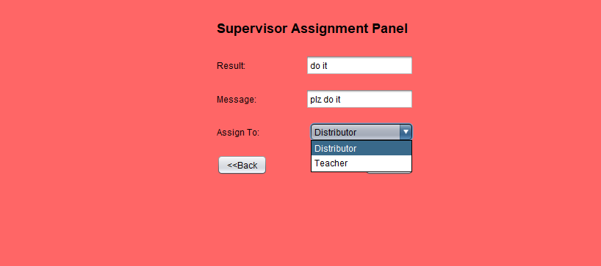
Supervisor can delegate the task to either teacher and distributor

Slide 30
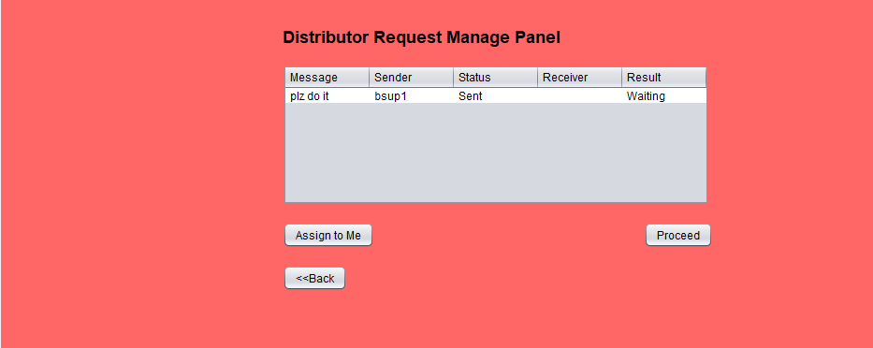
Distributor gets the same request which supervisor sends

Slide 31
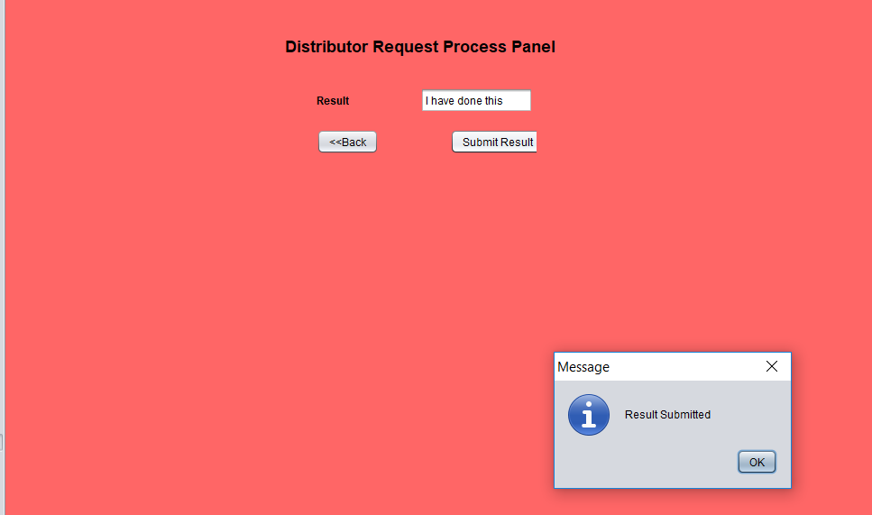
Distributor closes the request from his end once the task gets completed.

Slide 32
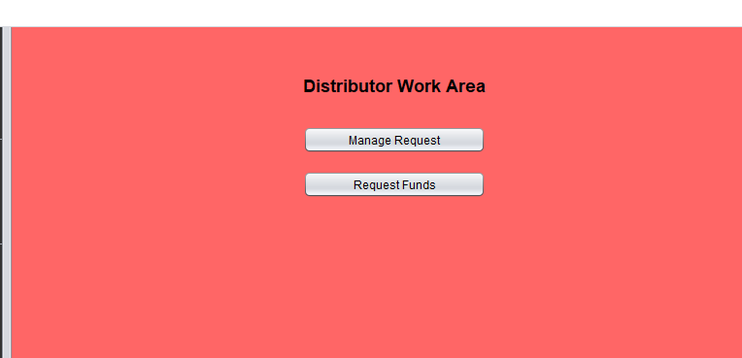
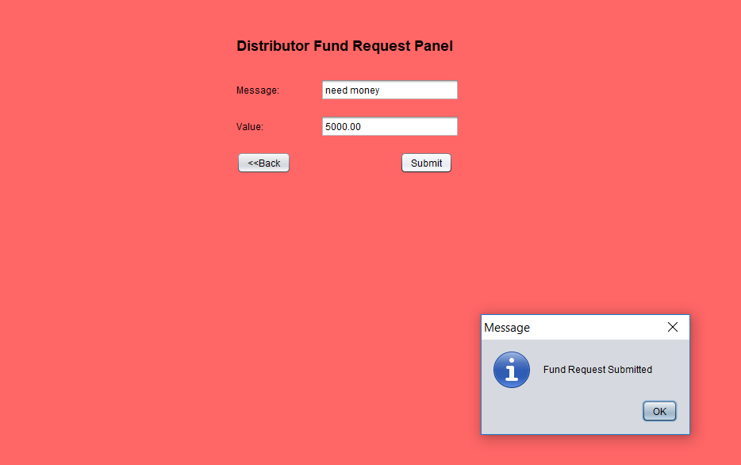
Distributor has additional option to request for funds. So the flow of fund request is
Distributor -> Supervisor -> BLO to approve.

Slide 33
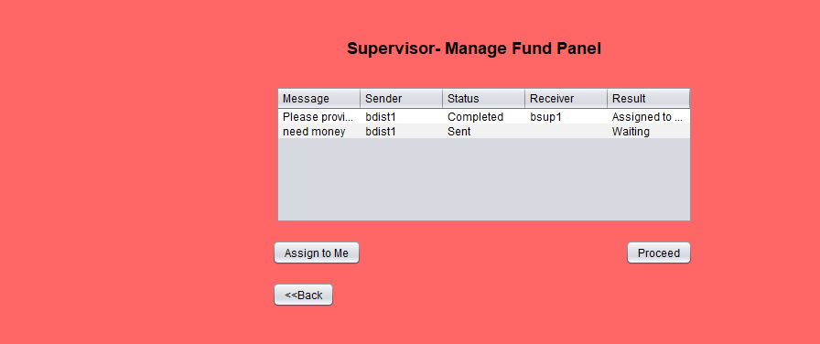
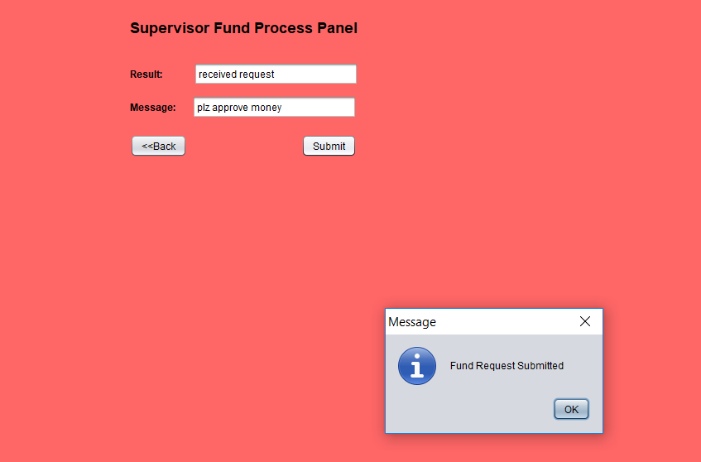
Supervisor receives request from Distributor and checks and forward to BLO to approve which shows flow of request
From bottom-up unlike most cases where it is generally top-down

Slide 34
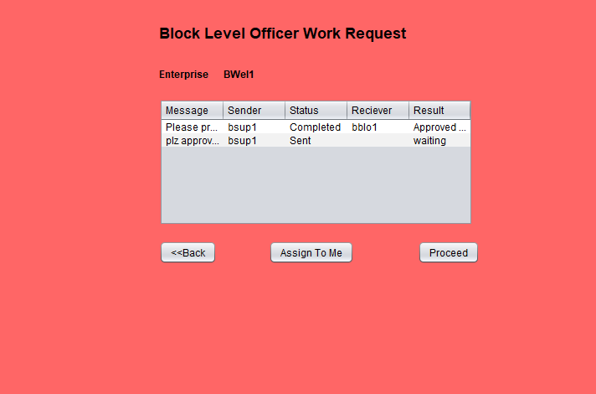
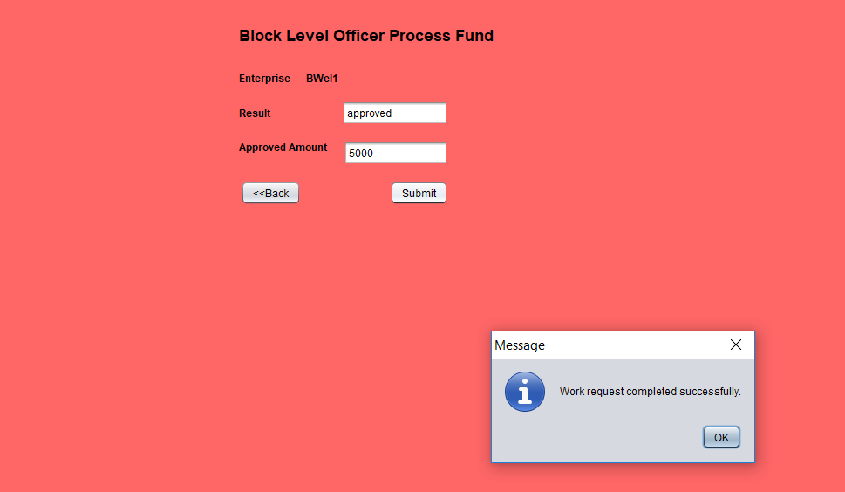
Finally BLO receive the request and approves.

Slide 35

Similarly Health enterprise also can receive request from BLO(Welfare Enterprise)

Slide 36
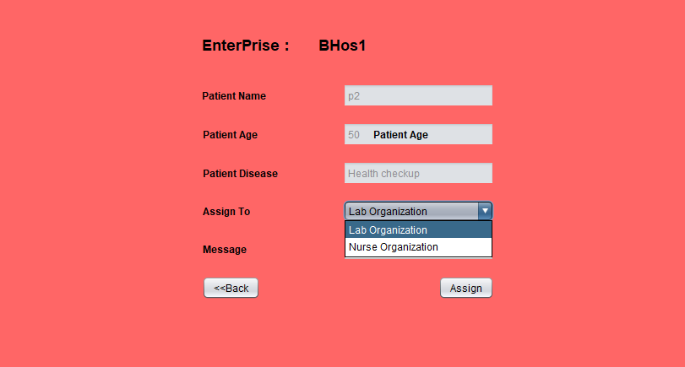
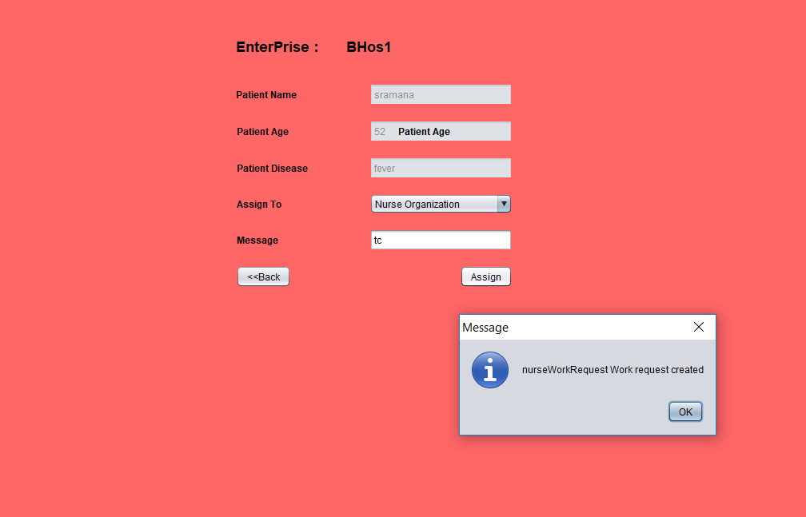
Doctor can check request and assign task to Lab Assistant and Nurse. Once assigned Nurse and Lab assistant
Can complete task from there end.

Slide 37
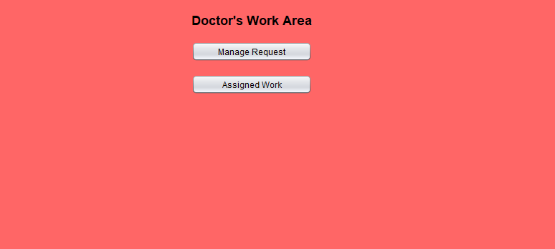
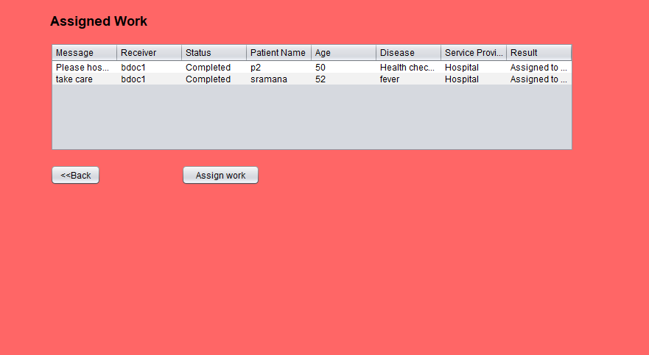
Doctor has additional panel to check what are request which are attended or not.

Slide 38
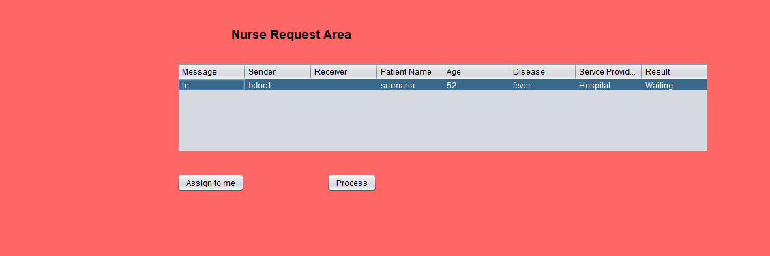
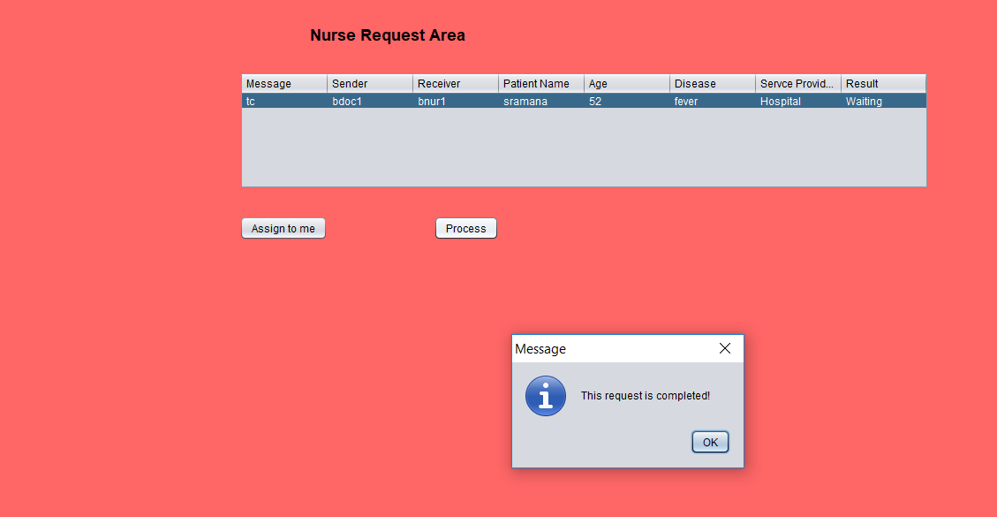
Nurse can process the request assigned by doctor. The same way Lab assistant also processes request

Slide 39
Thank You

