Slide 1

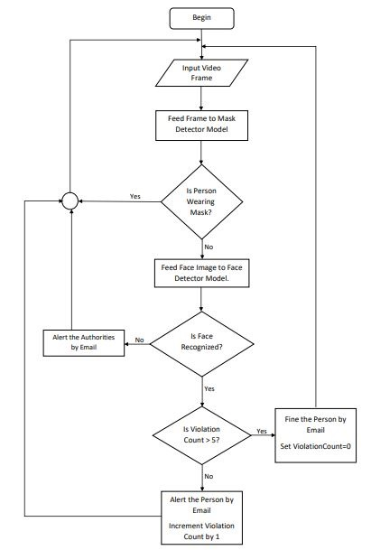
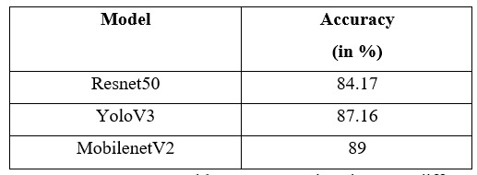
Title of the Project : Face Mask Detection using Live Video Streaming
St. Francis Institute of Technology , Department of Computer Engineering
BE Project Paper Presentation Competition
Group no: A11
Group Members: Yogita Likhi, Sherwin Mathias, Ujala Maurya, Nithin Menezes
Work done so far
Abstract
Proposed Methodology
Module No. | Completion status
1 | Referring other paper and studying different approaches to build mask detection model.
2 | Building our own model using MobileNetv2 and analysing its performance with other approaches.
A survey shows that 90% of people in India are aware of wearing a mask, but only 44% of them is wearing a face mask since the COVID-19 pandemic started.
Thus, we will be developing a system which will help to maintain the safety norm of wearing the mask. Using our system, any person violating the safety norm by not wearing the mask will be alerted and fined if he/she exceeds the limit.
By using our system, the whole process of manually ensuring the safety norm of mask will be automated saving both time and labour.
Our project is divided into two modules, Mask Detection and Face Detection. For the Mask Detection module, we will be using MobileNet V2 architecture.
Conclusion and future directions
In this presentation we have discussed the project and implementation of Face Mask Detection System.
We also discussed brief overview and working of MobileNetV2 model which will be used to create face mask detection model.
Using face mask detection system we can find out the people not wearing masks. These people can then be recognized via face recognition system.
Once the person is recognized he can be warned using the alert system via a message or mail. If someone is caught doing the same mistake more than five times he/she will be fined.
Problem Statement
To provide a system to monitor people who are not wearing mask by taking live video as input and detecting the people not wearing mask with a red box. The system should also be able to recognize that person and send him/her a warning through email or messaging system.
References
Figure 1: Workflow of the proposed Face Mask Detection system. The input is the Video frame Image and the output is an message to the person not wearing the mask and violating the rule
[1]Face mask detection using MobileNet and Global Pooling Block -2020
[2]Stefanos Kanellopoulos, “Face Mask Detection using darknet’s YOLOv3”, 12 April 2021
[3]Shashi Yadav “Deep Learning based Safe Social Distancing and Face Mask Detection in Pubklic Areas for COVID-19 Safety Guidelines Adherence” July 2020
[4]MobileNetV2: The Next Generation of On-Device Computer Vision Networks”, Mark Sandler and Andrew Howard, Google Research, Tuesday, April 3, 2018.
[5]Stefanos Kanellopoulos, “Face Mask Detection using darknet’s YOLOv3”, 12 April 2021 Samuel Ady Sanjaya, Suryo Adi Rakhmawan, “Face Mask Detection Using MobileNetV2 in The Era of COVID-19 Pandemic”, 20 January 2021.
[6]Arjya Das; Mohammad Wasif Ansari; Rohini Basak, “Covid-19 Face Mask Detection Using TensorFlow, Keras and OpenCV”, 05 February 2021 Shashi Yadav “Deep Learning based Safe Social Distancing and Face Mask Detection in Public Areas for COVID-19 Safety Guidelines Adherence”, July 2020.
Literature Survey
Algorithms used
In [1] they have trained model using ResNet50 model to implement the face mask detection system. For training model they collected dataset in which 1918 images are without a mask and the remaining 1915 images are with a mask. Their accuracy for the trained model is 84.17%.
In [2] they have proposed face mask detection system using YOLOv3 model and darknet repository. They took dataset from the Kaggle and splitted into testing data and training data. They found accuracy around 87.16% for the trained model.
Sashi Yadav [3] has proposed face mask detection system using MobileNetv2 model. They have used custom labelled dataset (3165 images) and divided this dataset into training and testing datasets. Model was developed using 80% of dataset with MobileNetV2. The system detects the masks with a precision score of 91.7%.
Classification :- MobileNetV2
MobileNetV2 builds upon the ideas from MobileNetV1 (previous version), using depth wise separable convolution as efficient building blocks. However, V2 introduces two new features to the architecture:
1) linear bottlenecks between the layers
2) shortcut connections between bottlenecks.
Also, MobileNetV2 is a very effective feature extractor for object detection and segmentation.
Experimental sets
Inputs:-
Our Dataset consists of two folders, namely: with mask and without mask from Kaggle. The with_mask folder consists of 1915 images of people wearing mask. The without mask folder consists of 1918 images of people not wearing mask. For training, we took 80% of the dataset and for testing, we took 20% of the dataset.

