Slide 1


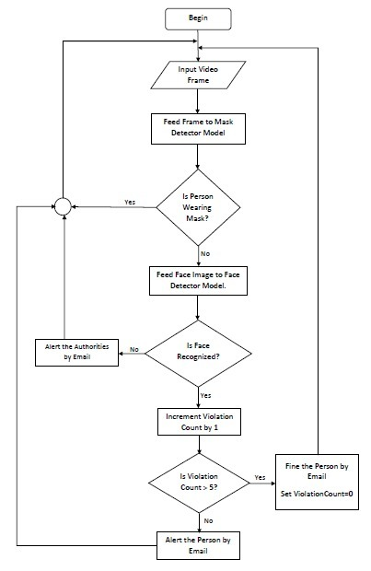
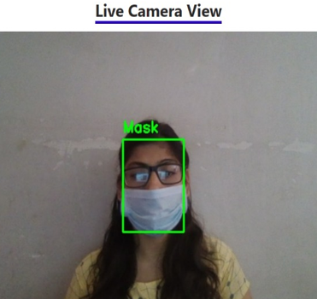
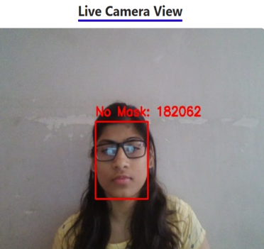
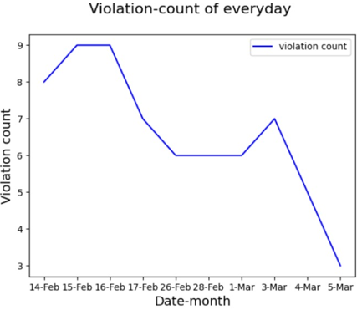
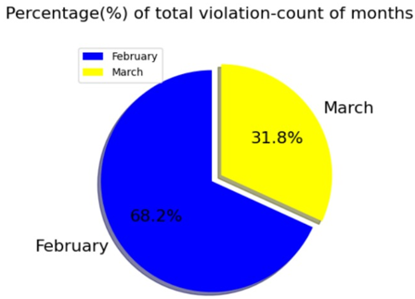
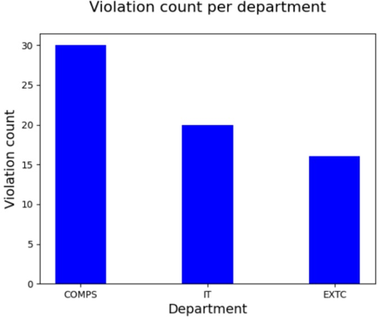
Title of the Project : Face Mask Detection using Live Video Streaming
St. Francis Institute of Technology
PRAKALP 2022 – 4th-Inter College BE Project Competition
Registration no: E14R567
Yogita Likhi(CMPN), Sherwin Mathias(CMPN), Ujala Maurya(CMPN), Nithin Menezes(CMPN)
Abstract
Algorithms used and Experimental setup
Analysis
COVID-19 pandemic is the most life-changing event. With the reopening of countries from the lockdown, it is recommended to wear masks to prevent spread of virus. A survey shows that only 44% of people are wearing masks. Our project makes the process of checking face mask on a person fast and efficient. It can be deployed in offices, schools, college. In our project we are using CNN based MobileNetV2 Architecture for Mask Detector Model. In our project we are using CNN based MobileNetV2 Architecture, OpenCV, Haar Face Detector, Facenet and Face Recognition Library.
Mask Detection: In our project we are using CNN based MobileNetV2 Architecture for Mask Detector Model. For live streaming as well as capturing of faces we are using OpenCV along with Haar Face Detector.
Face Recognition: For Face Recognition model, we are using FaceRecognition library to extract encodings of captured faces and FaceNet model to compute the similarity between faces. For live streaming as well as capturing of faces we are using OpenCV along with Haar Face Detector.
Experimental sets:
The dataset for mask detection model is taken from Kaggle. The collected data is labelled into two groups; with and without mask. The with_mask folder consists of 1915 images and the without mask folder consists of 1918 images.
The dataset for face recognition model has images of 37 persons, one image of each person. The collected data is labelled by a unique identification number such as PID.
( Pseudo code of main algorithm)
Table 1: Comparing the accuracy of the two models of face mask detection
Model | Dataset | Accuracy (in %)
MobilenetV2 | Mask Detection Dataset (from Kaggle) | 89
Resnet50 | Mask Detection Dataset (from Kaggle) | 90
Problem Statement
To provide a system to monitor people who are not wearing mask by taking live video as input and detecting the people not wearing mask with a red box. The system should also be able to recognize that person and keep a track of the violation count and send him/her a warning through email or messaging system after a specific number of counts crossed.
Conclusion and future directions
Here, we have discussed the project and implementation of Face Mask Detection System. Using face mask detection system we can find out the people not wearing masks. These people can then be recognized via face recognition system. Once the person is recognized he can be warned using the alert system via mail. If someone is caught doing the same mistake more than five times he/she will be fined.
In near future the threat of virus will end and the rule of wearing masks will be withdrawn but there are still various fields where wearing masks is important, virus or not. Surgeons, people working at pathology labs, research labs, mines and many manufacturing units and industries will still be required to wear masks. So this system can be used at such places to check if people working there are following the norms or not.
Results
Figure 2: Output of the face mask detection system under two circumstances (i) wearing mask (ii) not wearing mask
References
[1] “MobileNetV2: The Next Generation of On-Device Computer Vision Networks”, Mark Sandler and Andrew Howard, Google Research, Tuesday, April 3, 2018.
[2] Shashi Yadav “Deep Learning based Safe Social Distancing and Face Mask Detection in Public Areas for COVID-19 Safety Guidelines Adherence”, July 2020.
[3] Edwin Jose, Greeshma Manikandan, Mithun Haridas and Supriya M H, “Face Recognition based Surveillance System Using FaceNet and MTCNN on Jetson TX2”, March 2019.
Figure 1: Workflow of the proposed system
Figure 3: Shows three different visualizations that the system provides for analysing and understanding the violation count

