Slide 1

Hospital Management System
BY
SUBHASHKUMAR
ROLL NO: 68 PID: 182071
NITHIN MENEZES
ROLL NO: 58 PID: 182066
Under the guidance of
Mrs Pradnya Rane & Mrs Varsha Nagpurkar
Department of Computer Engineering,
St. Francis Institute of Technology
Notes:
1

Slide 2

Content
Introduction
Problem definition of the Application(Brief Description of Application)
System description
Architecture or block diagram or Data Flow Diagram(Detail description of the functions implemented and used in the system)
Hardware & software requirements
User Interface Design (GUI snapshots)
Applications of the System
Conclusions
Literature Cited (book and web References)
Acknowledgements
2
Flight Management System
Notes:
2

Slide 3
Introduction
Hospital information system also known as hospital management system its main use is to collecting, storing, processing, extracting, transmitting, summarizing and processing all kinds of data generated in various stages of medical activities to generate various information
Providing comprehensive and automated management for the overall operation of the hospital.
Used for billing, patient record, doctor record,appointment,medicines etc.
3
Hospital Management System
Notes:
3

Slide 4
Problem definition
It is an important guarantee for hospitals to deepen reform, strengthen management, improve efficiency. It will improve medical quality, promote resource sharing, expand information services, support teaching research, and improve hospitals. Competitiveness and so on are of great significance. Among them, the most important are:
· To optimize the workflow
· To improve the quality of operation
· Shorten the diagnosis and treatment cycle
· To strengthen scientific management
· Saving the cost of diagnosis and treatment
· To change the decision-making method
4
Hospital Management System
Notes:
4

Slide 5
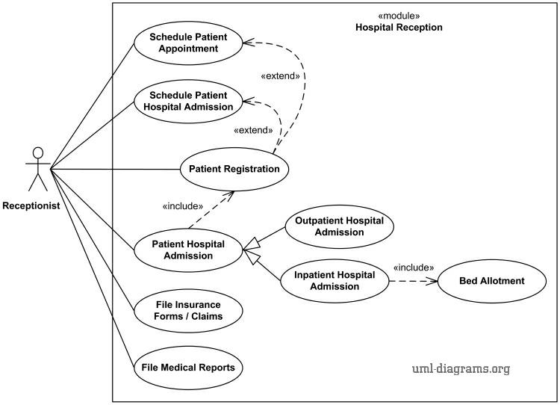
System description
5
Hospital Management System
Notes:
5

Slide 6
Hardware & software requirements
Hardware
The hardware environment consists of the following:
CPU : 3.3 gigahertz(GHz) or faster 64-bit dual core processor
Motherboard : AM4 socket
Hard disk space : 100 GB or more
Display : Super Vga with a display of 1024 *768
Memory : 4-GB Ram or more
Other Devices :Color Monitor, Keyboard, mouse.
Software
Win XP, Windows Vista, Windows 7 or Higher
Web Browser: Internet Explorer 6 or Higher
XAMPP as web server
MySQL version 5.0.1 or higher as database
Notepad++ or visual studio code
6
Hospital Management System
Notes:
6

Slide 7
User Interface Design
Snapshots of our website
7
Hospital Management System
Notes:
7

Slide 8
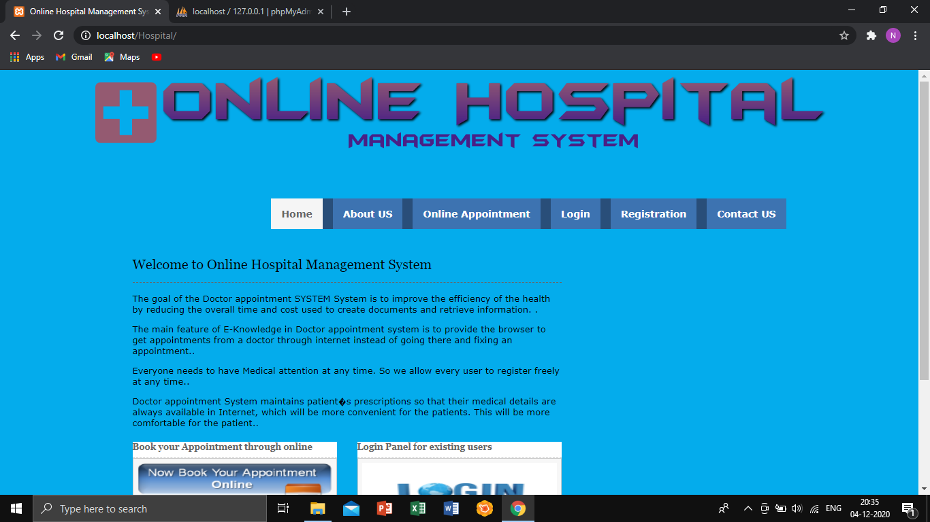
SCREENSHOTS Home page

Slide 9
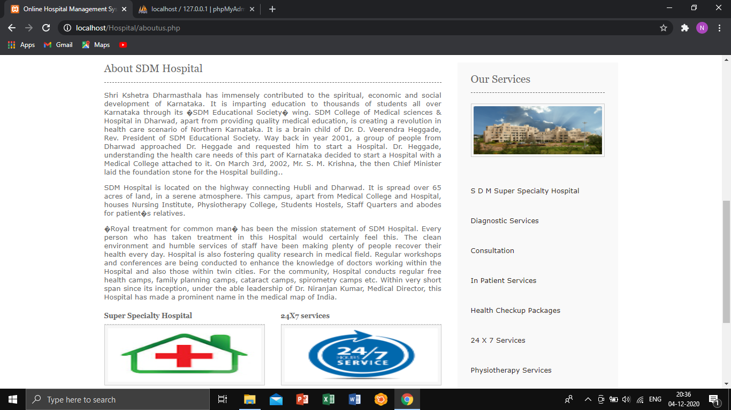
There will be a short summary regarding our hospital, what are its speciality and the facilities we provide to the society.

Slide 10
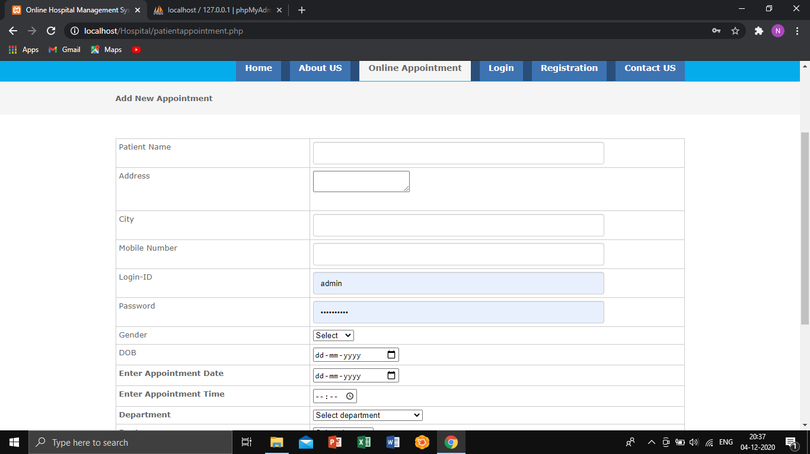
Under online appointment, the patient can fill the necessary details and book their appointments.

Slide 11
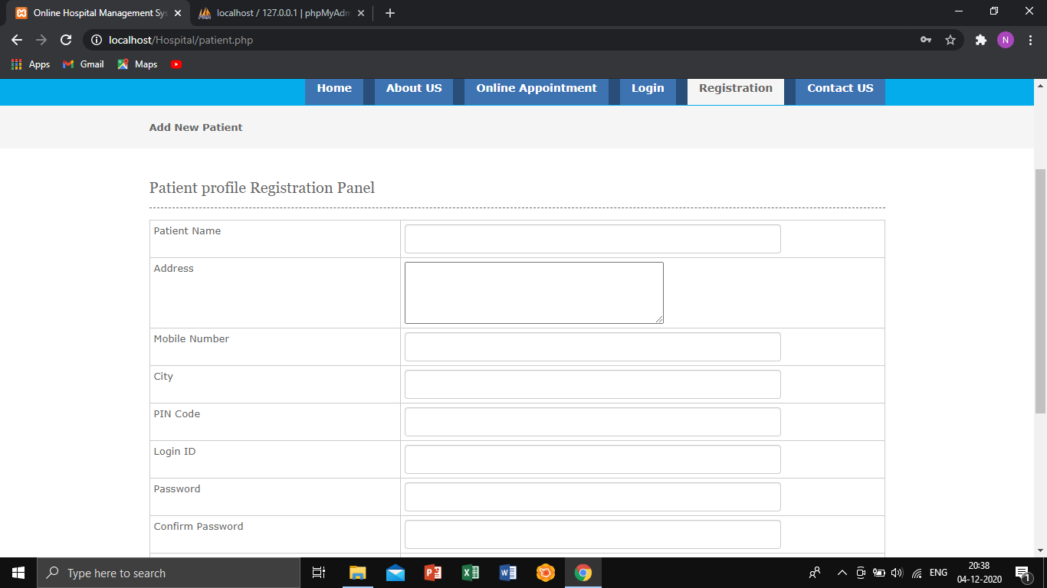
Under Registration, if a person does not have a Login ID, he/she can register and create a new login ID.

Slide 12
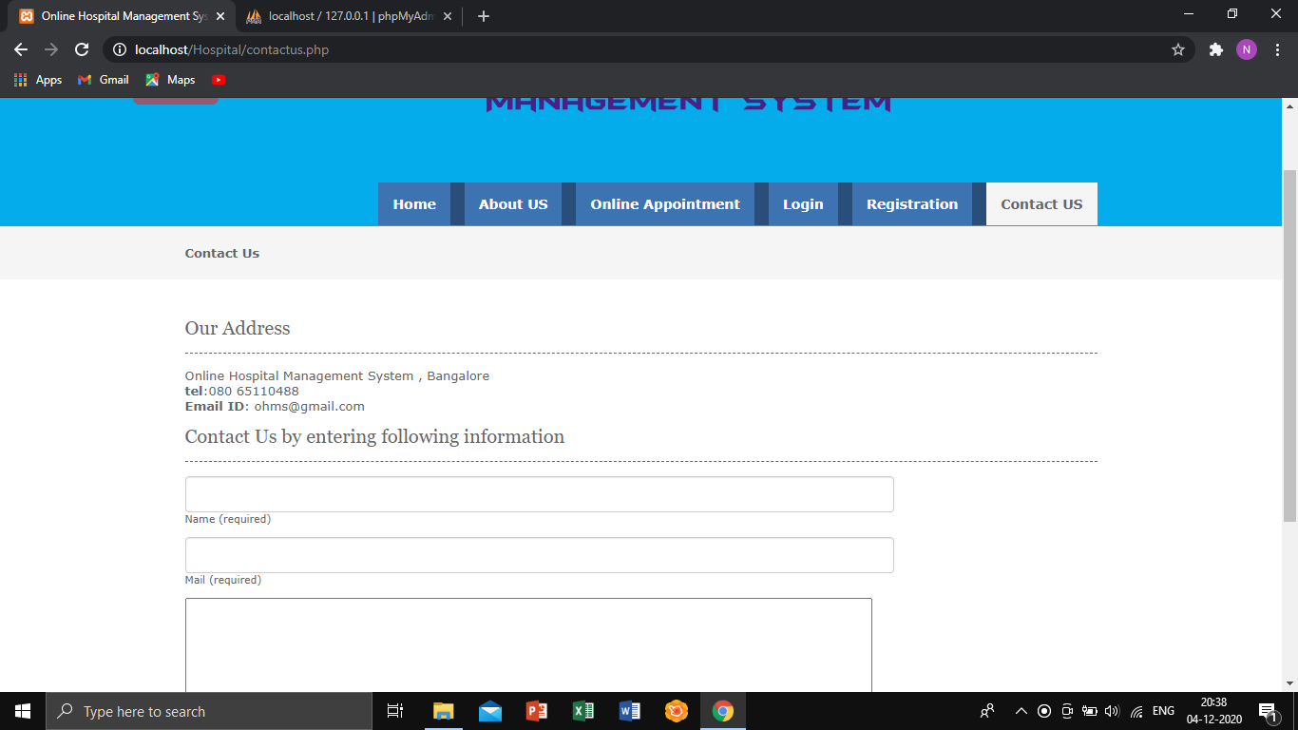
If a person has any queries or wants to give any feedback they can text or contact us.

Slide 13
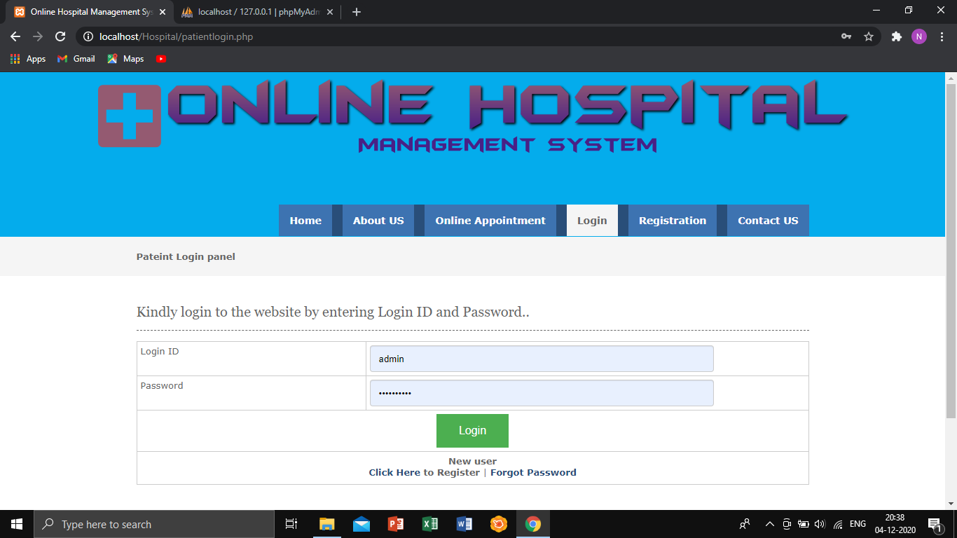
PATIENT LOGIN PAGE: After registration the person can login under the Patient Login panel.

Slide 14
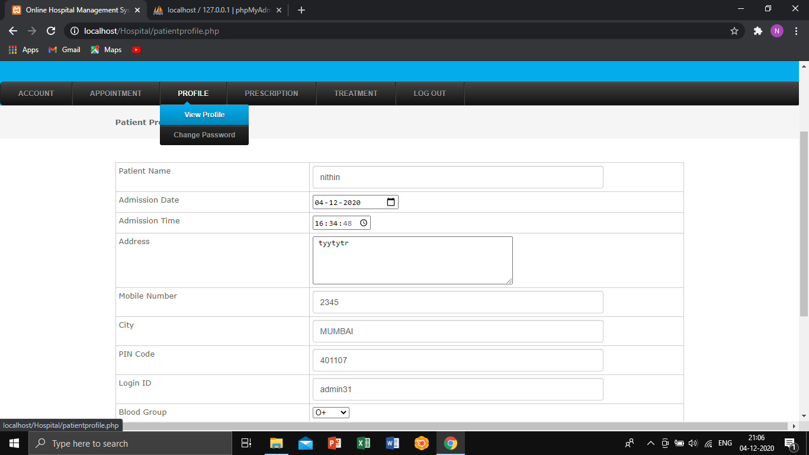
For security reasons a person can change their profile details and also their password.

Slide 15
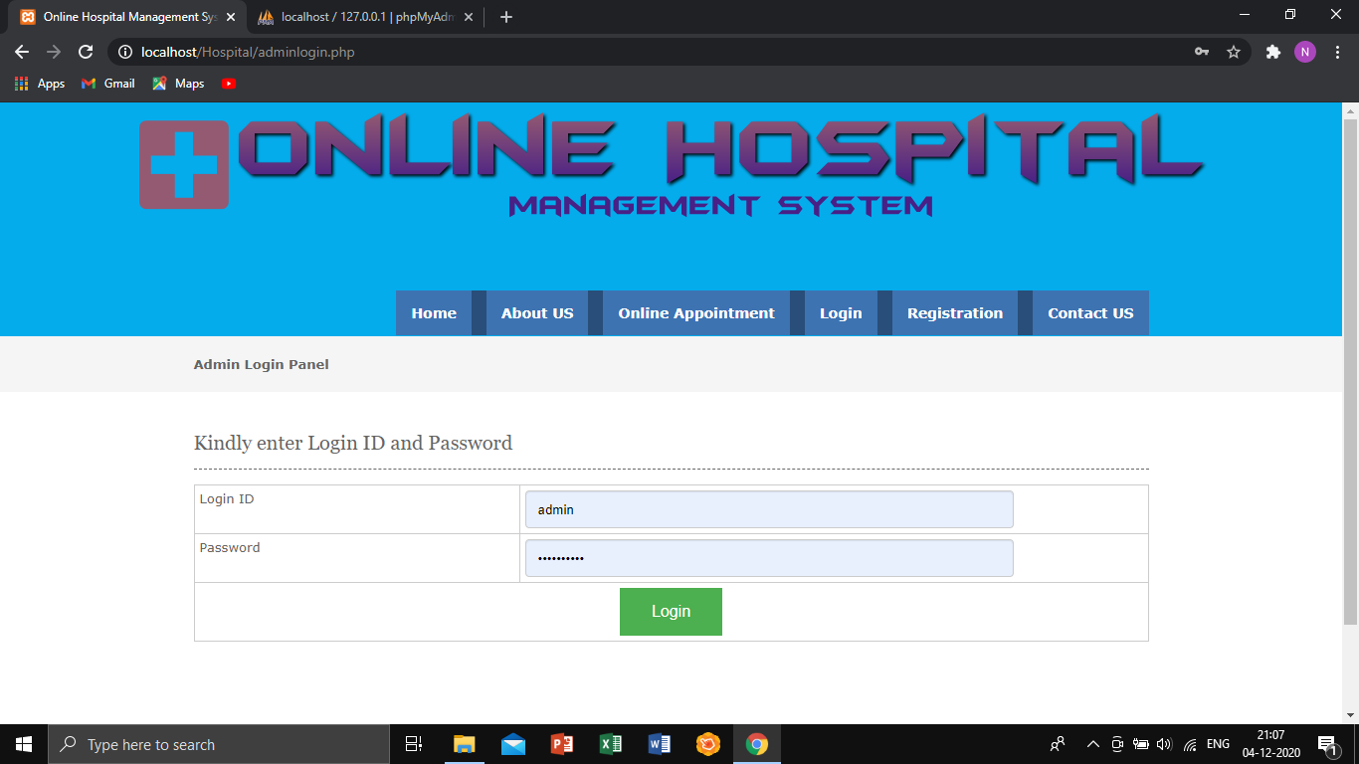
ADMIN LOGIN PAGE: In this page the receptionist can login under this panel.

Slide 16
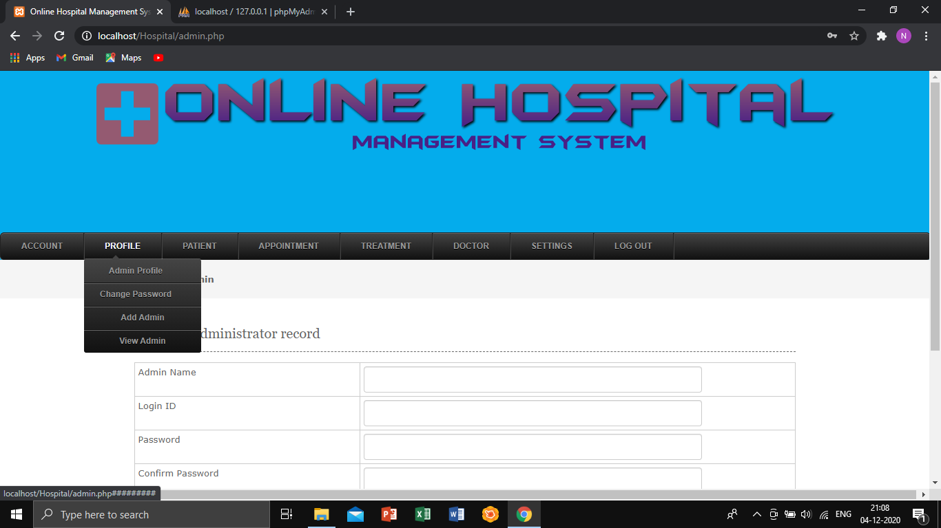
The admin can view their profile details, they can also change their password and add new admin.

Slide 17
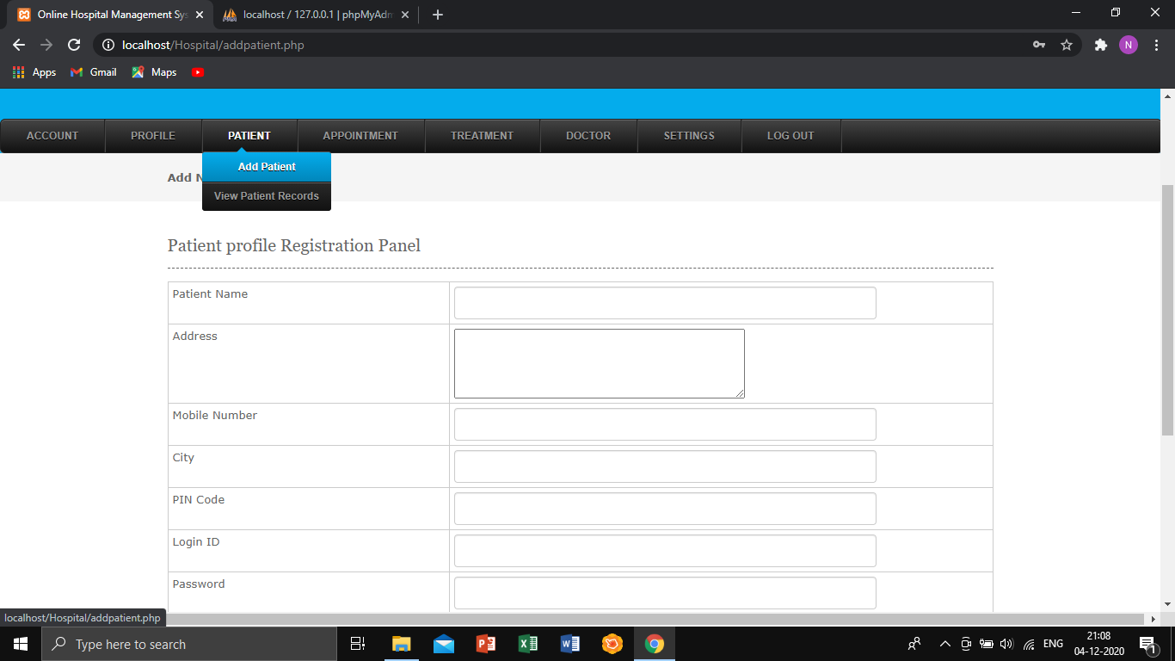
The admin can add patient details and view patient records.

Slide 18
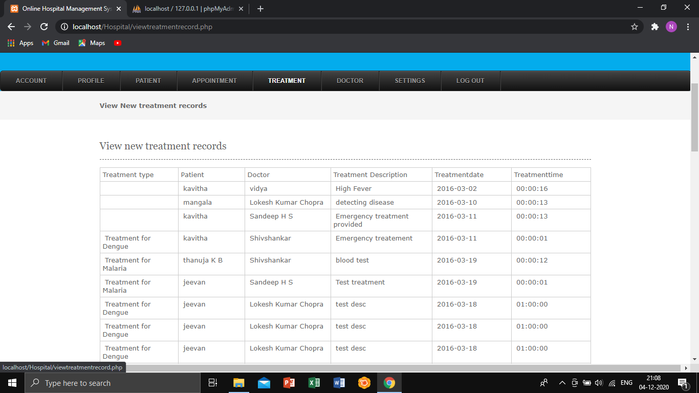
The admin can view 1) treatment records

Slide 19
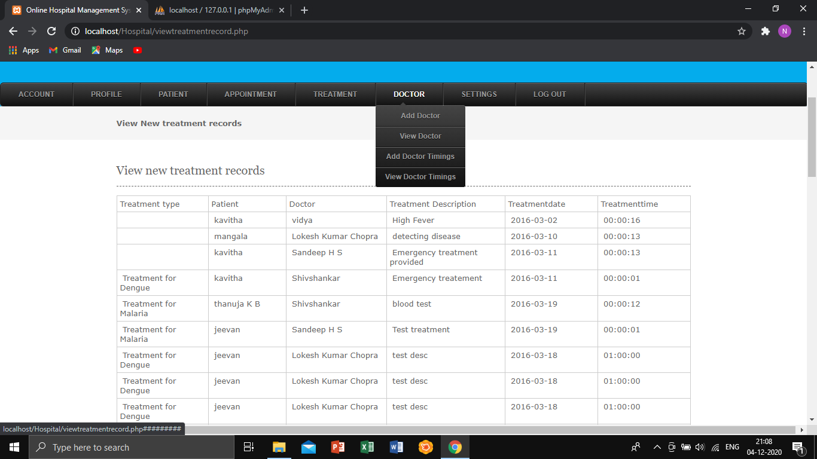
2) Can also add and view doctor timings

Slide 20
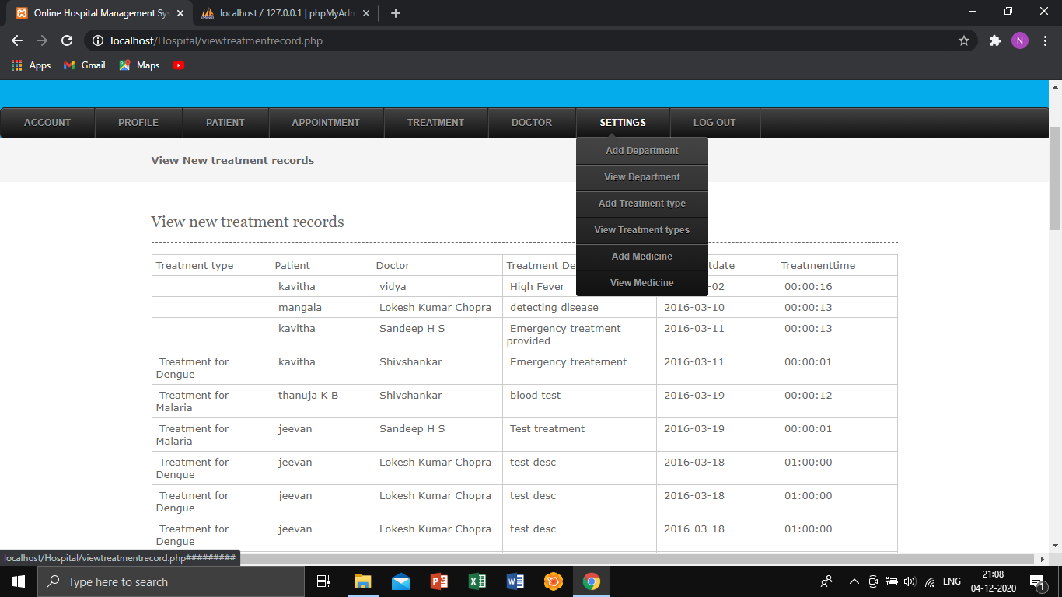
3) Add and view Treatments and medicines.

Slide 21

DOCTORS LOGIN PANEL: The doctor can login their ID and password.

Slide 22
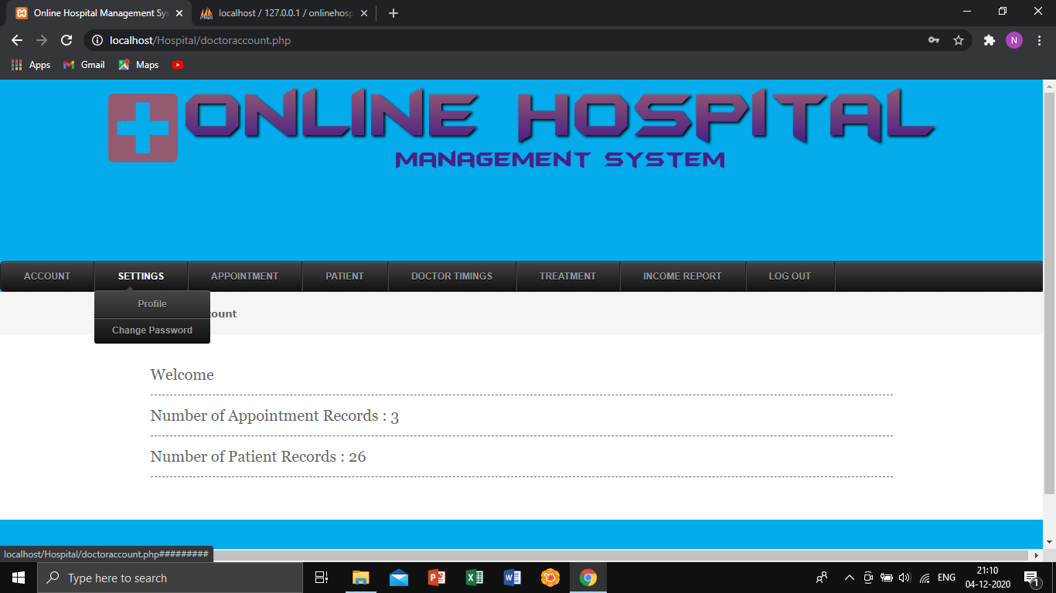
The doctor can view and change their profile details.

Slide 23
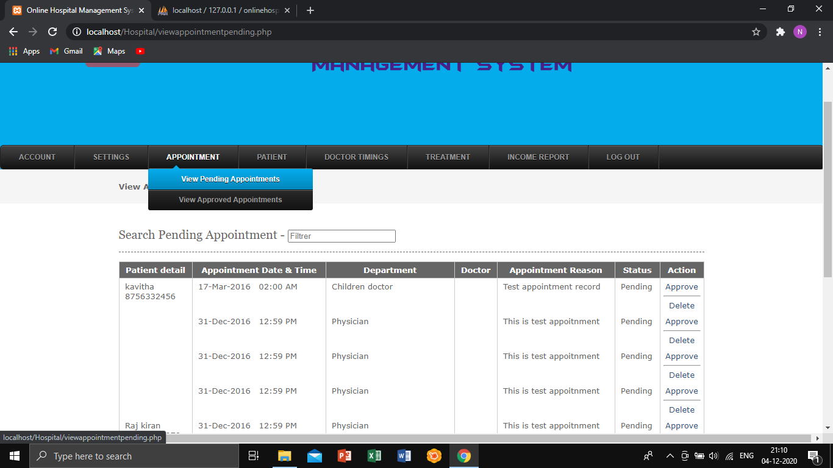
They can also view pending and approved appointments under them.

Slide 24
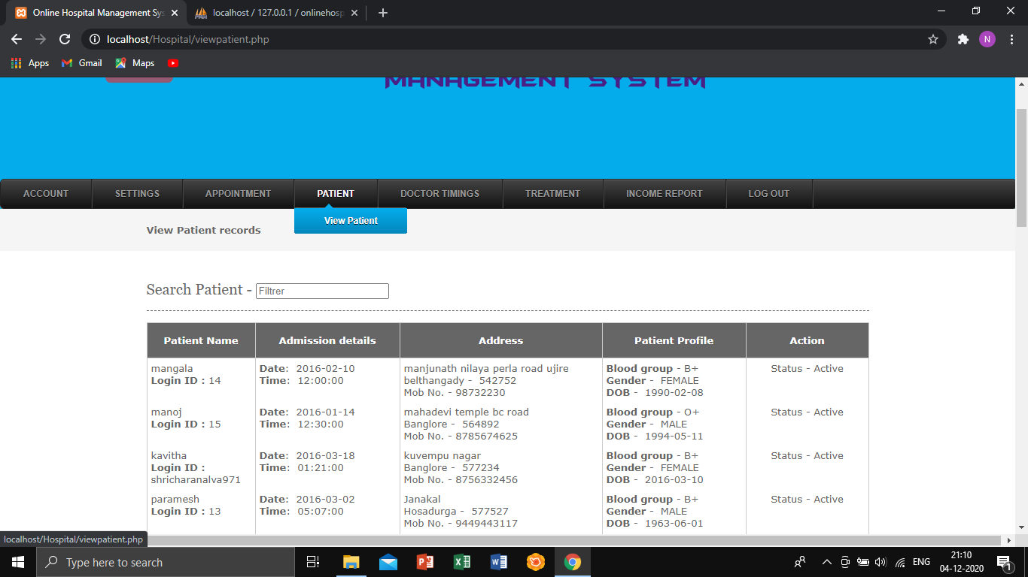
The doctor can view the patient records,.

Slide 25
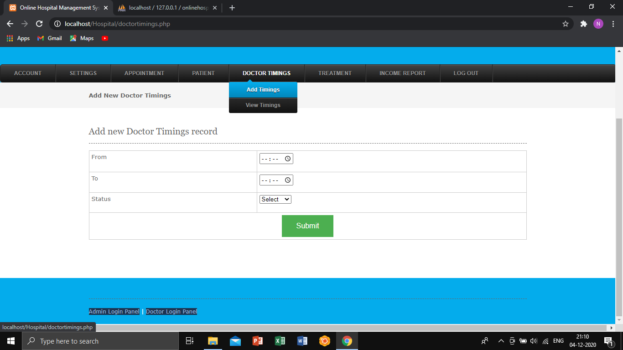
The doctor can view and add the Timings.

Slide 26
Applications of the System
The Software is for the automation of a Hospital Management.
It can be used in any Hospital, Clinic or Dispensary for maintaining patient details and their results.
To computerize all details, the project has information regarding the inpatient details, Billing details and doctor, staff details.
· To optimize the workflow
· To improve the quality of operation
· Shorten the diagnosis and treatment cycle
· To strengthen scientific management
26
Hospital Management System

Slide 27
Conclusions
The project Hospital Management System (HMS) is for computerizing the working in a hospital. The software takes care of all the requirements of an average hospital and is capable to provide easy and effective storage of information related to patients that come up to the hospital.
It generates test reports; provide prescription details including various tests, check-up and medicines prescribed to patient and doctor. It also provides injection details and billing facility.•
The system also provides the facility of backup as per the requirement.
27
Hospital Management System
Notes:
27

Slide 28
Literature Cited(book and web References)
Medium
W3schools
Stackoverflow
Youtube
Wikipedia
GeeksforGeeks
28
Hospital Management System
Notes:
28

Slide 29
Acknowledgements
We wish to express our sincere gratitude to Ms. Varsha Nagpurkar and Ms Pradnya Rane for guiding us throughout this project and giving us the chance to undertake this enlightening project.
We would also like to extend our sincere thanks to Ms. Kavita Sonawane the Head of computer department for providing us with this opportunity.
29
Hospital Management System
Notes:
29

Slide 30
Questions??
Thank You!
30

