Slide 1
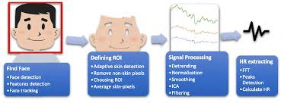
Efficient Approach for Measuring Heart Pulse from Real Time Facial RGB Color Videos
PRESENTED BY
NITHIN B S
UNDER THE GUIDANCE OF
Dr. Selva Kumar S
ASSISTANT PROFESSOR OF CSE
BMSCE

Slide 2
INTRODUCTION
Photoplethysmography Imaging(PPGI) monitors the color changes due to blood perfusions through a video of an area of skin which displays the person's pulse rate.
Acquiring real-time heart rate variability (HRV) data can be challenging, as patients may have limited access to the necessary medical equipment or an apt monitoring system.
Detection of pulse and respiratory rates using video recordings of human faces was done by extracting the signal of green camera channel and bandpass filtering through a Fast Fourier Transform to get the frequency spectrum.
We now apply the statistical Blind Source Spectrum (BSS) noise reduction method to separate our desired blood pulse signals. We can divide the video into small and independent regions to obtain a high accuracy of HRV results.
The name r-PPG has been coined due to the monitoring of remotely captured video through digital camera.

Slide 3
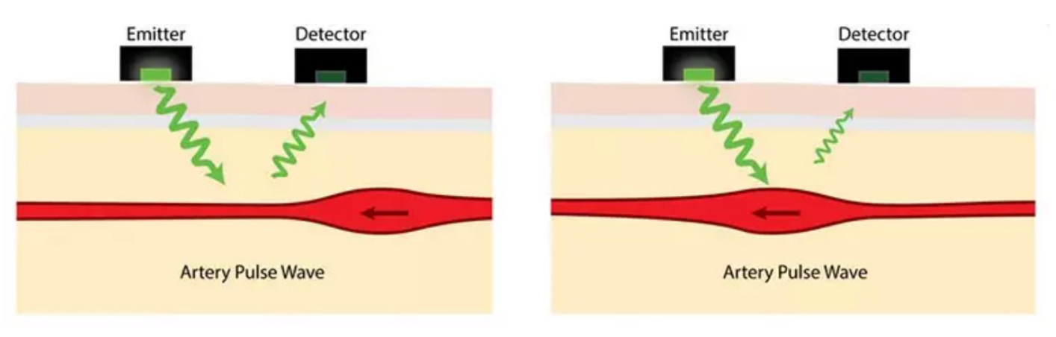
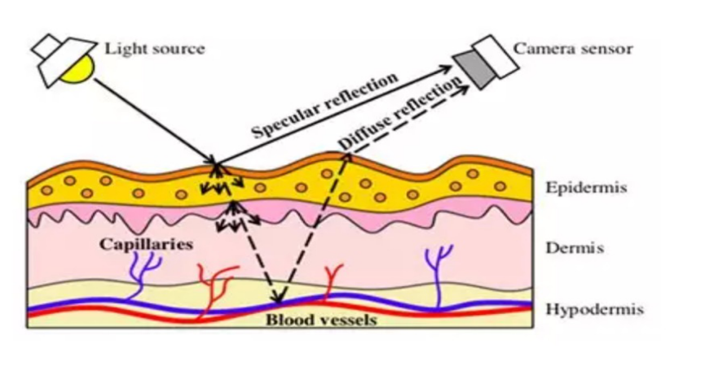
HOW PPGI WORKS
Light emits to the skin from one sensor and a second sensor detects how much light is returned to the device. This forms the contrast between emitted light and reflected light
It is the same principle as PPG but it is a contactless measurement. It measures the variance of red, green, and blue light reflection changes from the skin, as the contrast between specular reflection and diffused reflection.
A non-contact based system to measure Heart Rate: real-time application using camera.
Principal: extract heart rate information from facial skin color variation caused by blood circulation.

Slide 4
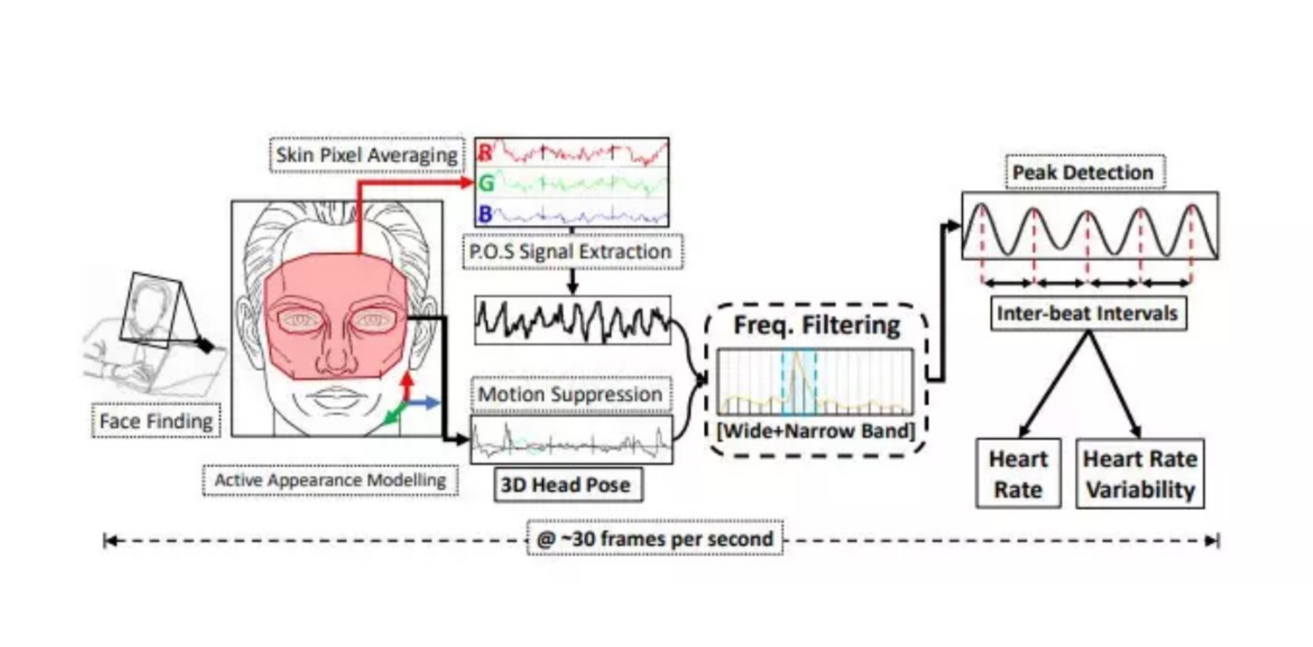
APPLICATIONS
This contactless technique facilitates medical applications.
Applicable scenarios include wound analysis and monitoring patients in isolation wards.
Driver state monitoring in automotive applications.
It monitors the drivers state and his critical parameters on highways also in city traffic. This enables safety of passengers and can be used to alert the nearest hospitals on the drivers health.
HR and HRV
This can suggest the presence of potential diseases in real time by back-end algorithms and that would aid doctors and health care providers in diagnosing diseases and conditions in resource-limited settings.

Slide 5
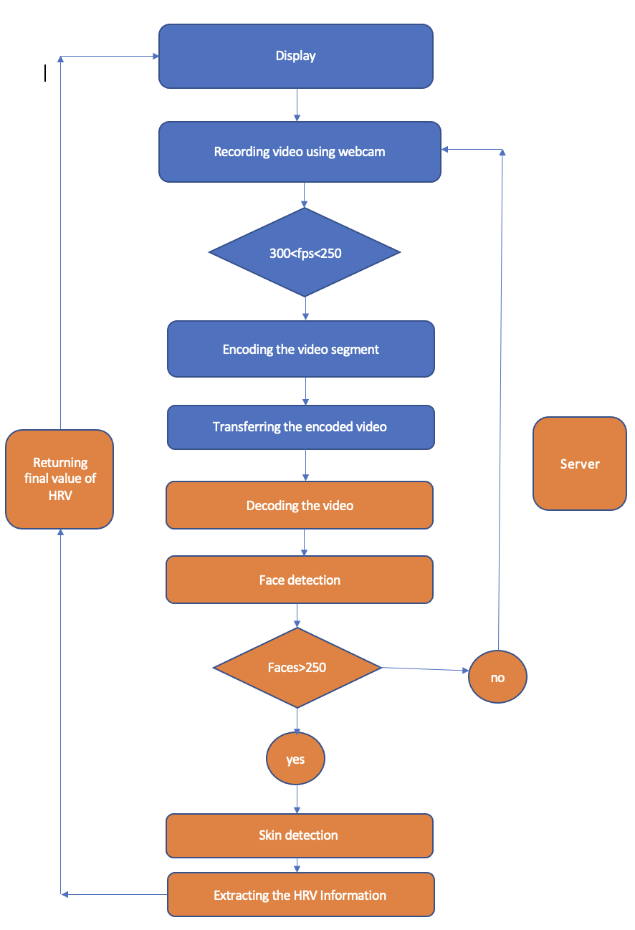
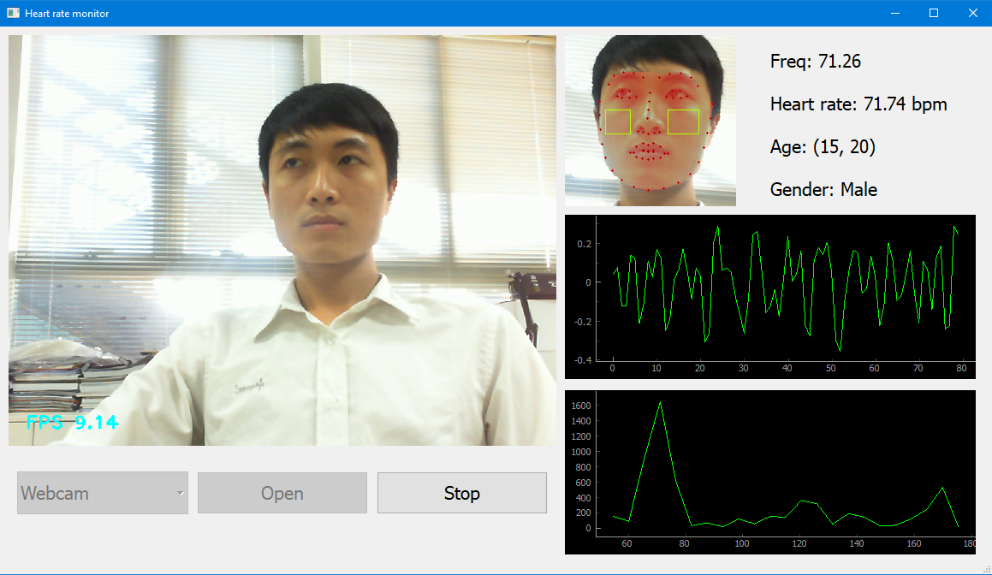
CONTROL FLOW

Slide 6
OBJECTIVES
At User end
In this part of the system records video segments using a webcam.
Recording the video
Encoding the video
Transferring the encoded video
Displaying the returned value
At Server end
We are going to develop an application where the encoded video segment that is sent from the user’s device will be decoded and analyzed to detect the heart rate and heart rate variability.
Face Detection
Skin Detection
Extracting HRV Information
Returning value of HRV
After calculating the heart rate and heart rate variability the system sent back the values to the user. As long as the user allows the system to do so, it will continuously monitor the heart rate and heart rate variability by analyzing the incoming video segments and return the HR and HRV values.

Slide 7

RELATED WORKS
Non-contact methods to detect heart rate include the laser radar method , microwave Doppler radar method ultrasonic method and a method using thermal imaging which can be complex, expensive, and highly impractical a heart rate monitor in specific scenarios due to its large size .
The technique of imaging photoplethysmography (IPPG) is a non-contact physiological parameter detection technology developed on the basis of PPG.
Recently TATA motors launched Driver monitoring system

Slide 8
CONCLUSION
In this system we have implemented a heart rate and heart rate variability monitor using facial video. The first step of the video analysis is face detection. There are some challenges detecting the faces from the frames extracted from the video segment.
If the video is recorded in low light or if the camera is not focused properly on the face of the user, then the number of faces detected against the number of frames is low, and not enough to extract HRV information. Future exploration should focus on the face detection area so that the number of faces remains consistent under any adverse scenarios.

Slide 9
THANK YOU.

