Slide 1
Smart Energy Meter
“Electricity monitoring made smart”

Slide 2
Why Smart Energy Meter ?
No more huge electricity bills
Get notified with instant alerts
Get usage and cost overview
Save money and electricity with the power of Artificial intelligence and Machine learning algorithms
Security at its finest by employing Blockchain technology

Slide 3
Basic Model
Appliances or KSEB Meter
Micro-controller
Wifi or LoRA Transmitter
Android Application
KSEB Cloud Server or Local KSEB Server

Slide 4
There are a lot of meter reader’s who work for KSEB ? Would they loose their jobs
Our smart meter have 2 modes of operation:
Semi automatic : This mode mainly focusses on old age people who cant use smartphones and internet the meter reading are transmitted via radio frequencies to a local KSEB station where the data is later is uploaded to the cloud. For this purpose we shall be needing the workforce of people so the people who lost their jobs have a opportunity !
Fully automatic : This mode is self explanatory the functions are automatic and hassle free without any assistance the systems functions

Slide 5
What about power theft ? What if the hardware is hacked ?
We have implemented some counter-measures stop power theft and other malpractices in hardware sections and software sections of the smart meter:
Hardware section: The system verifies whether the internal connections are intact, in case of malpractice the system waits for 5 seconds and alerts using the buzzer and send a power theft alert to KSEB server and shuts down.
Software section: The system is soon to be updated with blockchain technology which shall ensure maximum security in the cloud and thereby ensuring maximum reliability

Slide 6

Blockchain Techonlogy: A Glimpse into the future !

Slide 7
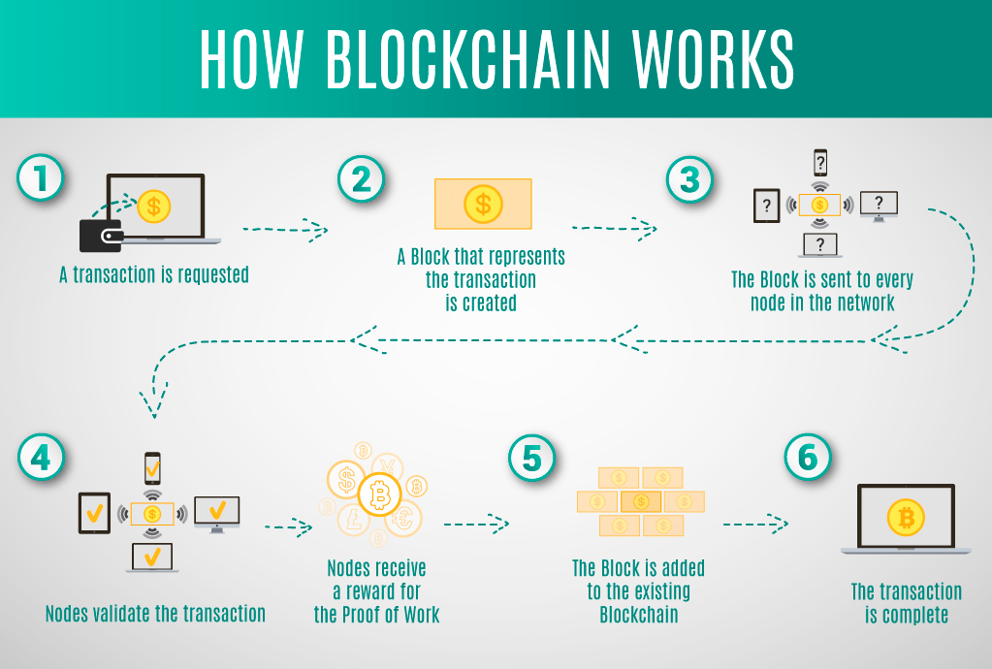
Blockchain in smart meter ?! So the payments are in cryptocurrency?

Slide 8
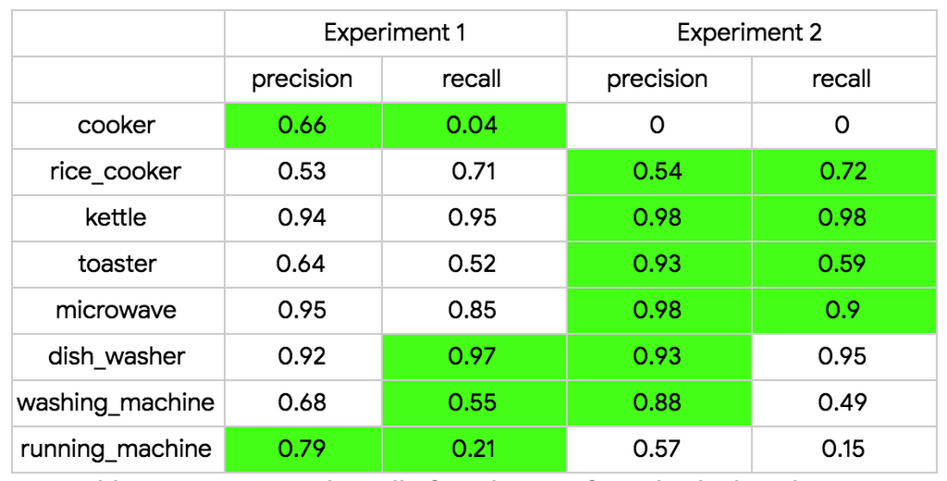
AI in depth: Machine learning for smart power savings.
We adopt a long short-term memory (LSTM) based network as our classification model.
The system entirely based on Google Cloud Platform, including data collection through Cloud IoT Core, a model built using TensorFlow and trained on Cloud Machine Learning Engine, and real-time serving

Slide 9
AI and ML : How it helps ?
Once the algorithm identifies an appliance’s operating status, we can then build out a few more applications. For example:
Anomaly detection: Usually the TV is turned off when there is no one at home. An application can send a message to the user if the TV turns on at an unexpected or unusual time.
Habit-improving recommendations: We can present users the usage patterns of home appliances in the neighborhood at an aggregated level so that they can compare or refer to the usage patterns and optimize the usage of their home appliances.

