Slide 1


Personalized Carbon Footprint Prediction
and Sustainability Optimization
Prepared By: (Yata Veera Shiva Reddy, Aparadapu Nithin, Mannem Ruthwik)
Reg. NO: 12201954,12219603,12219937 ROLL No: 09,33,44
Course Code : CSE461
Submitted To: (Mr. Aman Kumar)
Dept: (CSE)
University: Lovely Professional University Jalandhar Punjab India

Slide 2
Content of Presentation
Introduction
Literature survey & Comparative Analysis
Requirement Analysis
Proposed Methodology
Project Plan & Feasibility
Conclusion
References

Slide 3
1. Introduction
Project Title: A clear, concise, and professional name for your project.
Problem Statement: A detailed description of the specific issue you are trying to solve.
Motivation: Why is this project important? What drove your team to choose this?
Objectives: 3–5 high-level goals you aim to achieve by the end of the semester.
2. Literature Survey / Market Research
Existing Systems: An analysis of current products, software, or research papers similar to your idea.
Gap Analysis: Identifying what is missing in existing solutions that your project will provide.
Comparative Study: Often presented as a table comparing different methodologies or existing tools.
3. Requirement Analysis
Functional Requirements: What the system must do (e.g., "The user must be able to log in").
Non-Functional Requirements: Performance, security, scalability, and usability goals.
Hardware Requirements: The physical components needed (e.g., specific sensors, RAM, GPU).
Software Requirements: Operating systems, languages (Python, Java), frameworks (React, TensorFlow), and IDEs.
4. Proposed Methodology
System Architecture: A high-level block diagram showing how different parts of your project interact.
Proposed Algorithm/Workflow: A step-by-step logic of how your solution will work.
Data Flow Diagram (DFD) or Flowchart: Visual representation of the process.
5. Project Plan & Feasibility
Feasibility Study: Technical, Economic, and Operational feasibility.
Work Breakdown Structure (WBS): Who is doing what in the team?
Gantt Chart: A timeline showing your milestones for Evaluation 2 and the Final Submission.
6. Conclusion & References
Expected Outcomes: What the final "deliverable" will look like.
References: A list of papers, websites, and books consulted (formatted in APA or IEEE style).

Slide 4
Introduction (An Explainable AI Framework for Personalized Carbon Footprint Prediction and Sustainability Optimization)
Problem Statement
Climate change is a critical global challenge, primarily caused by increasing carbon dioxide (CO₂) emissions from human activities such as transportation, electricity consumption, industrial processes, and lifestyle choices. Most existing carbon footprint calculators provide generic and static estimates and fail to account for individual behavior patterns and temporal trends. Additionally, many AI-based prediction systems function as black-box models, offering little to no explanation for their predictions, which reduces transparency and user trust. Moreover, current systems often focus only on present or historical emissions, lacking the ability to predict future CO₂ emissions, which is essential for proactive sustainability planning and policy decision-making. Therefore, there is a strong need for a personalized, accurate, explainable, and future-aware AI-based framework that can predict both current and future carbon footprints and guide users toward sustainable actions.

Slide 5
Literature review
Year | Reference of Paper(Title/ Name) | Research Gap | Proposed model
2023 | IEEE – Machine Learning Approaches for Carbon Emission Forecasting | • Dominance of traditional statistical models • Limited personalization • Weak handling of nonlinear relationships • No explainability | • ML models (Random Forest) • Improved prediction accuracy • Better nonlinear modeling
2024 | Springer – Deep Learning-Based CO₂ Emission Prediction Using Temporal Data | • Deep learning treated as black box • No transparency for predictions • Focus only on historical emissions | • LSTM-based deep learning • Captures temporal patterns • High forecasting accuracy
2024 | Elsevier (Energy Reports) – An explainable comparative study of statistical, machine learning, deep learning, and hybrid models for CO₂ emissions forecasting in Australia | • Lack of interpretability in existing models • No personalized emission analysis • Limited future prediction insights | • DL models • Improved accuracy and transparency
2024 | ScienceDirect – Explainable Artificial Intelligence for Energy Consumption and Emission Forecasting | • Explainability rarely integrated with forecasting • Limited user-level insights • No sustainability guidance | • Feature importance analysis • Transparent prediction outcomes
2025 | Elsevier – Hybrid AI Models for Sustainable Energy and Carbon Emission Optimization | • Forecasting not connected to sustainability actions • No optimization layer | • Hybrid forecasting + optimization framework • Actionable sustainability recommendations

Slide 6
GAP ANALYSIS
Identified Research Gaps
Based on the literature review, the following gaps are identified in existing systems:
Most existing models focus on historical CO₂ emissions and lack future emission prediction at the individual level.
Carbon footprint calculators provide generic estimates rather than personalized insights.
Deep learning models achieve high accuracy but operate as black-box systems.
Limited integration of Explainable AI (XAI) techniques for transparency.
Absence of sustainability optimization and actionable recommendations.
Forecasting models are rarely linked to behavioral change guidance.

Slide 7
REQUIREMENT ANALYSIS
Functional Requirements
The system shall collect user-specific activity data (transport, energy, lifestyle).
The system shall predict current and future carbon footprint.
The system shall compare multiple AI models for CO₂ prediction.
The system shall provide explainable insights for predictions.
The system shall recommend sustainability optimization actions.

Slide 8
Software Requirements
Operating System: Windows / Linux
Programming Language: Python
Libraries: Pandas, NumPy, Scikit-learn, TensorFlow
Frontend: Streamlit
Dataset: https://ourworldindata.org/co2-and-greenhouse-gas-emissions

Slide 9
WORKFLOW
CO₂ emission datasets are collected from publicly available on Our World in Data website.
Data preprocessing is performed to handle missing values, noise, and inconsistencies.
Feature selection and normalization are applied to improve model performance.
The dataset is divided into training and testing sets.
Statistical models (e.g.,) are implemented as baseline forecasting approaches.
Machine Learning model – XGBoost is applied for nonlinear CO₂ emission prediction.
Deep Learning model – LSTM is used to capture temporal dependencies in emission data.
A Hybrid model (XGBoost + LSTM) is developed to combine the strengths of ML and DL approaches.
All models are evaluated and compared using metrics such as RMSE and MAE.
Explainable AI techniques (SHAP) are applied to analyze feature importance and model behavior.
Sustainability optimization insights are generated based on explainable prediction results.

Slide 10
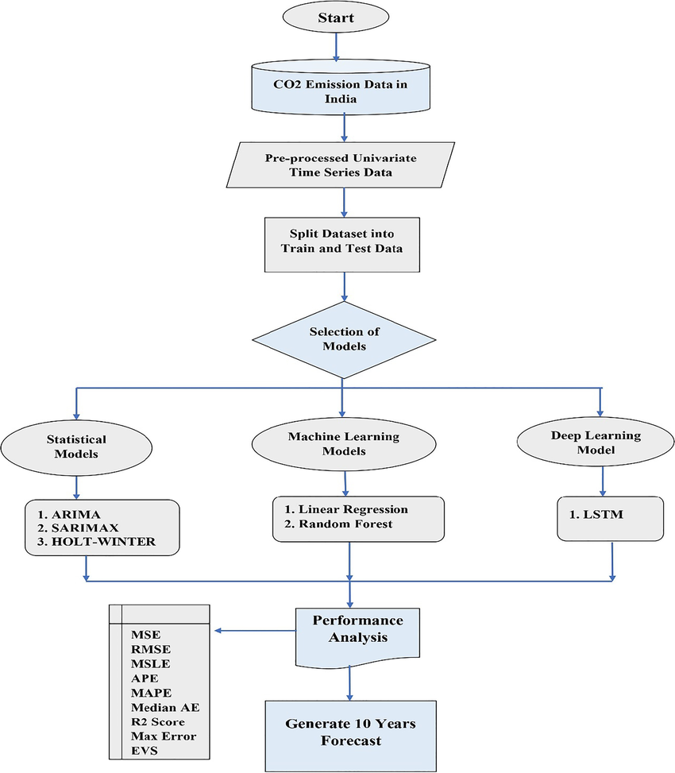
Data Flow Diagram

Slide 11
PROJECT PLAN & FEASIBILITY STUDY
Feasibility Study
1. Technical Feasibility
Availability of reliable CO₂ emission datasets from public repositories.
Use of proven algorithms such as XGBoost, and LSTM.
Availability of Explainable AI tools like SHAP.
Implementation using open-source libraries in Python.
2. Economic Feasibility
No cost involved in data acquisition (public datasets).
Open-source frameworks reduce development cost.
Minimal hardware requirements (optional GPU for training).
3. Operational Feasibility
Simple data-driven workflow without user dependency.
Easy to interpret results using Explainable AI.
Suitable for researchers, policymakers, and sustainability analysts.

Slide 12
GANTT CHART
Task / Phase | Week 1–2 | Week 3–4 | Week 5–6 | Week 7–8 | Week 9–10 | Week 11–12
Literature Review | ✔️
Dataset Collection |  | ✔️
Data Preprocessing |  | ✔️ | ✔️
Statistical Models |  |  | ✔️
ML Model (XGBoost) |  |  | ✔️ | ✔️
DL Model (LSTM) |  |  |  | ✔️ | ✔️
Hybrid Model |  |  |  | ✔️ | ✔️
Explainable AI (SHAP) |  |  |  |  | ✔️
Evaluation & Analysis |  |  |  |  | ✔️ | ✔️
Report & PPT |  |  |  |  |  | ✔️

Slide 13
CONCLUSION
This project presents an Explainable AI-based framework for CO₂ emissions forecasting and sustainability optimization. By comparing statistical, machine learning, deep learning, and hybrid models, the framework identifies the most accurate and reliable approach for future emission prediction .The integration of Explainable AI (SHAP) improves transparency and trust, enabling better understanding of model behavior. The proposed system supports data-driven sustainability planning and can assist policymakers, researchers, and environmental analysts in reducing carbon emissions.
Expected Outcomes
Accurate future CO₂ emission forecasts
Performance comparison of statistical, ML, DL, and hybrid models
Explainable insights using XAI techniques
Identification of key emission-driving factors
Support for sustainability optimization strategies

Slide 14
REFERENCES
Ghannam, S., An explainable comparative study of statistical, machine learning, deep learning,
and hybrid models for CO₂ emissions forecasting in Australia.
Available at: https://www.sciencedirect.com/science/article/pii/S2590005625002668
Şahin, V., Explainable machine learning-based prediction of CO₂ emissions using Extreme Gradient Boosting (XGBoost) (2025).
Available at: https://www.sciencedirect.com/science/article/abs/pii/S0029801825024357
Keykele, M. P., Predicting residential CO₂ emissions: Machine learning and LSTM comparison (2025).
Available at: https://www.sbt-durabi.org/articles/xml/bYw7/
Adam, A. M., Exploring machine learning models for predicting greenhouse gas emissions in buildings (2025).
Available at: https://link.springer.com/article/10.1186/s40068-025-00407-5
Li, X., A comparative study of statistical and machine learning models on near-real-time daily emissions prediction (2023).
Preprint: https://arxiv.org/abs/2302.01152

