Slide 1

Wine Classification
Nithin K Hydrose

Slide 2
Loading required R packages
library(tidyverse) # for easy data manipulation and visualisation
## -- Attaching packages -------------------------------------------- tidyverse 1.3.0 --
## v ggplot2 3.2.1 v purrr 0.3.3 ## v tibble 2.1.3 v dplyr 0.8.3 ## v tidyr 1.0.0 v stringr 1.4.0 ## v readr 1.3.1 v forcats 0.4.0
## -- Conflicts ----------------------------------------------- tidyverse_conflicts() -- ## x dplyr::filter() masks stats::filter() ## x dplyr::lag() masks stats::lag()
library(caret) # for easy machine learning workflow
## Loading required package: lattice
## ## Attaching package: 'caret'
## The following object is masked from 'package:purrr': ## ## lift

Slide 3
Reading the data
#View(vino) vino<-read.delim("F:/DSP Projects/Project 4/Dataset/wine.data.txt", header = FALSE, sep=",")

Slide 4
Labeling the input dataset
library(dplyr) vino<-data.frame(vino) oldnames<-c("V1","V2","V3","V4","V5","V6","V7","V8","V9","V10","V11","V12","V13","V14") newnames<-c("Type","Alcohol","Malic Acid","Ash","Alcalinity of Ash","Magnesium","Total phenols","Flavonoids","Non flavonoid phenols","Proanthocyanins","Color Intensity","Hue","Dilution","Proline") vino <- vino %>% rename_at(vars(oldnames), ~ newnames)

Slide 5
Preliminary analysis
dim(vino)
## [1] 178 14
str(vino)
## 'data.frame': 178 obs. of 14 variables: ## $ Type : int 1 1 1 1 1 1 1 1 1 1 ... ## $ Alcohol : num 14.2 13.2 13.2 14.4 13.2 ... ## $ Malic Acid : num 1.71 1.78 2.36 1.95 2.59 1.76 1.87 2.15 1.64 1.35 ... ## $ Ash : num 2.43 2.14 2.67 2.5 2.87 2.45 2.45 2.61 2.17 2.27 ... ## $ Alcalinity of Ash : num 15.6 11.2 18.6 16.8 21 15.2 14.6 17.6 14 16 ... ## $ Magnesium : int 127 100 101 113 118 112 96 121 97 98 ... ## $ Total phenols : num 2.8 2.65 2.8 3.85 2.8 3.27 2.5 2.6 2.8 2.98 ... ## $ Flavonoids : num 3.06 2.76 3.24 3.49 2.69 3.39 2.52 2.51 2.98 3.15 ... ## $ Non flavonoid phenols: num 0.28 0.26 0.3 0.24 0.39 0.34 0.3 0.31 0.29 0.22 ... ## $ Proanthocyanins : num 2.29 1.28 2.81 2.18 1.82 1.97 1.98 1.25 1.98 1.85 ... ## $ Color Intensity : num 5.64 4.38 5.68 7.8 4.32 6.75 5.25 5.05 5.2 7.22 ... ## $ Hue : num 1.04 1.05 1.03 0.86 1.04 1.05 1.02 1.06 1.08 1.01 ... ## $ Dilution : num 3.92 3.4 3.17 3.45 2.93 2.85 3.58 3.58 2.85 3.55 ... ## $ Proline : int 1065 1050 1185 1480 735 1450 1290 1295 1045 1045 ...
summary(vino)
## Type Alcohol Malic Acid Ash ## Min. :1.000 Min. :11.03 Min. :0.740 Min. :1.360 ## 1st Qu.:1.000 1st Qu.:12.36 1st Qu.:1.603 1st Qu.:2.210 ## Median :2.000 Median :13.05 Median :1.865 Median :2.360 ## Mean :1.938 Mean :13.00 Mean :2.336 Mean :2.367 ## 3rd Qu.:3.000 3rd Qu.:13.68 3rd Qu.:3.083 3rd Qu.:2.558 ## Max. :3.000 Max. :14.83 Max. :5.800 Max. :3.230 ## Alcalinity of Ash Magnesium Total phenols Flavonoids ## Min. :10.60 Min. : 70.00 Min. :0.980 Min. :0.340 ## 1st Qu.:17.20 1st Qu.: 88.00 1st Qu.:1.742 1st Qu.:1.205 ## Median :19.50 Median : 98.00 Median :2.355 Median :2.135 ## Mean :19.49 Mean : 99.74 Mean :2.295 Mean :2.029 ## 3rd Qu.:21.50 3rd Qu.:107.00 3rd Qu.:2.800 3rd Qu.:2.875 ## Max. :30.00 Max. :162.00 Max. :3.880 Max. :5.080 ## Non flavonoid phenols Proanthocyanins Color Intensity Hue ## Min. :0.1300 Min. :0.410 Min. : 1.280 Min. :0.4800 ## 1st Qu.:0.2700 1st Qu.:1.250 1st Qu.: 3.220 1st Qu.:0.7825 ## Median :0.3400 Median :1.555 Median : 4.690 Median :0.9650 ## Mean :0.3619 Mean :1.591 Mean : 5.058 Mean :0.9574 ## 3rd Qu.:0.4375 3rd Qu.:1.950 3rd Qu.: 6.200 3rd Qu.:1.1200 ## Max. :0.6600 Max. :3.580 Max. :13.000 Max. :1.7100 ## Dilution Proline ## Min. :1.270 Min. : 278.0 ## 1st Qu.:1.938 1st Qu.: 500.5 ## Median :2.780 Median : 673.5 ## Mean :2.612 Mean : 746.9 ## 3rd Qu.:3.170 3rd Qu.: 985.0 ## Max. :4.000 Max. :1680.0
table(vino$Type)
## ## 1 2 3 ## 59 71 48

Slide 6
Exploratory analysis

Slide 7
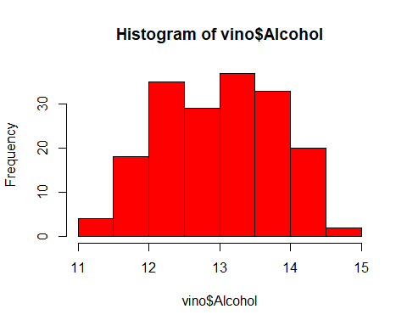
Histogram

Slide 8
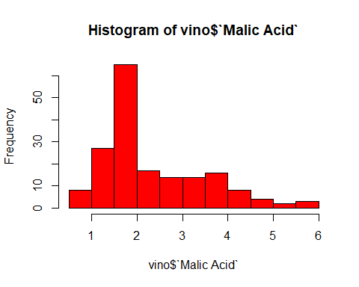

Slide 9
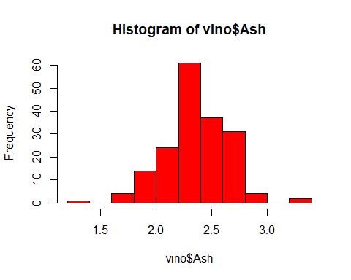

Slide 10
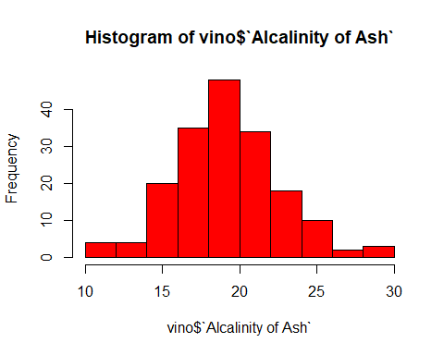

Slide 11
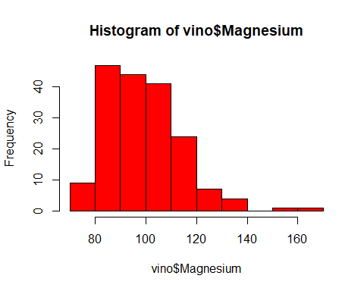

Slide 12
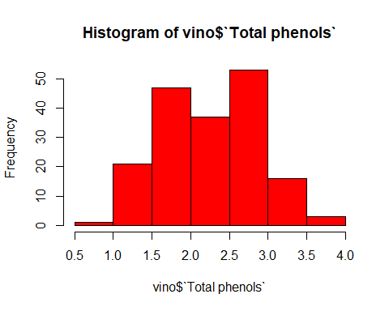

Slide 13
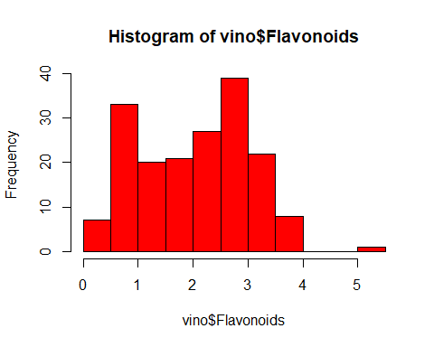

Slide 14
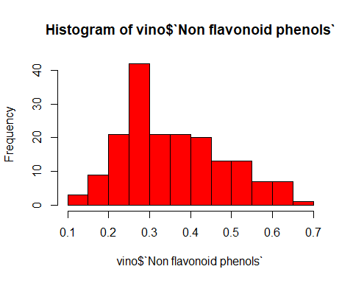

Slide 15
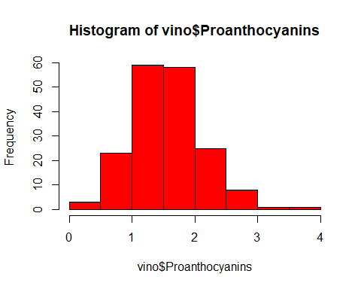

Slide 16
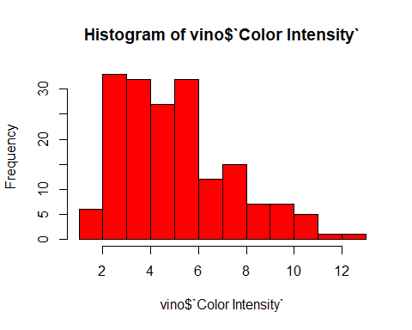

Slide 17
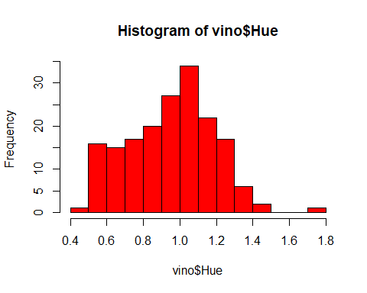

Slide 18
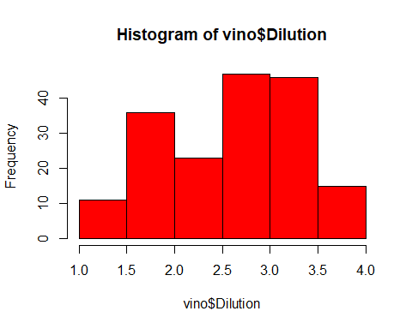

Slide 19
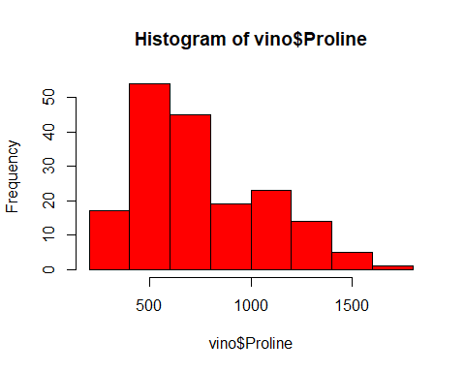

Slide 20
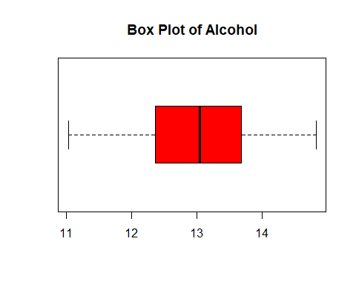
Box plot

Slide 21
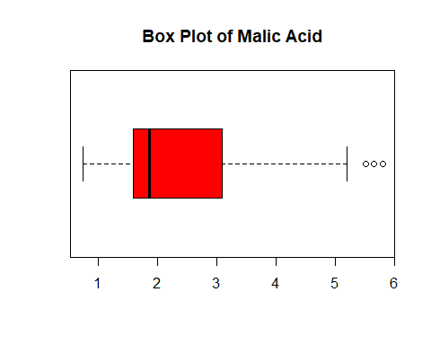

Slide 22


Slide 23
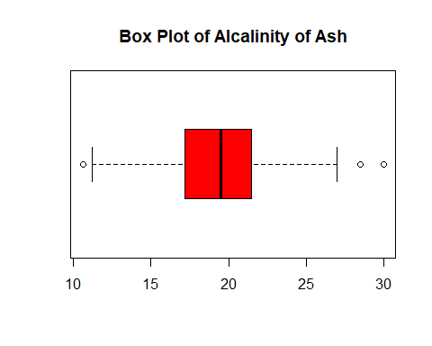

Slide 24
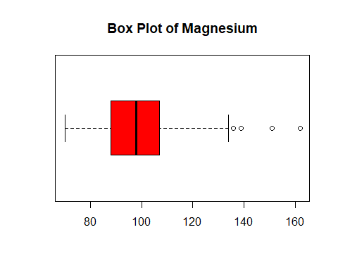

Slide 25
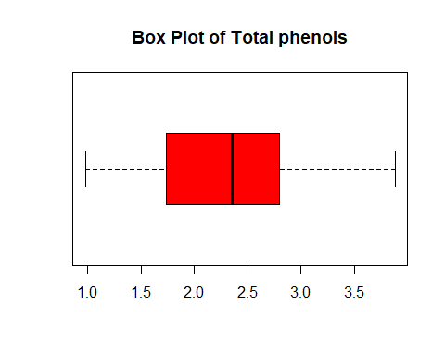

Slide 26
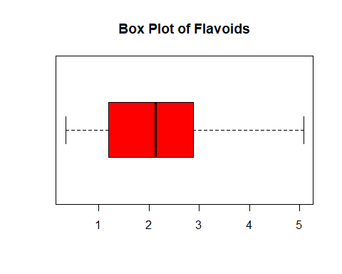

Slide 27
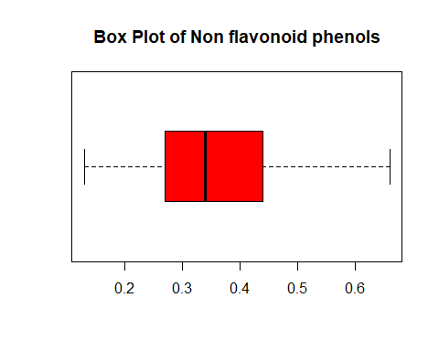

Slide 28
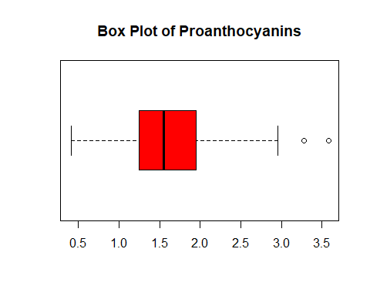

Slide 29
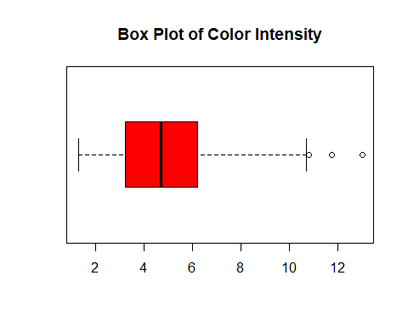

Slide 30
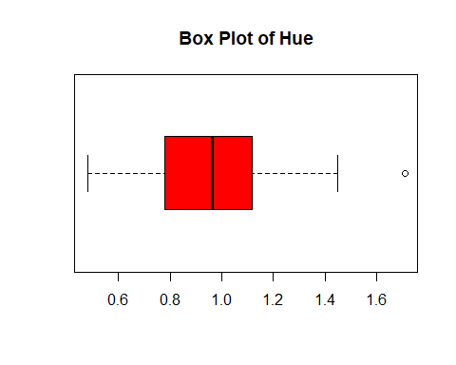

Slide 31
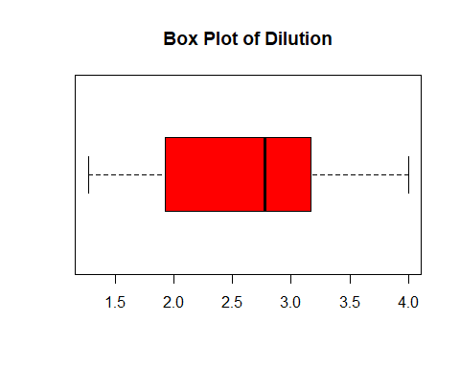

Slide 32


Slide 33
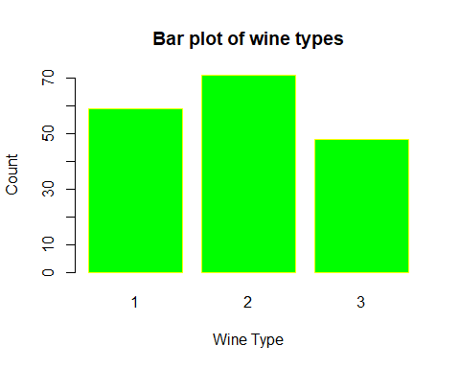
Bar plot

Slide 34
Test-Train data splitting
tr=seq(round(0.75*length(vino$Type))) Y_train=vino[tr,1] Y_test=vino[-tr,1] X_train=vino[tr,-1] X_test=vino[-tr,-1]

Slide 35
Estimate preprocessing parameters
preproc.param <- X_train %>% preProcess(method = c("center", "scale")) # Transform the data using the estimated parameters X_train.transformed <- preproc.param %>% predict(X_train) X_train.transformed['Type'] <- Y_train X_test.transformed <- preproc.param %>% predict(X_test) X_test.transformed['Type'] <- Y_test

Slide 36
Linear Discriminant Analysis
library(MASS)
## ## Attaching package: 'MASS'
## The following object is masked from 'package:dplyr': ## select
# Fit the model model <- lda(Type~., data=X_train.transformed) model
## Call: ## lda(Type ~ ., data = X_train.transformed) ## Prior probabilities of groups: ## 1 2 3 ## 0.44029851 0.52985075 0.02985075

Slide 37
Group means: ## Alcohol `Malic Acid` Ash `Alcalinity of Ash` Magnesium ## 1 0.9188305 0.02854616 0.39025223 -0.5341808 0.4065115 ## 2 -0.7553227 -0.05970739 -0.32980875 0.4101988 -0.3649877 ## 3 -0.1457725 0.63875030 0.09788493 0.5981376 0.4824867 ## `Total phenols` Flavonoids `Non flavonoid phenols` Proanthocyanins ## 1 0.6143123 0.6990724 -0.3390042 0.3139455 ## 2 -0.4043867 -0.4874078 0.3356349 -0.1726663 ## 3 -1.8832417 -1.6598288 -0.9572084 -1.5658706 ## `Color Intensity` Hue Dilution Proline ## 1 0.8118289 0.07308240 0.4631402 0.9507483 ## 2 -0.7036304 0.04026549 -0.2224411 -0.7571642 ## 3 0.5149635 -1.79267788 -2.8829886 -0.5838736 ##

Slide 38
## Coefficients of linear discriminants: ## LD1 LD2 ## Alcohol -0.829351218 0.27210902 ## `Malic Acid` -0.186302593 0.18306541 ## Ash -0.557013325 0.39560939 ## `Alcalinity of Ash` 0.680499097 0.17542707 ## Magnesium 0.008109674 0.08924165 ## `Total phenols` 0.195244701 -0.47668664 ## Flavonoids -0.248591443 -0.03369505 ## `Non flavonoid phenols` -0.024942971 -0.88965600 ## Proanthocyanins 0.118140207 -0.18075110 ## `Color Intensity` -0.048773946 0.62091476 ## Hue 0.019053061 -0.26721159 ## Dilution -0.572041036 -0.91725676 ## Proline -1.220627107 -0.32845639 ## ## Proportion of trace: ## LD1 LD2 ## 0.8457 0.1543

Slide 39
Make predictions
predictions <- model %>% predict(X_test.transformed) predictions
## $class ## [1] 2 2 3 2 2 2 2 2 2 2 3 2 3 3 3 3 3 3 3 3 3 3 3 2 3 3 3 2 2 3 3 3 3 3 3 3 3 3 ## [39] 3 3 3 3 3 3 ## Levels: 1 2 3 ## ## $posterior ## 1 2 3 ## 135 6.400551e-07 9.999960e-01 3.340753e-06 ## 136 1.514359e-05 9.984712e-01 1.513675e-03 ## 137 5.202487e-06 2.373842e-01 7.626106e-01 ## 138 8.922312e-07 9.772202e-01 2.277890e-02 ## 139 3.158119e-04 9.985311e-01 1.153063e-03 ## 140 7.241168e-06 9.999611e-01 3.169698e-05 ## 141 5.231525e-03 9.945289e-01 2.395945e-04 ## 142 2.430231e-01 6.734431e-01 8.353387e-02 ## 143 1.158195e-03 9.034505e-01 9.539129e-02 ## 144 7.220092e-03 9.911152e-01 1.664710e-03 ## 145 7.608338e-08 1.069540e-05 9.999892e-01 ## 146 2.547956e-04 7.965594e-01 2.031858e-01 ## 147 4.292258e-11 1.270957e-07 9.999999e-01 ##

Slide 40
## 148 2.758617e-07 2.378396e-04 9.997619e-01 ## 149 1.014538e-08 4.134235e-05 9.999586e-01 ## 150 6.816865e-16 7.359379e-12 1.000000e+00 ## 151 5.043994e-19 3.413786e-15 1.000000e+00 ## 152 6.988022e-20 7.224514e-15 1.000000e+00 ## 153 1.703454e-17 2.386500e-10 1.000000e+00 ## 154 4.489014e-06 4.352080e-03 9.956434e-01 ## 155 4.184442e-08 3.606571e-01 6.393428e-01 ## 156 1.038154e-05 3.102817e-02 9.689614e-01 ## 157 2.837217e-08 7.146420e-06 9.999928e-01 ## 158 5.479406e-06 9.096380e-01 9.035656e-02 ## 159 5.753371e-07 8.835634e-05 9.999111e-01 ## 160 6.942376e-08 4.103580e-04 9.995896e-01 ## 161 5.620339e-09 1.544970e-02 9.845503e-01 ## 162 4.543391e-02 8.082438e-01 1.463223e-01 ## 163 1.202497e-04 9.997394e-01 1.403356e-04 ## 164 3.955646e-05 1.257823e-02 9.873822e-01 ## 165 1.107101e-10 8.661599e-08 9.999999e-01

Slide 41
## 166 1.749970e-06 1.204071e-02 9.879575e-01 ## 167 5.090142e-11 8.150851e-09 1.000000e+00 ## 168 6.197842e-10 4.905785e-07 9.999995e-01 ## 169 6.203859e-09 5.915930e-07 9.999994e-01 ## 170 3.800473e-12 1.051042e-10 1.000000e+00 ## 171 2.889761e-08 1.167727e-02 9.883227e-01 ## 172 6.727365e-12 1.395543e-06 9.999986e-01 ## 173 2.548760e-07 8.686670e-07 9.999989e-01 ## 174 6.389837e-04 5.493301e-04 9.988117e-01 ## 175 6.210751e-08 4.609866e-05 9.999538e-01 ## 176 2.207628e-09 5.532440e-08 9.999999e-01 ## 177 9.749239e-06 1.329967e-03 9.986603e-01 ## 178 3.592310e-08 4.301649e-06 9.999957e-01

Slide 42
## $x ## LD1 LD2 ## 135 2.608680957 1.267031 ## 136 2.054500567 2.261075 ## 137 2.074551240 3.466478 ## 138 2.645786451 2.659229 ## 139 1.447980997 2.251382 ## 140 2.154272730 1.646349 ## 141 0.870626952 2.036083 ## 142 0.106882021 3.061489 ## 143 1.224974188 2.974940 ## 144 0.829585252 2.344240 ## 145 1.051227787 5.141681 ## 146 1.511387865 3.098222 ## 147 1.710345525 5.803903 ## 148 1.373678149 4.635372 ## 149 1.703401187 4.892999 ## 150 2.085909602 7.320354 ## 151 2.086539168 8.529523

Slide 43
## 152 2.618817213 8.382306 ## 153 3.467134389 6.696726 ## 154 1.361572158 4.177468 ## 155 3.108149044 3.316267 ## 156 1.560929279 3.852850 ## 157 1.171951398 5.198594 ## 158 2.288745429 2.907122 ## 159 1.043107006 4.809474 ## 160 1.749342272 4.528868 ## 161 2.924777651 3.890593 ## 162 0.480724590 3.100598 ## 163 1.614340637 1.910304 ## 164 1.127181346 4.021788 ## 165 1.450695820 5.878516 ## 166 1.738265798 3.995326 ## 167 1.164415125 6.266485 ## 168 1.431916879 5.606366 ## 169 1.009366144 5.599990 ## 170 0.868584181 6.968082 ## 171 2.547476338 3.955939 ## 172 2.525059712 5.381865 ## 173 0.343109147 5.575927 ## 174 -0.008874752 4.578994 ## 175 1.363893021 4.894419 ## 176 0.772805276 5.986222 ## 177 0.986588205 4.385215 ## 178 1.030459291 5.286301

Slide 44
str(predictions)
## List of 3 ## $ class : Factor w/ 3 levels "1","2","3": 2 2 3 2 2 2 2 2 2 2 ... ## $ posterior: num [1:44, 1:3] 6.40e-07 1.51e-05 5.20e-06 8.92e-07 3.16e-04 ... ## ..- attr(*, "dimnames")=List of 2 ## .. ..$ : chr [1:44] "135" "136" "137" "138" ... ## .. ..$ : chr [1:3] "1" "2" "3" ## $ x : num [1:44, 1:2] 2.61 2.05 2.07 2.65 1.45 ... ## ..- attr(*, "dimnames")=List of 2 ## .. ..$ : chr [1:44] "135" "136" "137" "138" ... ## .. ..$ : chr [1:2] "LD1" "LD2"
names(predictions)
## [1] "class" "posterior" "x"
# Model accuracy mean(predictions$class==X_test.transformed$Type)
## [1] 0.7045455
# Accuracy=70.45%

Slide 45
Multiple Discriminant Analysis
# Quadratic Discriminant Analysis is not used as the sample size is small. #install.packages("mda") library(mda)
## Loading required package: class
## Loaded mda 0.4-10
# Fit the model modelm <- mda(Type~., data=X_train.transformed) modelm
## Call: ## mda(formula = Type ~ ., data = X_train.transformed)

Slide 46
Dimension: 8 ## ## Percent Between-Group Variance Explained: ## v1 v2 v3 v4 v5 v6 v7 v8 ## 66.37 82.77 91.26 95.56 98.18 99.49 99.86 100.00 ## ## Degrees of Freedom (per dimension): 14 ## ## Training Misclassification Error: 0.00746 ( N = 134 ) ## ## Deviance: 5.958

Slide 47
Make predictions
predictionsm <- modelm %>% predict(X_test.transformed) predictionsm
## [1] 2 2 3 3 2 2 2 2 2 2 3 2 3 3 3 3 3 3 3 3 3 3 3 3 3 3 3 2 2 3 3 3 3 3 3 3 3 3 ## [39] 3 3 3 3 3 3 ## Levels: 1 2 3
str(predictionsm)
## Factor w/ 3 levels "1","2","3": 2 2 3 3 2 2 2 2 2 2 ...
names(predictionsm)
## NULL
# Model accuracy mean(predictionsm==X_test.transformed$Type)
## [1] 0.75
# Accuracy=70.45%

Slide 48
Flexible Discriminant Analysis
#install.packages("mda") #library(mda) # Fit the model modelf <- fda(Type~., data=X_train.transformed) modelf
## Call: ## fda(formula = Type ~ ., data = X_train.transformed) ## ## Dimension: 2 ## ## Percent Between-Group Variance Explained: ## v1 v2 ## 84.57 100.00 ## ## Degrees of Freedom (per dimension): 14 ## ## Training Misclassification Error: 0.00746 ( N = 134 )

Slide 49
Make predictions
predictionsf <- modelf %>% predict(X_test.transformed) predictionsf
## [1] 2 2 3 2 2 2 2 2 2 2 3 2 3 3 3 3 3 3 3 3 3 3 3 2 3 3 3 2 2 3 3 3 3 3 3 3 3 3 ## [39] 3 3 3 3 3 3 ## Levels: 1 2 3
str(predictionsf)
## Factor w/ 3 levels "1","2","3": 2 2 3 2 2 2 2 2 2 2 ...
names(predictionsf)
## NULL
# Model accuracy mean(predictionsf==X_test.transformed$Type)
## [1] 0.7045455
# Accuracy=70.45% # Regularized Discriminant Analysis is not applied as the no. of predictors is less than sample size.

Slide 50
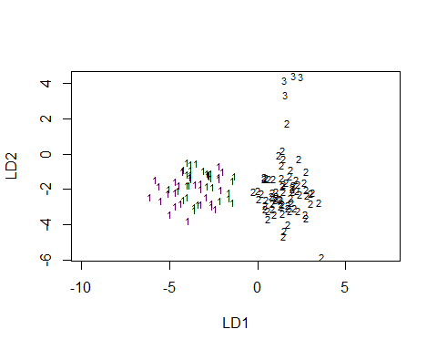
Plot of LDA

Slide 51
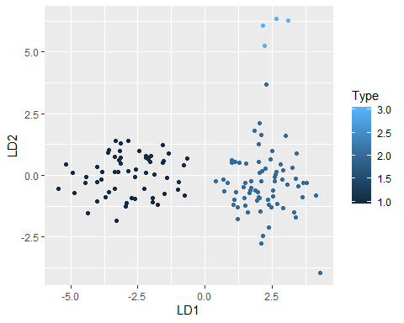
Create LDA plot using ggplot

Slide 52
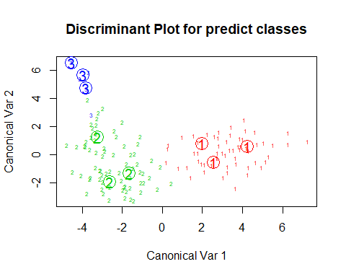
Plot data using MDA

Slide 53
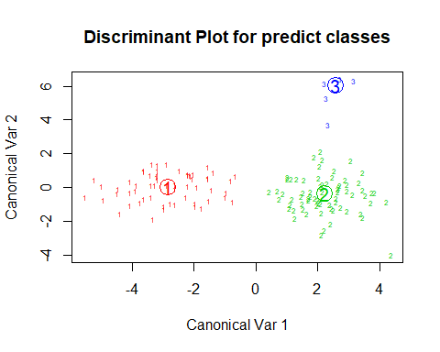
Plot data using FDA

Slide 54
CONCLUSION
The model to classify wine samples has been successfully created using LDA.
The accuracy has been found to be 70.45%, which is adequate.
Further confirmation has been achieved by using MDA and FDA analysis.

