Slide 1
Dev-Ops Office Model
By
Nithin N M
4NI14MCA29

Slide 2
AGENDA
INTRODUCTION
PROBLEM STATEMENT
PROPOSED SYSTEM
ADVANTAGE OF DEVOPS OFFICE MODEL
TOOLS USED
TOOLS DEPENDECIES
MODULES WISE EXPALNATION
CONCLUSION
FUTURE WORK

Slide 3
INTRODUCTION
The project aims at automation of the processes involving software testing, building , deployment and monitoring.
Customer needs a vendor who can deliver solutions faster
Companies have started to speed up their software delivery process
Companies use latest and advanced technologies to speed up software development process

Slide 4
PROBLEM STATEMENT
Infrastructure setup for software development is done manually
Tools and services are installed manually
Consumes a lot of time and human resources
Manual Deployment of products consumes time

Slide 5
Limitations of Existing System
Requires constant human intervention during any setup or modification in the system
Administration of large number of servers is difficult
Consumes a lot of time and human resources
Addition of new components and tools is not easy

Slide 6
PROPOSED SYSTEM
Automates the installation of tools and services
Frequent changes to the system can be done easily
Automates the deployment of code
Monitors the entire system

Slide 7
Advantages of Dev-ops Model
Code -> Code development and review, version control tools, code merging
Build -> Continuous integration tools, build status
Package -> Artifact repository, application pre-deployment staging
Release -> Change management, release approvals, release automation
Configure -> Infrastructure configuration and management, Infrastructure as Code tools
Monitor -> Applications performance monitoring, end user experience

Slide 8
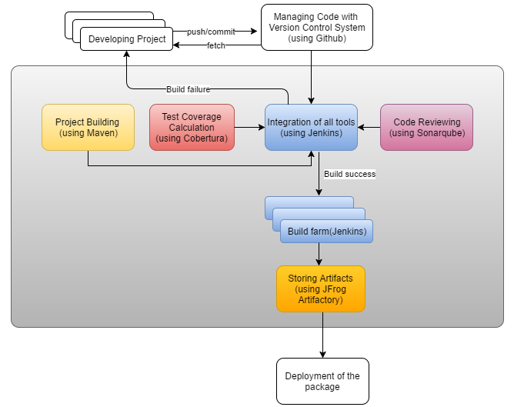
ARCHITECTURE

Slide 9
Tools used
Nagios : It is open source monitoring tool which monitors sites.
Git : It is open source version control system
Github : Public open source Repository which is used store codes
Maven : It is building tool which build the codes into binary files or packages
DNS : provides visitors access to websites using domain names rather than IP addresses.
Jenkins : Continuous Integration tool which is used to integrate the all other tools.
Jfrog : It's a single gateway through which you access external artifacts, and store your own build artifacts.
Puppet : is an open-source software configuration management tool. It runs on many Unix-like systems as well as on Microsoft Windows, and includes its own declarative language to describe system configuration.

Slide 10
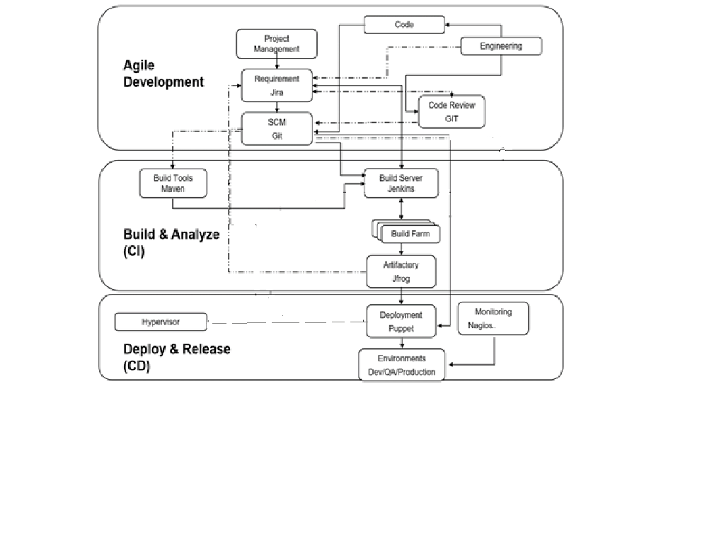
Tool Dependecies

Slide 11
AUTOMATED DEPLOYMENT AND MONITORING
HYPERVISOR EXSi
SLAVE PUPPET SERVERS
Monitors / sends
Alerts
BUILD SERVER
ARTIFACTORY
MONITORING SERVER
AUTOMATED SERVERS
TESTING SERVER
AUTOMATION SERVER
Updates Alert to
terminal
MONITORING TERMINAL
Automated Deployment
GIT
TOMCAT

Slide 12
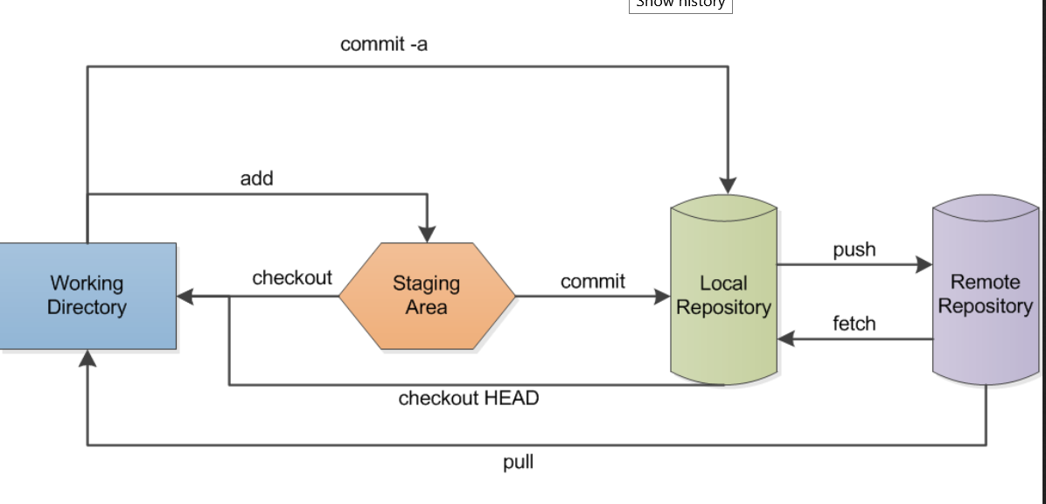
Module wise explanation of architecture
Git : It is a version control system which holds the code that needs to be built

Slide 13
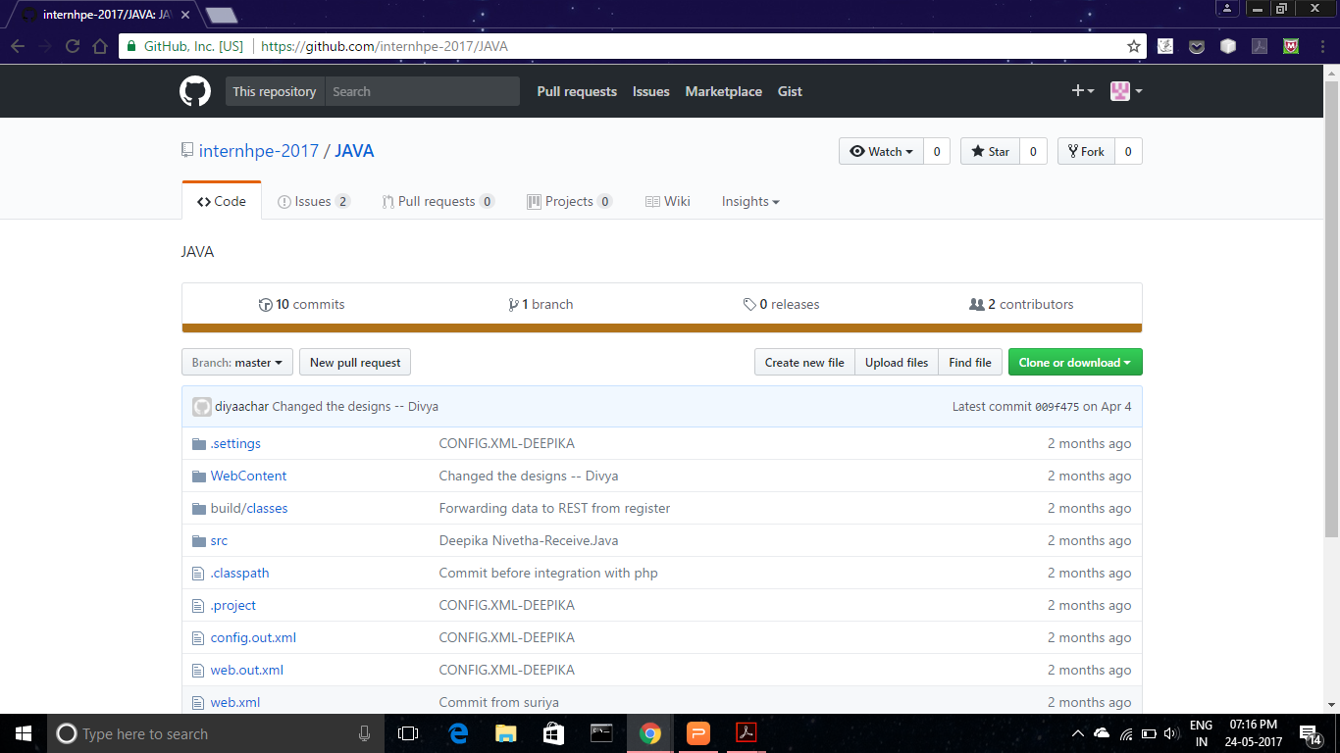

Slide 14
Jira
JIRA is a proprietary issue tracking product, developed by Atlassian.
JIRA is used in this project for
Bug tracking
Issue tracking
Project management

Slide 15
MAVEN
Maven is a project management and building tool.
Build is a software that converts source code in to application format. The building of the application is carried using a tool called Maven.
Maven is used in this project to provide,
Builds
Documentation Reporting
Dependencies SCMs
Releases
Distribution

Slide 16
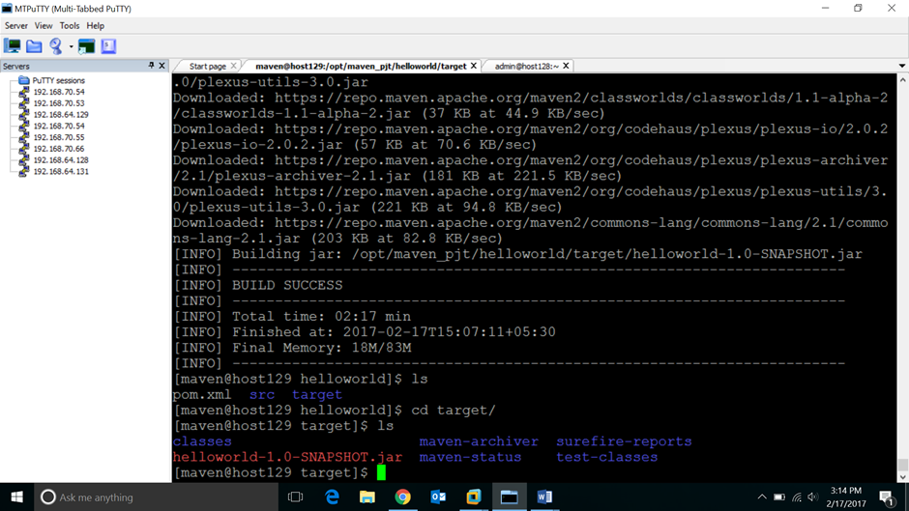
Maven Building

Slide 17
JENKINS
Jenkins is a self-contained, open source automation server which can be used to automate all sorts of tasks such as building, testing, and deploying software.
Jenkins is used in this project as
Continuous Integration server
Building tool
Deploying tool
Automation tool

Slide 18
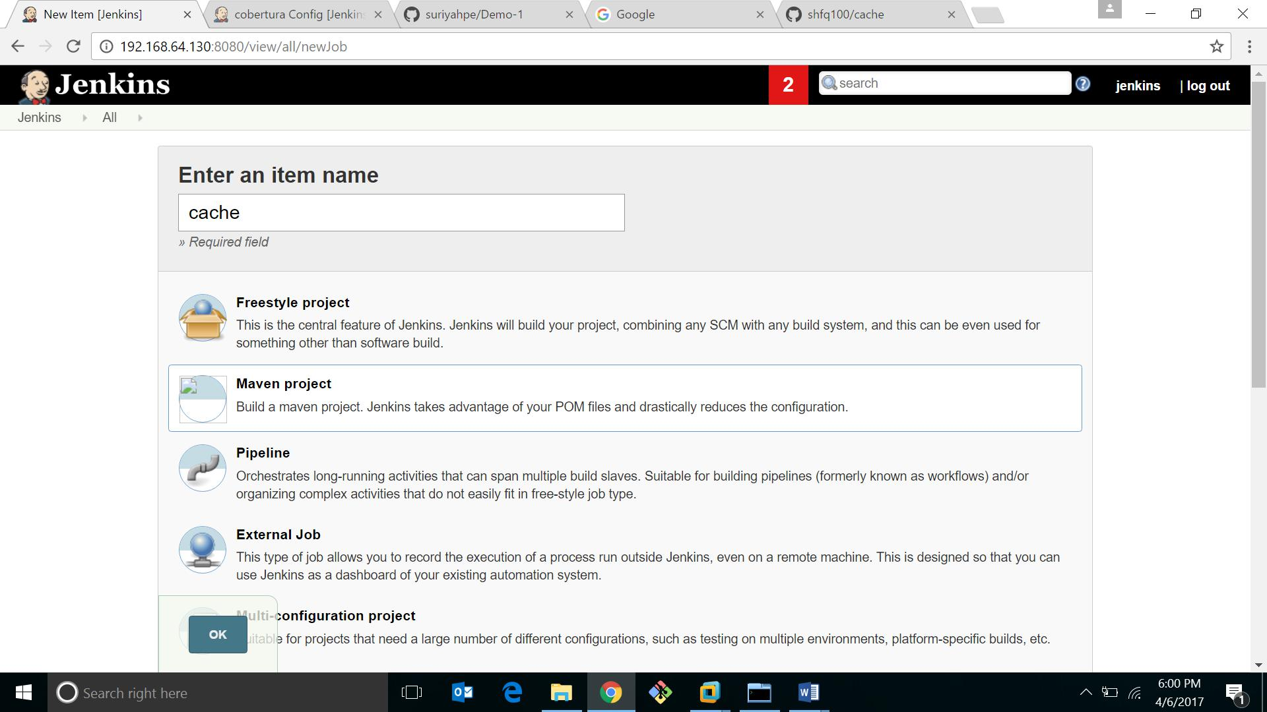
Jenkins Integration

Slide 19
What is Artifactory?
Advanced binaries repository - the binaries’ SCM
JavaFX and WebStart repository
Supports REST, Maven*, Gradle*, Ivy/Ant*, Buildr * native support
First “real” web-driven repository manager (2006)
Upload through UI, indexe searches,earches…

Slide 20
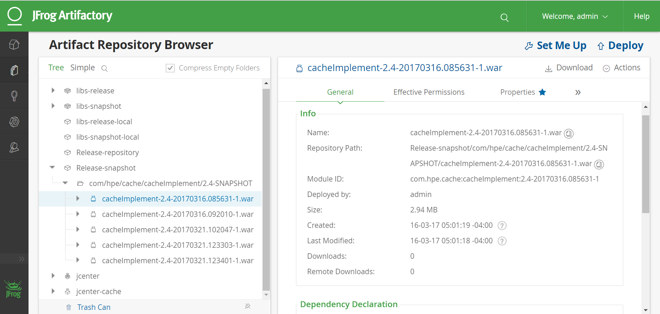
This is the location from where the code is automatically deployed

Slide 21
NAGIOS
Nagios is an open source computer-software application that monitors systems, networks and infrastructure.
Nagios is used in this project to,
Monitor all the services installed in the server
Monitor all the services installed in the slave
Monitor all the hosts and services

Slide 22
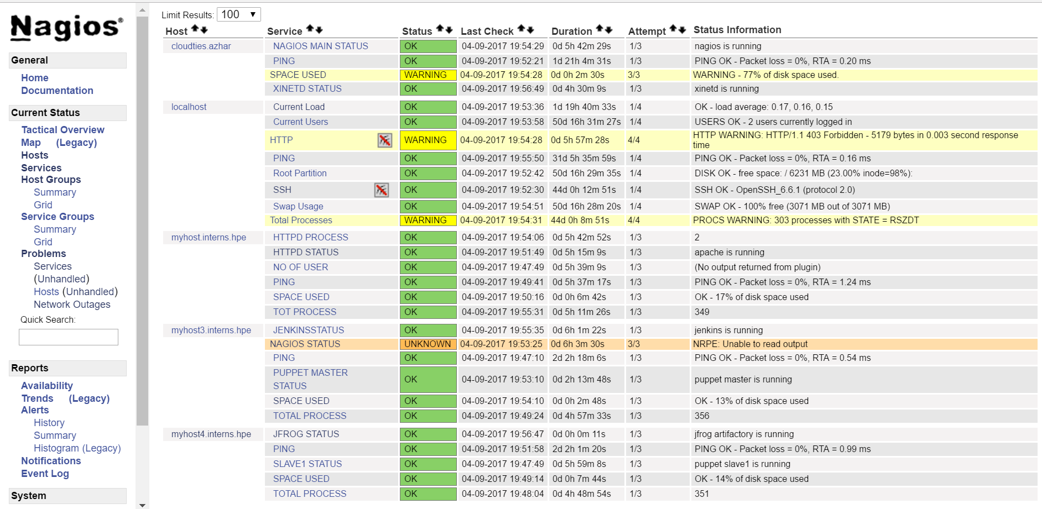
NAGIOS

Slide 23
PUPPET
Puppet is an open source systems management tool for centralizing and automating configuration management.
Puppet is used in this project to,
Automate installation of services
Automate deployment of software

Slide 24
Files associated with puppet configuration
Modules
Manifests
Files
Init.pp
Site.pp File
Slave Server

Slide 25
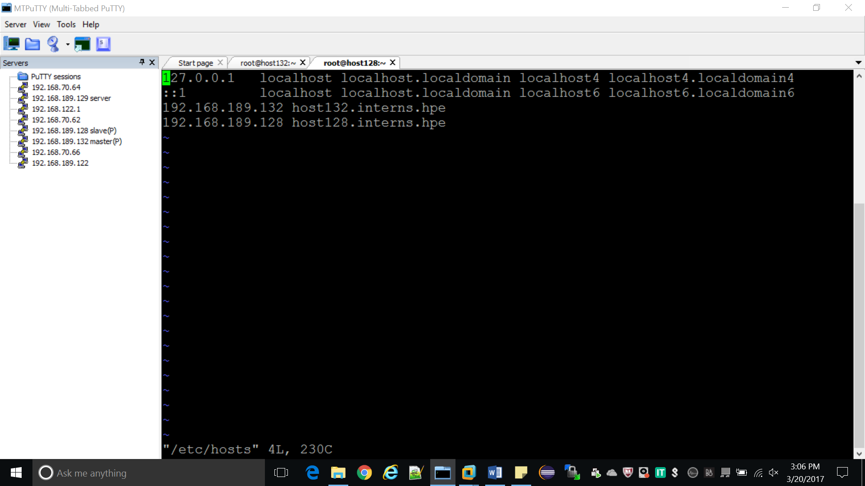

Slide 26
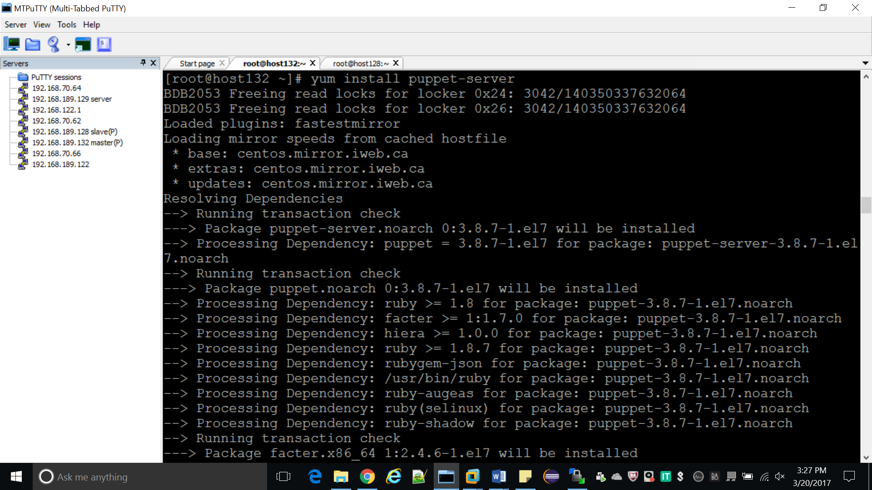

Slide 27
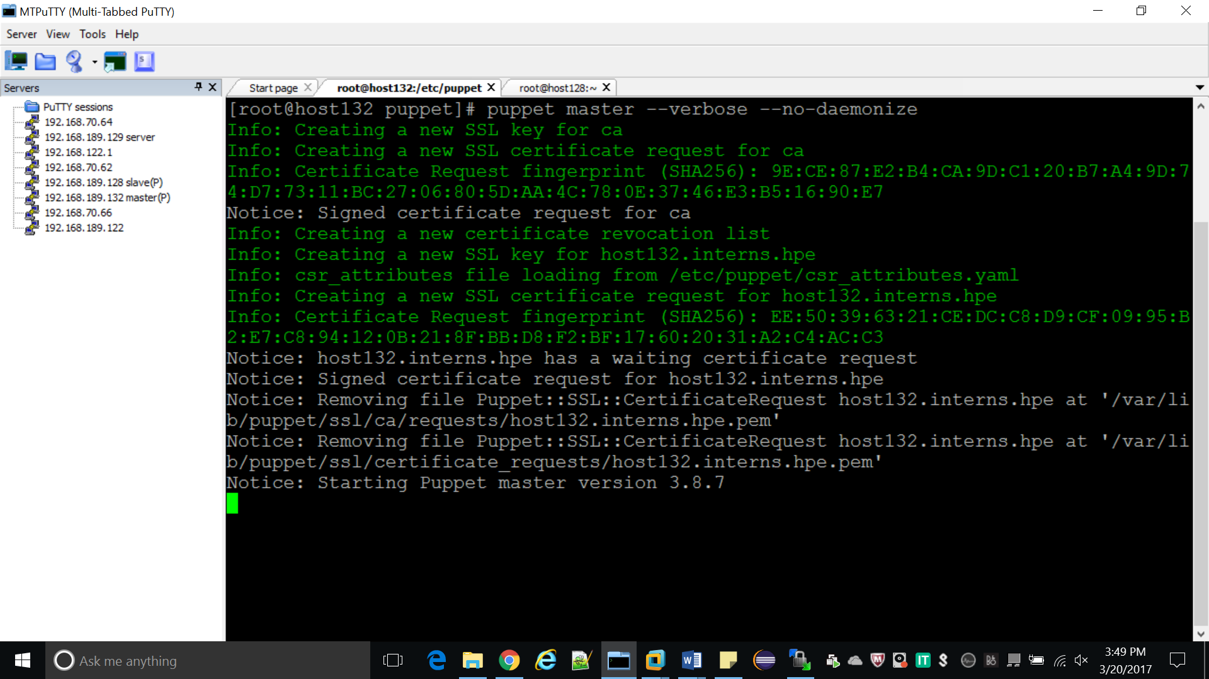

Slide 28
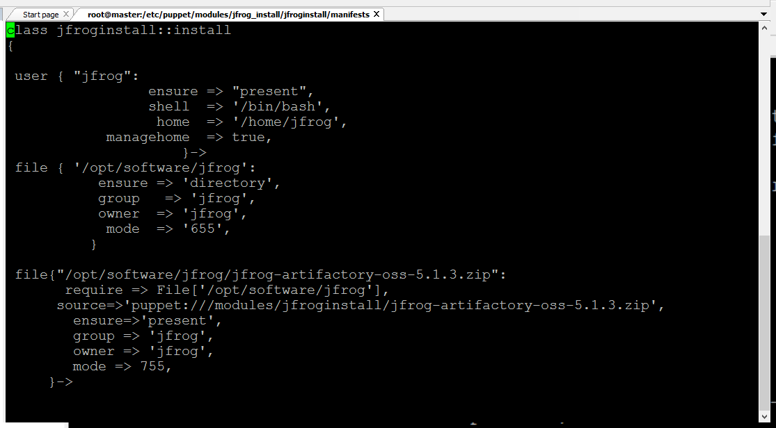

Slide 29
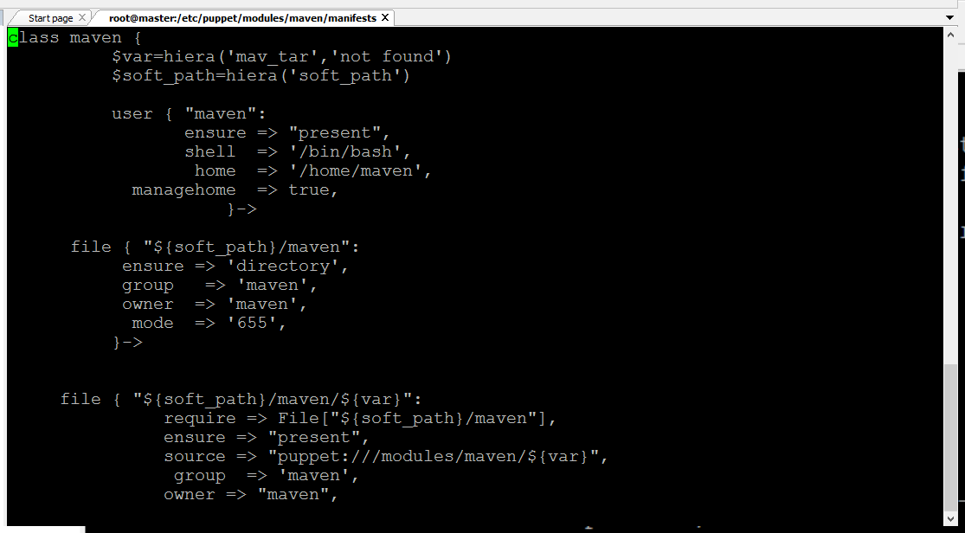

Slide 30
CONCLUSION
All the services have been automated using the tool puppet.
This helps in speeding up the software development process
All the services and hosts are monitored successfully using the tool Nagios
This makes sure that no service or host is left unnoticed in case of a crash

Slide 31
FUTURE WORK
The automated provisioning of the virtual machines by hypervisor can be done using the tool razor.
All services can be added to containers(Dockers).As containers ensures portability and extensibility . Concepts of containerization can also be implemented.
Kubernetes can be used for automation of containers.

Slide 32
References
HPE company Documentations
https://learn.perl.org/tutorials
https://en.wikipedia.org/wiki/Nagios
www.puppetresources.com
https://newrelic.com/devops/benefits-of-devops
http://www.devopsdigest.com/devops-advantages-1
https://docs.puppet.com/puppet/
https://assets.nagios.com/downloads/nagioscore/docs/nagioscore/4/en/configmain.html
https://docs.puppet.com/puppet/4.9/architecture.html

Slide 33
THANK YOU

