Slide 1
DevOps Office model
Nithin N M

Slide 2
INTRODUCTION
The project aims at automation of the processes involving software testing,building,deploymentandmonitoring.
The concept of automation came up and the companies have tried implementing the concept of automation in every possible way to fasten their software production process and to speed up the process of delivery to the customer.
So the every process in software system in automated such a single touch install every package and configures the systems

Slide 3
In order to achieve the enormous task of implementing the automation process of software delivery we need DevOps model
DevOps is a combination of "software DEVelopment" and "information technology OPerationS")
In Dev-Ops developers and the Operations team work together. with the help of the developers.

Slide 4
The following are the types of DevOps tools that can be integrated in the devops chain.
Code -> Code development and review, version control tools, code merging
Build -> Continuous integration tools, build status
Test -> Test and results determine performance
Package -> Artifact repository, application pre-deployment staging
Release -> Change management, release approvals, release automation
Configure -> Infrastructure configuration and management, Infrastructure as Code tools
Monitor -> Applications performance monitoring, end user experience

Slide 5
Tools used
Nagios : It is open source monitoring tool which monitors sites.
Git : It is open source version control system
Github : Public open source Repository which is used store codes
Maven : It is building tool which build the codes into binary files or packages
DNS : provides visitors access to websites using domain names rather than IP addresses.
Jenkins : Continuous Integration tool which is used to integrate the all other tools.
Jfrog : It's a single gateway through which you access external artifacts, and store your own build artifacts.
Corbertura : is a free Java tool that calculates the percentage of code accessed by tests. It can be used to identify which parts of your Java program are lacking test coverage.
Puppet : is an open-source software configuration management tool. It runs on many Unix-like systems as well as on Microsoft Windows, and includes its own declarative language to describe system configuration.

Slide 6
Architecture diagram

Slide 7
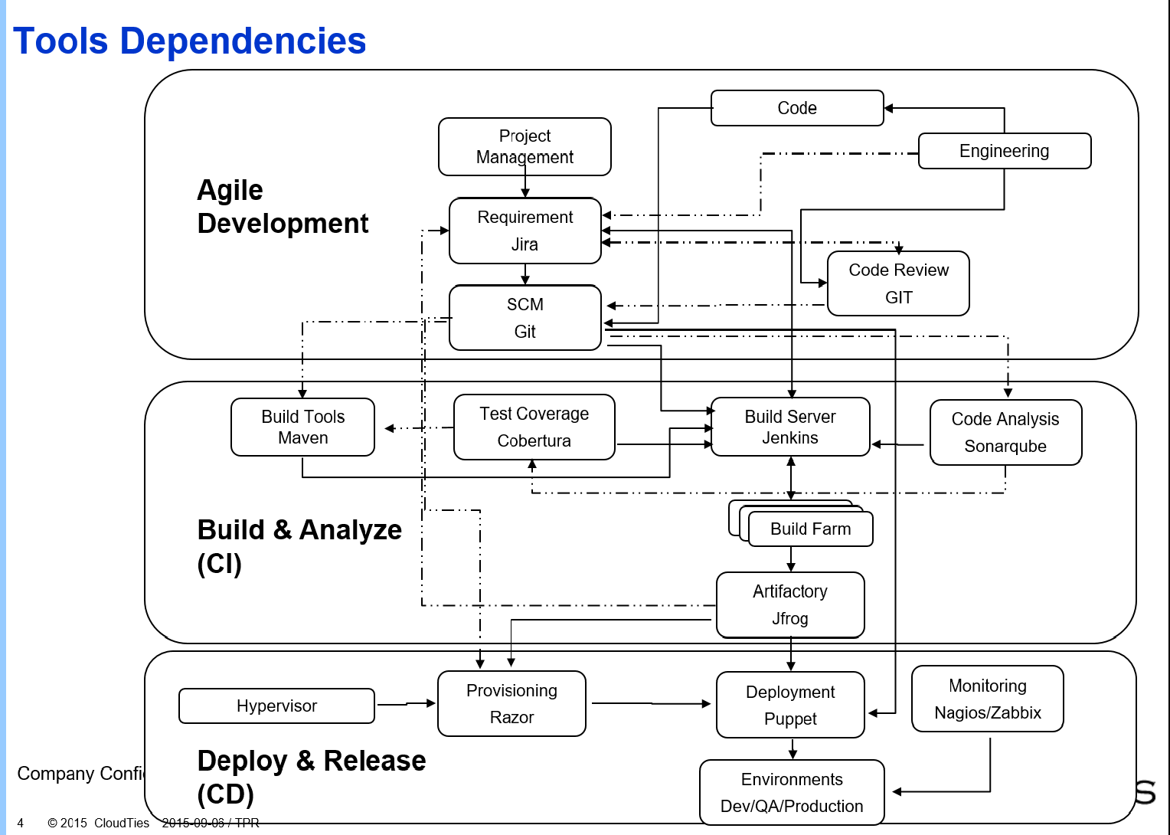
DFD Level 0

Slide 8
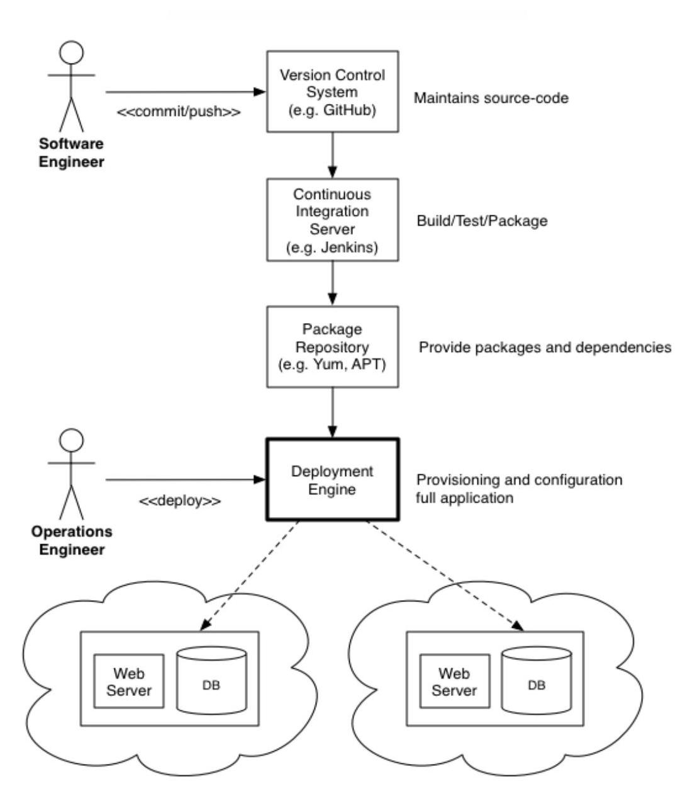
Use case Diagram

Slide 9
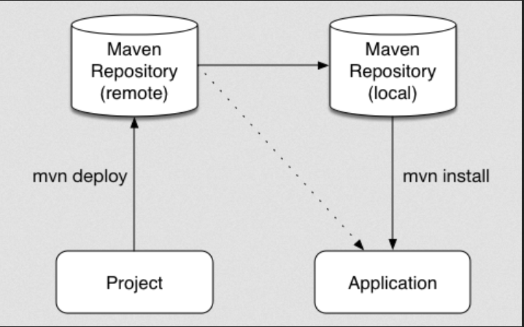
Level 1 DFD Maven

Slide 10
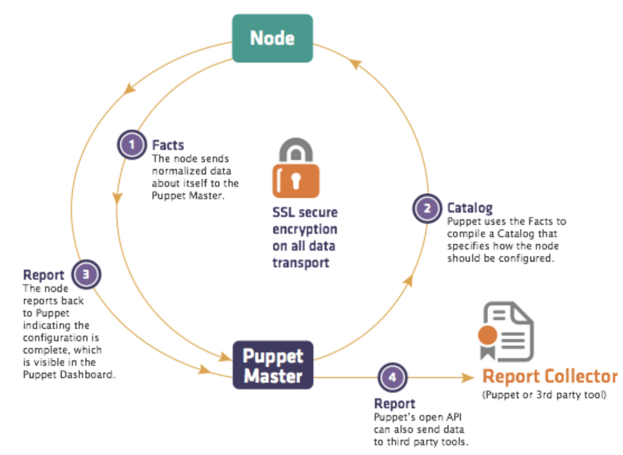
Level 1 DFD Puppet

Slide 11
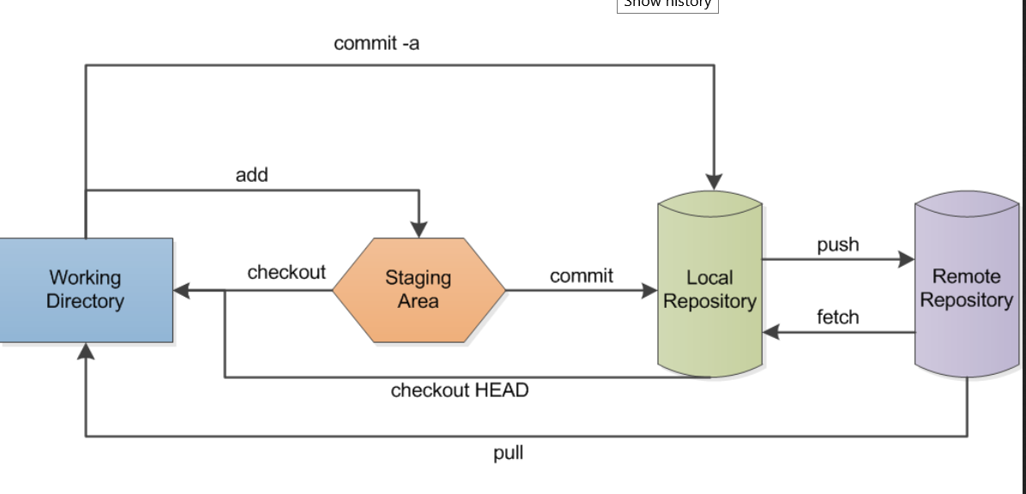
Level 1 DFD Git

Slide 12
Conclusion
The devops office model include rapid realese of working software
Since it every process is automated it save time and resources

