Slide 1




END-TO-END DATA ANALYSIS
OLA Rides
Analytics
July 2024 · Bengaluru
103,024 bookings · 50 areas · 7 vehicle types
Prepared for executive stakeholders
Cleaning · SQL · EDA · Power BI · Streamlit

Slide 2







01 · THE PROBLEM
Nearly 4 in 10 bookings never become a paid ride
The four business use cases
62.1%
1 · Peak demand & driver allocation
booking success rate
When is demand concentrated?
63,967 completed of 103,024 bookings
2 · Customer behaviour & marketing
Who are the high-value riders?
The question is not "how many rides?"
3 · Pricing patterns & surge
It is where is revenue leaking, and what is the cheapest lever to stop it?
Does fare track distance?
4 · Anomaly & fraud detection
Zero-distance fares, extreme rates, duplicates

Slide 3







02 · APPROACH
A six-stage pipeline, from raw file to decision
1
2
3
4
5
6
Clean
SQL
EDA
Power BI
Streamlit
Insights
Profile, parse, standardise, engineer 11 features
10 business questions, validated against the CSV
Distributions, trends, correlations, anomalies
5-page dashboard, 40 DAX measures
Natural-language Q&A over SQL
Prioritised, revenue-linked recommendations
Deliverables produced
✅ Cleaned CSV (103,024 × 37)
✅ SQLite database + 3 indexes
✅ queries.sql + SQL_RESULTS.md
✅ eda.py + 10 saved charts
✅ Power BI guide + theme + DAX
✅ 5-page dashboard mockup
✅ Streamlit app (5 tabs)
✅ Report + business insights

Slide 4




03 · DATASET OVERVIEW
103,024 bookings across 50 Bengaluru areas
RAW FILE
7
50
4
4
OLA_DataSet.xlsx
vehicle types
pickup areas
booking statuses
payment methods
Sheet: July
103,024 rows × 20 columns
Period: 1–31 July 2024
Column groups
Identity
Booking_ID · Customer_ID
Time
Date · Time
Trip
Vehicle_Type · Pickup · Drop
Ride_Distance · Booking_Value
Outcome
Booking_Status · Payment_Method
Incomplete_Rides + reason
Quality
V_TAT · C_TAT
Driver_Ratings · Customer_Rating
Grain
One row per booking attempt — completed, cancelled or unassigned.

Slide 5




04 · DATA CLEANING & QUALITY
Completeness 75.2% → 94.8%, zero rows lost
Before → After scorecard
11 derived features
Metric
Before
After
Booking_Hour
Booking_DayOfWeek
Is_Weekend
Time_of_Day
Rows
103,024
103,024
Distance_Bucket
Value_Bucket
Fare_per_km
Columns
20
37
Customer_Cancel_Category
Driver_Cancel_Category
Completeness
75.22%
94.77%
Incomplete_Reason_Category
Zero_Distance_Flag
Duplicate rows
0
0
Unparseable dates
0
0
Cleaning steps (logged)
Date+Time → single timestamp · whitespace trimmed · eBike → E-Bike
Structural blanks → "Not Applicable" · IQR outlier flags (8,468 fares)
De-duplicated on Booking_ID · 3 SQLite indexes built
No fabrication
39,057 non-successful bookings keep NULL ratings/TAT — flagged, never imputed.

Slide 6







05 · KEY KPIs
₹35.08M revenue from 63,967 completed rides
103,024
62.1%
₹35.08M
₹548
Total bookings
Success rate
Total revenue
Avg booking value
22.85 km
4.00
8.41%
94,544
Avg ride distance
Avg driver rating
Repeat-customer rate
Distinct customers
Booking status mix — where the 37.9% goes
Success
Driver cancel
Customer cancel
Not found
63,967 · 62.1%
18,434 · 17.9%
10,124 · 9.8%
10,499 · 10.2%

Slide 7

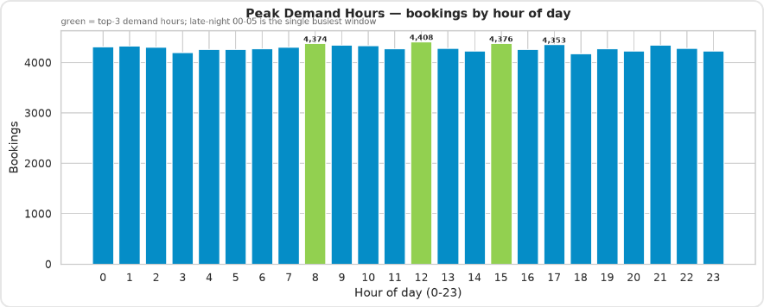


06 · EDA HIGHLIGHTS
Demand is flat; fare is not distance-driven
THE STRUCTURAL FINDING
r = 0.002
Fare ↔ distance correlation. A 5 km and a 45 km ride cost the same on average.
Other EDA findings
• Late night 00–05 is the largest demand block (20.8%)
• Auto averages 10.0 km vs ~25 km for all others
• Fare spread across vehicle types is only 3%
• Driver ↔ customer rating correlation r = −0.003
Hourly volume spans only 4,176–4,408 — a 5.6% spread. No rush hour to exploit.
Anomaly & fraud checks
✅ 0 duplicate Booking_IDs
✅ 0 same-customer-same-time
✅ 0 ratings outside 3.0–5.0
⚠️ 3,591 rides > ₹200/km
⚠️ 889 rides > ₹500/km

Slide 8

07 · THE 10 SQL QUESTIONS
Ten questions, ten validated answers
#
Business question
Answer
Validation
Q1
All successful bookings
63,967 bookings
✅ matches scorecard
Q2
Avg ride distance per vehicle type
Auto 10.0 km · others ~25 km
✅ sums to 63,967
Q3
Customer-cancelled rides
10,499
✅ 10.2% of total
Q4
Top 5 customers by bookings
CID954071 — 5 bookings
✅ max = 5
Q5
Driver cancels — personal & car
6,542 rides
✅ 35.5% of driver cancels
Q6
Min/max driver rating — Prime Sedan
3.0 / 5.0 (avg 3.99)
✅ 9,379 rated rides
Q7
All UPI rides
25,881 rides
✅ 40.5% of success
Q8
Avg customer rating per vehicle
3.99–4.01 (all 7 types)
✅ 63,967 rated
Q9
Total value of successful rides
₹35,080,467
✅ exact match
Q10
All incomplete rides + reason
3,926 rides
✅ reasons sum to 3,926
Full SQL, result tables and independent cross-checks: sql/queries.sql · sql/SQL_RESULTS.md

Slide 9






08 · INSIGHTS BY SEGMENT
Vehicle, payment and cancellation patterns
Avg distance by vehicle
Payment mix (success)
Driver cancel reasons
E-Bike
25.2 km
Cash
35,022 · 54.7%
Personal & Car
6,542
Prime Plus
25.0 km
UPI
25,881 · 40.5%
Customer related
5,413
Prime Sedan
25.0 km
Credit Card
2,435 · 3.8%
Customer sick
3,654
Mini
25.0 km
Debit Card
629 · 1.0%
Capacity violation
2,825
Bike
24.9 km
Cash + UPI = 95.2% · cards only 4.8%
18,434 driver cancels = biggest leak
Prime SUV
24.9 km
Auto
10.0 km
Customer cancel reasons — driver behaviour dominates
Driver not moving
Driver asked to cancel
Change of plans
AC not working
Wrong address
3,175
2,670
2,081
1,568
1,005

Slide 10
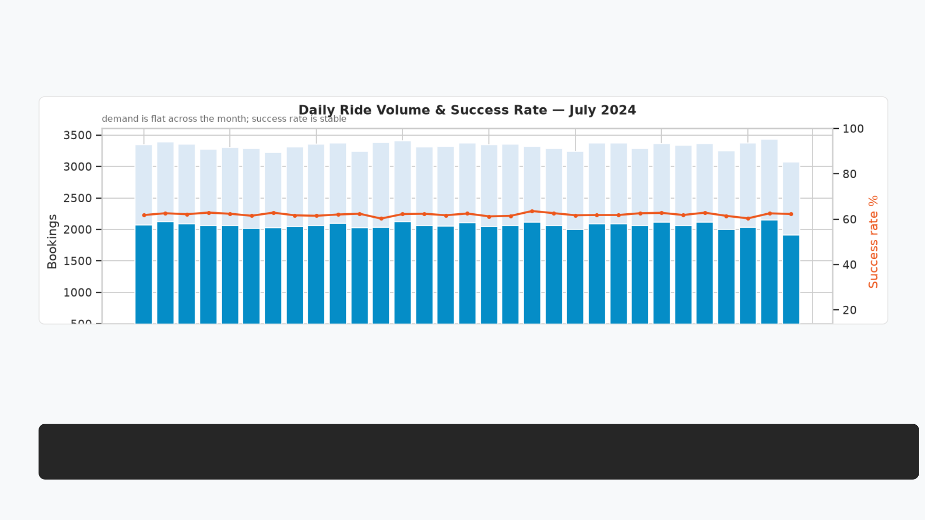

09 · TRENDS
Stable volume, stable quality — no drift
3,323
3,072–3,432
62.09%
±0.71
avg daily bookings
daily range (31 days)
avg success rate
success-rate std dev
Read: a 0.71-point standard deviation on a 62% success rate means the operation is in statistical control. The problem is structural, not a bad week — so the fix must be structural too.

Slide 11


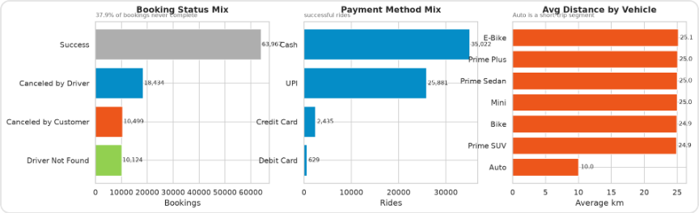


10 · POWER BI DASHBOARD
Five pages, one story per page
1 · Overall
2 · Vehicle Type
3 · Revenue
4 · Cancellation
5 · Ratings
Ride Volume Over Time
Booking Status Breakdown
4 KPI cards
Top 5 by Ride Distance
Avg Distance by Vehicle
Performance matrix
Revenue by Payment Method
Top 5 Customers by Value
Distance per Day
Reasons (Customer)
Reasons (Driver)
Revenue lost
Driver Distribution
Customer Distribution
Customer vs Driver
BUILD KIT INCLUDED
✅ Step-by-step build guide
✅ theme.json (Ola palette + Poppins)
✅ ~40 copy-paste DAX measures
✅ Static 5-page HTML mockup
✅ .pbit template spec + acceptance test
Slicers synced across all 5 pages: Date · Vehicle Type · Payment Method · Booking Status

Slide 12





11 · STREAMLIT APP
Ask a question in English, get SQL and a chart
USER TYPES
Five tabs
Which vehicle type earns the most revenue?
💬 Ask the Data — NL → SQL → table → chart
🧮 10 SQL Questions — one-click run
🔎 Data Explorer — filters + search
📊 Power BI — iframe embed + fallback
✅ Data Quality — scorecard + outliers
↓ GENERATED SQL
SELECT Vehicle_Type,
SUM(Booking_Value) AS revenue
FROM bookings
WHERE Booking_Status='Success'
GROUP BY Vehicle_Type
ORDER BY revenue DESC;
Two engines: LLM (if an API key is set) with a robust rule-based fallback covering totals, averages, counts, group-bys, top-N and trends. Read-only SELECT only.
Verified
✅ App boots, HTTP 200
✅ All 5 tabs render
✅ 10/10 queries execute
✅ 9 example questions
✅ CSV download on every result

Slide 13



12 · RECOMMENDATIONS
Fix supply reliability first — it is worth ₹5M/month
PRIORITY 1
PRIORITY 2
PRIORITY 3
PRIORITY 4
Cut driver cancellations
Resolve the pricing question
Grow repeat riders
Shift payments to digital
6,542 "personal & car" cancels. Vehicle-health checks + a reliability score.
8.41% repeat rate. Target 12% with a ride-3 incentive on the existing cohort.
Cards only 4.8%. Cashless incentives cut settlement cost and enable instant refunds.
Fare ↔ distance r = 0.002. Confirm whether fare is genuine before any surge work.
+₹5.0M/mo
+3,400 riders
95.2% → 98%
Data governance
Also recommended
• Late-night incentive — 00–05 is the largest demand block (20.8%)
• Fare-per-km audit queue — 889 rides above ₹500/km
• Stop flagging zero-distance — 37.9% false positives
The one-line summary: the operation is stable and the customers are satisfied — the money is being lost to driver-side cancellations, and that is a fixable, measurable, high-return problem.

Slide 14




THANK YOU
Questions &
next steps
Full deliverables: cleaned data · SQL · EDA · Power BI kit · Streamlit app · report
103,024 bookings
₹35.08M revenue
62.1% success

