Slide 1
SLR Parser
Nithin Aditya (RA2011026010118)
Krishna Karthik (RA2011026010089)

Slide 2
SLR parser
What is a SLR parser?
An SLR (Simple LR) parser is a bottom-up parsing technique used in compiler construction to analyze and process programming languages based on a given grammar. It uses a deterministic finite automaton (DFA) called an LR(0) automaton, which represents the grammar rules and states of the parser.
Features
Simple Grammar Representation: SLR parsers work with a simplified form of the grammar,
Lookahead Symbol: The SLR parser uses a single lookahead symbol to decide the appropriate action at each
LR(0) Automaton: The SLR parser constructs an LR(0) automaton, which is a finite state machine that represents all possible states of the parser.

Slide 3
The Workflow
Enter Productions
First Calculations
Follow Calculations
Construction of SLR Table

Slide 4
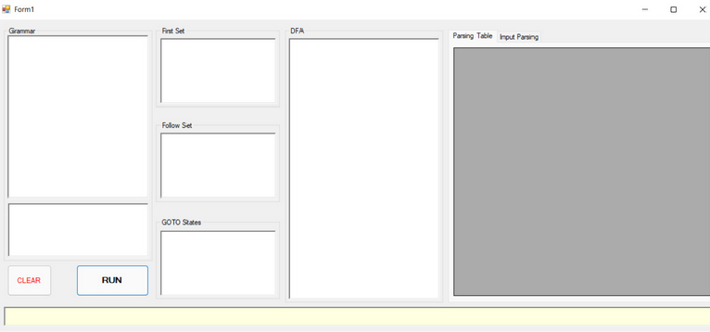
Enter Productions
Enter the productions in the editor box
Enter only atomic characters.
The prototype built cannot handle duplicate productions.

Slide 5
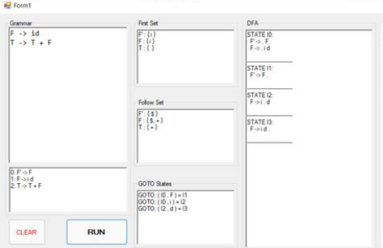
First and Follow Calculations
The Application calculates the first and follow sets
First and Follow sets are displayed accordingly.
The prototype built cannot handle duplicate productions.

Slide 6
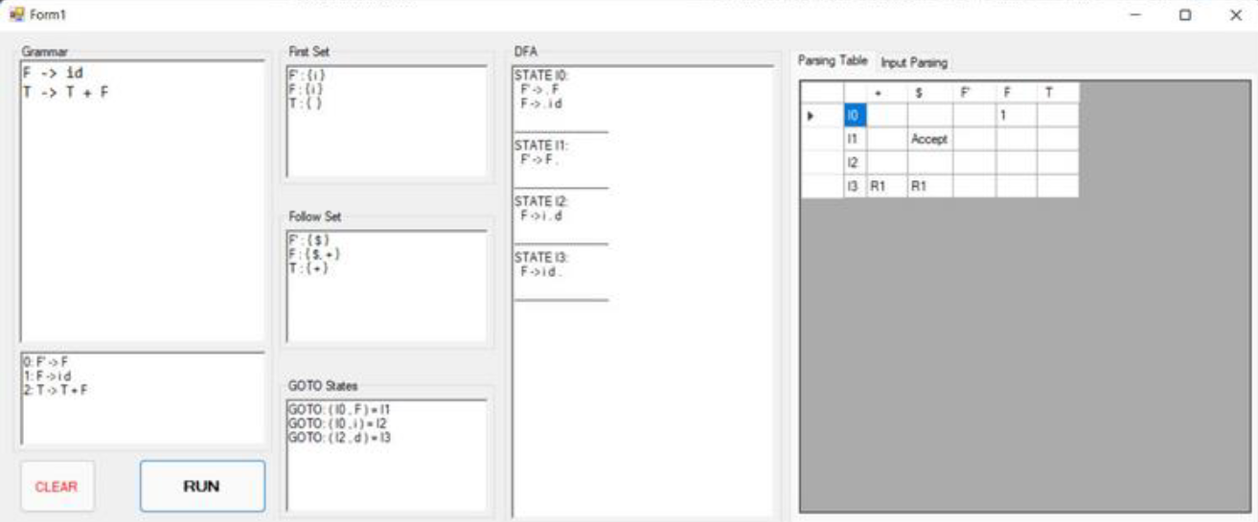
Construction of SLR table
Grammar Augmentation: The given grammar is first augmented by adding a new start symbol and a new production rule.
Compute Closure: The closure operation is performed to compute the closure of a set of LR(0) items.
Compute Goto: The goto operation is used to compute the transition from one state to another for a given symbol.

Slide 7
Tech Stack

Slide 8
Tech Stack
FrontEnd -
Ejs, CSharp
BackEnd -
.NET Framework
The entire processing is done in CSharp itself. .NET is used to run the developed CSharp scripts whenever necessary and communicate with the frontend.

Slide 9
Thank You!

