Slide 1
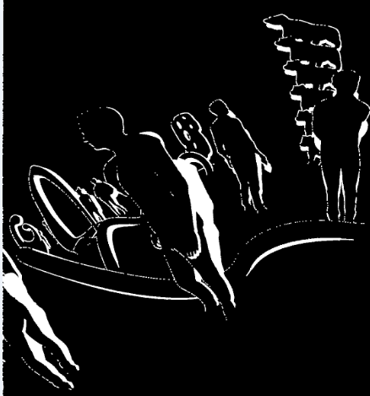

AggregatedMask @ frame i
AggregatedMask @ frame i + k
Notes:
Aggregated mask evolution within an intra period

