Slide 1
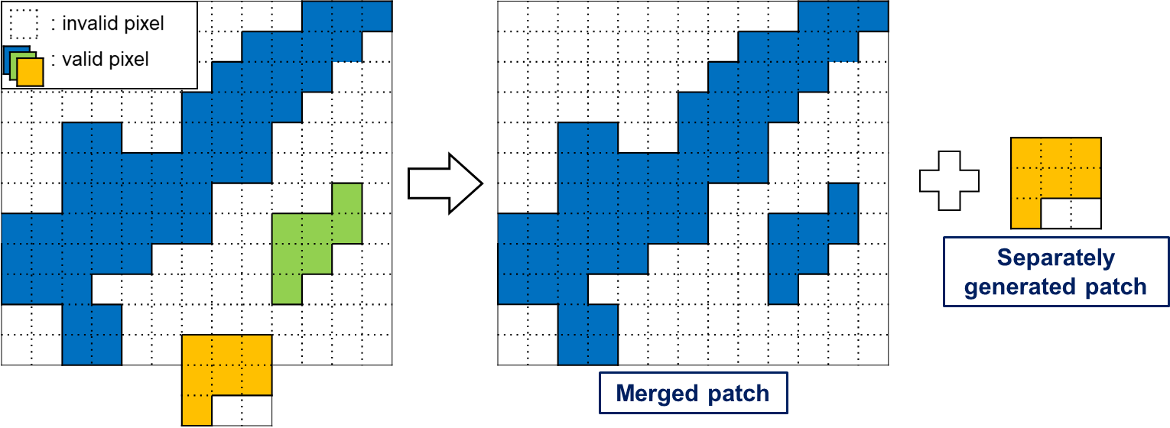
Fragment of (pruned) input view
Patch containing merged clusters a and b
Patch containing cluster c
a
b
c
Notes:
An example of cluster merging

