Slide 1
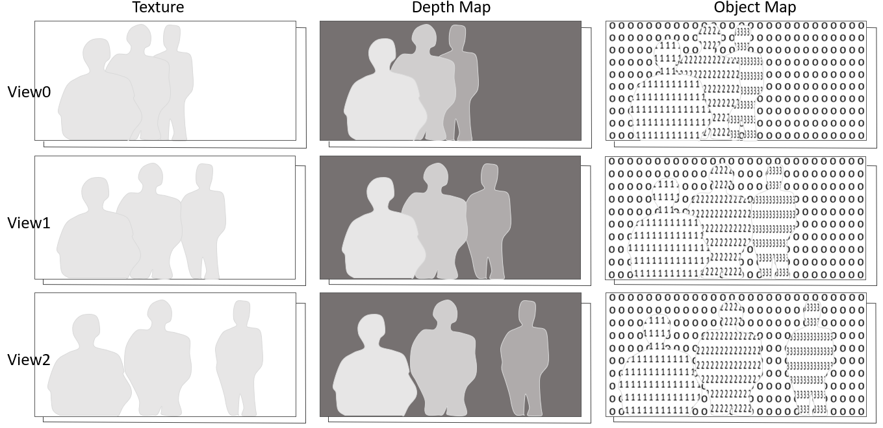
Texture Attribute
Geometry
Entity Maps
Notes:
Input source views composed of texture attribute and geometry components, and entity maps

