Slide 1
AWS
Amazon Web Services

Slide 2
AWS
Comprehensive Cloud Platform: AWS offers a wide range of services, including computing power, storage, databases, and machine learning.
Flexibility: AWS provides customizable solutions to meet diverse business needs.
Scalability: AWS services can scale up or down based on demand, making it suitable for businesses of all sizes.
Reliability: AWS is known for its high availability and reliable infrastructure.
Popular Choice: Many businesses choose AWS for its extensive features and proven performance.

Slide 3
Key Concepts of AWS
IaaS (Infrastructure as a Service): Providing the fundamental building blocks of IT infrastructure, like compute power (EC2), storage (S3), and networking.
PaaS (Platform as a Service): Offering a ready-to-go platform for developing, testing, and running applications, such as databases (RDS), application servers (Elastic Beanstalk), and managed Kubernetes (EKS).
SaaS (Software as a Service): Providing fully managed applications, like email (WorkMail), CRM (Salesforce on AWS), and human resources management (Workday).

Slide 4
AWS Alternatives
Microsoft Azure: Known for its integration with Microsoft products and services.
Google Cloud Platform (GCP): Strong in data analytics and machine learning.
IBM Cloud: Offers a wide range of services and a focus on hybrid cloud solutions.
Oracle Cloud Infrastructure (OCI): Emphasizes performance and security.

Slide 5
AWS vs Azure
 | AWS | Azure
Provider | Amazon | Microsoft
Ecosystem | Strong focus on open-source technologies | Deep integration with Microsoft products and services
Pricing | Generally considered more cost-effective | Can be more expensive for certain services
Ease of Use | Can be more complex for beginners | Often considered more user-friendly for those familiar with Microsoft products
Hybrid Cloud Integration | Strong capabilities | Seamless integration with on-premises Microsoft environments

Slide 6

Why AWS
Extensive Range of Services
AWS offers a broad array of services covering computing, storage, databases, machine learning, analytics, and more.
2. Global Reach
AWS has a global network of data centers, ensuring low latency and high availability
3. Cost Management
Pay-As-You-Go Pricing: AWS offers a flexible pricing model where businesses only pay for the resources they use, with options for reserved instances and savings plans to reduce costs further.
Cost Management Tools: AWS provides tools and reports to help monitor and manage cloud expenditures effectively.
4. Better Security
AWS, as a cloud service, offers enhanced security to protect your virtual organization. The data centres and servers have multiple layers of operational security.

Slide 7
Why AWS
5. Ease of Use and Management
User-Friendly Interfaces: AWS offers intuitive management consoles, command-line tools, and APIs for ease of use and automation.
Comprehensive Documentation and Support: AWS provides extensive documentation, tutorials, and support resources to assist with learning and troubleshooting.
6. Flexibility
AWS lets businesses easily adjust their resources and services as needed, so they can quickly handle changes and new demands.

Slide 8
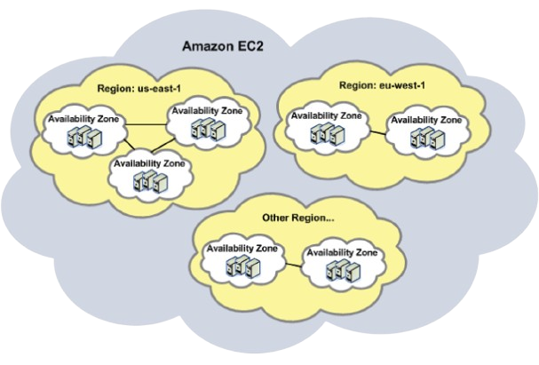
What are AWS Regions?
AWS Regions are geographically distinct locations around the world where AWS data centers are located. Each region is a separate and isolated environment with independent infrastructure, including compute, storage, and networking resources. This helps to ensure redundancy and minimize the risk of outages.
Choosing a region closer to your users can improve application performance and reduce latency.

Slide 9
What are AWS Availability Zones?
Within each AWS Region, there are multiple Availability Zones. These are distinct locations within a region that are physically separate and have independent power, cooling, and networking. This helps to protect your applications from failures that might affect a single data center.

Slide 10
Choosing the Right Region and Availability Zone
Latency
Choose a region closer to your users to minimize latency.
Compliance
Ensure that the region meets any relevant data residency or compliance requirements.
Cost
Evaluate the pricing for different regions and AZs to optimize your costs.
Scalability
Consider the availability of resources in the region to ensure that your applications can scale as needed.

Slide 11
AWS Services
Amazon Web Services is a cloud computing platform that provides a wide range of services, from computing power and storage to databases and machine learning. Here are some of the most essential services
1. EC2 (Elastic Compute Cloud)
Virtual computers for running applications.
2. S3 (Simple Storage Service)
Object storage for data of any size.
3. RDS (Relational Database Service)
Managed relational databases like MySQL and PostgreSQL.
4. VPC (Virtual Private Cloud)
Creates a private network within AWS.
5. IAM (Identity and Access Management)
a service that manages user identities and permissions in AWS.

Slide 12
amazon elastic compute cloud(EC2)
EC2 (Elastic Compute Cloud) is a cloud computing service that provides virtual servers, also known as instances. Think of these instances as virtual computers that you can rent from AWS. You can customize them with different amounts of CPU, memory, and storage to suit your specific needs.
Virtual servers: EC2 provides virtual computers that you can use to run applications.
Customization: You can choose the type of instance that best suits your workload.
Scalability: You can easily increase or decrease the number of instances as needed.
Flexibility: EC2 supports multiple operating systems and can be used for a variety of applications.

Slide 13
Simple Storage Service (S3)
S3 is a cloud-based object storage service that allows you to store and retrieve any amount of data, from a single file to petabytes of data. Think of it as a digital warehouse where you can store your files and access them from anywhere in the world.
Scalable: S3 can store virtually unlimited amounts of data.
Durable: S3 is designed to be highly durable and reliable, with multiple copies of your data stored across different data centers.
Versatile: S3 can store a wide variety of data types, including files, images, videos, and more.
Cost-effective: S3 offers various storage classes to meet different budget requirements.

Slide 14
RDS (Relational Database Service)
RDS is a managed cloud database service that simplifies the setup, operation, and scaling of relational databases.
Managed: AWS handles the underlying infrastructure and maintenance for your database, so you don't have to worry about managing servers or software.
Scalable: You can easily scale your database up or down to meet changing needs, without having to worry about manual configuration or provisioning.
Reliable: RDS provides automatic backups and patching to ensure data integrity and reliability.
Versatile: Supports a variety of popular databases, including MySQL, PostgreSQL, Oracle, and SQL Server.
Integrated: Works seamlessly with other AWS services, such as EC2 and Lambda, making it easy to build and deploy applications that rely on databases.

Slide 15
VPC (Virtual Private Cloud)
A private network within AWS that allows you to isolate your resources from other AWS customers.
Provides full control over your network infrastructure, including subnets, routing tables, and security groups.
Isolation: VPCs create a private network for your resources.
Control: You have full control over your network infrastructure.
Security: VPCs can be used to implement security measures like subnets and security groups.

Slide 16
IAM (Identity and Access Management)
A service that allows you to manage user identities and permissions within your AWS account.
Provides a central way to control who has access to your AWS resources and what they can do with them.
Includes users, groups, roles, and policies.
Security: IAM helps you control who can access your AWS resources.
Management: IAM simplifies the management of user identities and permissions.
Granular control: IAM allows you to define specific permissions for users and roles.

Slide 17
Thank You

