Slide 1


SayHear
Bhavya Karki, Fan Hu
Advisors: Anthony Tomasic, Matthias Grabmair
In collaboration with
Lucile Callebert, Nithin Haridas, Suhail Barot, Zihua Liu
11-632 (Fall 2018)
MCDS Capstone Course

Slide 2
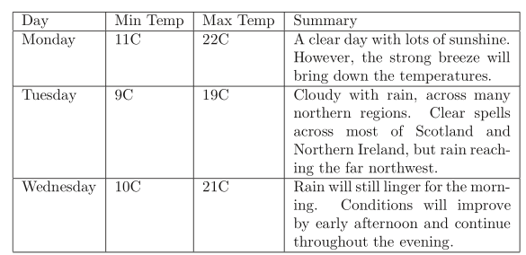
Introduction
Question: Alexa, what will be the maximum temperature on Tuesday?
SQL: SELECT “Max Temp” FROM Weather_Info WHERE Day=”Tuesday”
Weather_Info

Slide 3
Introduction
A part of a bigger project.
User asks a question; the answer is in a table on a webpage.
Main Objective: Extract the correct answer from the table
Question answering from structured data
Natural language is converted to a SQL query.

Slide 4
Literature Study
Language to Logical Form with Neural Attention [L. Dong et al] - Encode input utterances into vector representations, generate their logical forms by conditioning the output sequences on encoding vectors. Learn soft alignments between natural language and logical forms.
SQLNet: Generating Structured Queries from Natural Language Without Reinforcement Learning [Xu, Xiaojun et al] - Most Seq2Seq models will necessarily require the SQL queries to be serialized. Sketch-based approach is where the template contains a dependency graph so that one prediction can be done by taking into consideration only the previous predictions that it depends on. The sketch aligns naturally to the syntactical structure of a SQL query.
Tables as Semi-Structured knowledge for QA [Sujay Kumar Jauhar et al] - for multiple-choice question (MCQ) answering. Focus on tables that represent general knowledge facts, with cells that contain free-form text
SEQ2SQL: Generating Structured Queries from Natural Language Using Reinforcement Learning [Victor Zhong et al]- WikiSQL dataset, uses rewards from in the-loop query execution over the database to learn a policy to generate the query.
Notes:
focus on tables that represent general knowledge facts, with cells that contain free-form text. crowd-source a collection of over 9000 MCQs with alignment annotations to table elements
model uses rewards from inthe-loop query execution over the database to learn a policy to generate the query. Seq2SQL leverages the structure of SQL to prune the space of generated queries and significantly simplify the generation problem. WikiSQL, a dataset of 80654 hand-annotated examples of questions and SQL queries distributed across 24241 tables from Wikipedia that is an order of magnitude larger than comparable datasets

Slide 5
Dataset Curation
Collection:
Collect questions and answers from AMT
Collecting tables - for each question, to find the answer to the question in a table on the web
When extracting a table, the labeler writes the SQL query that corresponds to the NL question.
Dataset description:
Train: 238 tables and questions
Test: 63 tables and questions
-- Collection is also being done in parallel
Notes:
Workers were asked to look at their browser history and tell us about 5 times they were looking up information on the Internet
Second step of data collection is, for each question, to find the answer to the question in a table on the web, and collect that table. We alternatively use the words “labeling/extracting/wrapping” (a table) or collecting “wrappers”; these terms equally refer to collecting a table.
When extracting a table, the labeler is also asked to write the SQL query that corresponds to the NL question.

Slide 6
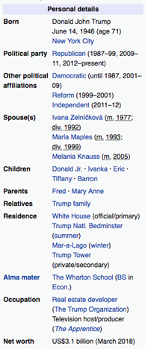
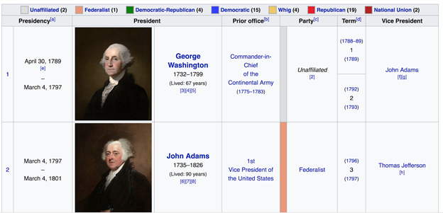
Data
A total of 302 question-table pairs.
238 (78.8%) training data, 64 (21.2%) testing data.
174 (57.6%) Entity type table, 128 (42.4%) Key-Value type table.
Entity type
Key-Value type

Slide 7
System Pipeline
Source Selection: Learn to identify the correct table for the given question
Table Classification: Learn Entity type or Key-Value type
SQL query formulation:
SELECT clause: learn to identify the correct column
ORDER BY clause: learn if sorting is needed
LIMIT clause: learn if top N display is needed
WHERE clause: learn to identify the correct row
4. SQL query execution: Evaluate and measure the performance

Slide 8
Result - Source Selection
Method:
1. Pre-process table into a bag-of-words, including stop-word removal, stemming etc.
2. TF-IDF to compare question with each table (BoW)
Result:
Accuracy = 76.5% for training dataset, 73.4% for testing dataset
Other exploration:
Doc2Vec Approach, but the accuracy is only ~56% (Also, does not converge)

Slide 9
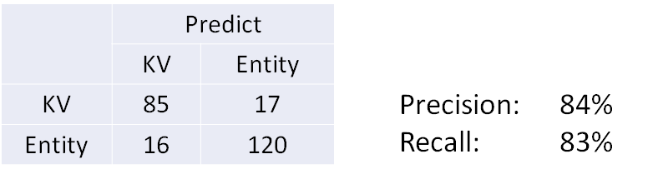
Result - Table Classification
Hypothesis:
Key-Value tables only have 2 columns after removing URL columns.
The 2 columns are all text-type (mixed data type) columns.
Result:

Slide 10
Column Projection
Method:
1. Learn and extract important features for each question and column
2. Build a neural network or random forest model to predict the relevance score
Relevance score [0, 1]
MLP or Random Forest
Features for Question
Features for Column

Slide 11
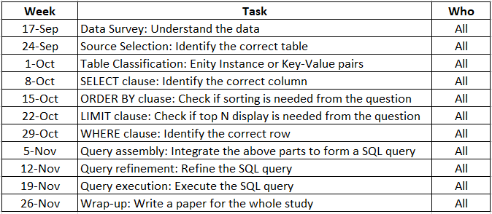
Milestone Plan

Slide 12
Conclusion
Completed source selection and table classification.
Working on column projection
Next Steps
Continue to complete other clauses in SQL (WHERE, ORDER BY, LIMIT etc.)
Assemble and refine the SQL query
Execute and evaluate the SQL query

Slide 13
References
[1] Jauhar, Sujay Kumar, Peter Turney, and Eduard Hovy. "Tables as semi-structured knowledge for question answering." Proceedings of the 54th Annual Meeting of the Association for Computational Linguistics (Volume 1: Long Papers). Vol. 1. 2016.
[2] Zhong, Victor, Caiming Xiong, and Richard Socher. "Seq2SQL: Generating structured queries from natural language using reinforcement learning." arXiv preprint arXiv:1709.00103 (2017).
[3] Dong, Li, and Mirella Lapata. "Language to logical form with neural attention." arXiv preprint arXiv:1601.01280 (2016).
[4] Sun, Huan, et al. "Table cell search for question answering." Proceedings of the 25th International Conference on World Wide Web. International World Wide Web Conferences Steering Committee, 2016.
[5] Xu, Xiaojun, Chang Liu, and Dawn Song. "Sqlnet: Generating structured queries from natural language without reinforcement learning." arXiv preprint arXiv:1711.04436(2017).

Slide 14
Questions?

