Slide 1


SayHear
Bhavya Karki, Fan Hu
Advisors: Anthony Tomasic, Matthias Grabmair
In collaboration with
Lucile Callebert, Nithin Haridas, Suhail Barot, Zihua Liu
11-632 (Fall 2018)
MCDS Capstone Course

Slide 2
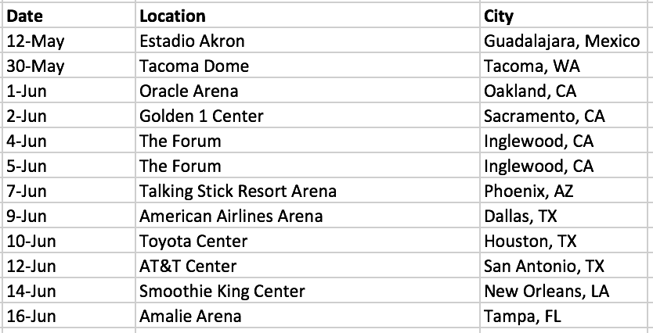
Introduction
Main Objective : Answer questions from tables collected on the web.
Question: Alexa, when is Maroon 5 coming to San Antonio for a concert?
SQL: SELECT “Date” FROM Maroon_5 WHERE “City” ~ “San Antonio”
Question answering from structured data
Convert natural language to SQL query
Table: Maroon_5

Slide 3
System Pipeline
Table Classification: Learn Entity type or Key-Value type
Transform/Process all tables to entity type.
Source Selection: Learn to identify the correct table for the given question
SQL query formulation:
SELECT clause: learn to identify the correct column
WHERE clause: learn to identify the correct row
ORDER BY clause: learn if sorting is needed
LIMIT clause: learn if top N display is needed
5. SQL query execution: Evaluate and measure the performance

Slide 4
Table Classification
ML classification problem:
Given a table, predict if the table is Entity type or Key-Value type.
Features used:
Number of columns when ignoring link columns
"key" or "property" in column header
Variation of cell length (normalized)
Variation of presence of digits (normalized)
Notes:
Is the length of the content of each cell in one column similar? averaged over the number of columns.
Do the cells in a column all contain digits or not?

Slide 5
Result of Table Classification
 | With Column Header |  | Without Column Header
 | Train | Test | Train | Test
Logistic Regression | 0.9789 | 1.0000 | 0.8819 | 0.7619
Decision Tree | 0.9831 | 1.0000 | 0.9283 | 0.8095
KNN | 0.9831 | 1.0000 | 0.9241 | 0.8095

Slide 6
SQL Query formulation: SELECT and WHERE clauses
Divided into two problems - (i) Identifying the column (value) to be projected and the (ii) row (key) which gives the condition.
Identifying important question words.
Sequence to sequence models cannot be used here - Few training examples.

Slide 7
Column Selection (SELECT clause)
ML classification problem:
Given a question, for each column in the table, predict if the column should be included in the SELECT clause.
Relevance score [0, 1]
Classification Model
Method:
Learn and extract important features for the question and each column.
Build a ML classification model (neural network, random forest etc.) to predict the relevance score.
Features for Question
Features for Column

Slide 8
Features used for column selection
Question type
(NUM, HUM, ENTY, LOC, ABBR, SQ, DESC etc.)
Column type
(DateTime, Text, Currency, Boolean, Number, Percentage, URL etc)
Edit distance between question and column header
Average Cell Length
Word2Vec

Slide 9
Results of column selection (SELECT clause)
Train
Test
pred_1
pred_0
pred_1
pred_0
actual_1
238 | 35
305 | 1468
actual_1
56 | 10
94 | 399
actual_0
actual_0
Accuracy: 0.8338
Recall: 0.8718
Precision: 0.4383
Accuracy: 0.8140
Recall: 0.8485
Precision: 0.3733

Slide 10
Row filtering (WHERE clause)
ML classification problem:
Format: WHERE column ==/LIKE keyword
Given a question, for each column in the table and each word in the question, predict if (column, q_word) pair should be included in the WHERE clause.
Relevance score [0, 1]
Classification Model
Method:
Learn and extract important features for each q_word and each column.
Build a ML classification model to predict the relevance score.
Features for Q_Word
Features for Column

Slide 11
Features used for row filtering
Minimum edit distance between q_word and column content
(Check if column X contain q_word)
Column type
(DateTime, Text, Currency, Boolean, Number, Percentage, URL etc)
Average Cell Length
Number of Rows
(Single-row tables do not need row filtering)
Columns selected in SELECT clause
POS/NER/Dependency parsing for q_word

Slide 12
Results of row filtering (WHERE clause)
Train
Test
pred_1
pred_0
pred_1
pred_0
actual_1
117 | 3
26 | 5199
actual_1
18 | 12
36 | 1731
actual_0
actual_0
Accuracy: 0.9946
Recall: 0.9750
Precision: 0.8182
Accuracy: 0.9733
Recall: 0.6000
Precision: 0.3333

Slide 13
Conclusion
Tasks Completed
Table type classification and processing
Source selection - Choose the table that contains the answer
Projection - Get the attributes for SELECT and WHERE clauses
Next Steps
Error analysis
Study the features for ORDER BY/LIMIT clause
Report/Presentation/Documentation and wrap up for the semester
Notes:
automatically get relation name and data

Slide 14
References
[1] Jauhar, Sujay Kumar, Peter Turney, and Eduard Hovy. "Tables as semi-structured knowledge for question answering." Proceedings of the 54th Annual Meeting of the Association for Computational Linguistics (Volume 1: Long Papers). Vol. 1. 2016.
[2] Zhong, Victor, Caiming Xiong, and Richard Socher. "Seq2SQL: Generating structured queries from natural language using reinforcement learning." arXiv preprint arXiv:1709.00103 (2017).
[3] Dong, Li, and Mirella Lapata. "Language to logical form with neural attention." arXiv preprint arXiv:1601.01280 (2016).
[4] Sun, Huan, et al. "Table cell search for question answering." Proceedings of the 25th International Conference on World Wide Web. International World Wide Web Conferences Steering Committee, 2016.
[5] Xu, Xiaojun, Chang Liu, and Dawn Song. "Sqlnet: Generating structured queries from natural language without reinforcement learning." arXiv preprint arXiv:1711.04436(2017).

Slide 15
Questions?

