Slide 1
Update 11/26 Error Analysis on WHERE clause
Fan

Slide 2
Summary
Prediction
exactly matched
(10)
With WHERE
(33)
Not really wrong
(4)
Prediction not exactly matched
(23)
Hard to get the expected SQL (2)
Wrong
(19)
Include less due to stop-word removal (3)
Test tables
(64)
Include more (4)
Prediction
exactly matched
(24)
Others (10)
Without WHERE
(31)
Not really wrong
due to KV table
(6)
Prediction not exactly matched
(7)
Wrong
(1)

Slide 3
Case 1: KV table
Q 267: Alexa does Swagbucks work
Actual SQL: SELECT \"VERDICT:_LEGIT\" FROM \"Swagbucks\“
Precited SQL: SELECT \"VERDICT:_LEGIT\" FROM \"Swagbucks\“ WHERE Name ~ Swagbucks
Q 248: Alexa what is Google Adsense
Actual SQL: SELECT \"Type\" FROM \"Table_1\"
Precited SQL: SELECT \"Type\" FROM \"Table_1\“ WHERE Website ~ Adsense
Developer(s) | Initial_release | Operating_system | Type | Website
Google | June 18, 2003; 14 years ago (2003-06-18)[1] | Cross-platform | Online advertising | www.google.com/adsense

Slide 4
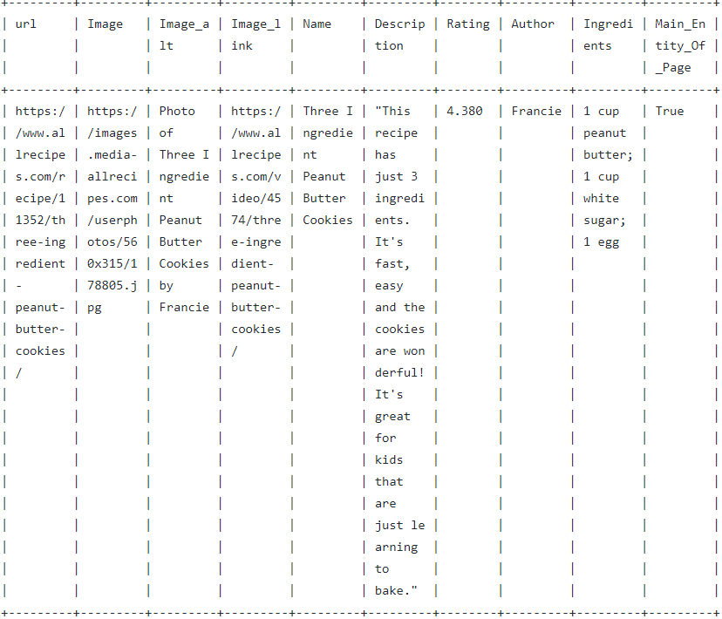
Case 2: KV table
Q 250: how to make 3 ingredient peanut butter cookies
Actual SQL: SELECT \"Ingredients\" FROM \"Table_1\" WHERE \"Name\" LIKE \"%%Three%Ingredient%Peanut%Butter%Cookie%\“
Precited SQL: SELECT \"Ingredients\" FROM \"Table_1\"

Slide 5
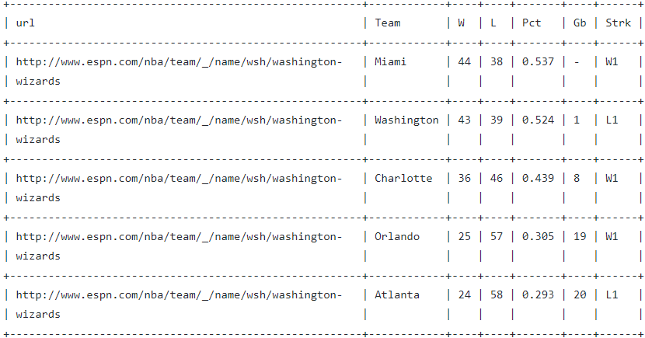
Case 3: Prediction not really wrong
Q 242: What is washington wizards record
Actual SQL: SELECT \"W\", \"L\" FROM NBA_Southeast_Standings WHERE \"Team\" ~ \"washington_wizards\
Precited SQL: SELECT \"W\", \"L\" FROM NBA_Southeast_Standings WHERE \"Team\" ~ \"washington\

Slide 6
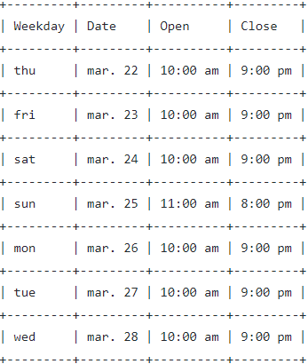
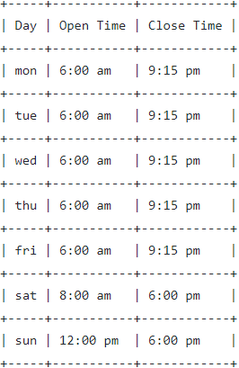
Case 4: Prediction not really wrong
Q 269: What time does Best Buy close
Actual SQL: SELECT \"Close\" from \"Store_Hours\" WHERE \"Weekday\" ~ \"external ( \"day_of_week\" ) \"
Precited SQL: SELECT \"Close\" from \"Store_Hours\"
Q 290: When does Squashbusters gym close
Actual SQL: SELECT \"Close_Time\" from \"SquashBusters_Hours\" WHERE \"Day\" ~ \"external ( \"day_of_week\" ) \"
Precited SQL: SELECT \"Close_Time\" from \"SquashBusters_Hours\"

Slide 7
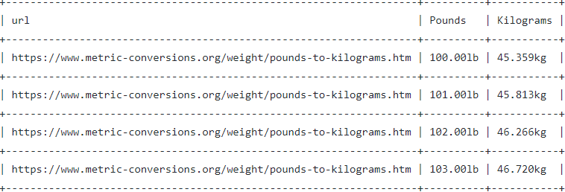
Case 5: Hard to get the correct SQL
Q 268: Alexa who is the actress that plays Sheldon’s mother
Actual SQL: SELECT \"Portrayed_by\" FROM \"Character_Appearances\" WHERE \"Character\" LIKE \"%%Mary Cooper%\“
Precited SQL: SELECT \"Portrayed_by\" FROM \"Character_Appearances\"
Q 292: Alexa what is my weight in kilograms
Actual SQL: SELECT \"Kilograms\" FROM \"Table_1\" WHERE \"Pounds\" = \"100.00lb\"
Precited SQL: SELECT \"Kilograms\" FROM \"Table_1\"

Slide 8
Case 6: Predicted wrongly due to stop-word removal
Q 272: where do I buy a cheap laptop
Actual SQL: SELECT \"Answer\" FROM \"Cheap_Laptops\" WHERE \"Question\" ~ \"where_buy\"
Precited SQL: SELECT \"Answer\" FROM \"Cheap_Laptops\" WHERE \"Question\" ~ \"buy\"
Q 299: How many feet are in a mile
Actual SQL: SELECT \"Foot\" FROM \"Table_1\" WHERE \"Mile\" ~ \"a_mile\"
Precited SQL: SELECT \"Foot\" FROM \"Table_1\" WHERE \"Mile\" ~ \"mile\"
Q 294: How tall is will smith
Actual SQL: SELECT \"Height\" FROM \"Table_1\" WHERE \"Name\" LIKE \"will smith\"
Precited SQL: SELECT \"Height\" FROM \"Table_1\" WHERE \"Name\" LIKE \"smith\"

