Slide 1
Update on Oct 8th
by
Fan, Zihua, Bhavya

Slide 2
Remove both table header and column headers
 | Train Dataset (+table name+column headers) |  |  | Train Dataset (+column headers) |  |  | Train Dataset
 | Cosine Sim | Dot Product | Inverse Euclidean | Cosine Sim | Dot Product | Inverse Euclidean | Cosine Sim | Dot Product | Inverse Euclidean
Top 1 | 60.5% | 68.9% | 70.6% | 47.1% | 60.1% | 60.1% | 50.0% | 60.5% | 62.2%
Top 3 | 79.0% | 81.5% | 81.9% | 66.0% | 74.8% | 76.1% | 68.9% | 76.1% | 76.9%
Top 5 | 84.5% | 85.3% | 86.1% | 69.7% | 79.4% | 79.4% | 73.5% | 79.8% | 79.8%
Top 8 | 89.5% | 90.3% | 90.8% | 76.1% | 83.2% | 83.2% | 79.4% | 83.6% | 84.0%
Top 10 | 89.9% | 91.2% | 92.0% | 78.2% | 84.9% | 84.9% | 80.7% | 85.3% | 85.3%

Slide 3
Completed Tasks
Table Classification
Column Type Recognition

Slide 4
Manually classification on train dataset
Total 238 tables
102 Key-Value tables (42.86%)
136 Entity tables (57.14%)

Slide 5
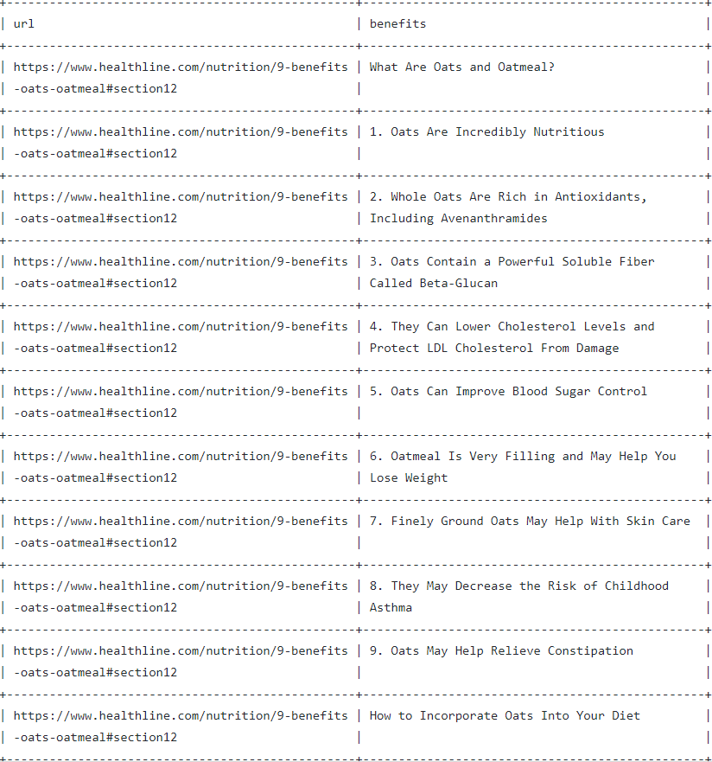
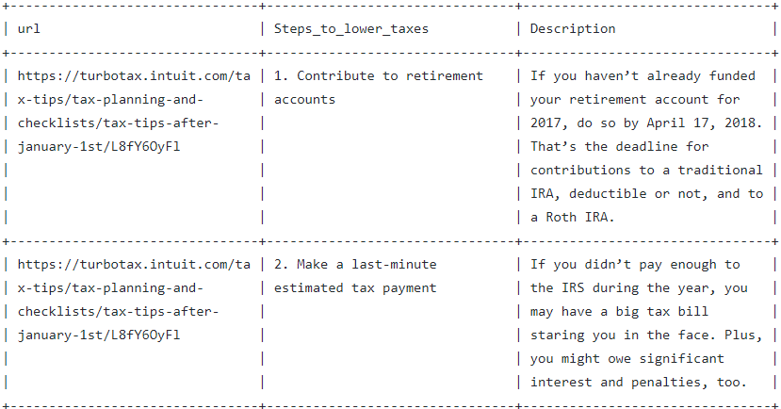
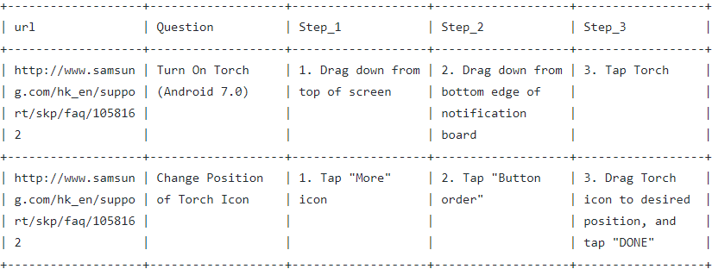
Some tables are hard to be classified
98.txt
102.txt
131.txt

Slide 6
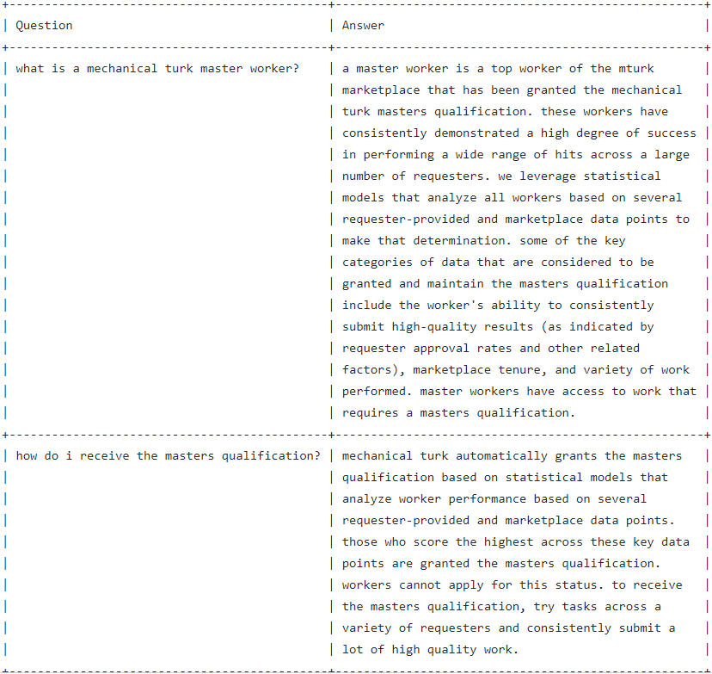
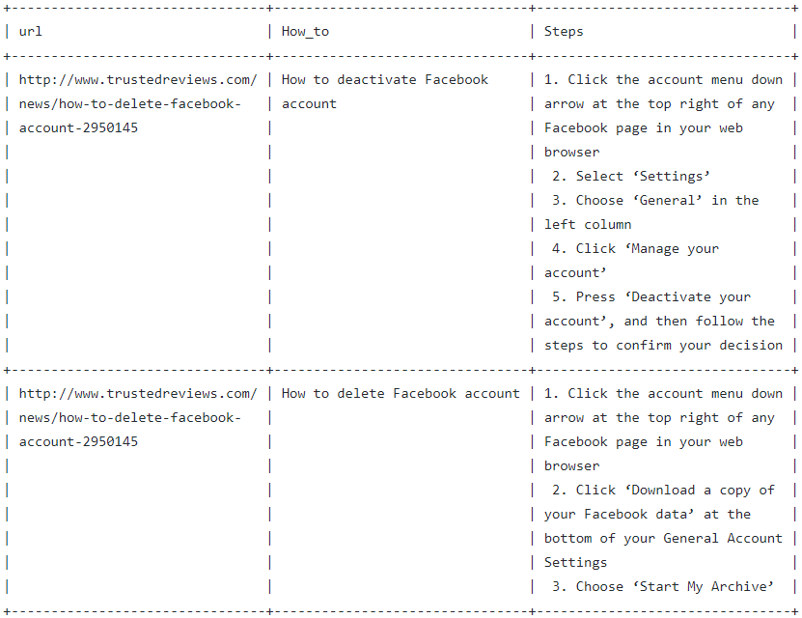
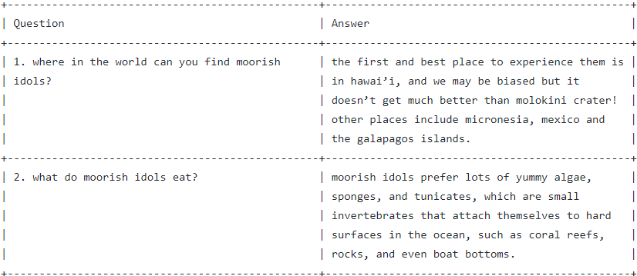
Some tables can be classified to both categories
146.txt
167.txt
207.txt

Slide 7
Method 1
If “key” or “property” or “attribute” in column names => contain_key = True
If “value” in column names => contain_value = True
If contain_key = True and contain_value = True => table = KV type
 | Predict
 | KV | Entity
KV | 99 | 3
Entity | 0 | 136
Precision: 100%
Recall: 97%

Slide 8
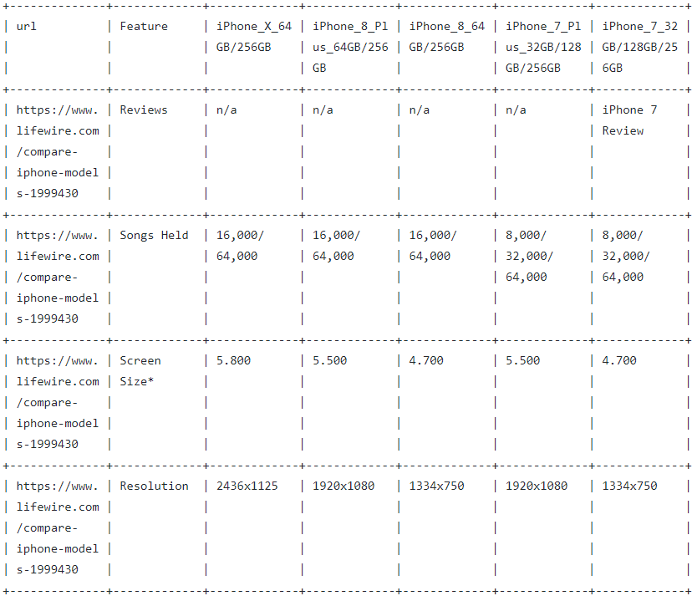
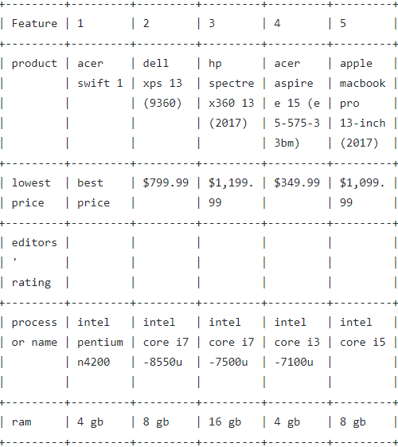
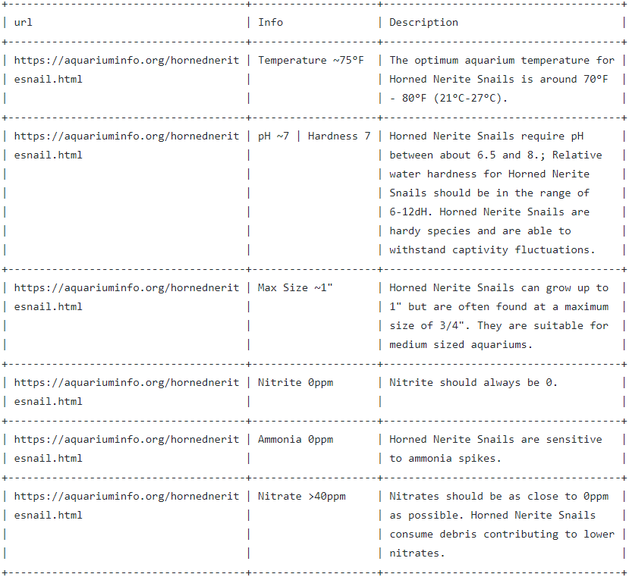
Error Analysis (KV->Entity)
100.txt
130.txt
148.txt

Slide 9
Method 2
Remove “URL” columns
If number of remaining columns = 2 => table = KV type
Else => table = Entity type
 | Predict
 | KV | Entity
KV | 100 | 2
Entity | 38 | 98
Precision: 72%
Recall: 98%

Slide 10
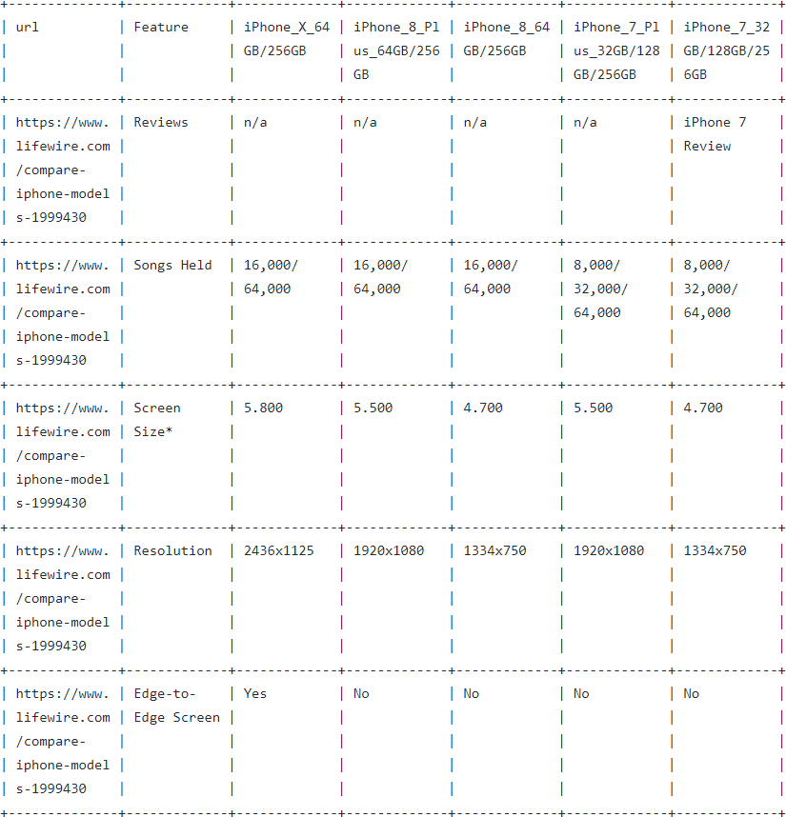
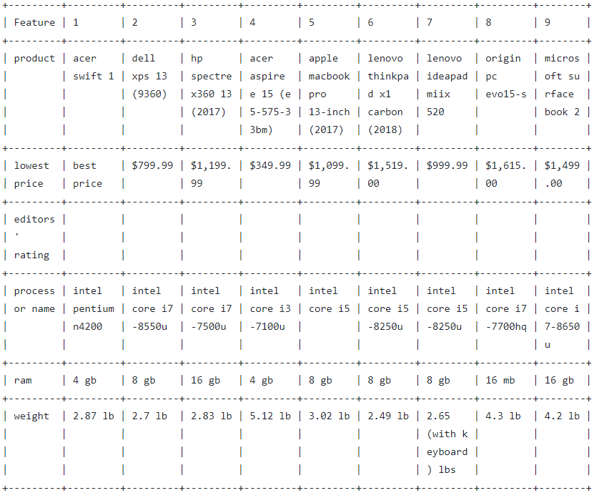
Error Analysis (KV->Entity)
100.txt
130.txt

Slide 11
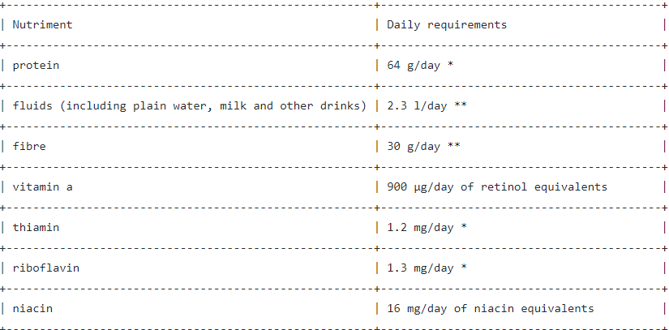
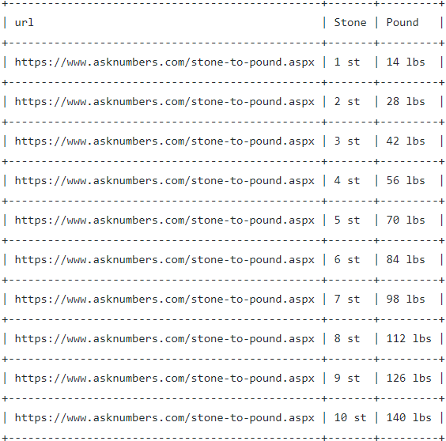
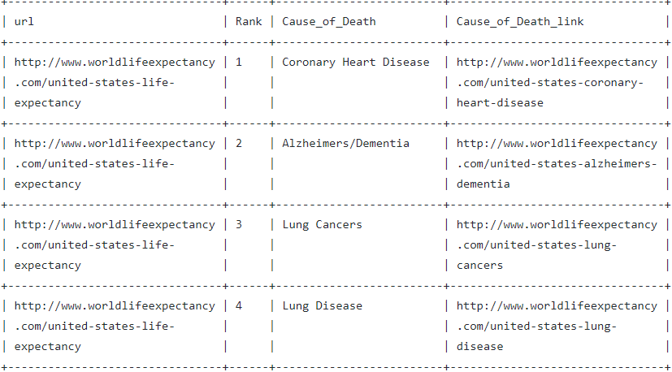
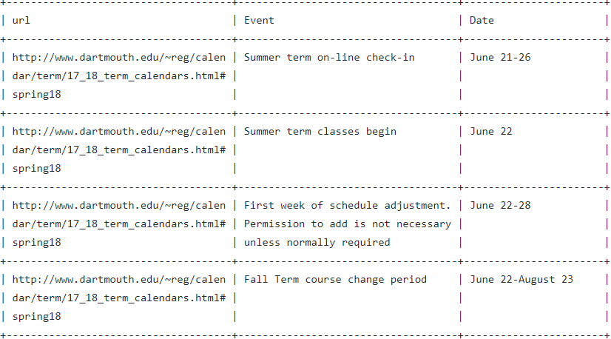
Error Analysis (Entity->KV)
10.txt
101.txt
136.txt
155.txt

Slide 12
Method 3
Remove “URL” columns
If (number of remaining columns = 2) and (both are text columns)
=> table = KV type
Else => table = Entity type
 | Predict
 | KV | Entity
KV | 85 | 17
Entity | 16 | 120
Precision: 84%
Recall: 83%

Slide 13
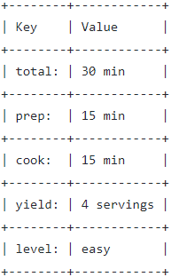
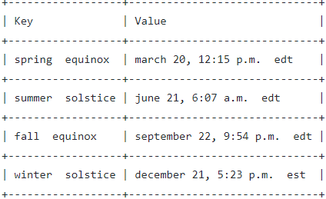
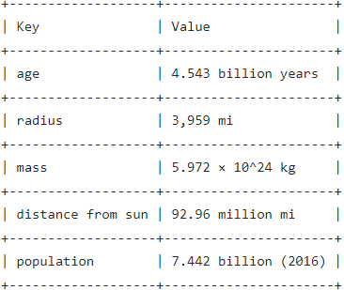
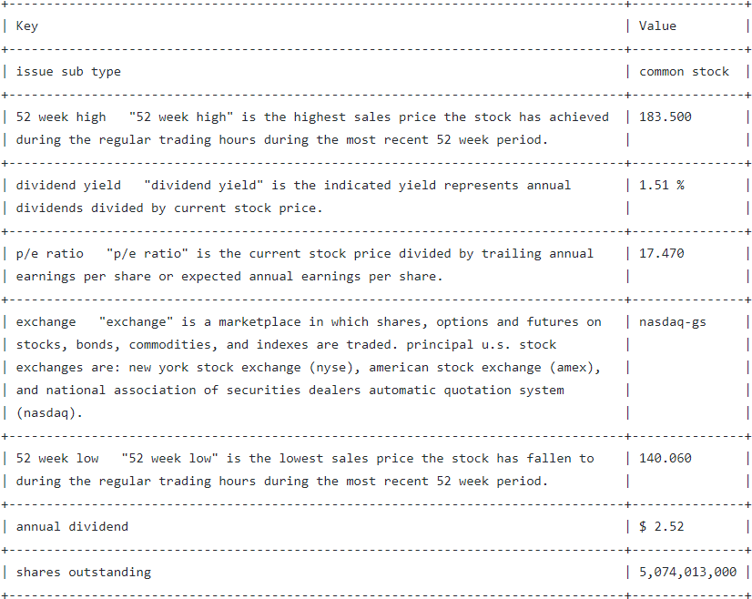
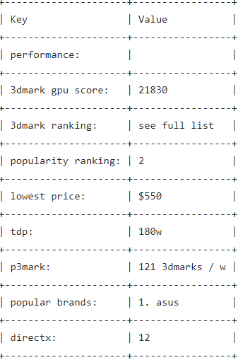
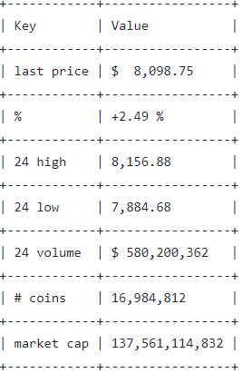
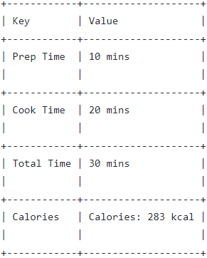
Error Analysis (KV->Entity)
109.txt
174.txt
191.txt
24.txt
233.txt
216.txt
224.txt

Slide 14
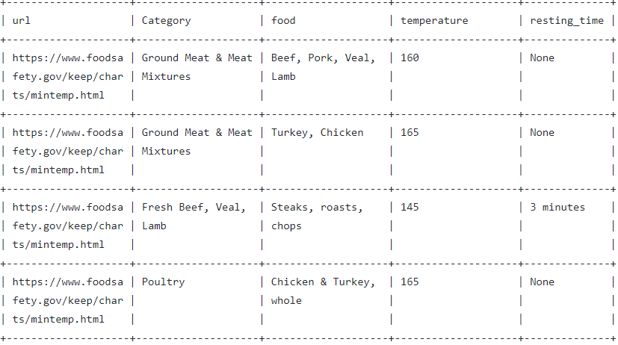
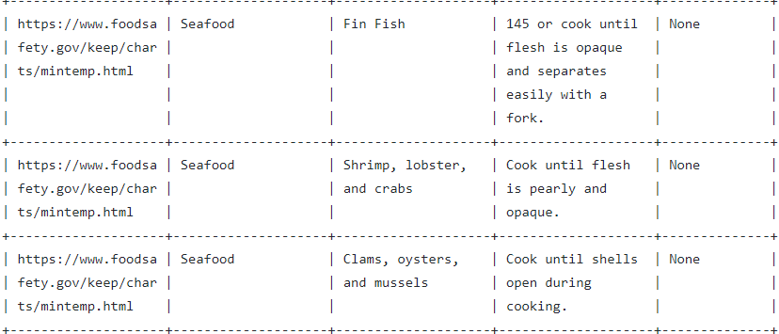
Why the threshold is not 100% for numerical?
2.txt

Slide 15
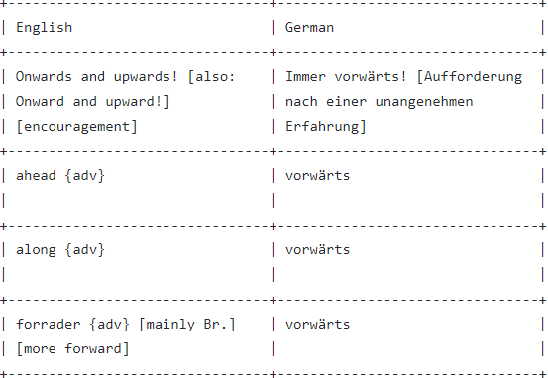
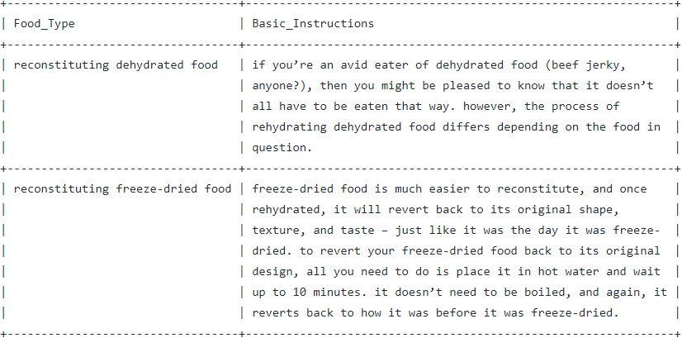
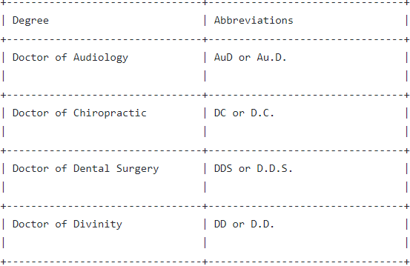
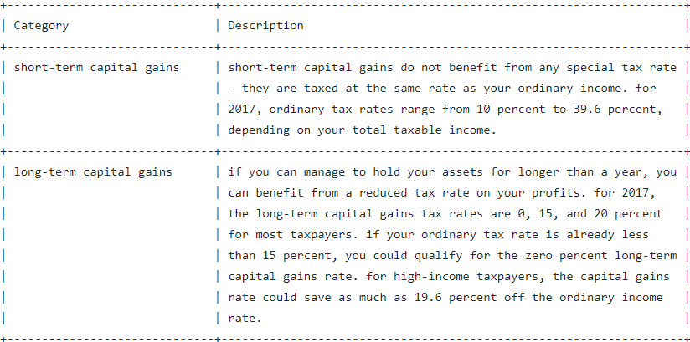
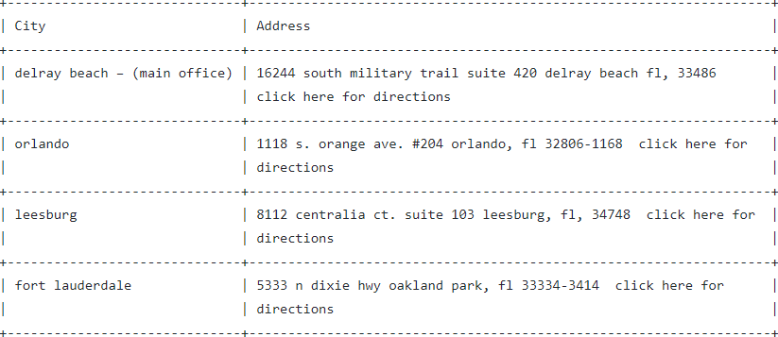
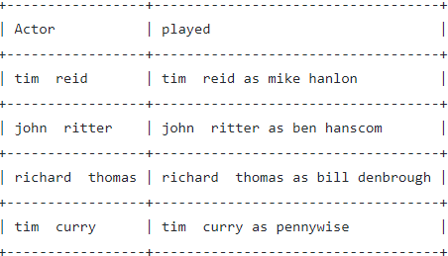
Error Analysis (Entity->KV)
3.txt
212.txt
234.txt
193.txt
237.txt
14.txt

Slide 16
Summary
Method 1
Method 2
Method 3
 | Predict
 | KV | Entity
KV | 99 | 3
Entity | 0 | 136
 | Predict
 | KV | Entity
KV | 100 | 2
Entity | 38 | 98
 | Predict
 | KV | Entity
KV | 85 | 17
Entity | 16 | 120
Precision: 100%
Recall: 97%
Precision: 72%
Recall: 98%
Precision: 84%
Recall: 83%

Slide 17
 | Predict
 | KV | Entity
KV | 85 | 17
Entity | 16 | 120
Precision: 84%
Recall: 83%

Slide 18
Column Type Recognition
URL type
Boolean type
DateTime type
Percentage type
Currency type
Numerical type
Text type

Slide 19
10: How many vitamins do you need a day
Nutriment Text
Daily requirements Numerical
96: Alexa when was Groundhog Day released
url URL
Country Text
Release_date DateTime
Notes Text
97: Siri when is I prevail playing next in Texas 2018
url URL
Date DateTime
Date_link URL
Venue Text
Venue_link URL
Location Text
Location_link URL
11: Alexa what is the current Bitcoin price
url URL
Currency Text
Price Currency
104: Alexa how many miles is it to drive from Los Angeles to San Francisco
url URL
Distance_from_Los_Angeles Text
Distance_from_Los_Angeles_link URL
Distance Numerical
126: Alexa when does Disney on Ice perform in San Antonio
url URL
Date DateTime
Show Text
Show_link URL
Location Text
City Text
State Text
156: Alexa how much does a 2016 ford fusion SE cost
Configuration Text
Price Currency
18: Alexa when is Easter this year
url URL
Date DateTime
Weekday Text
Holiday_Name Text
Holiday_Name_link URL
Holiday_Type Text
Where_It_Is_Observed Text
87: How long do dogs live
url URL
Animal Text
Life_Expectancy Numerical
145: Alexa when is taylor swift coming to dallas
url URL
Date DateTime
Market Text
Building Text
186: Alexa when is Maroon 5 coming to San Antonio for a concert
url URL
Date DateTime
Date_link URL
Location Text
Location_link URL
City Text
City_link URL
136: What is the leading cause of death in the U S
url URL
Rank Numerical
Cause_of_Death Text
Cause_of_Death_link URL
30: What should I buy my wife for our 5th anniversary
url URL
Year Numerical
Gift Text
47: Alexa when does season 2 of Jessica Jones come out on Netflix
url URL
No._overall Numerical
No._in_season Numerical
Title Text
Directed_by Text
Written_by Text
Original_release_date DateTime
Description Text
123: which is the most common language in the world
url URL
Rank Numerical
Language Text
Native_Speakers_In_Millions Numerical
Fraction Percentage
139: Alexa who is the top musician of today
url URL
Current_Rank Numerical
Name Text
Previous_Rank Numerical
Peak_Position Numerical
48: Siri when are you able to file federal taxes for 2018
url URL
2018_Deadline DateTime
Activity Text

Slide 20
Pros & Cons
Pros:
Easy to implement
Do not rely on column header information
Cons:
Only works for Entity tables
Generally works better for tables with few columns

Slide 21
Next Step
Question/Column name matching
Question/Column content matching
POS tagging

