Slide 1
Update 10/22
Fan Hu

Slide 2
Data Issue
24.csv
exchange___"exchange"_is_a_marketplace_in_which_shares,_options_and_futures_on_stocks,_bonds,_commodities,_and_indexes_are_traded._principal_u.s._stock_exchanges_are:_new_york_stock_exchange_(nyse),_american_stock_exchange_(amex),_and_national_association_of_securities_dealers_automatic_quotation_system_(nasdaq).___
77.csv
221.csv
2,979 cc V6 Twin Turbo petrol
Cause_of_death,_by_injury_(%_of_total)
298.csv
exchange___"exchange"_is_a_marketplace_in_which_shares,_options_and_futures_on_stocks,_bonds,_commodities,_and_indexes_are_traded._principal_u.s._stock_exchanges_are:_new_york_stock_exchange_(nyse),_american_stock_exchange_(amex),_and_national_association_of_securities_dealers_automatic_quotation_system_(nasdaq).___

Slide 3
Features
Question type (NUM, HUM, ENTY, LOC, ABBR, SQ, DESC)
Column type (DateTime, Text, Currency, Boolean, Number, Percentage, URL, Location, Person_Name, Description, Instruction? )
Edit Distance (column->question)
Average Cell Length
Word2Vec (Average proximity of column and q, Average proximity without stop words, Max proximity of column and q, Max proximity without stop words)
Number of Columns

Slide 4
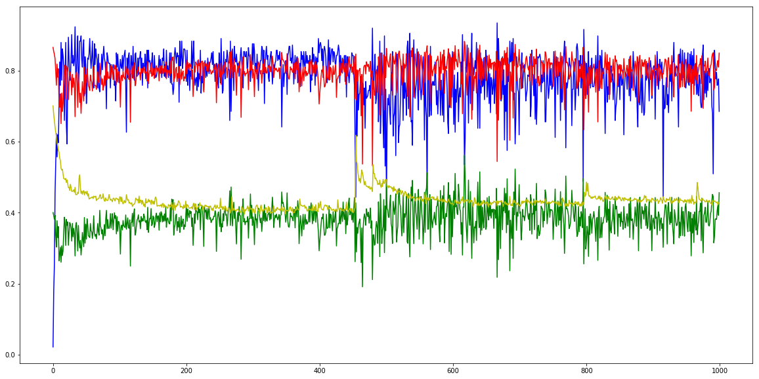
column type + question type + word2vec (train)
Accuracy Recall Precision Loss
 | Predict
 | 1 | 0
1 | 238 | 35
0 | 383 | 1390
Accuracy: 0.7957
Recall: 0.8718
Precision:0.3833

Slide 5
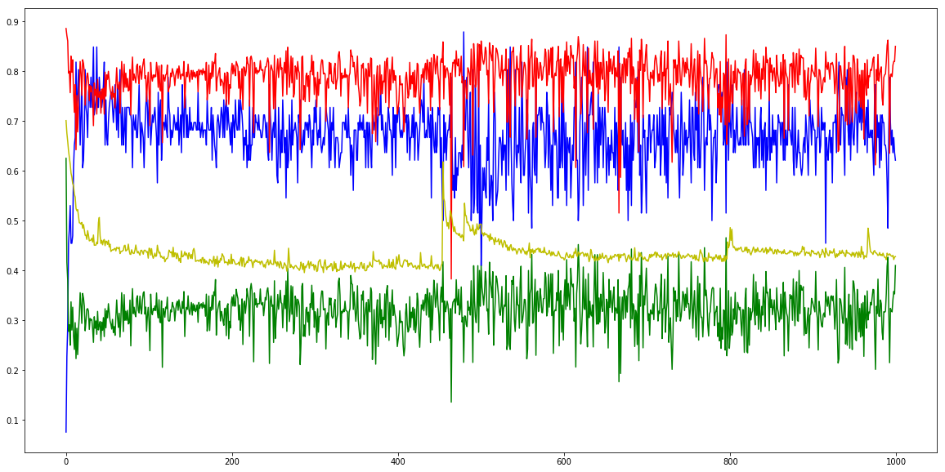
column type + question type + word2vec (test)
Accuracy Recall Precision Loss
 | Predict
 | 1 | 0
1 | 44 | 22
0 | 118 | 375
Accuracy: 0.7496
Recall: 0.6667
Precision:0.2716

Slide 6
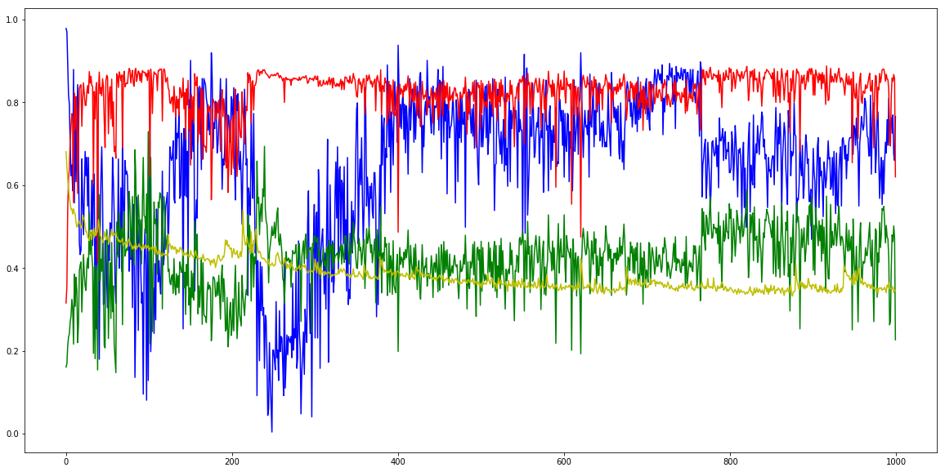
+ edit distance (train)
Accuracy Recall Precision Loss
 | Predict
 | 1 | 0
1 | 238 | 35
0 | 305 | 1468
Accuracy: 0.8338
Recall: 0.8718
Precision:0.4383

Slide 7
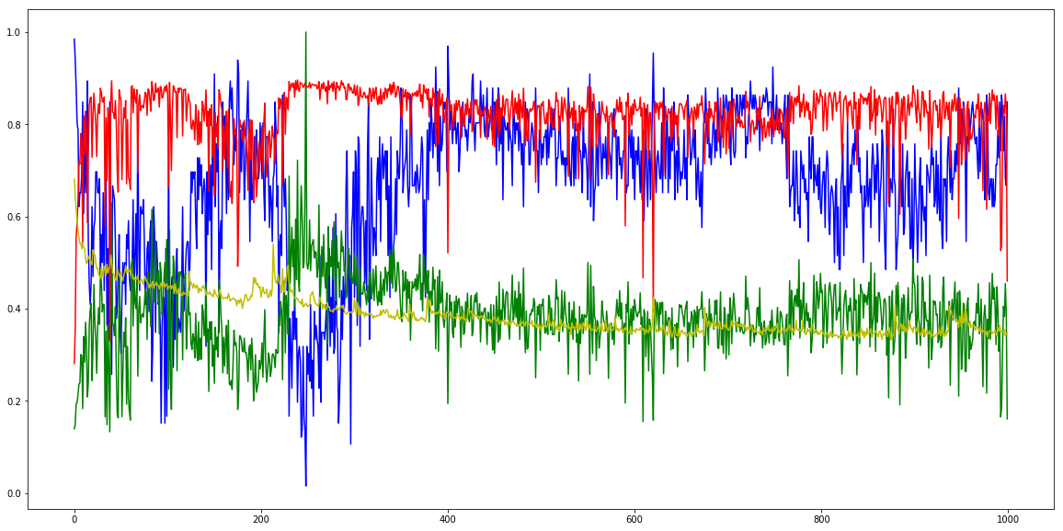
+ edit distance (test)
Accuracy Recall Precision Loss
 | Predict
 | 1 | 0
1 | 56 | 10
0 | 94 | 399
Accuracy: 0.8140
Recall: 0.8485
Precision:0.3733

Slide 8
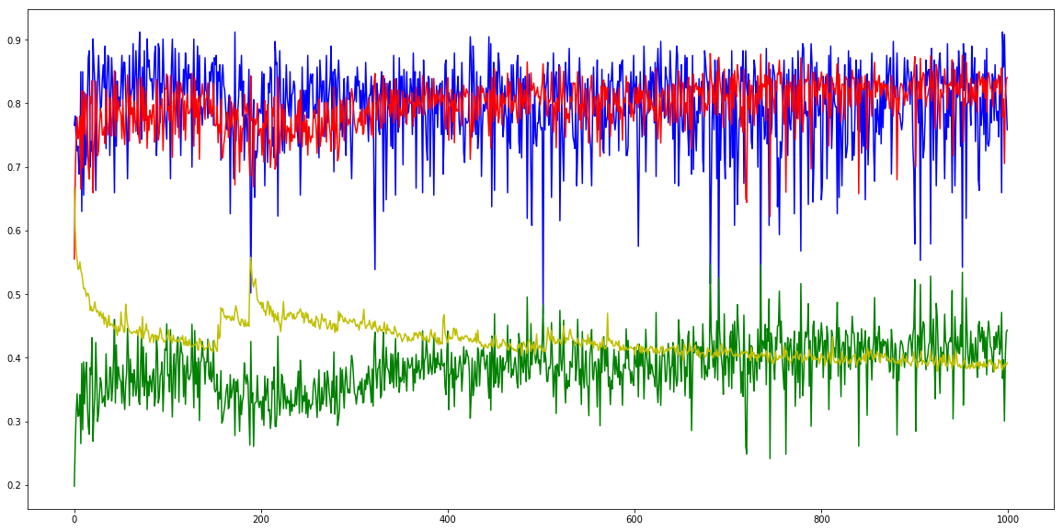
+ average cell length (train)
Accuracy Recall Precision Loss
 | Predict
 | 1 | 0
1 | 241 | 32
0 | 350 | 1423
Accuracy: 0.8133
Recall: 0.8828
Precision:0.4078

Slide 9
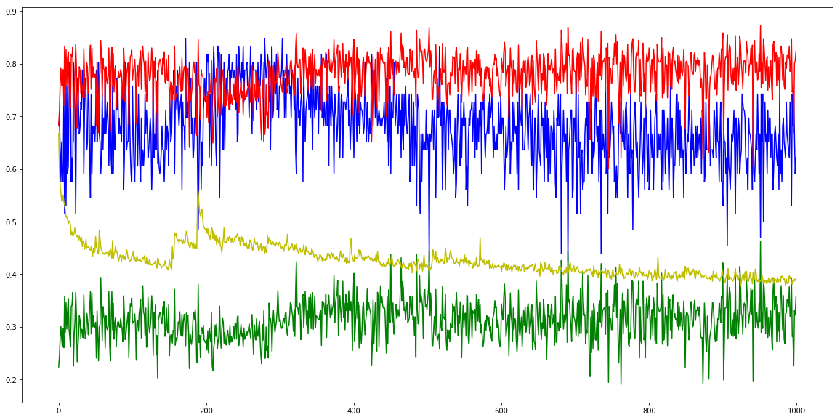
+ average cell length (test)
Accuracy Recall Precision Loss
 | Predict
 | 1 | 0
1 | 49 | 17
0 | 112 | 381
Accuracy: 0.7692
Recall: 0.7424
Precision:0.3043

Slide 10
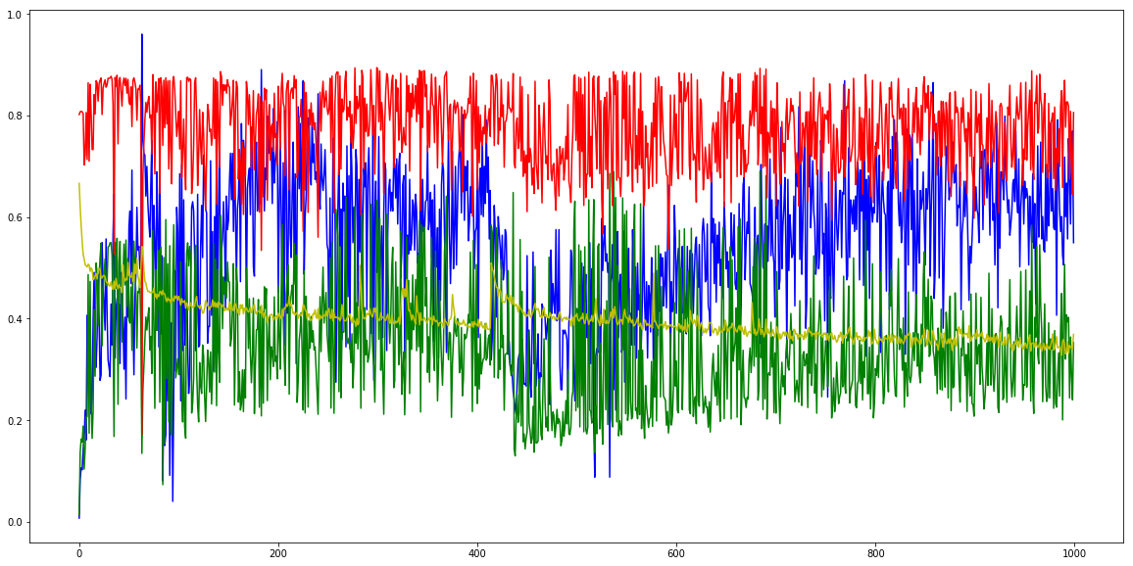
+ edit distance + average cell length (train)
Accuracy Recall Precision Loss
 | Predict
 | 1 | 0
1 | 215 | 58
0 | 328 | 1445
Accuracy: 0.8113
Recall: 0.7875
Precision:0.3959

Slide 11
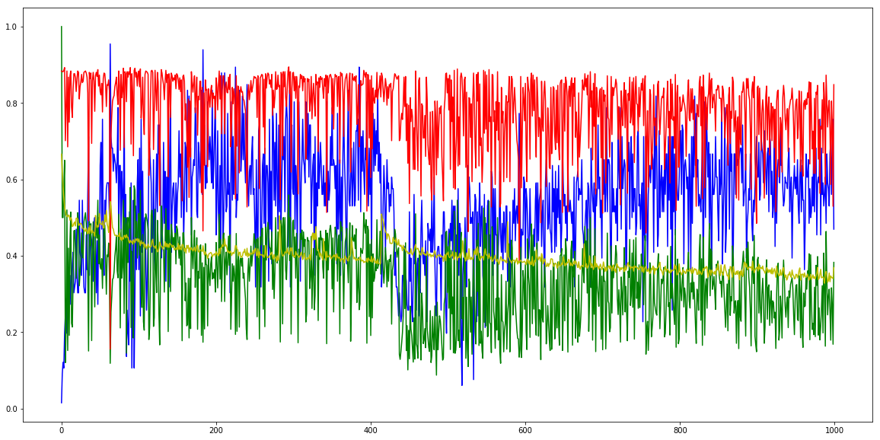
+ edit distance + average cell length (test)
Accuracy Recall Precision Loss
 | Predict
 | 1 | 0
1 | 54 | 12
0 | 85 | 408
Accuracy: 0.8265
Recall: 0.8182
Precision:0.3885

