Slide 1
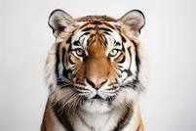
BCSE332L-TIGER DETECTION USING TRANSFER LEARNING
FACULTY : Dr Sudheer Kumar E
Team Members:
KARNAM NITHIN,21BAI1091
GAJJALA SAI CHARAN REDDY,21BAI1521
VULLI PATTABHI RAMANNA,21BAI1589

Slide 2
WHY THIS PROJECT?
Importance of Tiger Conservation: Tigers are endangered, and innovative solutions are crucial for their preservation.
Significance of Technology: Advanced technologies play a key role in effective wildlife preservation.
Potential Impact: An accurate tiger detection system can revolutionize conservation efforts.

Slide 3
Scope Of the Project:
Target Application:
Wildlife Conservation: Enhancing monitoring and anti-poaching efforts through automated tiger detection.
Project Goals:
Develop a Robust Model: Implement a tiger detection model using transfer learning techniques.
Utilize Pre-trained Models: Incorporate pre-trained ResNet and Inception models for improved performance.
Contribute to Conservation: Support the global initiative for wildlife preservation.

Slide 4
Implementation Plan:
Base Technologies:
TensorFlow: Utilized as the primary deep learning library for model development.
OpenCV: Applied for image processing to prepare data for the model.
Transfer Learning: Leveraging pre-trained ResNet and Inception models to enhance the detection model.
Dataset:
Overview of Datasets: Utilizing tiger and non-tiger datasets for training and testing.
https://images.cv/download/tiger/2641/CALL_FROM_SEARCH/%22tiger%22

Slide 5
Applications,Future impact:
Practical Applications:
Conservation Areas: Deployment of the model in wildlife reserves and national parks for continuous monitoring.
Surveillance Systems: Integration into existing camera networks for real-time tiger presence monitoring.
Future Impact:
Positive Influence: Anticipated positive impact on tiger population and habitat preservation.

Slide 6
Necessary Packages and Libraries Used:
The project requires various Python libraries and frameworks, including TensorFlow, TensorFlow Hub, OpenCV, and Matplotlib. These libraries are fundamental for tasks such as deep learning model development, image preprocessing, and result visualization.

Slide 7
Explanation of ResNet:
ResNet (Residual Networks): ResNet is a deep neural network architecture that introduced the concept of residual learning. Traditional deep networks can suffer from vanishing gradient problems when training deep networks. ResNet addresses this by introducing skip connections, allowing information to bypass certain layers and be directly fed to deeper layers. This architecture enables the training of very deep networks, making it highly effective for image recognition tasks.

Slide 8
Explanation of InceptionV3:
InceptionV3: InceptionV3, part of the Inception architecture series, is designed to improve the computational efficiency of deep neural networks. It incorporates the idea of using multiple filter sizes in parallel to capture features at different scales. This architecture facilitates the extraction of both fine and coarse-grained features from images, making it suitable for a wide range of computer vision tasks.

Slide 9
Title: Model Development Process
Data Preparation
Model Architecture
Model Compilation and Training
Performance Evaluation
Model Saving and Loading
Predictions and Results

Slide 10


Title: Data Preparation
Description of data directory structure and organization:
Organized dataset into separate folders for training and testing.
Ensured each folder contains subfolders representing different classes (e.g., tiger, non-tiger).
Model Architecture
Selection of pre-trained models:
Utilized state-of-the-art models like InceptionV3 and ResNet for feature extraction.
Configuration of the feature extraction and classification layers:
Extracted high-level features using pre-trained layers.
Added custom classification layers for specific task (e.g., tiger detection).
Discussion on transfer learning and fine-tuning strategies:
Transferred knowledge learned from pre-trained models to improve performance on the target task.
Fine-tuned model parameters to adapt to the characteristics of the tiger detection dataset.

Slide 11


Model Compilation and Training
Compilation of the model with appropriate loss function and optimizer:
Used categorical cross-entropy loss for multi-class classification.
Employed Adam optimizer for efficient optimization.
Utilization of callbacks for monitoring training progress:
Integrated TensorBoard callback for visualizing training metrics and logs.
Performance Evaluation
Monitoring training and validation loss curves:
Tracked changes in loss values over epochs to assess model convergence.
Calculation of accuracy metrics during training:
Evaluated training and validation accuracy to measure model performance.
Comparison of model performance on test data:
Conducted evaluation on unseen test data to assess generalization ability of the model.

Slide 12


Model Saving and Loading
Saving trained models to disk for future use:
Serialized trained model parameters and architecture into a file format (e.g., HDF5).
Loading saved models for inference or further training:
Retrieved saved model from disk for making predictions or continuing training.
Predictions and Results
Showcase of model predictions on sample images:
Displayed sample images along with predicted classes generated by the trained model.
Visualization of confusion matrix to assess model performance:
Presented confusion matrix to analyze model's ability to correctly classify tiger and non-tiger images.
Discussion on model accuracy and areas for improvement:
Analyzed model accuracy and discussed potential areas for model enhancement or fine-tuning based on prediction results and evaluation metrics.

Slide 13
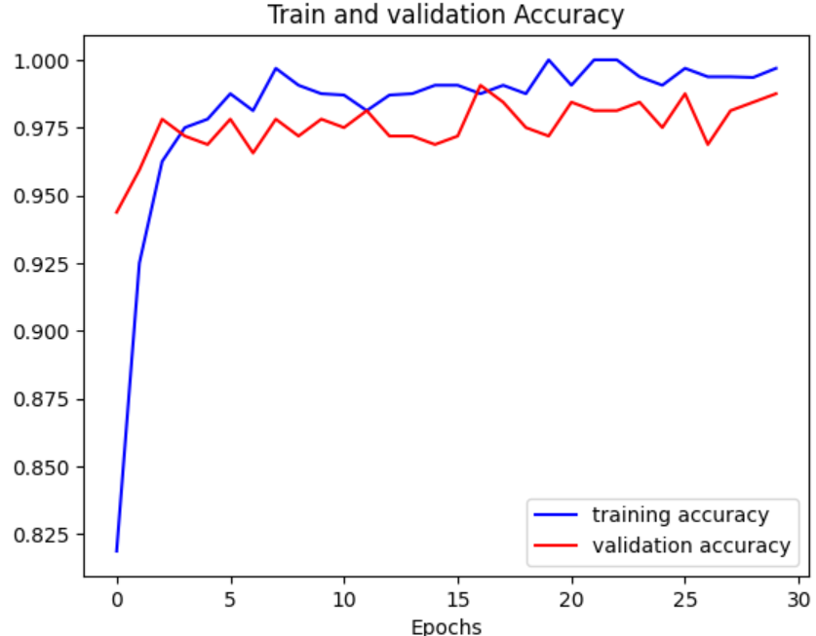
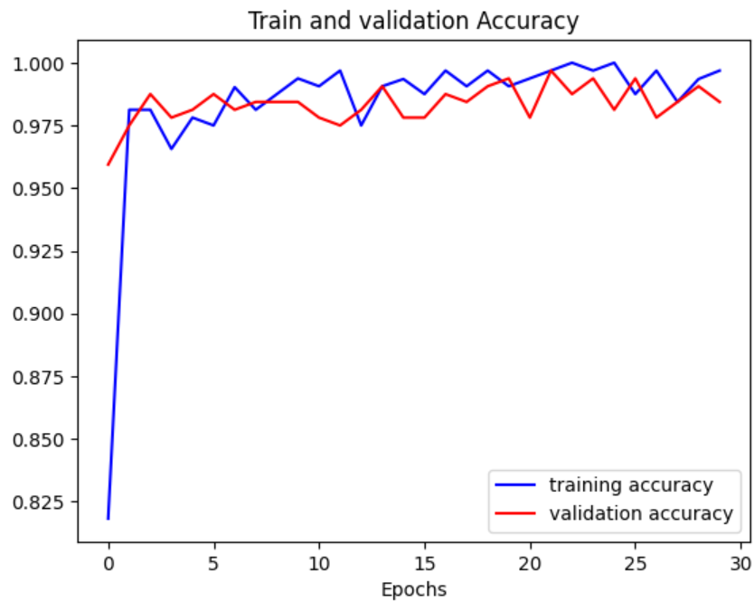
RESULTS COMPARISION:
RESNET MODEL: ACCUARACY-98.7% AFTER 30 EPOCHS
INCEPTION MODEL: ACCUARACY-98.4% AFTER 30 EPOCHS

Slide 14
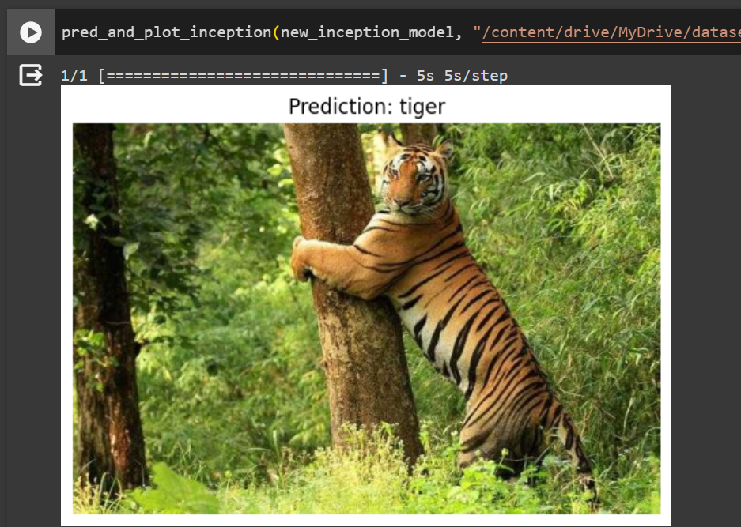
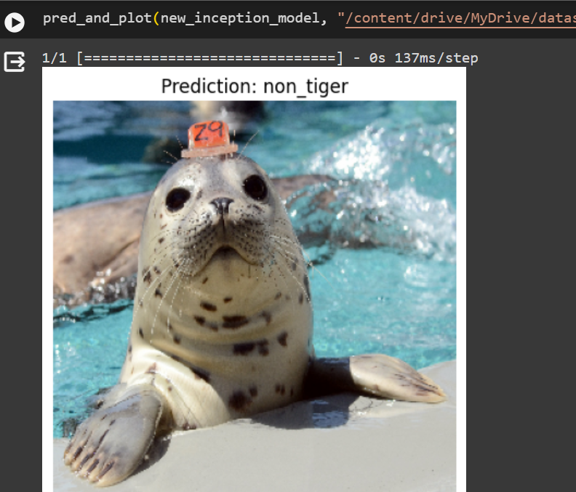
Model Functioning ON IMAGES:

Slide 15
In conclusion, this project focuses on utilizing transfer learning with ResNet and InceptionV3 to develop a tiger detection model. The need for such a system arises from the importance of efficiently monitoring and conserving the endangered tiger population. The chosen architectures, ResNet and InceptionV3, bring unique advantages to the table, and the project aims to compare their performances in tiger detection tasks. The success of this project could significantly contribute to wildlife conservation efforts by providing a reliable and automate method tiger identification.

Slide 16
THANK YOU

