Slide 1
LiberBot
Smart Library Assistant
PG Diploma ROS
Batch - 4
Present By,
Nithin B
LiberBot
01
Notes:
2

Slide 2

INTRODUCTION
The system uses technology to automate sorting and finding of books and digital files.
Traditional libraries rely on manual book handling.
Information can be accessed anytime, from anywhere.
The Automatic Library project brings innovation to managing knowledge.
It offers fast and easy access to information.
Libraries rely on staff to locate, retrieve, and re-shelve books.
LiberBot
02

Slide 3
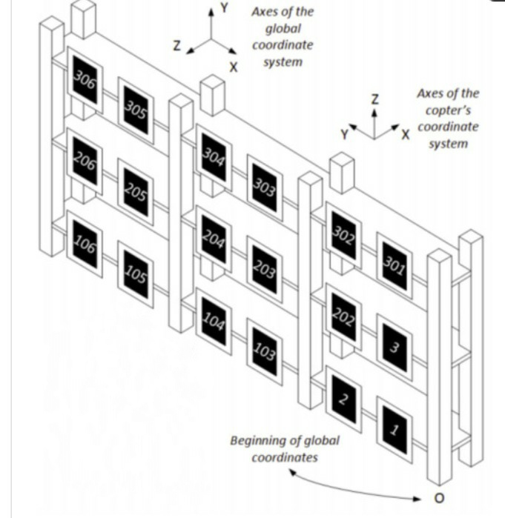
What is an Autonomous Library System ?
A system that uses automation technologies to:
Locate, retrieve, and shelve books.
Track inventory in real time.
Assist users with book availability.
LiberBot
3

Slide 4
OBJECTIVES
Faster & accurate book retrieval by automating the locating and delivery process.
Improved staff productivity by reducing time spent searching for books.
Higher operational efficiency by reducing manual book handling and re-shelving.
Fewer errors & mismanagement through automated tracking and retrieval.
LiberBot
4

Slide 5
TOOLS
TOOLS AND SOFTWARE USED:
The following tools and software were employed for the design and fabrication of LiberBot.
Autodesk Fusion for 3D modelling of Robot and simulation.
GitHub repositories for open-source codes.
Arduino IDE
PROGRAMMING LANGUAGES AND HARDWARE COMPONENTS USED:
Embedded C.
C programming.
LiberBot
5

Slide 6
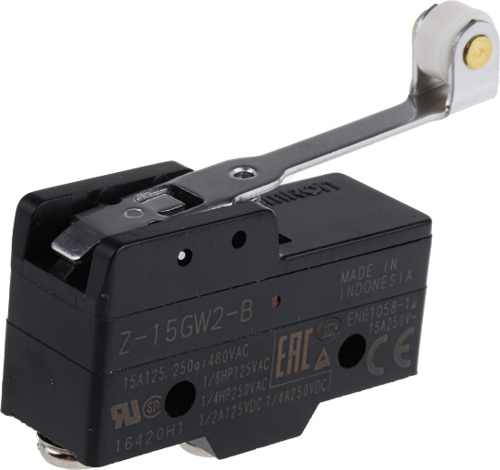
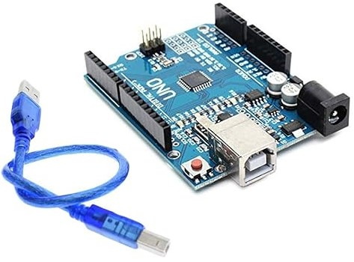
COMPONENTS
 | SPECIFICATIONS | PURPOSE | FIGURE
Limit Switch | detect the presence Contact Type: SPDT. Operating Force: 1.5 N. Operating Voltage: 250V AC / 5A. | To provide feedback. To detect position or limit of motion. Stop/control machinery safely.
Arduino UNO R3 | Operating Voltage: 5 – 12 V. 14 digital input/output pins. 6 analog input/output pins. Clock Speed: 16 MHz. Flash Memory: 32 KB. | Motion Control. Stepper Motor Control. Integration With CNC Shield.
LiberBot
6

Slide 7
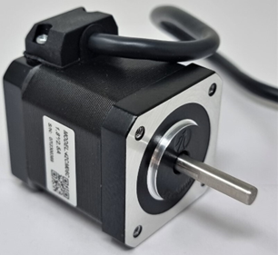
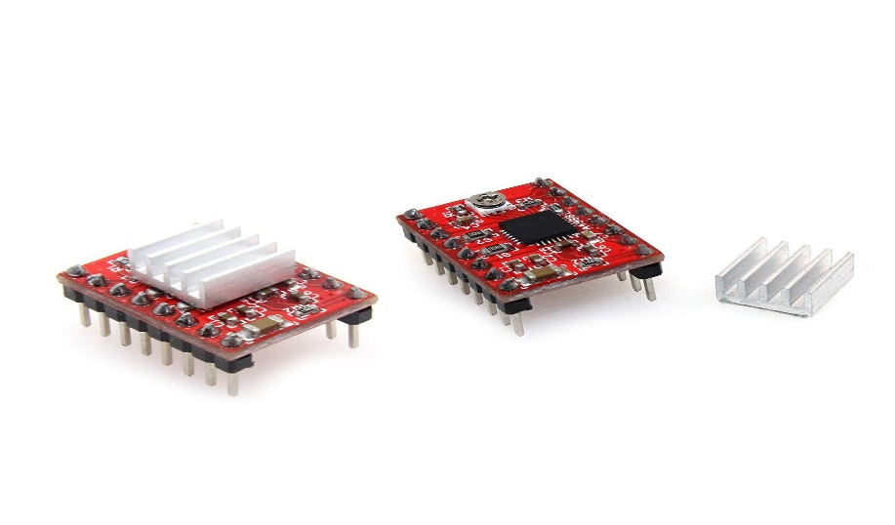
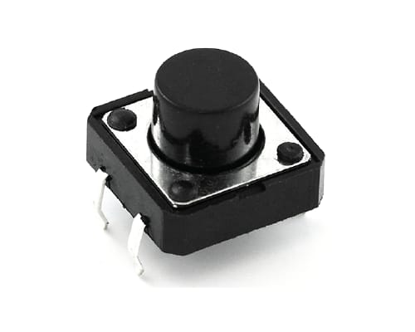
COMPONENTS
Nema 17 Stepper Motor | 5 mm (0.197 inch) shaft size. Step angle 1.8 degree. Operating Voltage: 12 – 24 V. | High precision. Low motor heating. Low vibration. End effector and axis movement.
A4988 Stepper Motor Driver | Operating Voltage: 12V to 35V Maximum Output Current: 2A per coil. | Micro stepping. Overcurrent and Thermal Protection. Stepper Motor Control.
Push Button | Operating Voltage: 24-250V. Current: 0-5A. | Ease of Use. Versatility & Durability.
LiberBot
7

Slide 8
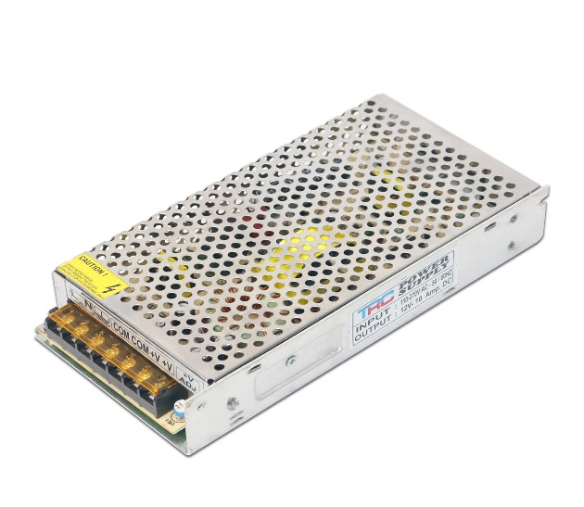
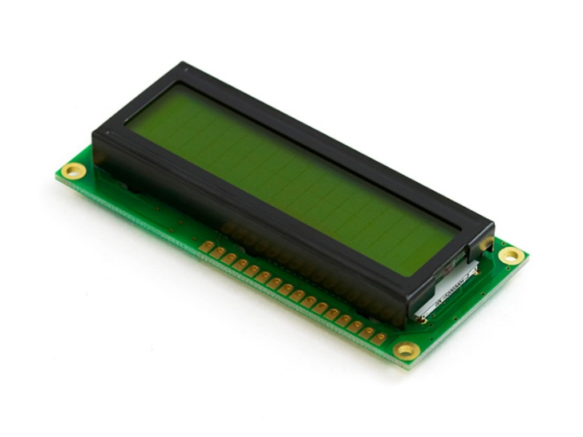
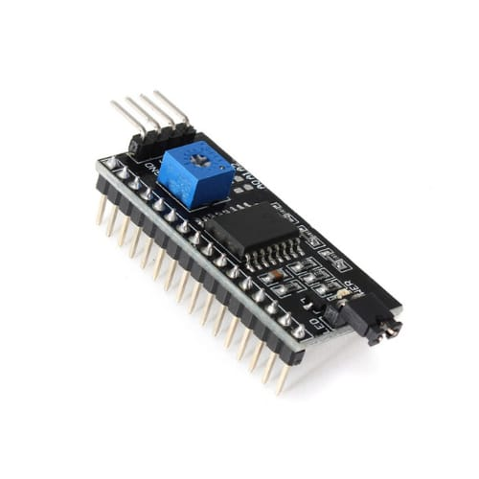
COMPONENTS
12V 10A SMPS | Maximum Current:10A. Power:120W. Operating Voltage: 12V DC. | High Efficiency. Built-in protection. Safe Operation. Overvoltage Protection. | E
16×2 LCD | Operating Voltage: 5V. LED based Backlighting. Alphanumeric display module. | Embedded systems. Onboard HD44780 controller.
LCD 12C Module | Operating voltage : 5V. | Lowers the number of GPIO pins. Easy to connect 16×2 LCD to a microcontroller.
LiberBot
8

Slide 9
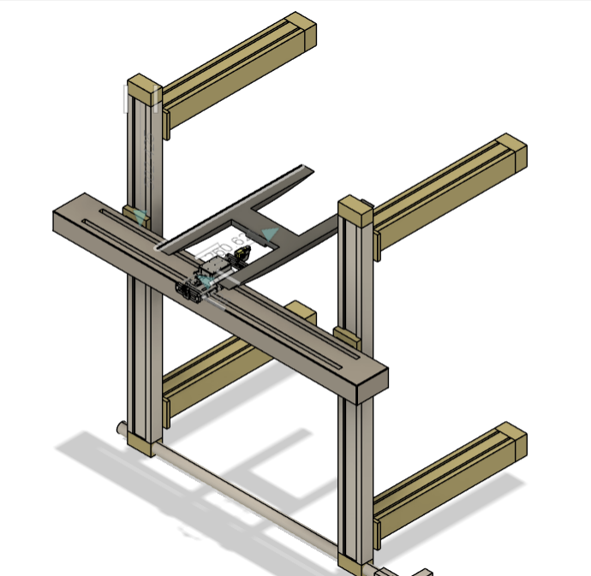
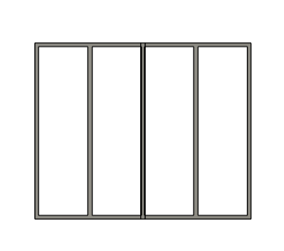
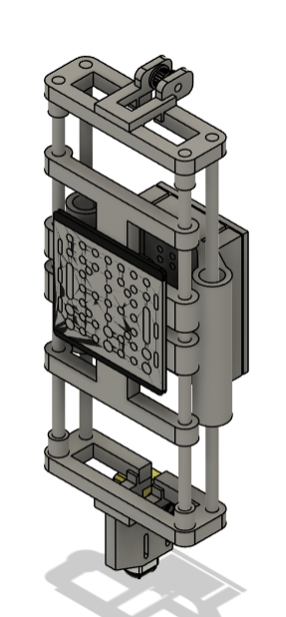
DESIGN
LiberBot
9

Slide 10
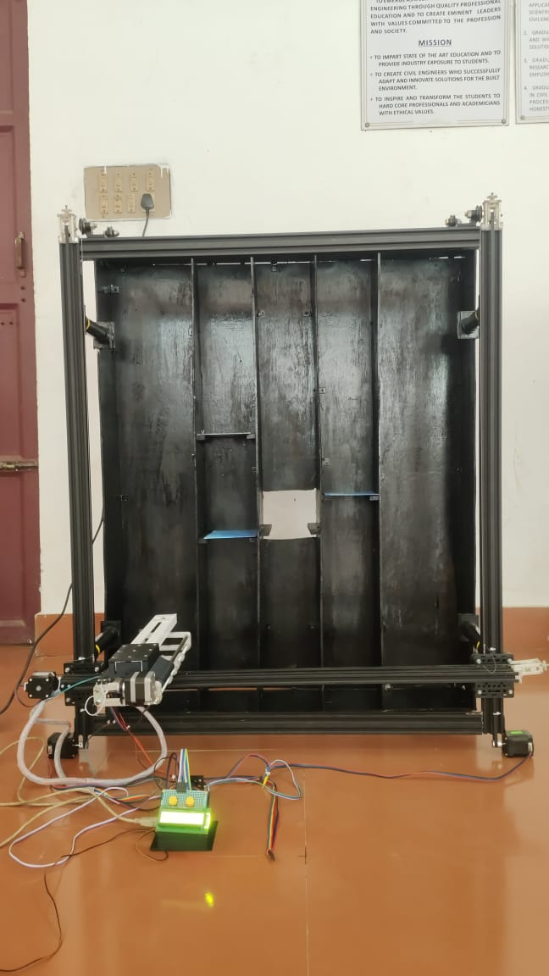
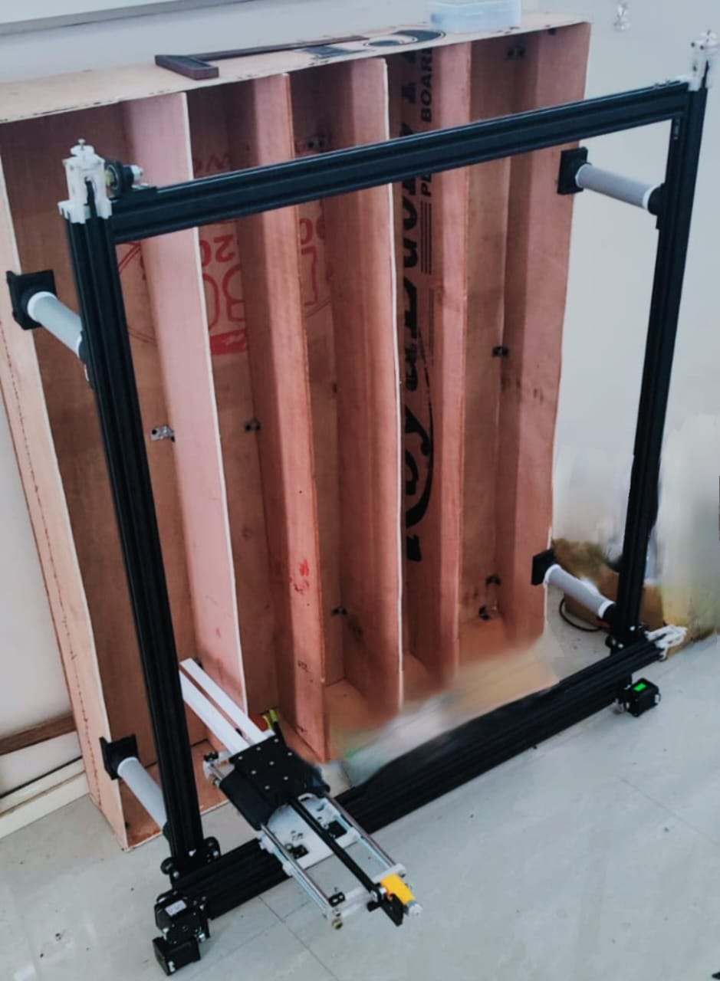
LiberBot
10

Slide 11
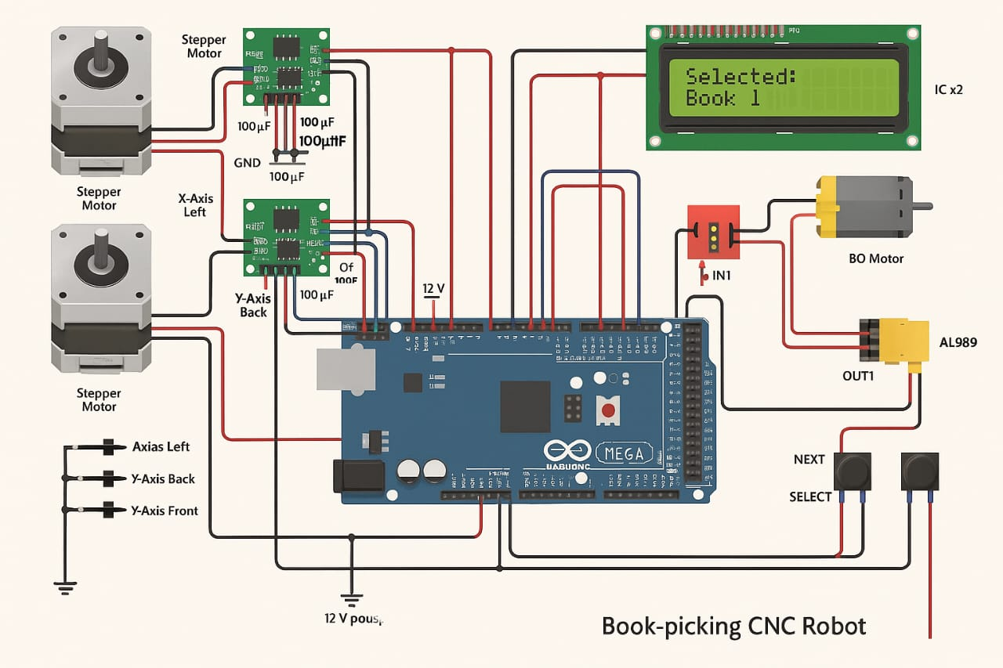
CIRCUIT DIAGRAM
LiberBot
11

Slide 12
Requires maintenance
ADVANTAGES
Reduced human workload.
Faster retrieval times.
Better inventory management.
Minimizes misplaced books.
Real time inventory tracking
LiberBot
12

Slide 13
DISADVANTAGES
High initial cost.
Requires maintenance.
Technology training for staff.
Power/technical failures can disrupt service..
LiberBot
13

Slide 14
APPLICATION
University Libraries.
Corporate Knowledge Hubs.
Research Centre.
Public Libraries.
Digital Book Distribution Systems.
LiberBot
15

Slide 15
Future Scope
Integration with AI for predictive book suggestions.
Voice-enabled retrieval systems.
Drone-based delivery inside campus.
Enhanced mobile app interfaces.
LiberBot
15

Slide 16
CONCLUSION
Autonomous Library Systems transform traditional libraries.
A step toward smart, digital library ecosystems.
Real-time updates ensures accurate inventory and easy book tracking.
User-friendly interface makes system adoption smooth for library staff.
Regular maintenance will keep the system running effectively over time.
LiberBot
14

Slide 17
THANK YOU
LiberBot
15

