Slide 1
Welcome to Backend Development (S25)

Slide 2
Agenda
Introduction
Project overview, goals
Refresher about previous API session
Quick Hands-on Exercise
Introduction to Postman
Introduction to FastAPI framework
Sample scenario Homework

Slide 3
Introduction

Slide 4
Introduction
Restful APIs & Introduction to FastAPI
Moderators
Shahriar Fakhar (Shah)
Felipe valverde campos (Felipe)
29. Sep 2025

Slide 5
Project Overview & Goals

Slide 6
Project Overview & Goals
Objective: Today, we’ll dive into building modern, fast, and efficient APIs using FastAPI, a powerful Python framework.
What You’ll Learn:
Quick recap of RESTful APIs and HTTP basics from the last session.
Hands-on practice to solidify your understanding.
Introduction to Postman for testing APIs.
Core concepts of FastAPI with step-by-step examples.
A real-world scenario to apply what you’ve learned.
Why FastAPI?
High performance (on par with Node.js and Go).
Automatic generation of interactive API documentation.
Built-in support for data validation and asynchronous programming.
Let’s Get Started!

Slide 7
Refresher on RESTful APIs and HTTP Basics

Slide 8
Refresher on RESTful APIs and HTTP Basics
Quick Recap: What We Learned Last Session
Content:
What is a RESTful API?
A way for systems to communicate over the web using standard HTTP methods.
Follows REST principles: stateless, resource-based, uniform interface.
Key HTTP Methods:
GET: Retrieve data (e.g., fetch a list of users).
POST: Send data to create something (e.g., add a new user).
PUT: Update existing data (e.g., modify a user’s info).
DELETE: Remove data (e.g., delete a user).
HTTP Status Codes:
200 OK: Request succeeded.
201 Created: Resource successfully created.
404 Not Found: Resource doesn’t exist.
500 Internal Server Error: Something went wrong on the server.

Slide 9
Refresher on RESTful APIs and HTTP Basics
Request & Response Structure:
Request: URL, method, headers, body (optional).
Response: Status code, headers, body (usually JSON).
Example from Last Session:
GET /users → Returns a list of users in JSON.
POST /users with { "name": "Alice", "age": 25 } → Creates a new user.

Slide 10
Refresher on RESTful APIs and HTTP Basics
Title: Let’s Interact with a Real API Using curl
Content:
Goal: Practice RESTful API concepts by making HTTP requests to a live API with curl.
API: JSONPlaceholder - A free, public API for testing (no setup required).
Tool: curl - A command-line tool to make HTTP requests.
Task: Perform GET and POST requests to explore API interaction.
Step-by-Step Guide:
1. GET Request:
Purpose: Fetch a list of users.
Command: curl https://jsonplaceholder.typicode.com/users
Expected Response (JSON snippet):
[
{"id": 1, "name": "Leanne Graham", "email": "Sincere@april.biz"},
{"id": 2, "name": "Ervin Howell", "email": “Shanna@melissa.tv”}.
…
]
What’s Happening: You’re retrieving data with GET (status: 200 OK).

Slide 11
Refresher on RESTful APIs and HTTP Basics
1. POST Request:
Purpose: Create a new user.
Command: bash curl -X POST -H "Content-Type: application/json" -d '{"name": "John Doe", "email": "john@example.com"}' https://jsonplaceholder.typicode.com/users
Expected Response (JSON): json {"name": "John Doe", "email": "john@example.com", "id": 11}
What’s Happening: You’re sending data to simulate creating a resource (status: 201 Created).
Try It:
Open a terminal.
Run the curl commands above.
Observe the JSON responses.
Challenge (2 mins):
Write a curl command to fetch a single user by ID (e.g., https://jsonplaceholder.typicode.com/users/1). Share with a neighbor!

Slide 12
Introduction to Postman

Slide 13
Introduction to Postman
Title: Meet Postman: Your API Testing Companion
Content:
What is Postman?
A user-friendly tool for sending HTTP requests and testing APIs.
Simplifies interacting with APIs (like JSONPlaceholder) without writing curl commands.
Why Use Postman?
Graphical interface for creating requests (GET, POST, etc.).
View responses in a clean format (JSON, headers, status codes).
Save and organize requests for reuse.
Great for debugging and exploring APIs.
Step-by-Step Guide:
1. Install Postman:
Download free from https://www.postman.com/downloads/.
Install on your system (Windows, Mac, Linux).
2. First Request (GET):
Open Postman, click “New” > “HTTP Request”.
Set method to GET, enter URL: https://jsonplaceholder.typicode.com/users.
Click “Send”.
Expected Output: List of users in JSON (same as curl).

Slide 14
Introduction to Postman
3. Second Request (POST):
New request: Set method to POST, URL: https://jsonplaceholder.typicode.com/users.
Go to “Body” tab, select “raw”, choose “JSON”.
Enter: {"name": "Jane Doe", "email": "jane@example.com"}.
Click “Send”.
Expected Output: {"name": "Jane Doe", "email": "jane@example.com", "id": 11}.
Key Features:
Save requests to a “Collection” (e.g., “JSONPlaceholder Tests”).
Check status codes (200, 201) and headers in the response pane.
Quick Task (3 mins):
Use Postman to fetch a single user (e.g., https://jsonplaceholder.typicode.com/users/2). Compare with curl

Slide 15
Introduction to FastAPI Framework

Slide 16
Introduction to FastAPI Framework
Title: Getting Started with FastAPI
Content:
What is FastAPI?
A modern, high-performance Python framework for building APIs.
Built on Starlette (for web features) and Pydantic (for data validation).
Asynchronous by design, with automatic interactive docs.
Why FastAPI?
Super fast (competes with Node.js and Go).
Easy to write and debug (type hints, less boilerplate).
Auto-generates Swagger UI for testing endpoints.
Step-by-Step Guide:
1. Install FastAPI & Uvicorn:
Run: pip install fastapi
Run: pip install uvicorn
2. Create a Full API:
Refer to main.py

Slide 17
Introduction to FastAPI Framework
3. Run the API:
Command: python main.py
Access at: http://127.0.0.1:8000.
4. Test It (Use Postman or curl):
GET /users: [{"id": 1, "name": "Alice"}, {"id": 2, "name": "Bob"}]
POST /users (Body: {"id": 3, "name": "Charlie"}): {"id": 3, "name": "Charlie"}
PUT /users/1 (Body: {"id": 1, "name": "Alicia"}): {"id": 1, "name": "Alicia"}
DELETE /users/2: {"id": 2, "name": "Bob"}
5. Explore Docs:
Visit http://127.0.0.1:8000/docs for Swagger UI.
Key Features:
Path parameters ({user_id}), automatic JSON handling, all HTTP methods
Quick Task (5 mins):
Run the code. Use Postman to test each endpoint. Add a new user and update one!

Slide 18
Homework
Title: Build Your Own API with FastAPI
Content:
Objective: Apply your FastAPI skills to create a custom API.
Assignment: Build a “Book Library API” with the following endpoints:
GET /books: List all books.
POST /books: Add a new book.
PUT /books/{book_id}: Update a book’s details.
DELETE /books/{book_id}: Remove a book.
Requirements:
Store books in a list (like the given examples ).
Each book should have: id (int), title (str), author (str), published (bool).
Use FastAPI with proper HTTP methods and status codes.

Slide 19
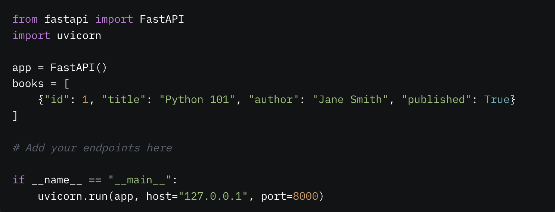
Homework
Starter Code:

Slide 20
Homework
Tasks:
Implement all four endpoints.
Test each endpoint using Postman.
Bonus: Add a GET /books/{book_id} endpoint to fetch a single book by ID.
Submission:
Submit your books.py file and a screenshot of your Postman tests by [insert deadline].
Tips:
Use the Todo scenario as a reference.
Check http://127.0.0.1:8000/docs for interactive testing.
Handle errors (e.g., “Book not found”) gracefully.

Slide 21
Questions & Answers

Slide 22

Before you go…
Please take 2 minutes to give us feedback on today’s lesson.
This feedback is anonymous and only seen by the DCP team!
Scan the QR code or go to: https://redischool.typeform.com/lessonfeedback

