Slide 1
Requirements
Process up to 400 caps/minute – <150ms processing time for top + bottom images (2 cameras)
Detect any defect that would be visible to the human eye -> Tested and verified Resnet + Autoencoder is the best solution
-Scrapes
-Major dents
-Misprinted logos
-Misaligned logos
-Any other major defects (poorly cut caps etc.)
Low cost
Easy to add new cap designs to the software as-needed

Slide 2
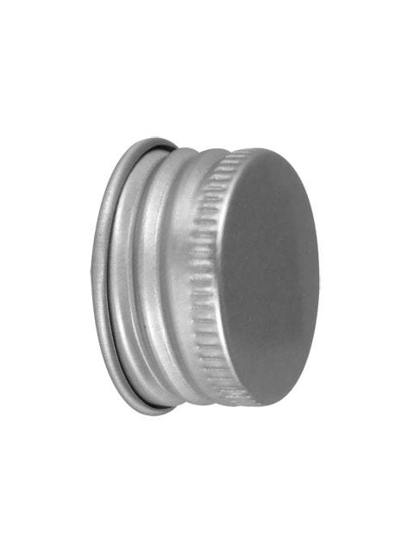
System Overview
One-Shot Trigger Sensor
One-shot trigger:
Sensor to determine when the cap is stopped and ready for a frame capture. Computer measures sensor output and triggers a single frame capture on both cameras.
Fail Output Relay:
Relay to allow the computer to control an actuator that pushes defect caps off the line.
Cameras:
Hardware triggered frame output is a must. Polling frames from the camera would require an extremely high frame rate to maintain an acceptable worst-case delay.
Camera
Camera
Compute
‘Fail’ Output Relay
To actuator

Slide 3
Compute - Centralized
Line 1
One-Shot Trigger Sensor
Line 2
Line 4
Compute
Camera
Camera
‘Fail’ Output Relay
To actuator
…

Slide 4
Compute - Centralized
Expensive
$2-3k on a high-end desktop PC with GPU
multi-port ethernet NIC,
ethernet/USB GPIO expander for relay control
Gigabit Ethernet cameras – tend to be higher cost
Power hungry – 500-1000W
Too much coupled software and hardware makes development and testing difficult
Camera trigger and frame latency will be high, reducing maximum potential throughput
Bad idea.

Slide 5
Per-Line Embedded Compute
One-Shot Trigger Sensor
~$300 for embedded compute on each assembly line
Capable of low latency capture and analysis (10’s of ms)
Each assembly line functions independently with its own system
Software is relatively easy – very little CPU involvement (mostly AI accelerator workload)
With the right trigger circuit, cameras can be triggered directly for ultra-low latency. After completing frame readout, a SYNC/INT signal can trigger DMA interrupt for frame buffering. No CPU involvement.
Good solution
Camera
Camera
MIPI CSI-2, SYNC/INT
MIPI CSI-2,
SYNC/INT
Nvidia Jetson Orin Nano
GPIO
‘Fail’ Output Relay
To actuator

Slide 6
Coral dev board limited to one camera per board – only one CSI interface and limited RAM for frame buffering
Beaglebone is a non-starter – will take seconds to process a single frame using the CPU for inference
Pi has no AI hardware acceleration. Cannot use GPU for AI inference, it only supports OpenGL. Will take seconds to process a frame.
Jetson Nano will struggle to process 2 simultaneous image streams, but may work with a single cam stream with some optimization.
Orin Nano can easily perform control and inference of a two-camera system at a frame rate of 100+ fps.

Slide 7
Camera Selection
If you can accommodate a short 15-30cm flex cable in the system, CSI-2 is by far the most reliable and highest performing interface.

Slide 8
Camera Requirements
Proof-of-concept done on 224x224 images from laptop webcam (cropped region of interest)
900x900 should be more than enough to detect even small defects
2MP camera should be sufficient – must have a hardware trigger input and ideally should have a VSYNC/HSYNC output to interrupt CPU
Purchase some cheap M12 lenses with varying FOV to allow flexibility in camera position and maximize pixel density in the region of interest
Use a global shutter if you plan on capturing the caps as they’re actively moving across the camera field of view. Local shutter is fine if the caps are stopping in front of the camera and remaining static for a short time.

Slide 9
Cameras
https://www.e-consystems.com/nvidia-jetson-orin-nx-orin-nano-cameras.asp
Based in Chennai
FHD AR0234 Global Shutter Camera for NVIDIA® Jetson Orin NX / Orin Nano
Seems like an OK camera – should get datasheet for more info. Website download link is broken.

