Slide 1
Implementation
Pre-trained Resnet model extracts features
Trained autoencoder reconstructs original image using Resnet extracted features
Only good samples are required to train the model!
Industry-standard approach
Watch this for more details: Deep Learning for Computer Vision with Pytorch: Complete Project for Beginners - YouTube
Image capture and inference on HP 840 G7 laptop.
-No GPU
-1MP webcam (224x224 cropped region of interest)

Slide 2
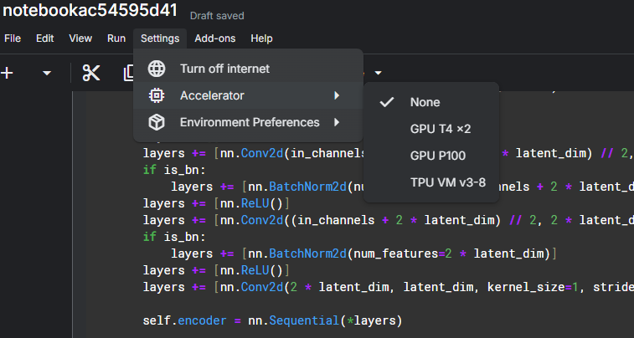
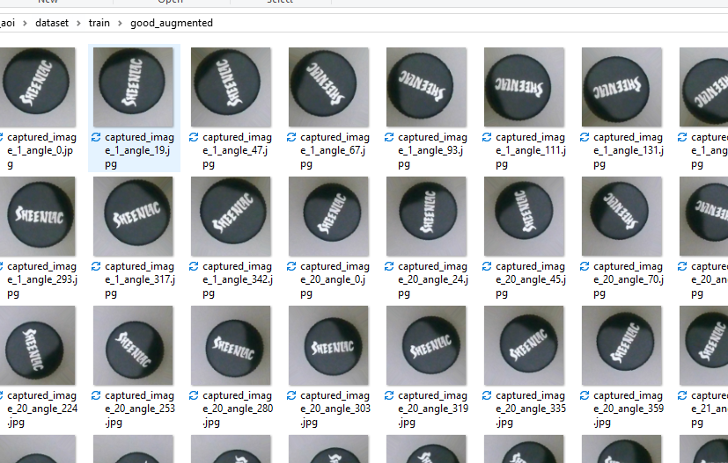
Training
Augmented limited sample size of good caps with random rotation angles, lighting variations, positional variation.
Trained model on ~177 images using cloud-based Nvidia T4 GPU on Kaggle.com
~2mins training time

Slide 3
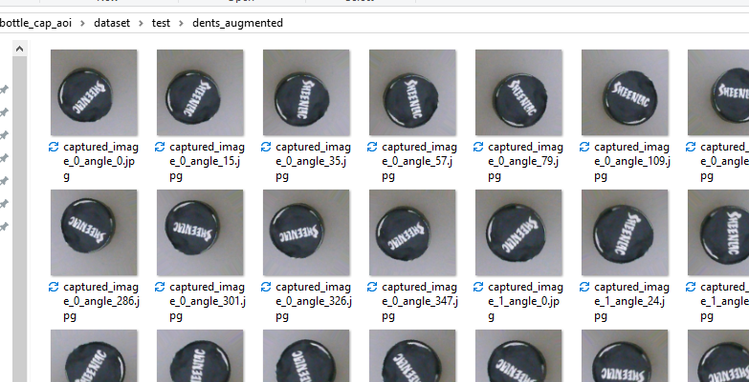
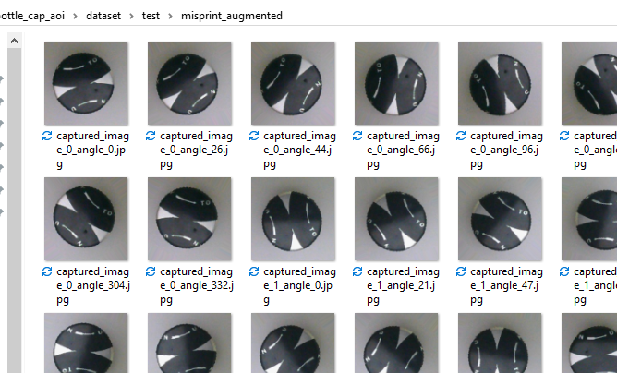
Testing
Augmented the limited sample set of caps with random rotations, lighting variations, position/zoom within the frame.
Ran model inference on both original and augmented images to determine pass/fail thresholds and performance

Slide 4
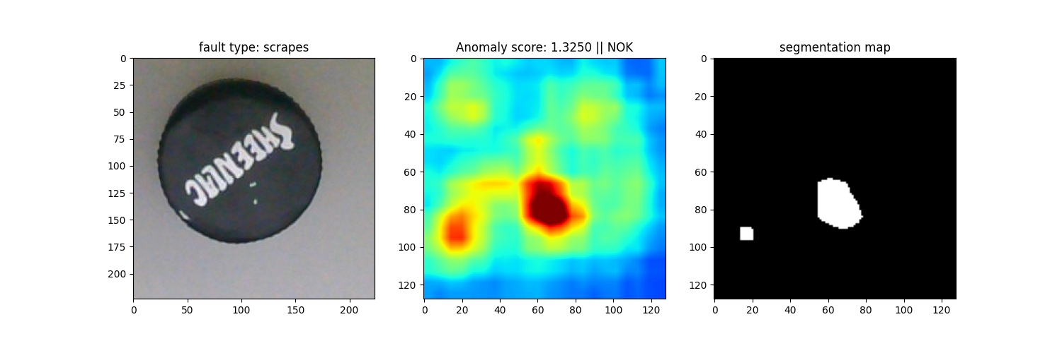
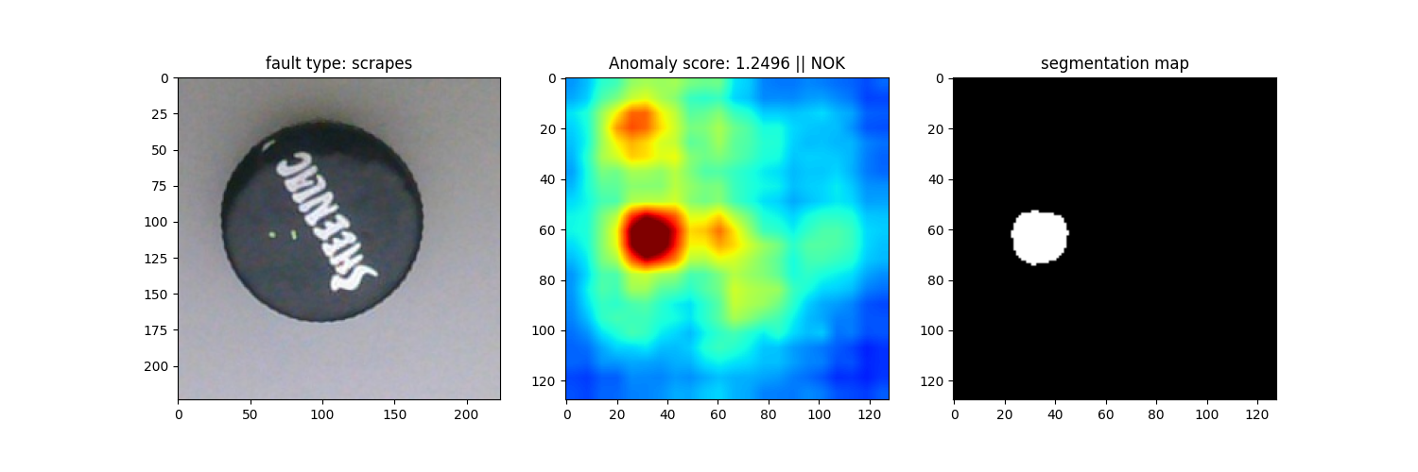
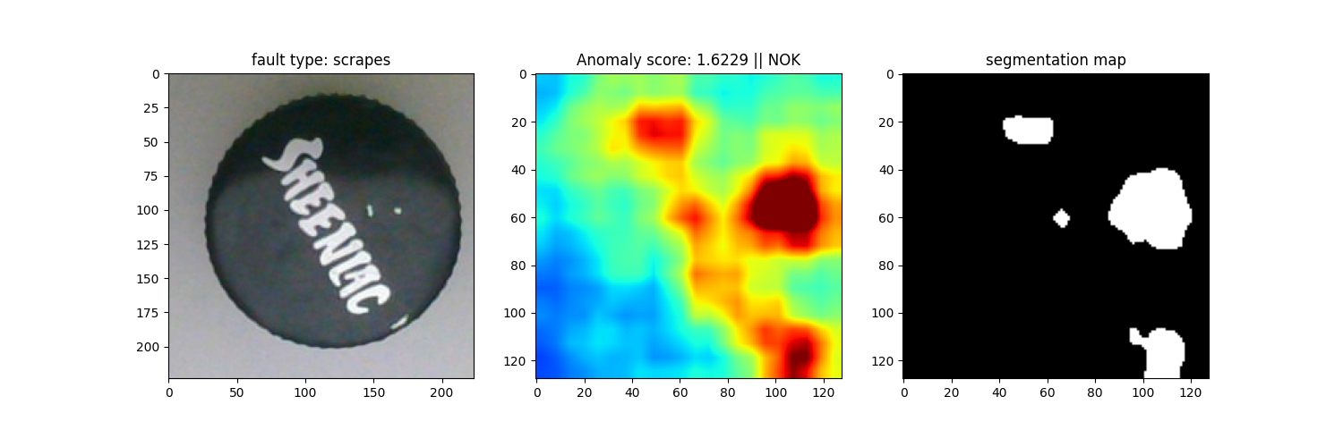
Scrapes
Excellent model performance under all rotation, zoom, and shadow/reflection conditions

Slide 5
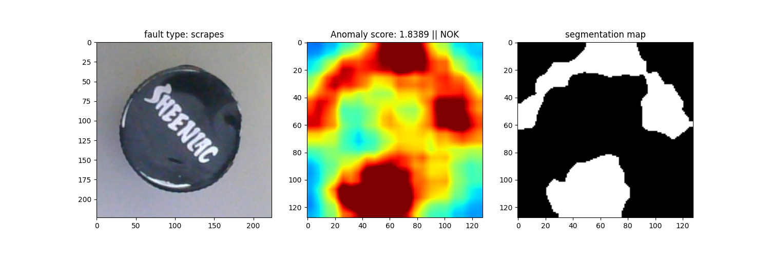
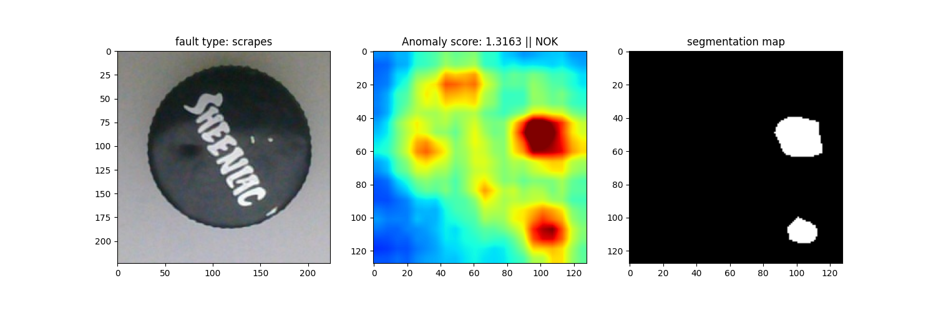
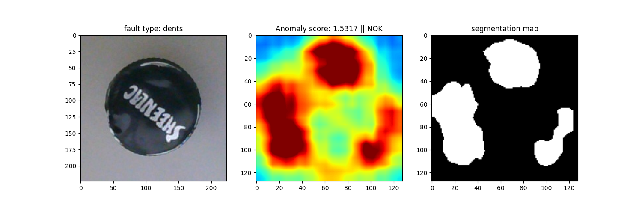
Dents
Major dents easily flagged as fail
Minor dents are visible on heatmap but do not exceed the fail threshold (not visible on segmentation map)
Human visual identification of minor dents in caps is also difficult without ideal lighting
Experiment further with higher resolution camera if needed

Slide 6
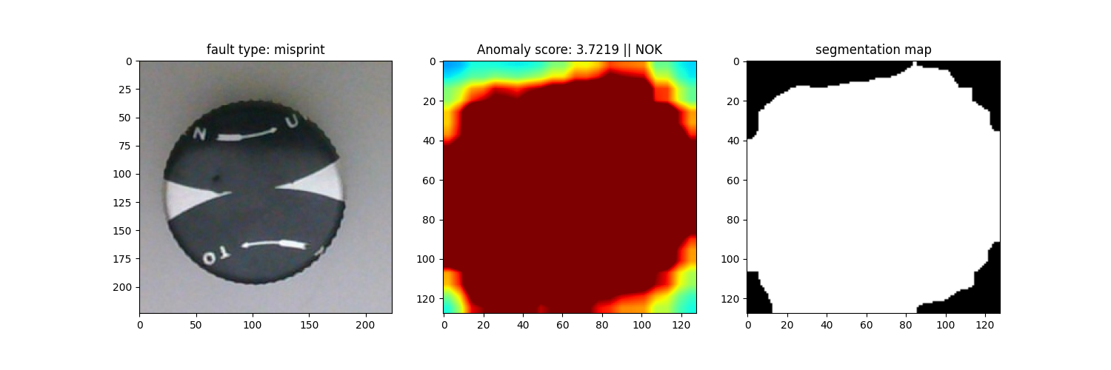
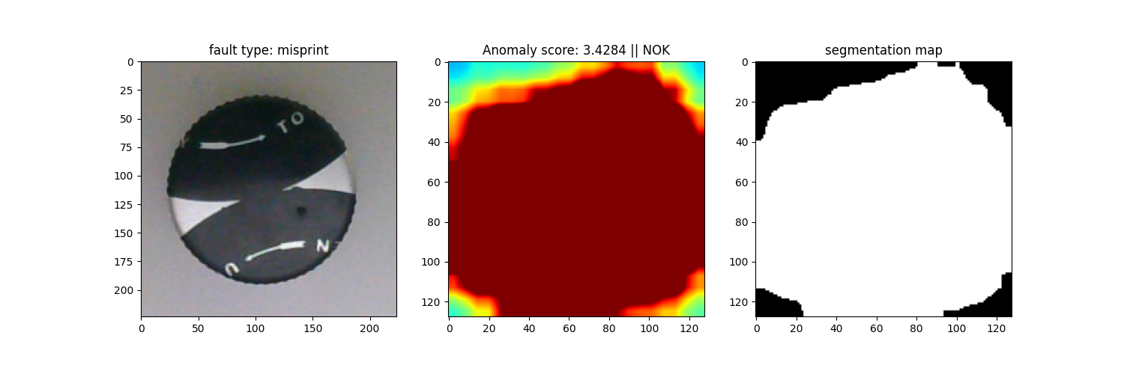
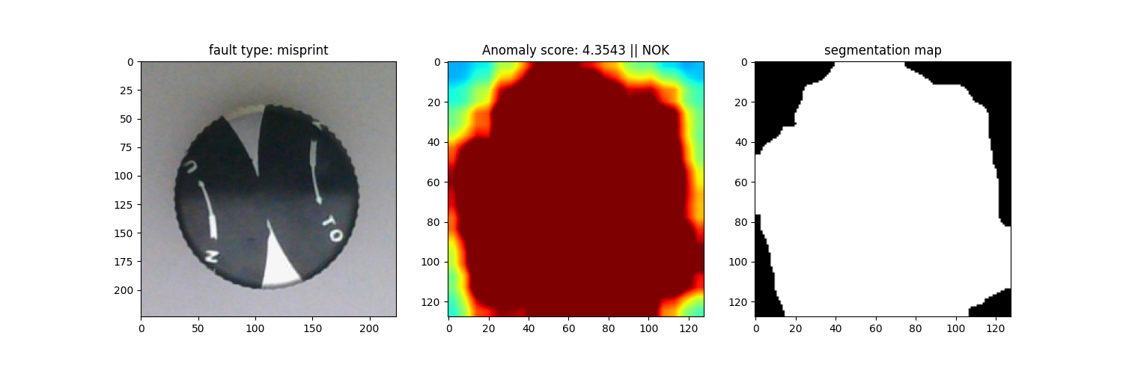
Misprints
Trivial to identify.

Slide 7
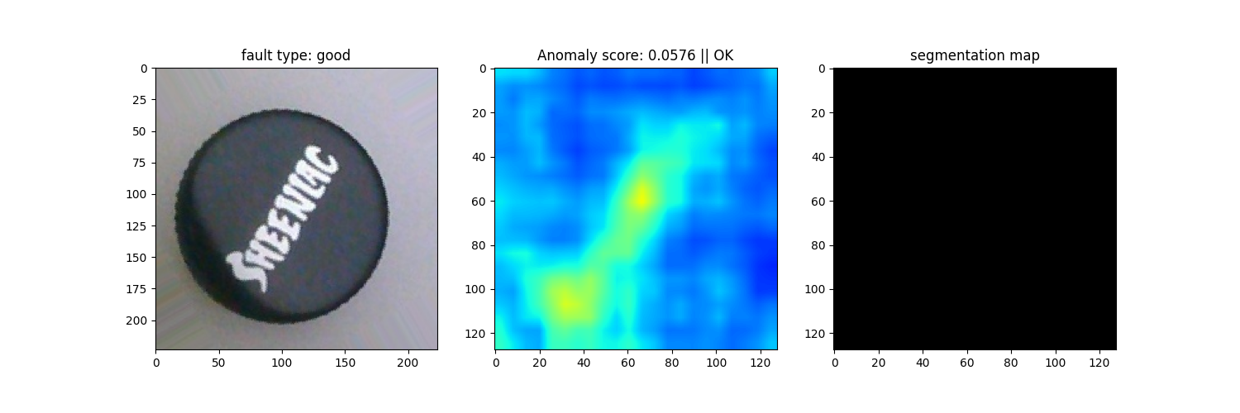
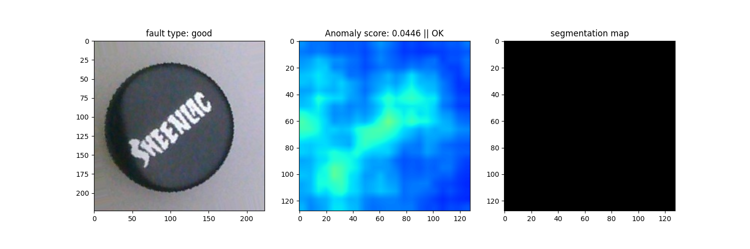
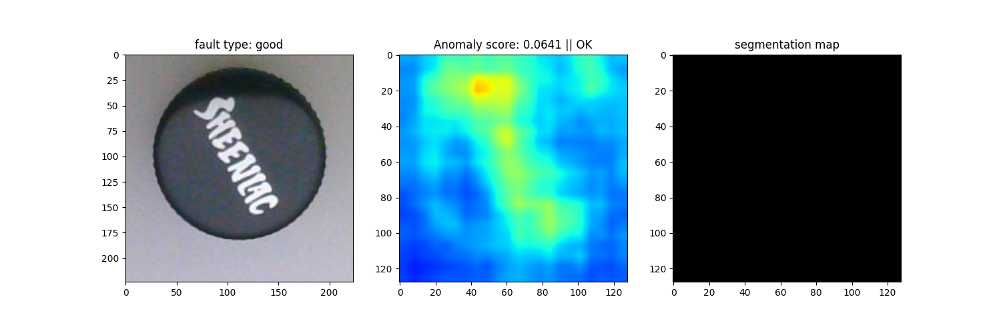
No Defect
Good performance across many rotations and shading.

Slide 8
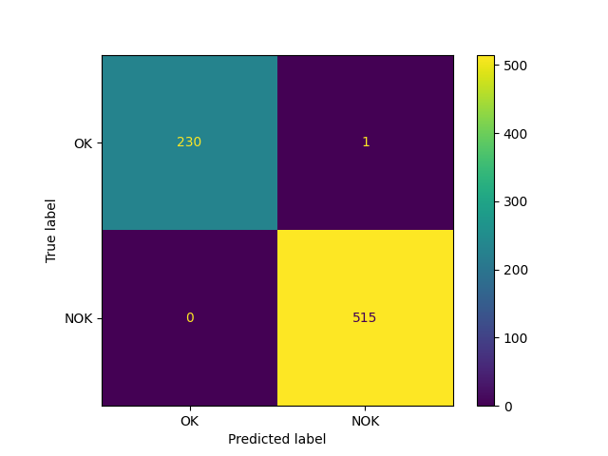
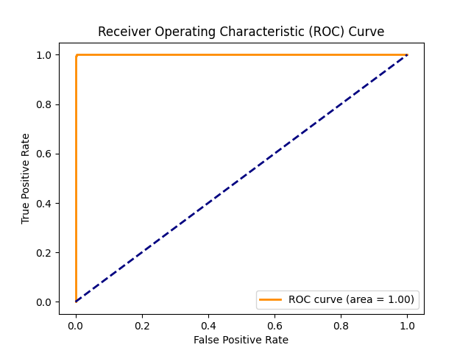
Overall Performance
Excellent performance over ~700 augmented sample images with varying zoom, lighting, position, and rotation (1 incorrectly identified sample – ~0.13% failure rate)
OK = Pass
NOK = Fail

