Slide 1
International Business
Strategy, Management & the New Realities
Theories of International Trade and Investment

Slide 2
Learning Objectives
Theories of international trade and investment
Why nations trade
How nations enhance their competitive advantage: contemporary theories
Why and how firms internationalize
How firms gain and sustain international competitive advantage

Slide 3
Comparative advantage
  Superior features of a country that provide it with unique benefits in global competition – derived from either national endowments or deliberate national policies
Competitive advantage
  Distinctive assets or competencies of a firm – derived from cost, size, or innovation strengths that are difficult for competitors to replicate or imitate

Slide 4
Perspectives of the Nation and the Firm
Comparative advantage
Is the concept that helps answer the question of all nations can gain and sustain national economic superiority
Competitive advantage
Is the concept that helps explain how individual firms can gain and sustain distinctive competence vis-à-vis competitors

Slide 5
Examples of National Comparative Advantage
China is a low labor cost production base
India’s Bangalore region offers a critical mass of IT workers
Ireland’s repositioning enabled a sophisticated service economy
Dubai, a previously obscure Emirate, has been transformed into a knowledge-based economy

Slide 6

Examples of Firm Competitive Advantage
Dell’s prowess in global supply chain management
Nokia’s design and technology leadership in telecommunications
Samsung’s leadership in flat-panel TV
Herman Miller’s design leadership
in office furniture
(e.g., Aeron chairs)

Slide 7
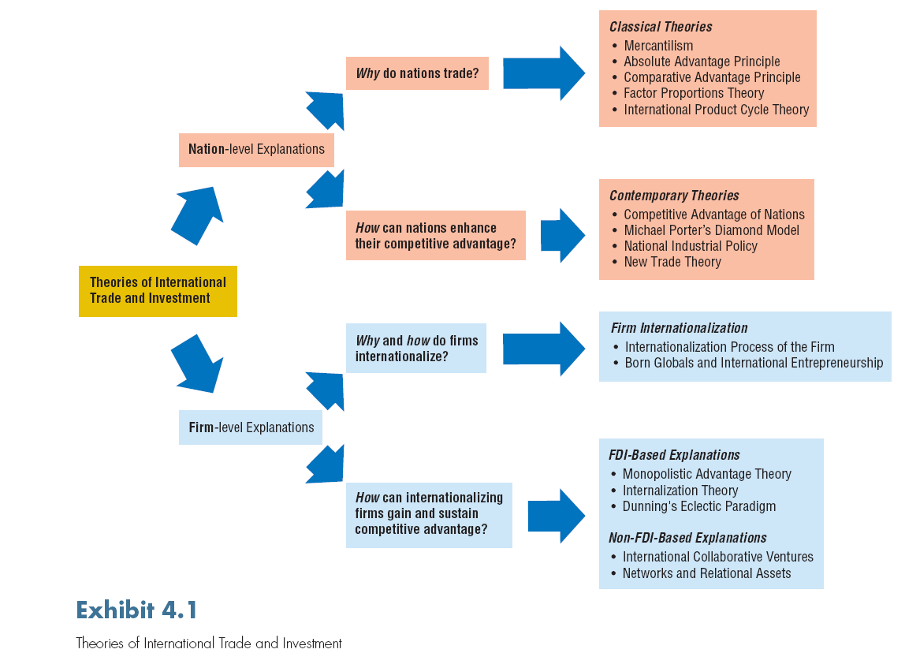

Slide 8
Why Nations Trade: Classical Theories
Mercantilism: the belief that national prosperity is the result of a positive balance of trade – maximize exports and minimize imports
Absolute advantage principle: a country should produce only those products in which it has absolute advantage or can produce using fewer resources than another country

Slide 9
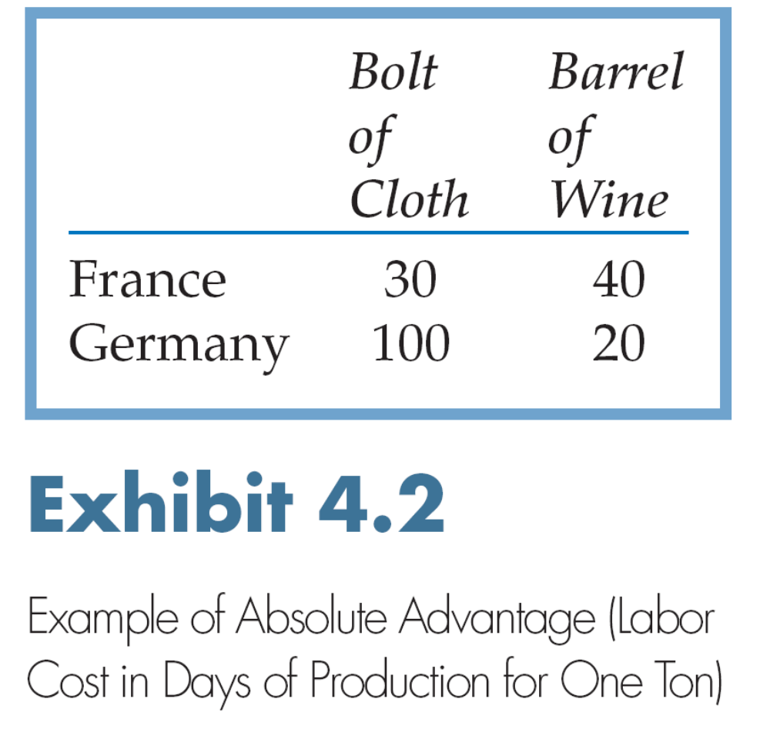

Slide 10
Why Nations Trade: Classical Theories
Comparative advantage principle: it is beneficial for two countries to trade even if one has absolute advantage in the production of all products; what matters is not the absolute cost of production but the relative efficiency with which it can produce the product
By specializing in what they produce best and trade for the rest, countries can use scarce resources more efficiently

Slide 11
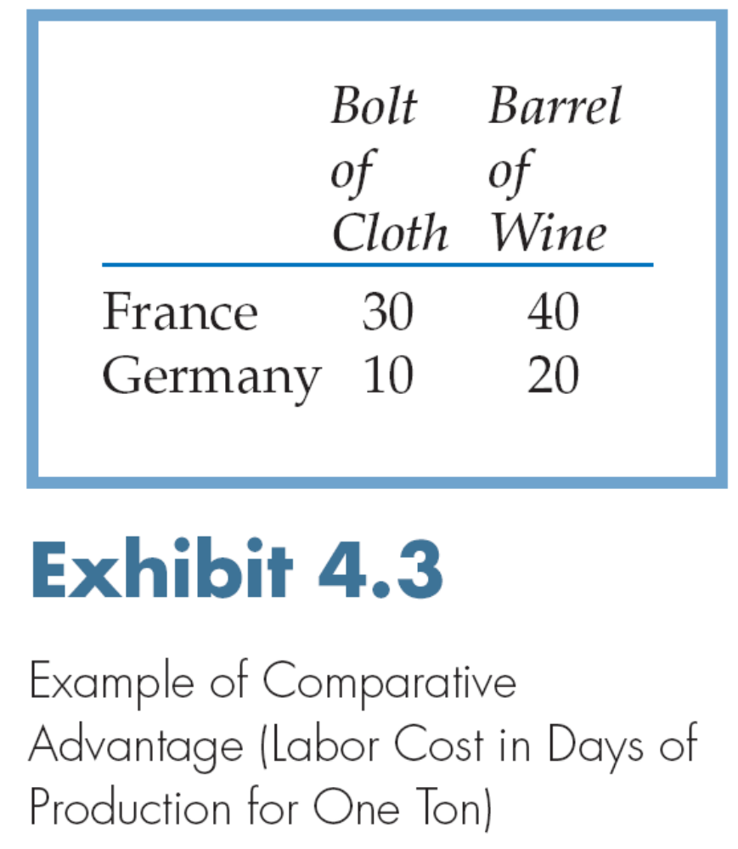

Slide 12
Limitations of Early Trade Theories
Do not take into account the cost of international transportation
Tariffs and import restrictions can distort trade flows
Scale economies can bring about additional efficiencies
When governments selectively target certain industries for strategic investment, this may cause trade patterns contrary to theoretical explanations
Today, countries can access needed low-cost capital on global markets
Some services do not lend themselves to cross-border trade

Slide 13
Classical Theories: Factor Proportions Theory
Factor proportions (endowments) theory: each country should produce and export products that intensively use relatively abundant factors of production, and import goods that intensively use relatively scarce factors of production
Leontief paradox suggested that countries can be successful in the export of products that require a less abundant resource (e.g., the U.S. with its labor-intensive exports)
The Leontief paradox implies that international trade is complex and cannot be fully explained by a single theory, e.g., the abundance of a certain production input

Slide 14
Classical Theories:
International Product Cycle Theory
International product cycle theory: each product and its associated manufacturing technologies go through three stages of evolution:
Introduction, growth, and maturity
In the introduction stage, the inventor country enjoys a monopoly both in manufacturing and exports
As the product’s manufacturing becomes more standard, other countries will enter the global marketplace

Slide 15
International Product Cycle Theory contd…
When the product reaches maturity, the original innovator country will become a net importer of the product
Applicability to the contemporary global economy: Today, the cycle from innovation to maturity is much shorter making it harder for the innovator country to sustain its lead in a particular product

Slide 16
How Nations Enhance Competitive Advantage
The contemporary view suggests that governments can proactively implement policies to enhance a nation’s competitive advantage, beyond the natural endowments the country possesses
Governments can create national economic advantage by: stimulating innovation, targeting industries for development, providing low-cost capital, and through other incentives

Slide 17
Michael Porter’s Diamond Model:
Sources of National Competitive Advantage
Firm strategy, structure, and rivalry – the presence of strong competitors at home serves as a national competitive advantage
Factor conditions – labor, natural resources, capital, technology, entrepreneurship, and know how
Demand conditions at home – the strengths and sophistication of customer demand
Related and supporting industries – availability of clusters of suppliers and complementary firms with distinctive competences

Slide 18
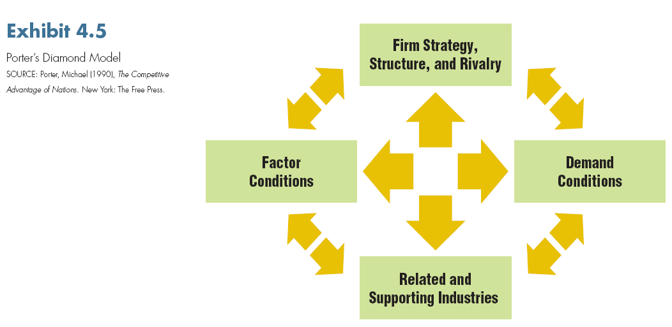

Slide 19
Industrial Clusters
A concentration of suppliers and supporting firms from the same industry located within the same geographic area
Examples include: the Silicon Valley, fashion cluster in northern Italy, Pharma cluster in Switzerland, Footwear industry in Pusan, South Korea, and the IT industry in Bangalore, India
Industrial clusters can serve as an export platform for individual nations

Slide 20
National Industrial Policy
Proactive economic development plan implemented by the public sector to nurture or support promising industry sectors with potential for regional or global dominance.
Public sector initiatives can include:
Tax incentives
Monetary and fiscal policies
Rigorous educational systems
Investment in national infrastructure
Strong legal and regulatory systems

Slide 21
National Industrial Policy:
Ireland as an Example
Beginning in the 1980s, the Irish government implemented a series of pro-business policies to build strong economic sectors. The “Irish Miracle” resulted from:
Fiscal, monetary, and tax consolidation
Partnership with the industry and unions
Emphasis on high-value adding industries such as pharma, biotechnology, and IT
Membership in the European Union; subsidies and investment received from the EU
Investment in education

Slide 22
New Trade Theory
The argument that economies of scale are an important factor in some industries for superior international performance – even without any clear comparative advantage possessed by the nation. Some industries succeed best as their volume of production increases.
For example, the commercial aircraft industry has very high fixed costs that necessitate high-volume sales to achieve profitability.

Slide 23
Why and How Firms Internationalize
The internationalization process model of the firm suggests a gradual, evolutionary path to internationalization
The slow and incremental nature of internationalization by the firm results from the uncertainty and uneasiness that managers have about cross-border transactions
A predictable pattern of internationalization may include the following stages: domestic focus, pre-export stage, experimental involvement, active involvement, and committed involvement

Slide 24


Slide 25
Born Global Firms and
International Entrepreneurship
The slow, gradual internationalization predicted by the process model is no longer practical or realistic in today’s fast-paced, interconnected economy
Today many firms, even those that are young or without much experience, take bold steps to internationalize
Indicative of this trend is the emergence of Born Global companies – young, entrepreneurial firms that take on internationalization early in their evolution and leapfrog into global markets

Slide 26
How Firms can Gain and Sustain
International Competitive Advantage
Since the MNE has traditionally been the major player in international business, many scholars have offered explanations of what makes these firms pursue, and succeed in, internationalization
FDI has been the principal strategy used by MNEs in international expansion; therefore, earlier theoretical explanations relate to motives for, and patterns of, foreign direct investment

Slide 27
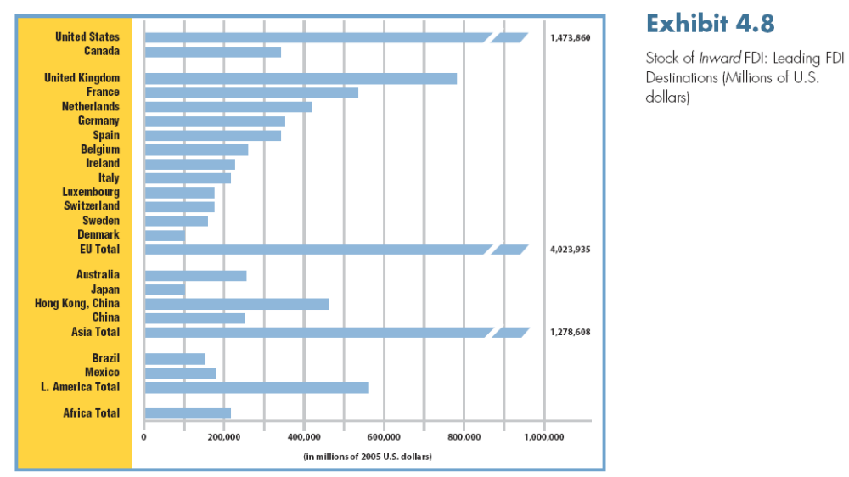

Slide 28
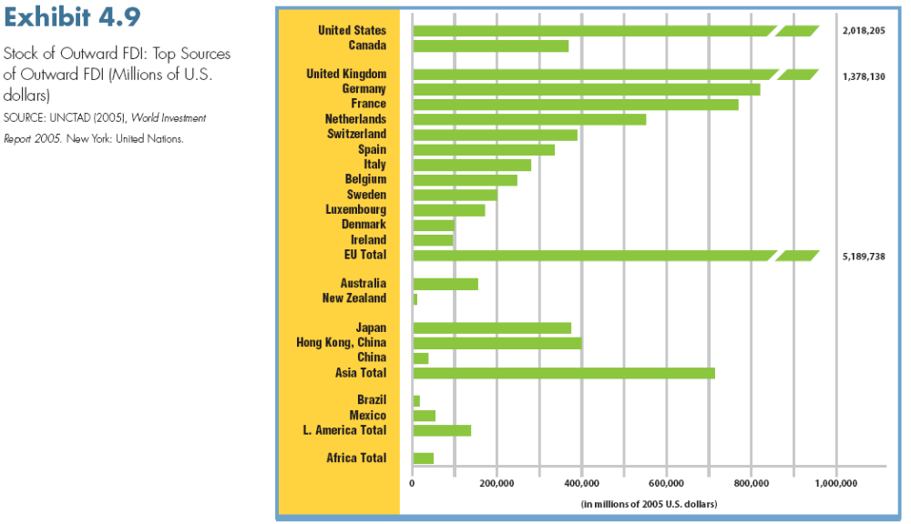

Slide 29
FDI Based Explanations:
Monopolistic Advantage Theory
Suggests that FDI is preferred by MNEs because it provides the firm with control over resources and capabilities in the foreign market, and a degree of monopoly power relative to foreign competitors
Key sources of monopolistic advantage include proprietary knowledge, patents, unique know-how and skills, and sole ownership of other assets

Slide 30
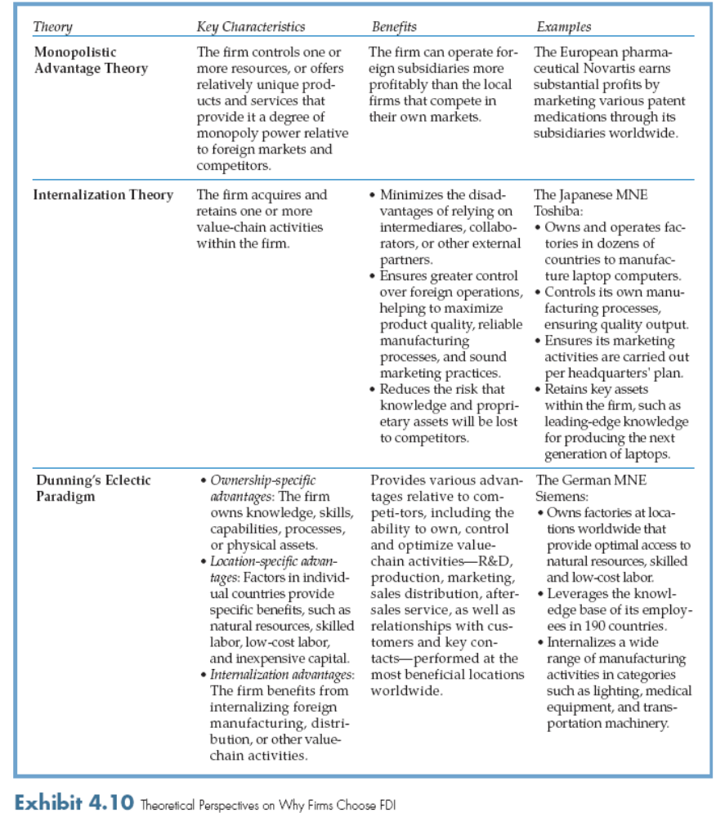

Slide 31
FDI Based Explanations:
Internalization Theory
Explains the process by which firms acquire and retain one or more value-chain activities inside the firm – retaining control over foreign operations and avoiding the disadvantages of dealing with external partners
In contrast to arm’s-length foreign market entry strategies (such as exporting and licensing) which imply developing contractual relationships with external business partners, FDI implies control and ownership of resources

Slide 32
FDI Based Explanations:
Dunning’s Eclectic Paradigm
Three conditions determine whether or not a company will internalize via FDI:
Ownership-specific advantages – knowledge, skills, capabilities, relationships, or physical assets that form the basis for the firm’s competitive advantage
Location-specific advantages – advantages associated with the country in which the MNE is invested, including natural resources, skilled or low cost labor, and inexpensive capital
Internalization advantages – control derived from internalizing foreign-based manufacturing, distribution, or other value chain activities

Slide 33
Non-FDI Based Explanations:
International Collaborative Ventures
While FDI-based internationalization is still common, beginning in the 1980-90’s firms have increasingly utilized non-equity, flexible collaborative ventures in international market entry.
A collaborative venture is a form of cooperation between two or more firms. Through collaboration, a firm can gain access to foreign partner’s know-how, capital, distribution channels, and marketing assets, and overcome government imposed obstacles.
In an international collaborative venture partners share this risk of their joint efforts and pool resources and capabilities to create synergy.

Slide 34
Two Types of
International Collaborative Ventures
Equity-based joint ventures result in the formation of a new legal entity. In contrast to the wholly-owned FDI, the firm collaborates with local partner(s) to reduce risk and commitment of capital.
Project-based alliances do not require equity commitment from the partners but simply a willingness to cooperate in R&D, manufacturing, design, or any other value-adding activity. Since project-based alliances have a narrowly defined scope of activities and timeline, they provide greater flexibility to the firm than equity-based ventures.

