Slide 1


What’s new in .NET Core 3.0 / C# 8.0
CS80
The future of .NET and C#:
Nithin Mohan
@nithinmohantk
www.thingx.cloud
Addict! - .NET Foundation Member
LKMUG.org – Founder / Community Lead

Slide 2
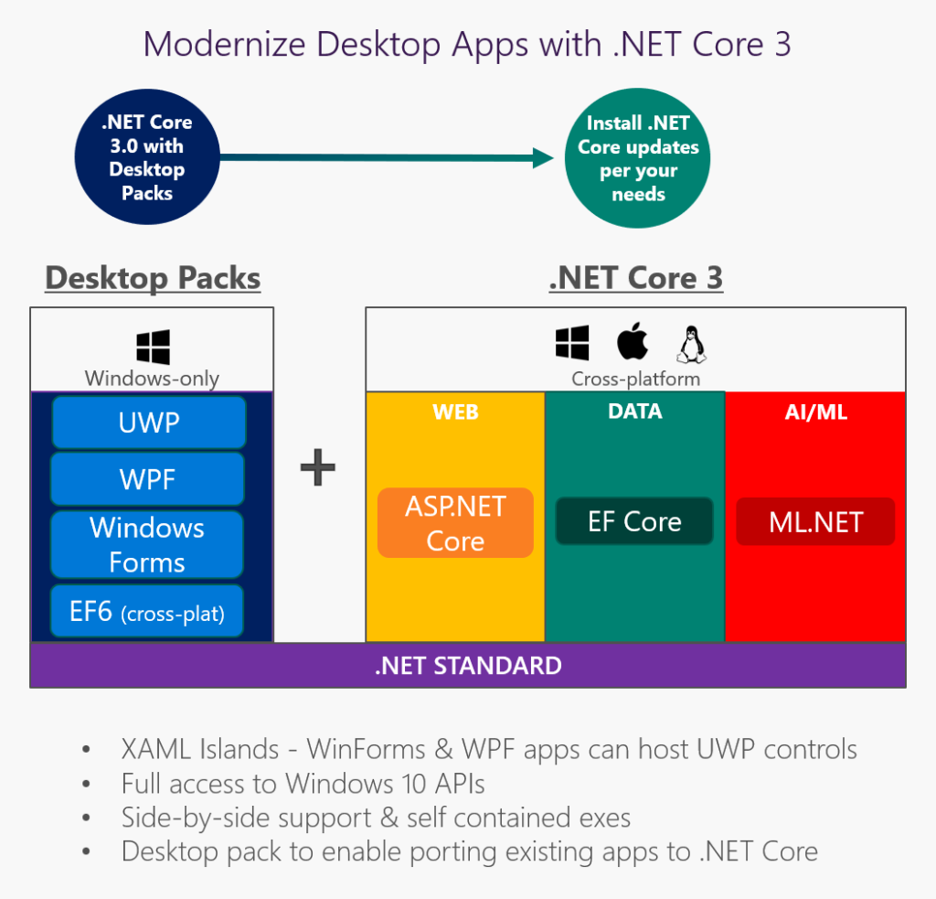
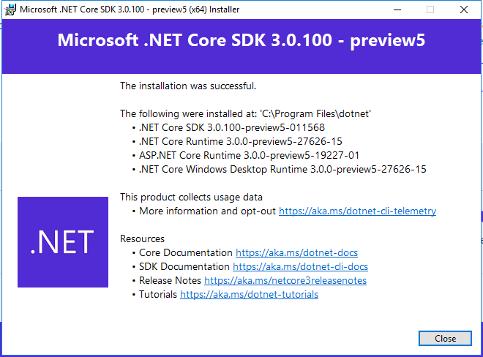
.NET Core 3.0
Notes:
The architectural environment of .NET Core includes common language specifications to define the implementation of objects, Framework Class Library to collect reusable resources, and Common Language Runtime to manage execution of programs.
As an open-source platform, it offers features like:
A Convenient Deployment Model:
Targeting the .NET Standard library that is available on all runtimes. It enables building a cross-platform library to use across the projects.

Slide 3
.NET Core vs .NET Standard
.NET Core:
This is the latest .NET implementation.
It’s open source and available for multiple OSes.
With .NET Core, you can build cross-platform console apps and ASP.NET Core Web applications and cloud services.
.NET Standard:
This is the set of fundamental APIs (commonly referred to as base class library or BCL) that all .NET implementations must implement.
By targeting .NET Standard, you can build libraries that you can share across all your .NET apps, no matter on which .NET implementation or OS they run.

Slide 4
Standards and Languages

Slide 5
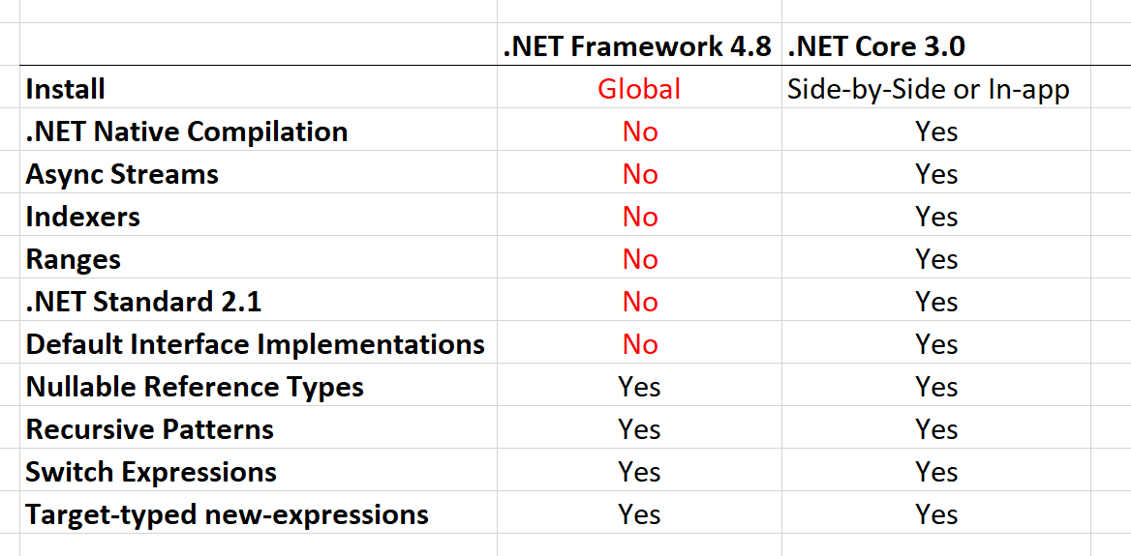
.NET Standard 2.1
Span<T>
Index and Range
IAsyncEnumerable<T>
Reflection emit and capability APIs
SIMD Hardware Intrinsics API [post 1, post 2]
DbProviderFactories
No support in full .NET Framework
.NET Standard is a specification for implementing the BCL.
Notes:
IAsyncEnumerable<T> - for async streams
Reflection emit and capability APIs - for dynamic code generation, checks and generating code
SIMD API
using Intel SSE, SSE2, AVX2, ARM, ARM64 directly from managed code
moving from C++ portion of runtime to C#
better for JIT targeting
optimized basic operations in BCL, such as string comparison
DbProviderFactories - use ADO.NET provider without knowing its type at compile type

Slide 6

F#
F# 4.6 [announcement]
dotnet fsi - F# interactive

Slide 7
.NET Core BCL and tools

Slide 8

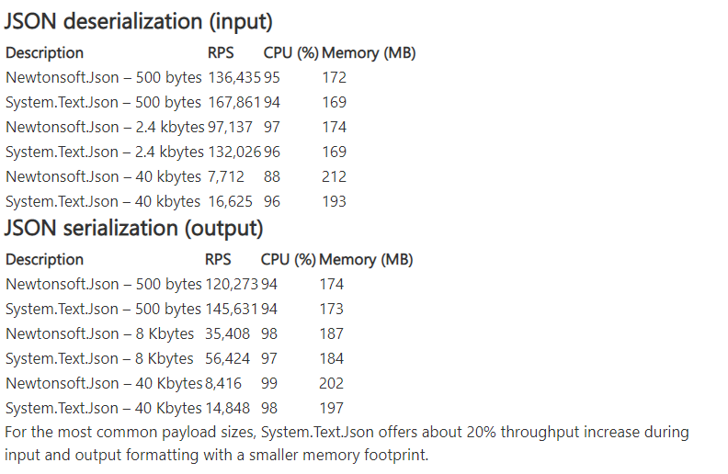
JSON
System.Text.Json
Utf8JsonReader
Utf8JsonWriter
JsonDocument
JsonSerializer [info and samples]
Announcement / Roadmap

Slide 9
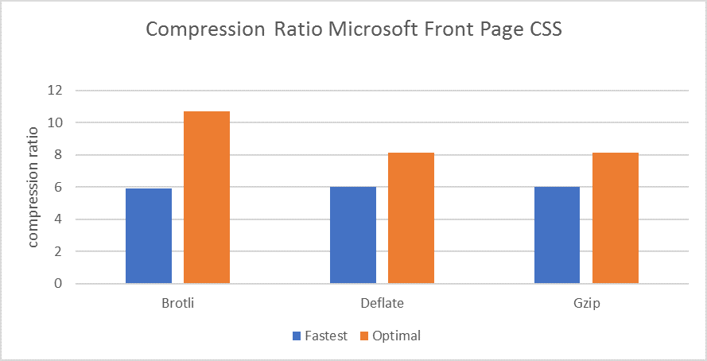
BCL improvements
Span<T> and Memory<T> optimizations
String types optimized when used as keys with Dictionary<TKey, TValue>
HttpClient
Brotli compression
HTTP/2 [announcement]
Microsoft.Data.SqlClient
Notes:
Span<T> added in .NET Core 2.1
Currently, ASP.NET developers have two compression methods available to use in their web applications: Deflate and gzip. But there is a trade off between compression time and size reduction. Different algorithms can perform quite differently.
In 2015, two engineers at Google designed a new compression algorithm called Brotli that can have a better compression without spending more time.
Brotli is already supported by the most browsers such as Google Chrome, Mozilla Firefox, Opera, and Microsoft Edge.
HTTP/2 is a major revision of the HTTP protocol. Some of the notable features of HTTP/2 are support for header compression and fully multiplexed streams over a single connection. While HTTP/2 preserves HTTP’s semantics (HTTP headers, methods, etc) it's a breaking change from HTTP/1.x on how this data is framed and sent over the wire.
What does this mean for System.Data.SqlClient?
System.Data.SqlClient will still be supported and receive important security updates, so there is no need to move if your application works well with it. But if you want to take advantage of any new features, you should consider upgrading to Microsoft.Data.SqlClient.

Slide 10
.NET Core tools
Local dotnet tools
dotnet-tools.json
dotnet new tool-manifest
dotnet tool list (-g)
dotnet tool restore / run / install / uninstall
dotnet build copies dependencies by default
no need for dotnet publish
dotnet publish for single-file exe [more info]
dotnet publish -r win10-x64 /p:PublishSingleFile=true
Tiered compilation on by default
ARM64 for Linux [status] ???
Install on Linux with Snap [setup]
Notes:
Tiered
Optimize for both startup and throughput
Was opt-in, under a switch in .NET Core 2.1 and 2.2
ARM64
Primary use case - IoT scenarios
.NET Core 2.1 - added ARM32 for Linux
.NET Core 2.2 - added ARM32 for Windows
Publishing Single EXEs
You can now publish a single-file executable with dotnet publish.

Slide 11
.NET Core other
AssemblyDependencyResolver [samples]
Assembly Unloadability [samples]
Windows Native Interop [samples]
DLLMap and Native image resolver events [samples]
Serial Port APIs supported on Linux [samples]
System.Devices.Gpio - for IoT ports [samples]
TLS 1.3 & OpenSSL 1.1.1 on Linux
Cryptography
AES-GCM & AES-CCM algorithms
Cryptographic key import / export
Notes:
AssemblyDependencyResolver - for plugin scenarios, dynamically loaded assemblies
Unloadability - for plugins, scripts, web sites
Windows Native
P/Invoke since .NET Core 1.0
CoCreate COM APIs and Activate WinRT APIs in .NET Core 3.0
NativeLibrary APIs - multiplatform
Serial Port
Controlling Arduino with .NET using Raspberry Pi
Flash Arduino from Raspberry Pi
System.Devices.Gpio
separate NuGet package
GPIO, PWM, SPI and I2C APIs
TLS 1.3 - Linux only, with OpenSSL lib... Windows and macOS support will be provieded by respective operating system in future
Crypthographic key import / export - various formats

Slide 12
Entity Framework Core
EF 6.3 ported to .NET Core
Lots of breaking changes
Cosmos DB support
LINQ improvements
C# 8 support
like async streams and nullable reference types
Database views reverse engineering
using Query types Entities without keys
Property bag entities
EF Core no longer part of ASP.NET Core shared framework
Targets .NET Standard 2.1

Slide 13
.NET Framework 4.8
The .NET Framework 4.8 includes an updated toolset as well as improvements in several areas: [Runtime] JIT and NGEN Improvements [BCL] Updated ZLib [BCL] Reducing FIPS Impact on Cryptography [WinForms] Accessibility Enhancements [WCF] Service Behavior Enhancements [WPF] High DPI Enhancements, UIAutomation Improvements

Slide 14
C# 8.0
What’s new in Csharp

Slide 15

C# 8
Index and Range
Async streams [tutorial]
Using declarations
using var reader = file.OpenText();
Switch expressions
Default implementation for interface members
IEEE 754-2008 floating point API improvements [introduction]
Notes:
Async streams - with IAsyncEnumerable<T>
Floating point changes - alignment and fixes for platforms implementations

Slide 16
C# 8.0: Default interface members
public interface IConferenceSpeaker
{
void Speak();
public string GetSpeakerName()
{
return "John Doe";
}
}
public class ConferenceSpeaker : IConferenceSpeaker
{
public void Speak()
{
Console.WriteLine("Present a talk");
}
}

Slide 17
C# 8.0: ReadOnly members
You can apply the readonly modifier to any member of a struct.
It indicates that the member does not modify state.
It's more granular than applying the readonly modifier to a struct declaration.

Slide 18
C# 8.0: Nullable Reference Types
A reference can be null. No warnings are issued when a reference type is initialized to null, or later assigned to null.
A reference is assumed to be not null. The compiler doesn't issue any warnings when reference types are dereferenced.
(With nullable references, the compiler issues warnings whenever you dereference a variable that may be null).
string? name;
Any variable where the ? is not appended to the type name is a non-nullable reference type.
The compiler warns you if you dereference a nullable reference when it may be null.
You can override this behavior by using the null-forgiving operator (!) following a variable name.
For example, if you know the name variable isn't null but the compiler issues a warning, you can write the following code to override the compiler's analysis:
name!.Length;

Slide 19
C# 8.0: Async streams and disposables
IAsyncEnumerable<Person> people = database.GetPeopleAsync();
public static async System.Collections.Generic.IAsyncEnumerable<int> GenerateSequence() { … }
await foreach (var p in people) { … }
await using (IAsyncDisposable resource = await store.GetRecordAsync(…)) { … }

Slide 20
Windows Desktop

Slide 21
Windows Desktop
Windows Forms
WPF
WinUI
Open-source
How to port desktop applications to .NET Core 3.0
Notes:
Why Windows Desktop on Core?
Performance
Side by side execution
Self-contained exe
BCL improvements
Open-source

Slide 22
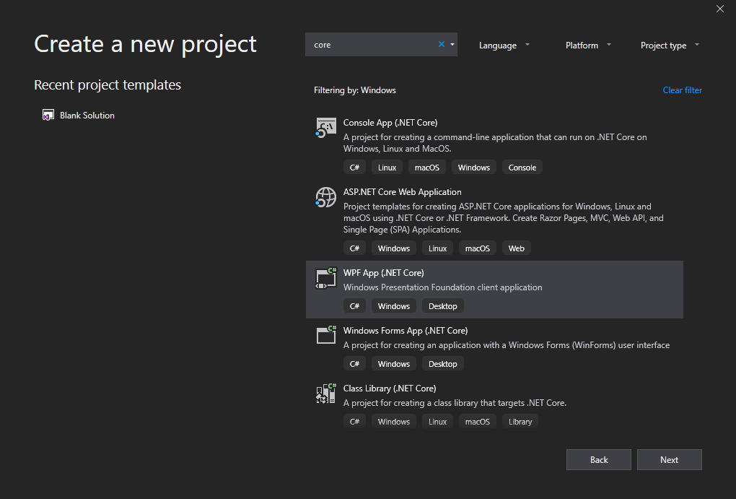
Tools
dotnet new wpf
dotnet new winforms
.NET Core apps have .exe by default
MSIX Deployment for Desktop apps
WinForms Chart

Slide 23
ASP.NET Core

Slide 24
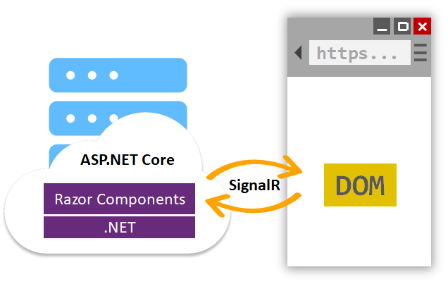
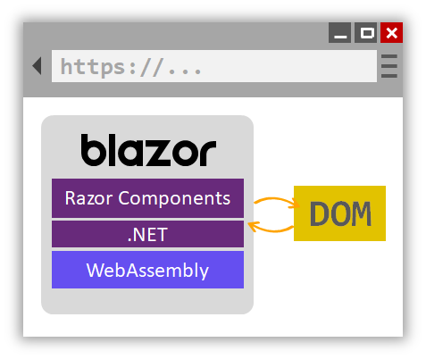
Server-side Blazor
Project templates in VS 2019
.razor files
Hosting on server and client (Blazor)
JavaScript interop - IJSRuntime interface
Class libraries for sharing components
MVC and Razor Pages integration (<Counter>)
Server-side prerendering
Reconnect interface
Integrated with Endpoint routing
Built in support for forms and validation
Notes:
Check out the documentation
https://docs.microsoft.com/en-us/aspnet/core/razor-components/components?view=aspnetcore-3.0

Slide 25
Endpoint routing
app.UseRouting(); app.UseAuthentication(); app.UseAuthorization(); app.UseCors(); app.UseEndpoints(endpoints => { endpoints.MapControllers(); endpoints.MapRazorPages(); endpoints.MapBlazorHub(); endpoints.MapHub<ChatHub>(„hubs/chat“); endpoints.MapGrpcService<CalculatorService>(); });

Slide 26
ASP.NET Core
Json.NET removed from shared framework
services.AddMvc().AddNewtonsoftJson();
Runtime compilation removed
not depending on Roslyn, but can be added manually
System.IO.Pipelines on HttpContext
Generic host inside templates [docs]
HostBuilder instead WebHostBuilder
More options for MVC service registration
AddControllers()
AddControllersWithViews()
AddRazorPages()
Notes:
Endpoint routing
Endpoint class,
New MapXxx() extension methods
CORS
HealthChecks

Slide 27
SPA templates improvements
Upgraded Angular to version 7
SPA authentication with IdentityServer [docs]
services.AddIdentityServer() .AddApiAuthorization<ApplicationUser, ApplicationDbContext>();
services.AddAuthentication() .AddIdentityServerJwt();
Notes:
SPA auth not available from VS
dotnet new react -au Individual
Angular template has at least one problem
React has multiple issues

Slide 28
SignalR improvements
Client-to-server streaming [docs]
https://streamr.azurewebsites.net/
Endpoint Routing support
Long Polling for Java clients
if WebSockets aren’t supported

Slide 29
Templates

Slide 30
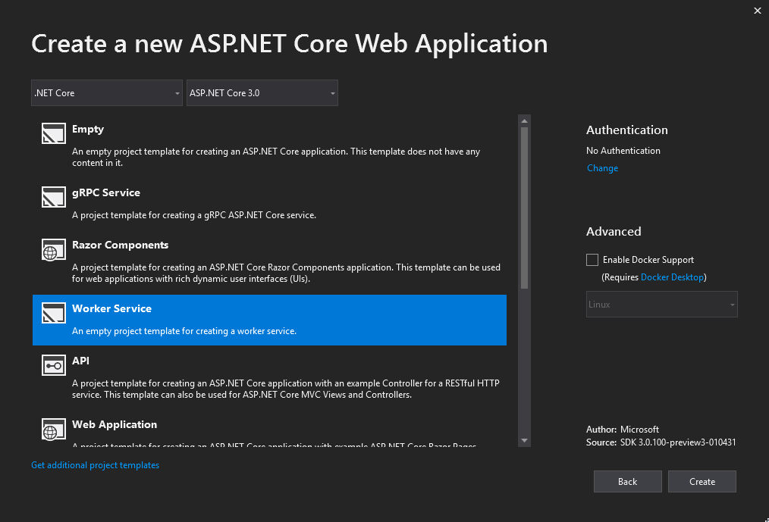
Worker Service template
Long running background processes
Windows Service or Linux Daemon
Logging, DI, Configuration…
but without web dependencies
Microsoft.NET.Sdk.Worker

Slide 31
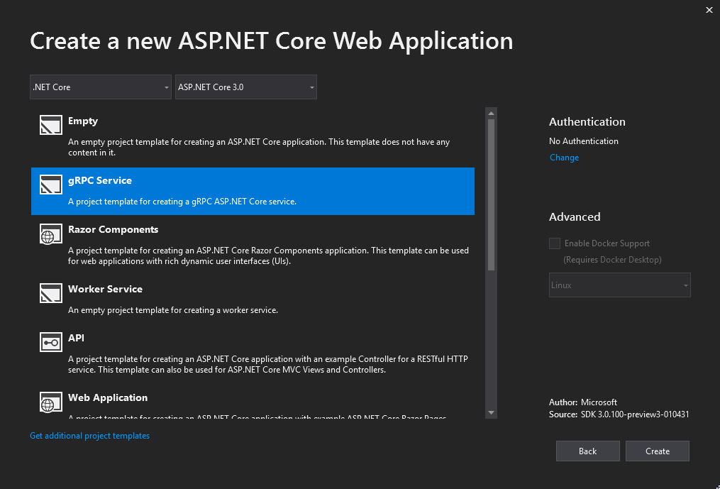
gRPC template
HTTP/2 transport
Protocol Buffers
Design-time code generation
https://github.com/grpc/grpc-dotnet/

Slide 32
Docker
Memory limits fix
Better CPU limits (--cpus)
Switch to Microsoft Container Registry (MCR)
FROM mcr.microsoft.com/dotnet/core/sdk:3.0
PowerShell Core in SDK image
Notes:
docker run --rm mcr.microsoft.com/dotnet/core/sdk:3.0 pwsh -c Write-Host "Hello Powershell“
mcr.microsoft.com/dotnet/core/sdk:3.0

Slide 33
Other

Slide 34
Client-side Blazor
Full stack web development with C# and WebAssembly
https://blazor.net/
First preview is out! [announcement]
Released with future .NET Core (> 3.0)

Slide 35
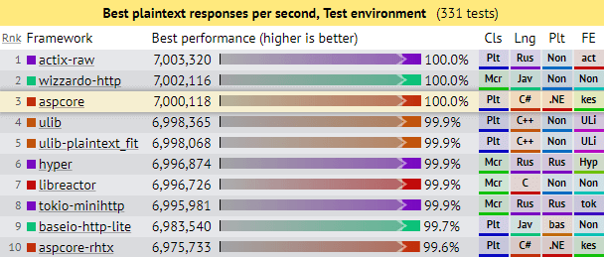
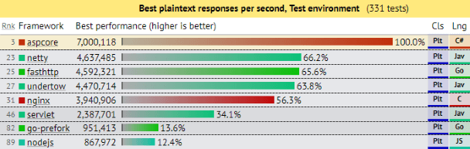
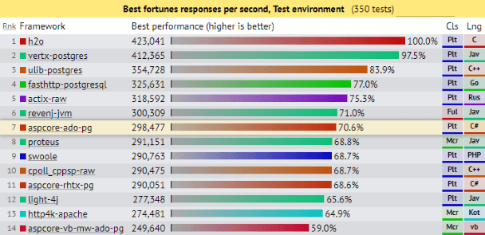
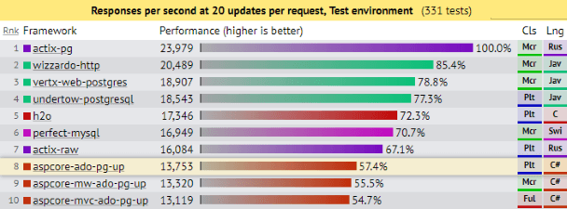
Current performance
ASP.NET Core: Saturating 10GbE at 7+ million request/s
Notes:
Current perfornance with ASP.NET Core 2.2

Slide 36
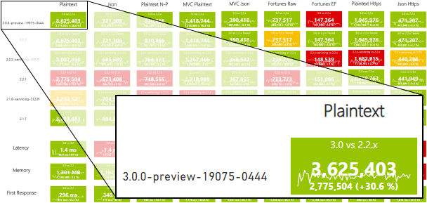
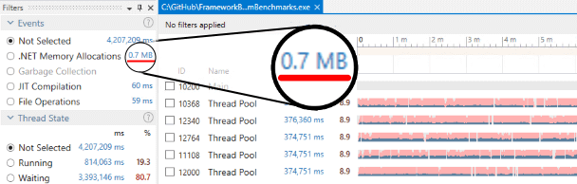
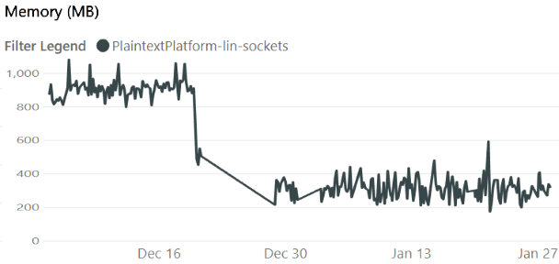
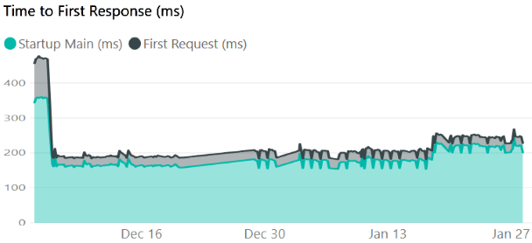
Future performance
https://aka.ms/aspnet/benchmarks
6 minutes, 64 connections, 120.000.000 requests

Slide 37
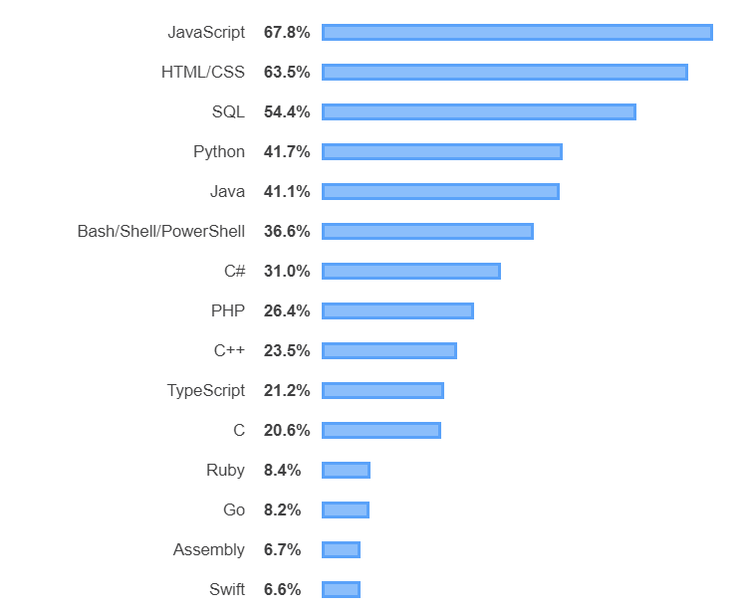

Stack Overflow - most popular technologies
https://insights.stackoverflow.com/survey/2019#technology

Slide 38
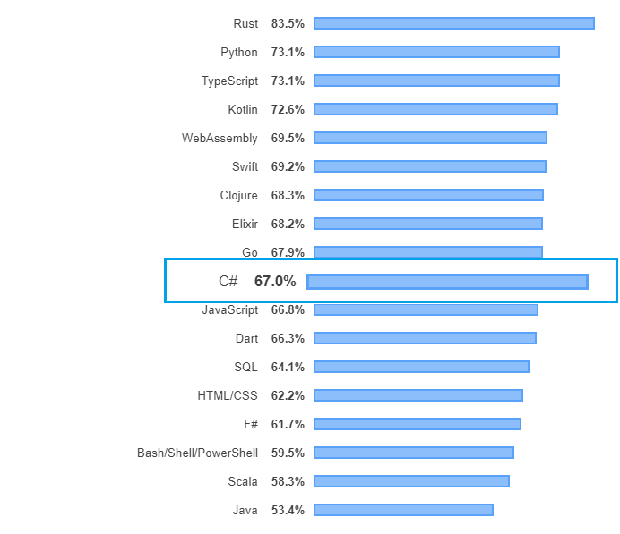
Stack Overflow - most loved technologies
https://insights.stackoverflow.com/survey/2019#most-loved-dreaded-and-wanted

Slide 39
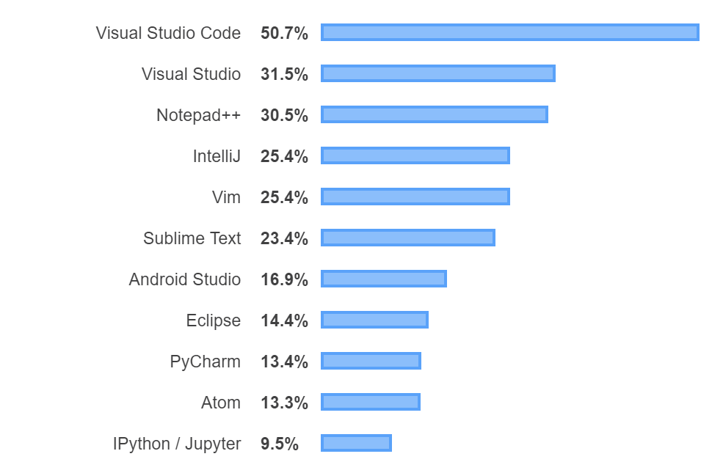
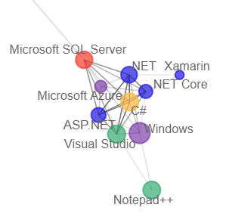
Stack Overflow - most popular development environments
https://insights.stackoverflow.com/survey/2019#development-environments-and-tools

Slide 40
.NET Language Strategy
C#
1,000,000’s
Millions
VB
100,000’s
Hundreds of thousands
F#
10,000’s
Tens of thousands

Slide 41
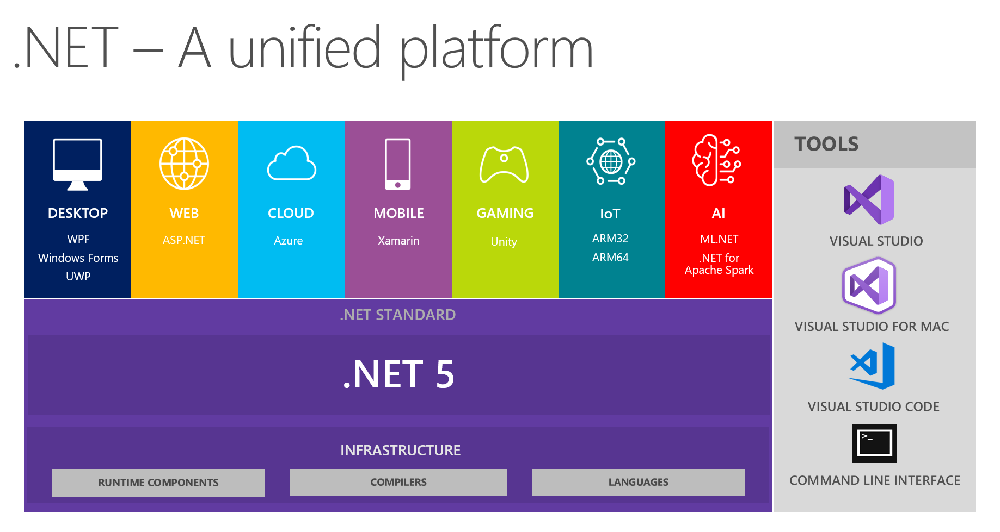
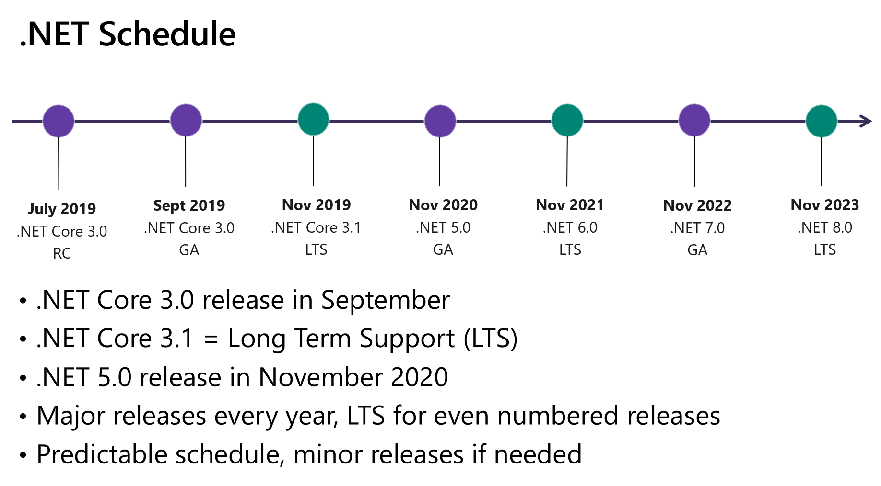
.NET 5!
https://devblogs.microsoft.com/dotnet/introducing-net-5/

Slide 42
References
Announcing .NET Standard 2.1
.NET Core announcements
Preview 1, Preview 2, Preview 3, Preview 4, Preview 5
ASP.NET Core announcements
Preview 2, Preview 3, Preview 4, Preview 5
Entity Framework Core announcements
What is new in EF Core 3.0, Preview 4
ASP.NET Community Standup
https://live.asp.net/

Slide 43
Conclusion
Bunch of new features
Performance, performance, performance
Play with it:
https://dotnet.microsoft.com/download/dotnet-core/3.0
https://visualstudio.microsoft.com/vs/preview/
Options > Projects and Solutions > .NET Core > Use previews of .NET Core SDK

Slide 44
Thank you!
Questions?
@nithinmohantk
https://www.thingx.cloud
https://github.com/nithinmohantk

