Slide 1
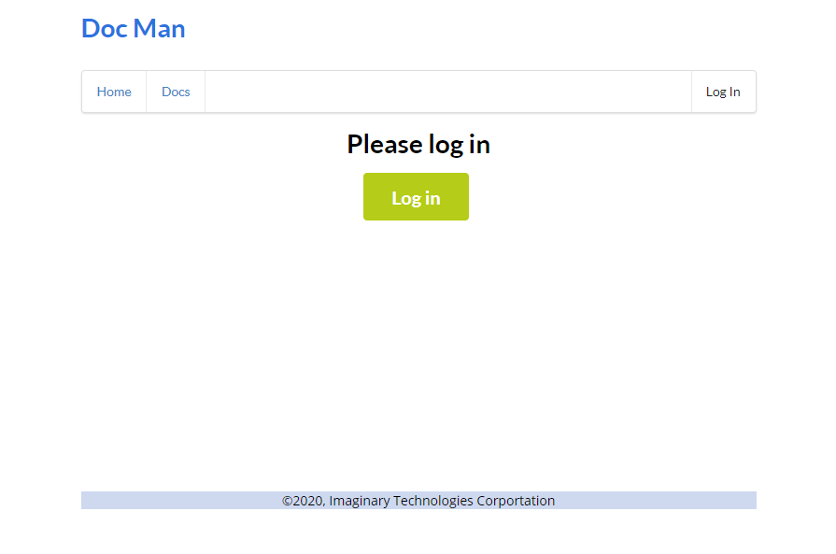
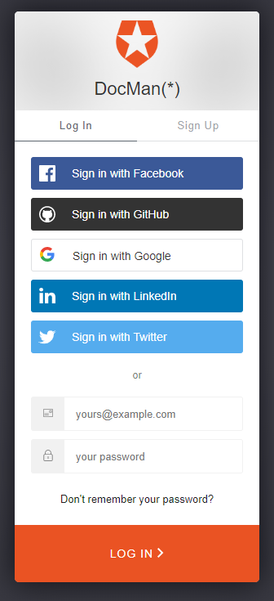
Login
Click Login to initiate OpenID auth

Slide 2
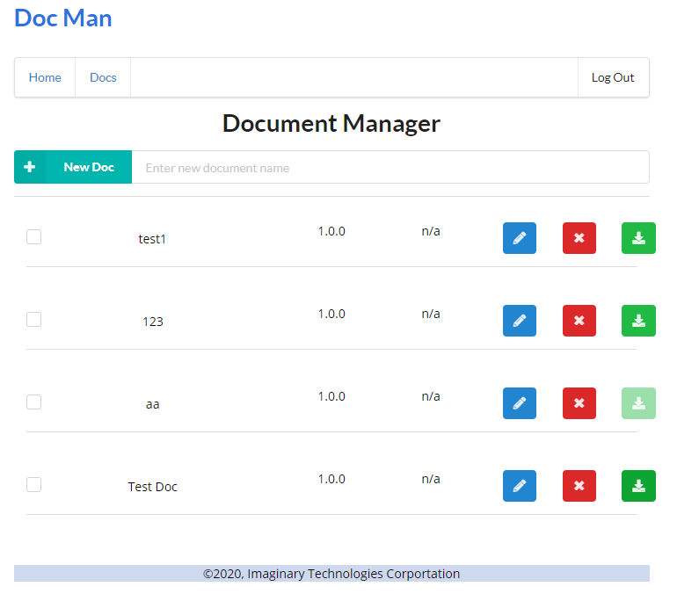
Homepage
Enter document name and click on ‘New Doc’ button to add a new entry.
If attachments are uploaded, user can click the button to download/view the attachment.
If there are not attachment uploaded, download will be disabled.
Click on Edit to upload new/replace existing attachment.

Slide 3
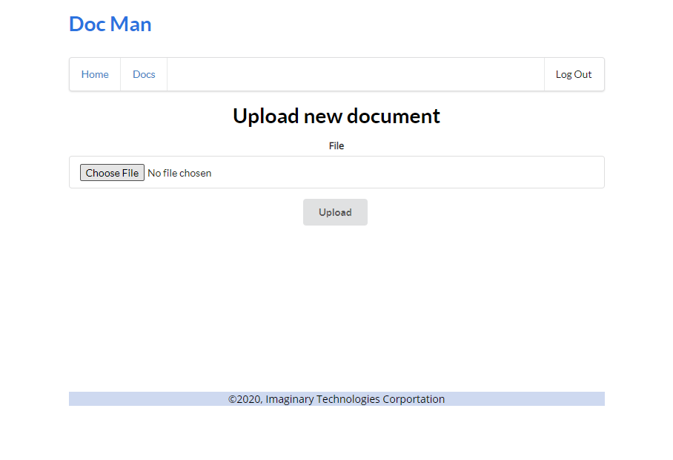

Slide 4
