Slide 1
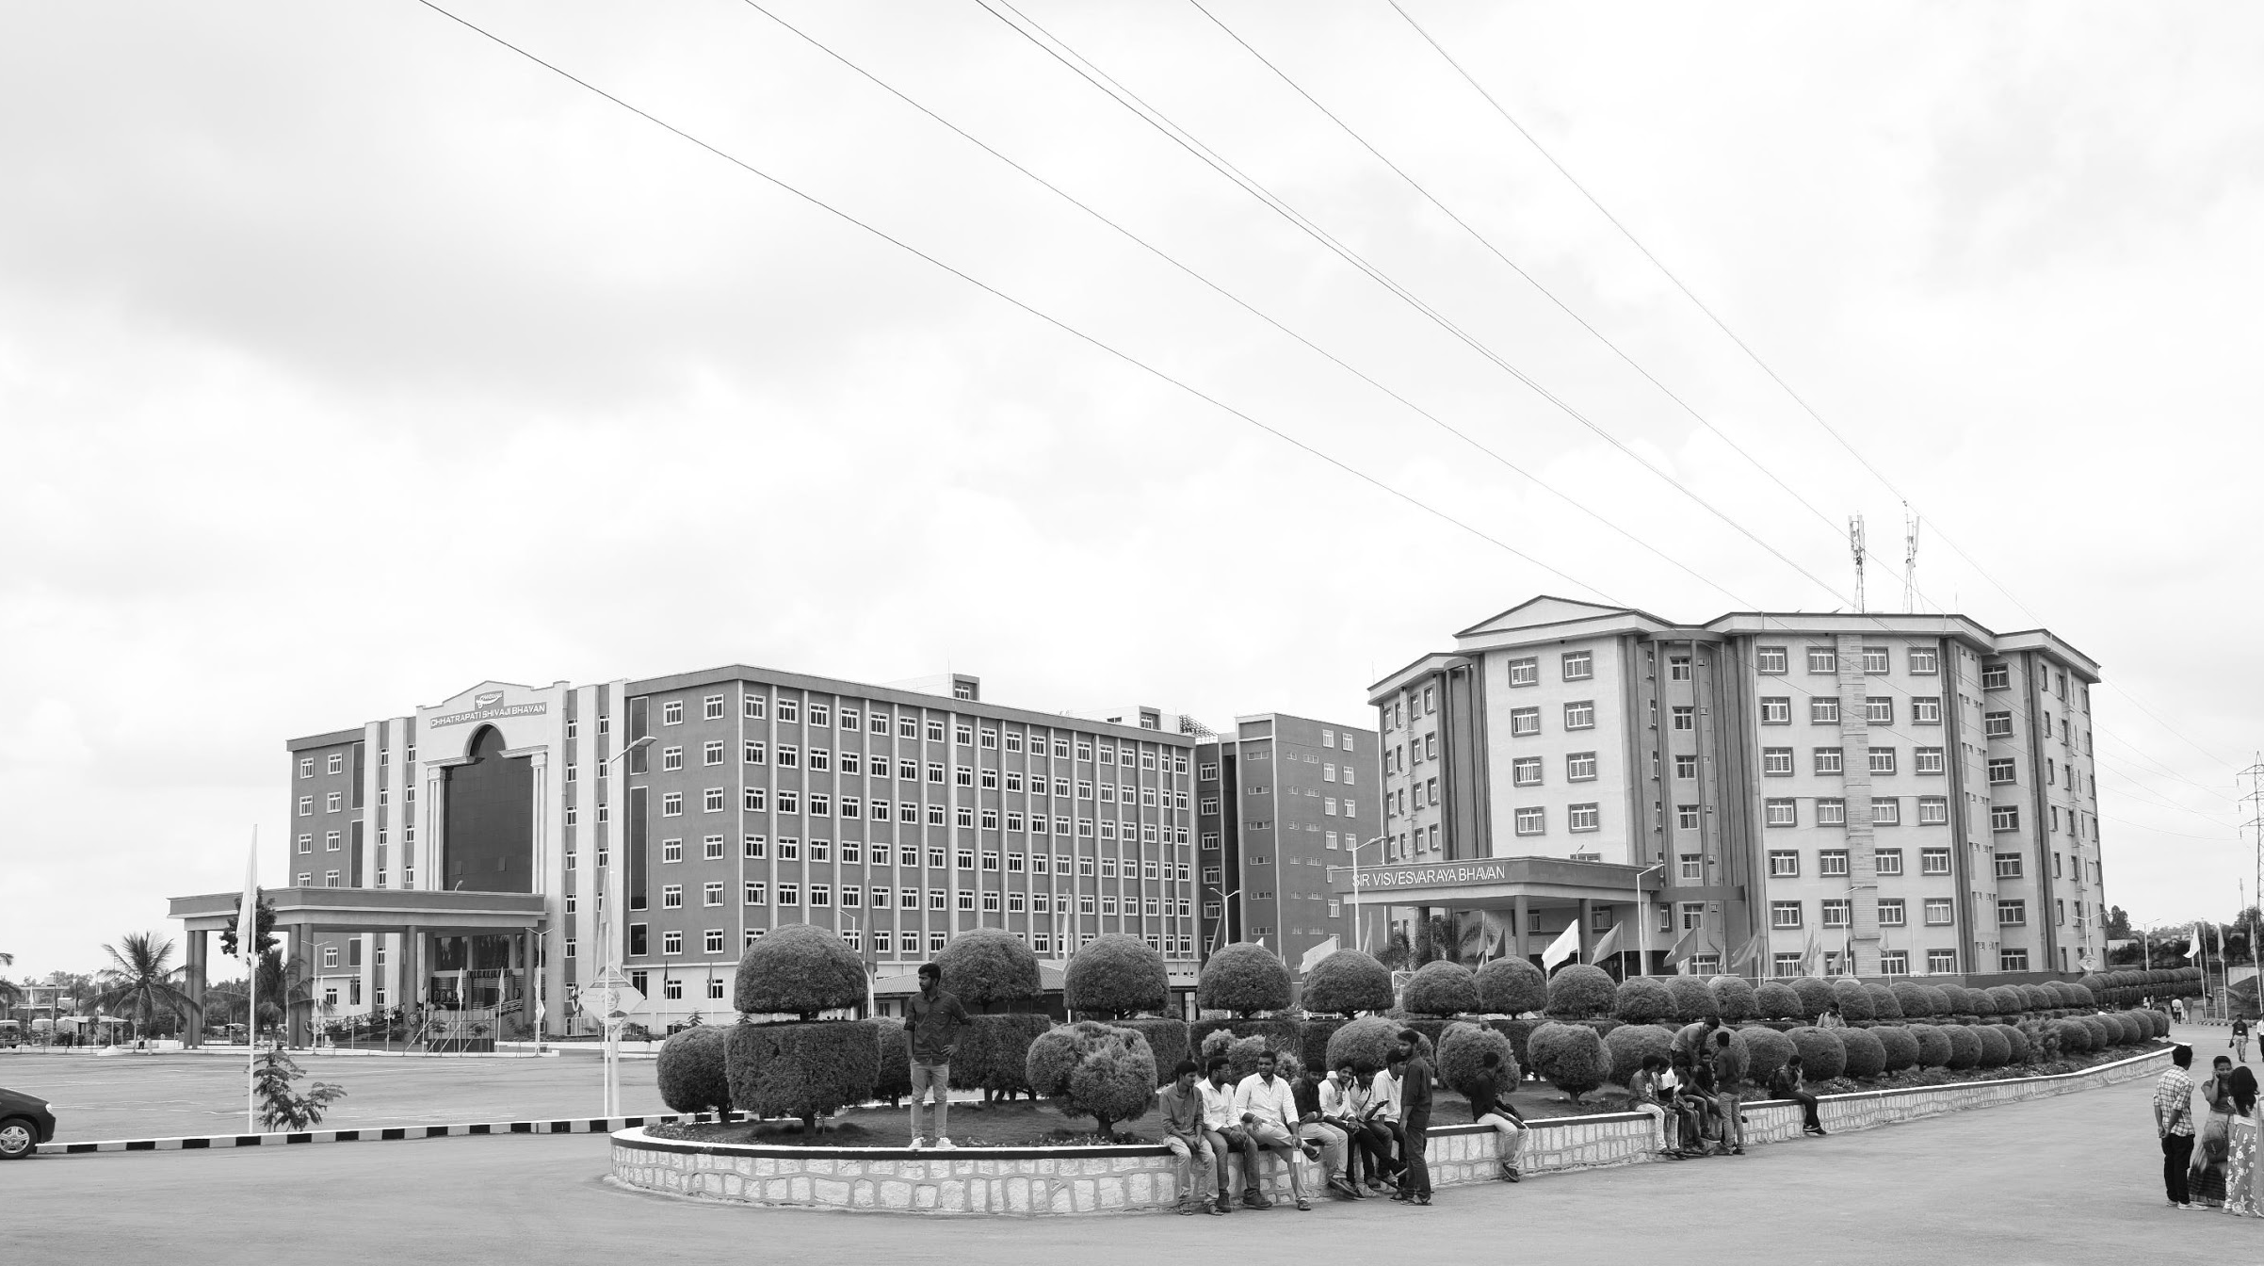

AI-Powered Exam Supervision Monitoring System
AY 2021-25
GITAM UNIVERSITY
Major Project id : CS15
A University should be a place of light, of liberty, and of learning.
Department of Electrical Electronics and Communication Engineering
Project Team:
Mure Nithin Reddy(BU21EECE0100602)
Shaik Nabi Baba(BU21EECE0100565)
Project Mentor:
Dr. Sanhita Manna
www.gitamedu.com

Slide 2



Project Group – Details
Photo
Track
Roll No
Name
ECE REGULAR
BU21EECE0100565
Shaik Nabi Baba
ECE REGULAR
BU21EECE0100602
Mure Nithin Reddy

Slide 3

Introduction
AI-Powered Examination Invigilation Monitoring System: Artificial intelligence technology designed to monitor students during classroom and online examinations. Commonly, human invigilators watch over the students during the conduct of examinations to ensure that they do not engage in cheating; however, the method has many pitfalls, including human error, fatigue, and bias.
AI can equip cameras to monitor students automatically, determine suspicious activities, and recognize prohibited items such as the use of unauthorized devices, unusual movements, or looking away too frequently. As a matter of fact, the system sends real-time alerts the moment it feels something abnormal to invigilators, therefore making the process of monitoring much more accurate and reliable.

Slide 4
Abstract
Exam integrity refers to the fairness, honesty and ethical standards upheld during the examination process. This ensures that all the students are evaluated based on their knowledge and skills without any form of dishonesty or cheating. Exam integrity is an al application in enhancing exam security by detecting cheating behaviours through CCTV live footage and this work aims to distinguish the suspicious activities of students such as copying, pulling up others papers, communicating or transferring answer sheets, turning heads more often, this kind of behaviour results in making learners less capable this leads to unqualified individuals in the society. We are using the man power to follow the students in examinations but it is preventing cheating in some extent only as the time we as humans gets the fatigue and due to limited human abilities which results in not finding expected outcome from the students.
Those errors can be reduced with the help of Automatic Invigilation system, in this automated process we are using deep learning algorithms such as CNN structure and faster regional convolution neural network (RCNN).it is an object detection algorithm that is implemented to detect suspicious activities of students during examination based on their movements and we are using MTCNN (Multi task Cascaded Convolution Neural Networks) for face detection and recognition.
There are some AI models based upon video and face recognition models based on YOLO V8, VGG-19, Faster R-CNN and Mask R-CNN and Vision Transformer architectures to classify these types of fraudulent actions, although those models have 90% accuracy in detecting actions of students but at the same time those models exhibit some errors like False Positives and Negatives, Privacy concerns, Model bias and Generalization, Technical and Operational Challenges and many more, So we are focusing upon not to exhibit same technical error and in order to make our model more accurate we are going to implement enhancing model accuracy and robustness, Reducing false positives and negatives and real time processing and scalability.
Tools: CCTV Cameras, Networking Equipment, cloud, machine learning frameworks, DBMS.

Slide 5
Objective and Goals
Objective
Develop an AI-powered system for automated exam invigilation using CCTV footage.
Implement deep learning algorithms (CNN, Faster R-CNN, MTCNN) to detect and classify suspicious behaviours during exams.
Improve upon existing AI models by enhancing accuracy, reducing false positives/negatives, and enabling real-time processing.
Create a more reliable alternative to human invigilation, addressing issues such as fatigue and limited observation capacity.
Contribute to maintaining exam integrity and fairness in educational settings.
Goals
Main Goals
To reduce academic dishonesty and cheating among the students during examinations.
To monitor and capture the prevalence of academic dishonesty among the students in the higher education context more precisely and accurately.
To reduce the burden on the Invigilation staff members.
To identify the students interpreting any suspicious task through the face recognition module.
To generate are port in which all students’ names are written along with the percentage of cheating activity.

Slide 6
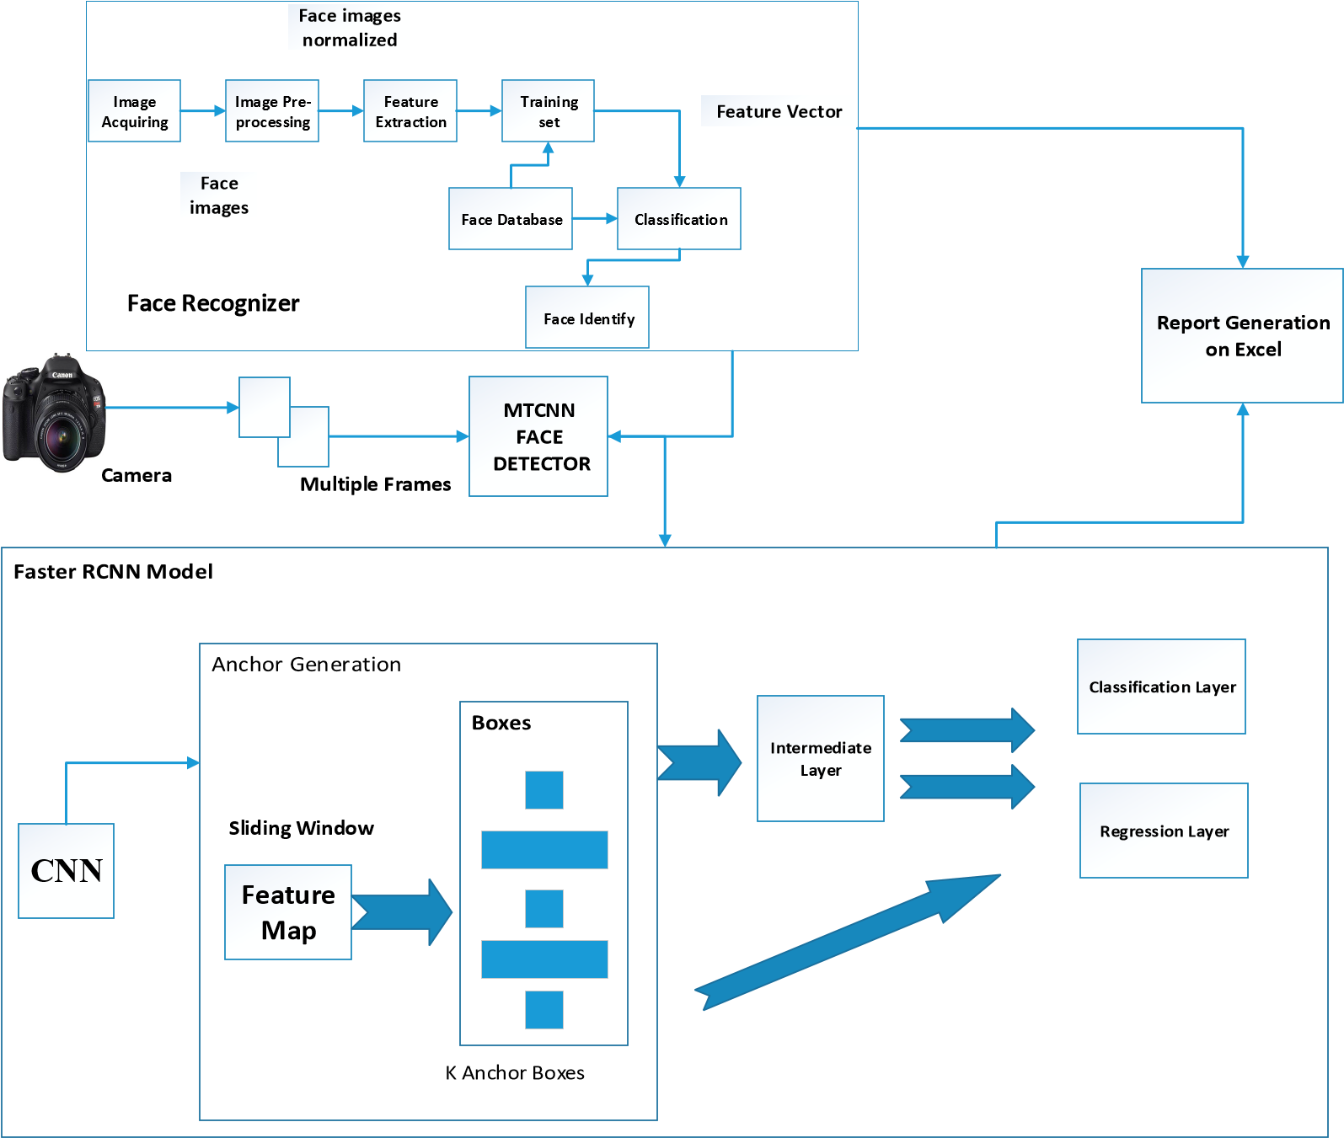
Project Plan

Slide 7
Literature Survey
Key Publications
Xiao, H. proposed a real-time invigilation system using the Single-Shot Multibox(SSD) detector, comparing its effectiveness with YOLO and other object detection methods. The system achieved a 79.8% accuracy in detecting student cheating during exams.
Malhotra, M. implemented YOLOv3 for identifying illegal student activities during exams, achieving an accuracy rate of 88%. This model has proven to be efficient in various applications beyond just education.
Adil, Md. developed a model to monitor unethical activities, such as whispering and hand contact, during exams. This system uses the Viola-Jones algorithm and the Adaboost algorithm to detect hand movements and facial recognition, though it requires multiple cameras due to its need for different angles.
Kulkarni, Rutuja used the Inception V3 model to classify student behaviors as either acceptable or unacceptable during exams. However, the model's limitations include difficulty in scaling to larger examinatiCNNon centers with more than 100 students.
Key Resources – Whitepaper| Application Notes | Datasheet| Others
Whitepapers: These documents provide in-depth technical details and theoretical explanations about various systems for inactivity detection and video surveillance. They cover a range of topics, such as face recognition, object detection, and student behavior monitoring during exams. The whitepapers often include discussions on different algorithms, like SSD detectors, YOLO, Viola-Jones, and Adaboost, providing insights into their effectiveness and applications.
Application Notes: These notes offer practical insights and usage guidelines for implementing specific surveillance systems and algorithms in real-world scenarios. They might include instructions on setting up the software and hardware, integrating machine learning models, and optimizing performance for different educational environments.
Datasheets: These technical documents provide specifications for the hardware and software components used in the surveillance and invigilation systems. They include details such as camera resolution, processing power requirements, and the capabilities of different algorithms like YOLOv3, Inception V3 CNN, and Faster R-CNN. Datasheets are essential for understanding the limitations and capabilities of the components used in the proposed models.
Others: This category includes various research papers, articles, and case studies that document experiments, results, and comparisons of different invigilation and surveillance systems. They provide insights into the development and implementation of these technologies in academic settings, offering examples of how these systems have been used to monitor and reduce cheating during examinations.

Slide 8
Title | Method and Year | Hardware | AUTHOR | Result
Automated Invigilation System for Detection of suspicious Activities during Examination.[c] | viola jones Algorithm, Ada-boost Algorithm, 2021 | CCTV cameras | Xiao, H | The SSD300 algorithm achieved 79.8% accuracy and 46 FPS for detecting cheating, with a 3.0% accuracy improvement after optimization​
Realization of Intelligent Invigilation System Based on Adaptive Threshold | Optimized Expectation Maximum(EM) Algorithm with adaptive threshold, 6–7 August 2021 | Monitoring and seat calibration module with identification Alarm | Malhotra, M. | implemented YOLOv3 for identifying illegal student activities during exams, achieving an accuracy rate of 88%.
Application of SSD core detection algorithm in intelligent visual monitoring of examination room.[c] | Single Shot Multi-Box Detector (SSD 300), 4–6 February 2019 | CCTV cameras | Adil, Md | The paper presents a computer vision system to automatically detect cheating in exams, showing 70-84% accuracy across different behaviors in initial testing.
Automatic Invigilation Using Computer Vision[c] | YoloV3 (Only look Once) Algorithm, 15 April 2022 | CCTV cameras | kulkarni, Rutuja | The model's limitations include difficulty in scaling to larger examinatiCNN on centers with more than 100 students.

Slide 9
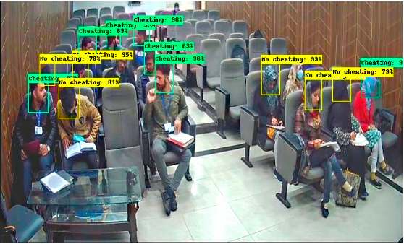
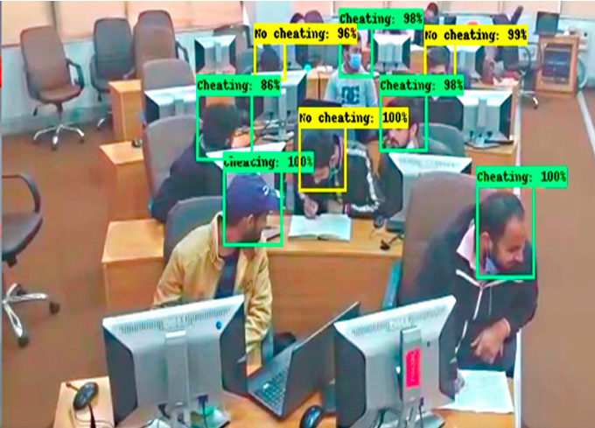
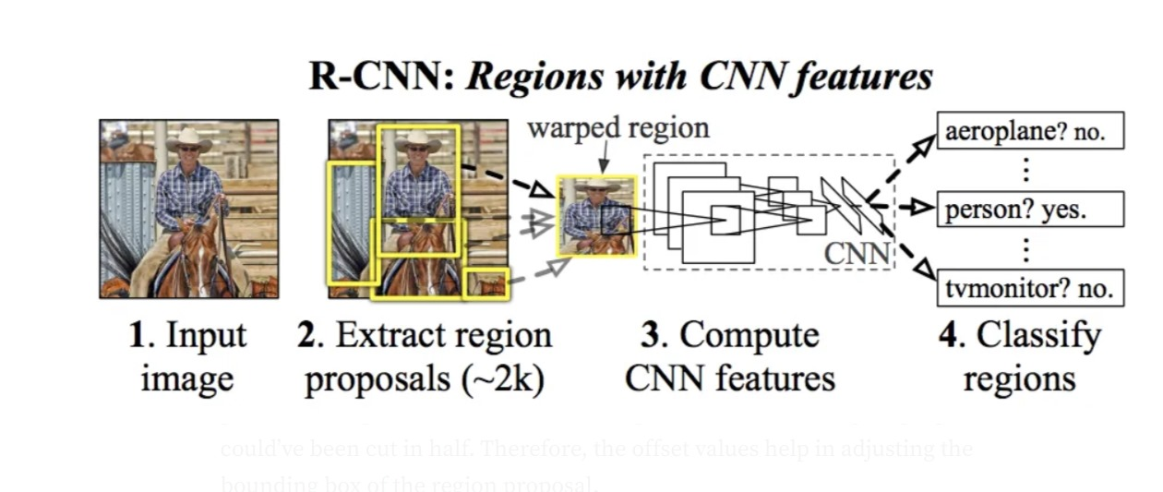

Slide 10

THANK YOU

