Slide 1

Basics of English Grammar
Comparative and superlative forms of adjectives
Sample Power Point Presentation
Notes:
How to change fonts, how to position simple elements on the page, how to change

Slide 2
Contents
Where you are:
Contents
Noun
Adjective
Syllable
Comparatives
Superlatives
Comparison
Practice
Help
Dictionary
Introduction
  What is a noun?
  What is an adjective?
  What is a syllable?
    Syllable – further examples
Adjectives
  Comparative form
    How to built comparative forms?
  Superlative form
    How to built superlative forms?
Summary
  Comparison chart
Practice
  Superlative forms
  Comparative forms
Skip introduction
Back

Slide 3
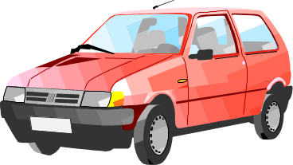

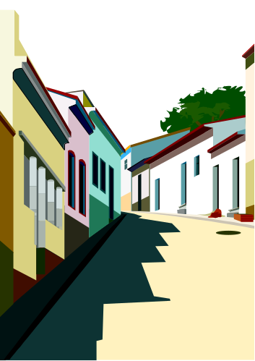
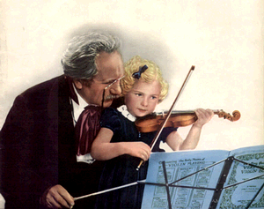
What is a noun?
Where you are:
Contents
Noun
Adjective
Syllable
Comparatives
Superlatives
Comparison
Practice
Help
Dictionary
Noun is a word which refers to a thing, person, activity, place etc.
car
reading
street
teacher
Back

Slide 4
What is an adjective?
Where you are:
Contents
Noun
Adjective
Syllable
Comparatives
Superlatives
Comparison
Practice
Help
Dictionary
Adjective is a word which describes a noun
adjectives
noun
big
car
fast
expensive
Back

Slide 5
What is a syllable?
Where you are:
Contents
Noun
Adjective
Syllable
Comparatives
Superlatives
Comparison
Practice
Help
Dictionary
Syllable is a part of a word containing vowel sound
read
ing
read
ing
1st syllable
2nd syllable
Back

Slide 6
Syllables – examples
Where you are:
Contents
Noun
Adjective
Syllable
Comparatives
Superlatives
Comparison
Practice
Help
Dictionary
1. One-syllable adjectives
fast
big
cheap
long
2. Two-syllable adjectives
hap
py
cra
zy
dir
ty
3. Three-syllable adjectives
im
por
tant
won
der
ful
Back

Slide 7
What is a “comparative form”?
Where you are:
Contents
Noun
Adjective
Syllable
Comparatives
Superlatives
Comparison
Practice
Help
Dictionary
Comaprative form expresses the idea of ‘more’
fast
-er
My car is fast.
But his car is faster.
Back

Slide 8
“Comparative form”?
Where you are:
Contents
Noun
Adjective
Syllable
Comparatives
Superlatives
Comparison
Practice
Help
Dictionary
How is a ‘comparative’ form built?
long
er
one syllable adjectives
two syllable adjectives
ending in -ly
funn
y
ier

other two and three syllable adjectives
modern
more
modern
irregular adjectives
for example ‘good’
good
better
Back

Slide 9
What is a “superlative form”?
Where you are:
Contents
Noun
Adjective
Syllable
Comparatives
Superlatives
Comparison
Practice
Help
Dictionary
Comaprative form expresses the idea of ‘most’
fast
-est
My car is fast.
Your car is fast.
But his car is the fastest.
Back

Slide 10
“Superlative form”?
Where you are:
Contents
Noun
Adjective
Syllable
Comparatives
Superlatives
Comparison
Practice
Help
Dictionary
How is a ‘superlative’ form built?
long
est
one syllable adjectives
two syllable adjectives
ending in -ly
funn
y
iest

other two and three syllable adjectives
modern
most
modern
irregular adjectives
for example ‘good’
good
best
Back

Slide 11
Summary comparison
Where you are:
Contents
Noun
Adjective
Syllable
Comparatives
Superlatives
Comparison
Practice
Help
Dictionary
comparative
superlative
long
long
er
long
est
funny
funn
iest
funn
iest
modern
more
modern
most
modern
good
better
best
Back

Slide 12


Exercises
Where you are:
Contents
Noun
Adjective
Syllable
Comparatives
Superlatives
Comparison
Practice
Help
Dictionary
On the following three slides you will find the instructions for three exercises related to your subject.
Exercise I
Give Polish translation
Exercise II
Give comparative forms
Exercise III
Give superlative forms
All the excersises are prepared on the basis of the following list of adjectives. [Go to the list]
Exercise
Key
Exercise
Key
Exercise
Key
Back

Slide 13
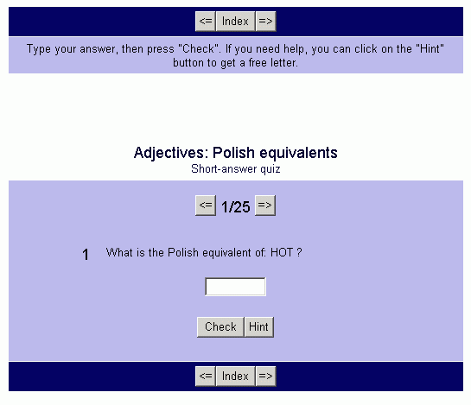
Exercise – Polish equivalents
Where you are:
Contents
Noun
Adjective
Syllable
Comparatives
Superlatives
Comparison
Practice
Help
Dictionary
Give Polish translation for a group of 25 adjectives
title
question
number – press arrows to go to the next word
Click to go to the exercise
adjective
to be translated
Key
supply translation
check your answer
Back

Slide 14
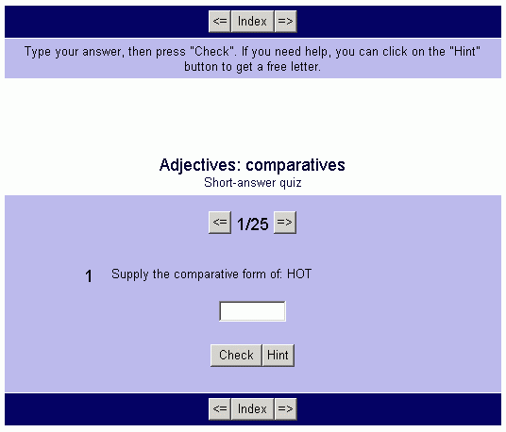
Exercise – comparatives
Where you are:
Contents
Noun
Adjective
Syllable
Comparatives
Superlatives
Comparison
Practice
Help
Dictionary
Give comparative forms for a group of 25 adjectives
title
question
number – press arrows to go to the next word
Click to go to the exercise
adjective
to be transformed
Key
supply the comparative
check your answer
Back

Slide 15
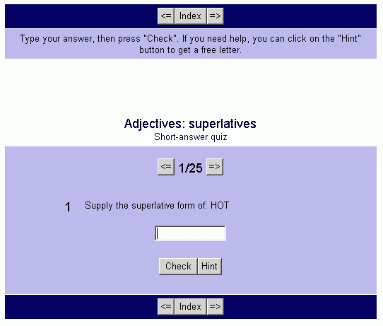
Exercise – superlatives
Where you are:
Contents
Noun
Adjective
Syllable
Comparatives
Superlatives
Comparison
Practice
Help
Dictionary
Give superlative forms for a group of 25 adjectives
title
question
number – press arrows to go to the next word
Click to go to the exercise
adjective
to be transformed
Key
supply the superlative
check your answer
Back

Slide 16
Exercises
Where you are:
Contents
Noun
Adjective
Syllable
Comparatives
Superlatives
Comparison
Practice
Help
Dictionary
List of adjectives
  hot big thin
  nice pleasant young
  short intelligent lovely
  kind happy attractive
  exciting pretty unhappy
  good annoyed careless
  bad tasty perfect
  tired upset terrible
  ugly
Back

Slide 17
Change of ‘y’ into ‘i’
Where you are:
Contents
Noun
Adjective
Syllable
Comparatives
Superlatives
Comparison
Practice
Help
Dictionary
We want the comparative form
of the adjective ‘funny’
funny
+er
y ➔ i
funnier
funn
+ier
Back

Slide 18
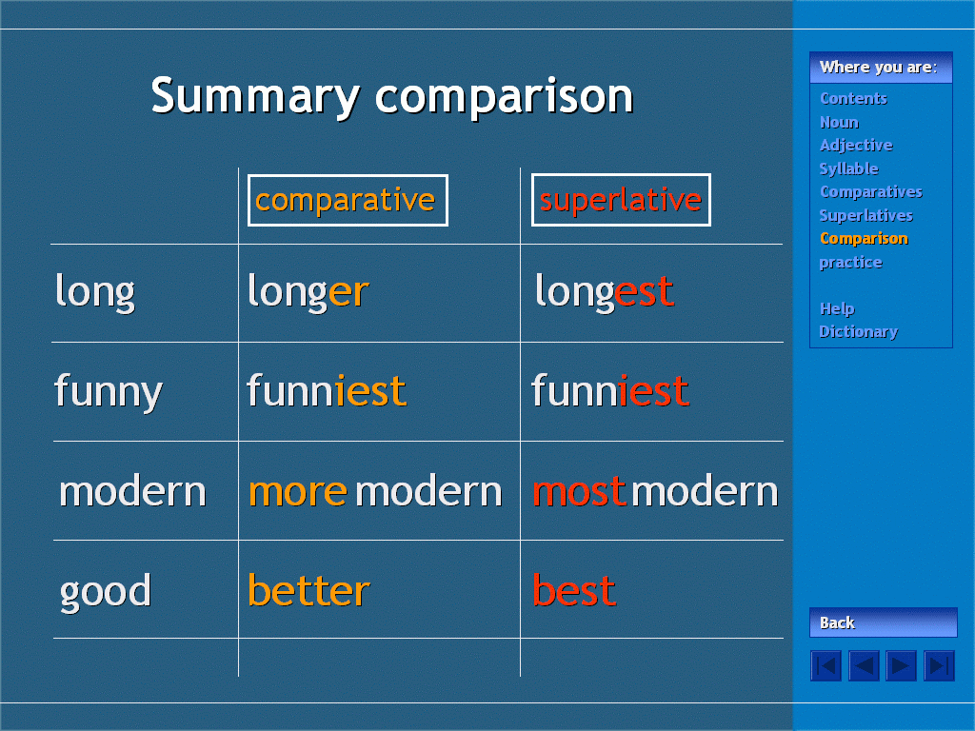
Help
Where you are:
Contents
Noun
Adjective
Syllable
Comparatives
Superlatives
Comparison
Practice
Help
Dictionary
Slides change after you press ENTER
Shows your position
Click to learn more

Helps you navigate – backwards and forwards
Back

Slide 19
Dictionary
Where you are:
Contents
Noun
Adjective
Syllable
Comparatives
Superlatives
Comparison
Practice
Help
Dictionary
English to Polish translation (sample)
  nice - miły pleasant - przyjemny
  short - krótki lovely – uroczy
  Etc.
Back

