Slide 1
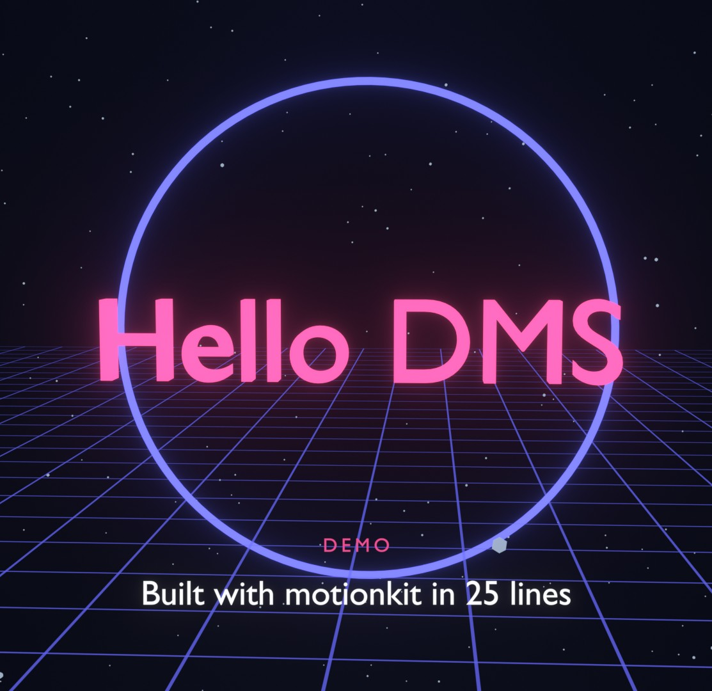
DEVELOPER SESSION
motionkit
Make motion-graphics videos in Blender 5 with a few lines of Python, or just ask Gemini to write them
[Presenter] · [Team] · [Date]
Notes:
Today I want to show you how you can make videos like our ERM trailer yourselves, without learning Blender.
What you see behind me is rendered by a twenty-five line Python script. By the end of this session you'll have run it, changed it, and asked Gemini to write a new one.

Slide 2
The trailer taught us what's hard
WHY
1,661
lines of Blender Python in the ERM trailer script
WHAT USED TO BE HARD, NOW HANDLED BY THE KIT
Blender version quirks
Keyframes, compositor, EEVEE and the sequencer changed between 4.x and 5.x: one compatibility file absorbs it
Materials and glow
Self-lit materials with fade, glow and colour you can animate, plus bloom
Camera maths
Say where to stand and what to look at; orbits, push-ins and cuts are one line
Frames and easing
Think in seconds and named eases: "smooth", "back", "bounce"
Rendering
One command for a still, a preview or the final MP4 with music
25
lines for a polished title shot with motionkit
0
Blender knowledge needed to start
Notes:
Making the trailer took one Blender script of about sixteen hundred lines, and most of that wasn't creative work. It was fighting Blender: keyframes that behaved differently in Blender 5, glow that needed the compositor, camera maths, frame counting.
So we took everything we learned and packaged it as a library called motionkit. The creative part stays with you. The Blender part is handled.

Slide 3
From an idea to an MP4 in four hops
HOW IT WORKS
1
Idea
"A 10-second intro: our name types itself among stars"
2
Shot Script
Plain-language plan: what, when, camera, transitions
3
Gemini gem
motionkit Director writes the Python for you
4
motionkit
Your script: assets, motions, camera, overlay
5
Blender 5
EEVEE renders it: still, preview or final MP4
Two ways in. Write the motionkit script yourself (it reads like a storyboard), or describe the video to the gem and paste its code. Either way, the result is a normal Python file you can read, change and keep in git.
Notes:
Here's the flow. You start with an idea. You can turn it into a Shot Script, a plain-language plan that says what appears, when, and what the camera does. The Gemini gem we set up, motionkit Director, turns that into Python. The Python uses motionkit, and Blender 5 renders it with EEVEE.
You can skip the gem and write the Python directly. As you'll see, it reads almost like the storyboard.

Slide 4
Reusable components for everything we needed
WHAT'S INSIDE
Movie
Clean scene, EEVEE settings, shots, music, still / preview / render from the command line
Assets
Text3D · Counter · Card · Screen · Logo · Sphere · Ring · Arc · Line · Starfield · GridFloor · Globe · BarChart · ScreenWall · Portal · Group
Motions (every asset)
fade · pop · slide · rise · move · scale · rotate · spin · float · pulse · glow · colour · draw-on · type-on
mk.Movie("intro", length=10)
mk.Globe().focus(43.6, 1.4, at=2)
.pop_in(at=0.5).float(1, 6)
Camera
place · move · cut · push-in · pull-out · orbit · crane · path · shake · zoom · dolly-zoom · focus
Overlay
caption · title · lower third · text · image · box · letterbox · fades · flash
Transitions + effects
cut · fade through black · dip · flash cut · whip pan · push through · through portal · glow · vignette · motion blur
camera.orbit(radius=9, at=2)
overlay.caption("Hi", at=1)
tr.flash_cut(movie, at=5, ...)
Notes:
This is everything in the box. A Movie object sets up the scene and rendering. Fifteen ready-made assets: text, counters, screenshots, logos, rings, a globe, bar charts, a screen wall and the portal from the trailer. Every asset shares the same motions, so once you know fade_in or pop_in, you know them for everything.
The camera works like a director: stand here, look there. The overlay handles captions and titles on screen. And there are transitions and effects for the finishing touches. All of it is documented in the docs folder, with an API reference listing every argument.

Slide 5

25 lines, 8 seconds of video
THE EASY DEMO
movie = mk.Movie("hello_title", length=8)
mk.Starfield()
mk.GridFloor(height=-1.6)
ring = mk.Ring(radius=2.6, color="indigo", glow=3).at(0, 1.5, 0.3)
ring.draw_on(at=0.3, duration=1.2).spin(turns=0.25, start=1.5, end=8, axis="Y")
title = mk.Text3D("Hello DMS", size=1.1, color="pink", glow=3, depth=0.12).at(0, 0, 0.3)
title.pop_in(at=0.8, duration=0.7).float(start=1.5, end=8, height=0.08)
movie.camera.place((0, -14, 1.5), look_at=(0, 0, 0.3))
movie.camera.orbit(center=(0, 0, 0.3), radius=11, start=-25, end=12,
height=1.0, at=0, duration=8)
movie.overlay.caption("Built with motionkit in 25 lines", eyebrow="Demo", at=3, until=6.6)
movie.overlay.fade_from_black(at=0, duration=1)
movie.overlay.fade_to_black(at=7.2, duration=0.8)
movie.effects.glow().vignette(0.3)
movie.run()
Create · place · animate
Every line is one idea. Times are seconds. Motions chain. The camera looks at a point.
Notes:
This is the whole demo, examples/01_hello_title.py. Read it top to bottom: a movie of eight seconds. Stars and a glowing grid for depth. A ring that draws itself and turns. The title pops in and floats. The camera orbits around it. A caption, fades in and out, and the glow.
Every line is one idea, and there's no Blender knowledge in it: no materials, no keyframes, no frames. On the right is exactly what it renders.

Slide 6
Three commands cover everything
RUN IT
blender -b -P examples/01_hello_title.py -- --still 3.5
One PNG at 3.5 s. Seconds, so check every change this way
blender -b -P examples/01_hello_title.py -- --preview --render
Half-size MP4: watch the timing
blender -b -P examples/01_hello_title.py -- --render
Final 1080p MP4 (with music if added)
blender -P examples/01_hello_title.py
Open Blender with the scene built: scrub, play, tweak by hand
-b no window -P run the script -- options for motionkit --percent 25 tiny, fast test renders Output: examples/render/
Notes:
You only need three commands, all in PowerShell from the motionkit folder. The still is the one you'll use most: a single frame renders in seconds, so check every change that way. Then a preview MP4 to judge the timing, then the final render.
The last one opens Blender itself with the scene already built, if you want to scrub through or adjust something by hand.
Live: run the still command now, then change the title text and run it again.

Slide 7
Camera moves and transitions, one line each
DIRECT THE CAMERA
movie.camera.…
tr.…(movie, at=…, to=shot.point(…), look_at=…)
place / move
stand here, look there; travel
push_in / pull_out
closer for emphasis, away to reveal
orbit
circle the subject
crane
rise or sink
follow_path
fly through points
shake
impact, handheld
zoom / dolly_zoom
lens change, vertigo
cut_to
hard cut
fade_through_black
calm chapter change
dip_to_color
soft reveal
flash_cut
energy, a beat in the music
whip_pan
fast sideways smear
push_through
rush into the next shot
through_portal
fly through a gate (the trailer)
Notes:
The camera is where videos come alive, so it gets the richest API. You never set rotation angles: you say where to stand and what to look at, and the kit keeps it pointed there.
Transitions combine a camera move with an overlay effect. Pick by feel: fade through black for a calm chapter change, flash cut for energy, through_portal for the trailer's signature move.

Slide 8
Describe the video; the gem writes the code
ASK GEMINI
YOU TYPE (SHOT SCRIPT)
THE GEM ANSWERS (PYTHON)
/script
MOVIE "kpi_story" 12s
SHOT data 0s-12s
ADD chart "bars" 345,120,95,60
labels B,O,P,A at 0,2,-1.4
bars: grow @0.5 | highlight 0 @2.5
ADD counter "users" to 892
suffix " users" @1 for 1.5s
CAMERA place 0,-12,1 look 0,1,0
CAMERA push-in to 0,-9,0.6 @0 for 12s
CAPTION "Used by 892 people" @3 until 10
EFFECTS glow
movie = mk.Movie("kpi_story", length=12)
with movie.shot("data", 0, 12):
bars = mk.BarChart([345, 120, 95, 60],
labels=["B", "O", "P", "A"]).at(0, 2, -1.4)
bars.grow(at=0.5).highlight(0, at=2.5)
mk.Counter(892, at=1, duration=1.5,
suffix=" users").at(3.5, 1.5, 0.5)
movie.camera.place((0, -12, 1), look_at=(0, 1, 0))
movie.camera.push_in(to=(0, -9, 0.6), at=0, duration=12)
movie.overlay.caption("Used by 892 people", at=3, until=10)
movie.effects.glow()
movie.run()
/idea
/script
/storyboard
/fix
/tweak
/vertical
free text → Shot Script
Shot Script → Python
shot table
paste an error
"slower", "gold title"
phone format
Notes:
If you'd rather not write code at all, use the gem. In Gemini it's called motionkit Director, and it knows the whole library because we uploaded the documentation as its knowledge.
You write a Shot Script like the one on the left: plain words, at-signs for times, a few verbs. The gem answers with the Python on the right, plus the commands to run it and a list of the files it needs.
You don't even need the Shot Script: type /idea and describe the video in your own words, and it drafts the Shot Script for you to check first. /fix takes an error message, /tweak takes a change like 'slower' or 'make the title gold', and /vertical converts it for phones.

Slide 9
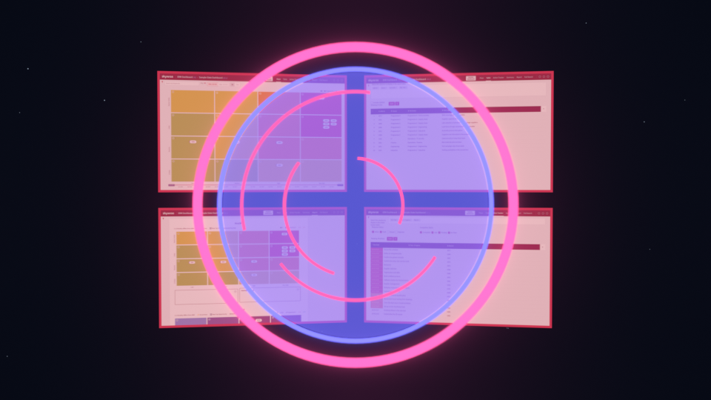
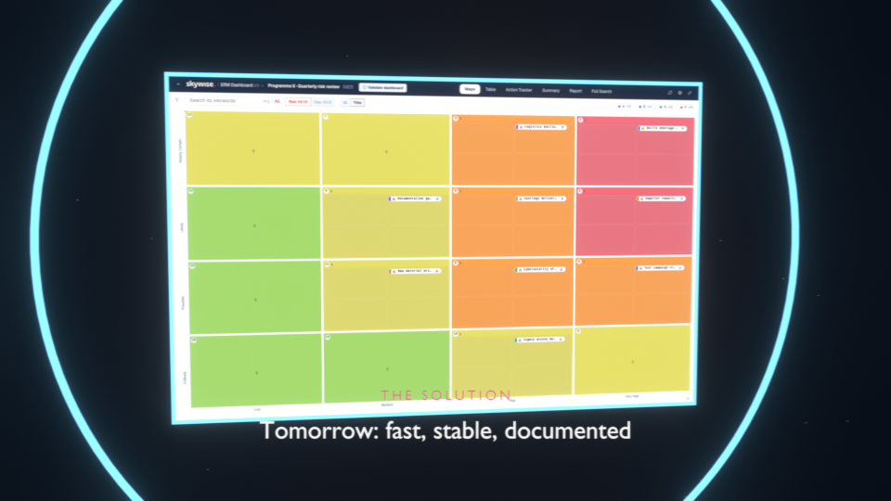
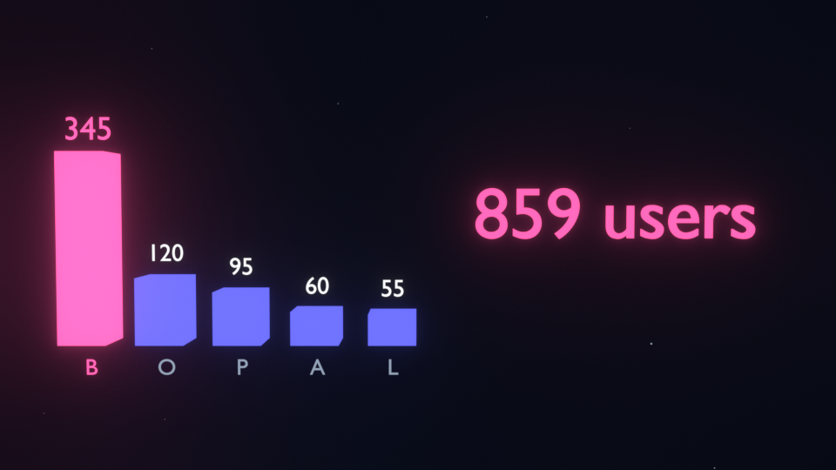
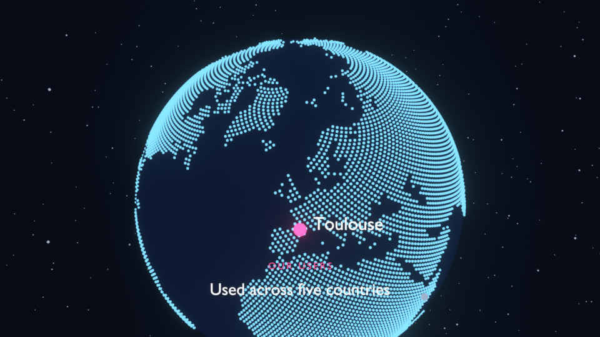
Three examples to copy from
EXAMPLES
02 · Product reveal (16 s) screen wall → portal → new app → chart and counter → end title. Shots, transitions, music.
03 · Globe tour (10 s)
The globe turns to each site; pins pop in with labels.
01 · Hello title (8 s)
The 25-line demo you just saw.
Notes:
There are three examples in the examples folder, and they're the best starting point for your own videos: copy one and change it.
The product reveal is the closest to our trailer: a wall of old screens, a portal opens, we fly through it to the new app, then a bar chart and a counter, and an end title. It shows shots, transitions and music. The globe tour turns the globe to each site and pins it. And the hello title is the demo you just saw.

Slide 10
Tested on Blender 5, documented, easy to extend
BUILT TO LAST
5.0.1
Blender version it's tested on (EEVEE); 4.2+ also works
25
checks in the smoke test: every asset, motion, move, transition
11
cookbook recipes, each run by a test so the docs stay true
1
file holds every Blender-version difference (_compat.py)
DOCUMENTATION (docs/)
Why EEVEE
Our look is self-lit objects plus glow: no light bounces to simulate. EEVEE renders it in real time and looks the same as Cycles here, many times faster.
The kit switches off what we don't use (shadows, ray tracing, volumes), uses 64 samples for finals and 16 for previews, and does the glow in the GPU compositor.
getting-started.md
install, run, first change
concepts.md
the six ideas behind the kit
api-reference.md
every class, method and argument
cookbook.md
copy-paste recipes
shot-script.md
the format for Gemini
troubleshooting.md · extending.md
fixes; adding your own assets
Notes:
A word on quality, because you'll build on this. It's tested on Blender 5.0.1 with EEVEE: a smoke test builds every asset, motion, camera move and transition and renders frames, and a second test runs every cookbook recipe so the docs can't drift from the code. Every Blender-version difference lives in one file, so when Blender 5.1 changes something, there's one place to fix.
Why EEVEE: our style is self-lit objects with glow, so there's nothing for a path tracer like Cycles to add. EEVEE gives the same look in real time.

Slide 11
Ten minutes, four steps
LIVE DEMO
1
Render a frame
blender -b -P examples/01_hello_title.py -- --still 3.5
The picture appears in examples/render/
2
Change it
Text3D("Hello DMS", ...) → Text3D("Hello <your team>", color="cyan")
Run the still again: the change shows in seconds
3
Ask the gem
/idea A 6-second sting: our logo appears among stars, a ring draws around it, flash, end
Paste the code into examples/my_sting.py
4
Render a preview
blender -b -P examples/my_sting.py -- --preview --render
Play the MP4
Notes:
Live demo, about ten minutes. Have PowerShell open in the motionkit folder and Gemini open with the gem.
One: render a frame of the demo with --still 3.5 and open the PNG.
Two: change the title text and colour in the script, run the same command, show the difference.
Three: in Gemini, type the /idea line on the slide. Read out the Shot Script it drafts, say yes, and paste the code into examples/my_sting.py. If it asks for a logo file, use examples/assets/react_heat.png or any PNG.
Four: render a preview and play it.
Backup if anything fails live: the rendered demo GIF is on the demo slide, and examples/render holds the outputs from rehearsal.

Slide 12
Your first video this week
GET STARTED
1
Install Blender 5
blender.org, then check: blender --version
2
Get the kit
repo folder erm-migration/motionkit
3
Run the demo
blender -b -P examples/01_hello_title.py -- --still 3.5
4
Open the gem
Gemini › Gems › motionkit Director (setup in gemini-gem/GEM.md)
Questions?
Notes:
To get started: install Blender 5, take the motionkit folder from the repo, run the demo, and open the gem. The getting-started guide in the docs folder walks through exactly this.
My suggestion: make one short video this week, even a five-second logo sting. Once you've done one, the rest is just more of the same.
Questions?

