Slide 1

QUARTERLY AWARDS · INNOVATION
Enterprise Risk Management (ERM)
AI-assisted migration from Slate to Airbus DevX (React + OSDK)
[Team name] · [Presenter names] · [Date]
Notes:
Open with the one-line pitch: two developers took ERM, a business-critical Slate application with no documentation, and rebuilt it for Airbus DevX with React and OSDK in one PI, ready for go-live, using an AI-assisted method we designed ourselves. The story: what ERM is and who relies on it, why it had to move, how we did it with AI, what it saved, how it serves our 2026 objectives, and why other teams can reuse it.

Slide 2
What ERM does and how it works
ERM helps stakeholders understand risks, decision bases and required actions. The ERM dashboard builds ERM reports from Active Risk Manager (ARM) data in Palantir Foundry Skywise.
Single place for ARM data
Live view of all ARM risks and opportunities, with role-based access
HOW DATA BECOMES A REPORT
Risk
Dashboard
Reports
Custom dashboards
Group the risks and opportunities you need into dedicated dashboards
Opportunity
Risk
Criticality, key messages, trend, status
Live editing and trend following
Risk managers update key parameters and follow status over time
Opportunity
Structured release workflow
Formal, governed quarterly review and release
from ARM
DATA PATH
ARM data
Restricted view
Ontology
ERM app
Cross-team collaboration
Share and co-manage individual risks across divisions
Notes:
Start with what ERM is, so the jury knows why this app matters. ERM helps stakeholders understand risks and the actions they need. The dashboard turns Active Risk Manager data in Skywise into ERM reports. Five capabilities: one place for ARM data with role-based views; custom dashboards; live editing and trend following; a governed quarterly release workflow; and sharing risks across divisions. On the right: risks and opportunities from ARM are grouped into dashboards, which produce reports and the criticality, key messages, trend and status views. Data flows from ARM through a restricted view and the Ontology into the app, so users only see the risks they have access to.

Slide 3
ERM adoption and user metrics
A migration that broke a feature would disrupt risk reporting for hundreds of risk managers in 6 countries
LIFETIME UNIQUE USERS
MONTHLY ACTIVE PEAK
DASHBOARDS CREATED
UPDATED DAILY
892
320+
1,600+
10+
Across engineering, programmes and operations
Active risk managers per reporting month
Custom dashboards created to date
Maintained continuously by risk owners
MONTHLY UNIQUE USERS TREND
Approximate monthly values, read from the ERM usage chart
Notes:
Make the stakes clear. 892 people have used ERM across engineering, programmes and operations, with a monthly peak above 320 active risk managers. More than 1,600 dashboards have been created and more than 10 are updated every day. The trend shows monthly unique users growing from launch in summer 2024 to around 300 a month in 2026. That is why the migration could not be a rewrite from memory: every feature had to be found and carried over.

Slide 4
Used across Airbus organisations and sites
More than half of ERM users work outside its largest organisation, across 6 countries
UNIQUE USERS BY ORGANISATION (SIGLUM 1)
LOCATION PROFILE
France
Blagnac Wings Campus 271, Saint-Martin 43 users
Germany
Hamburg Finkenwerder 205 users
United Kingdom
Broughton 32, Filton 26 users
Spain
Getafe 25 users
Canada
Mirabel 12 users
India
Bangalore 7 users
Plus about 12 smaller organisations (D, M, Z, Q, G, F, H, I, V, E, T…). Approximate values, read from the ERM usage chart
Notes:
ERM is not one team's tool. By organisation, the largest group, siglum B, has around 345 users, followed by O, P, A, L, S and K, and about a dozen smaller organisations. By site, Blagnac and Hamburg lead, with users in the UK, Spain, Canada and India too. The values on the organisation chart are read from the usage dashboard, so treat them as approximate. A migration that broke ERM would hit risk reporting across the company.

Slide 5
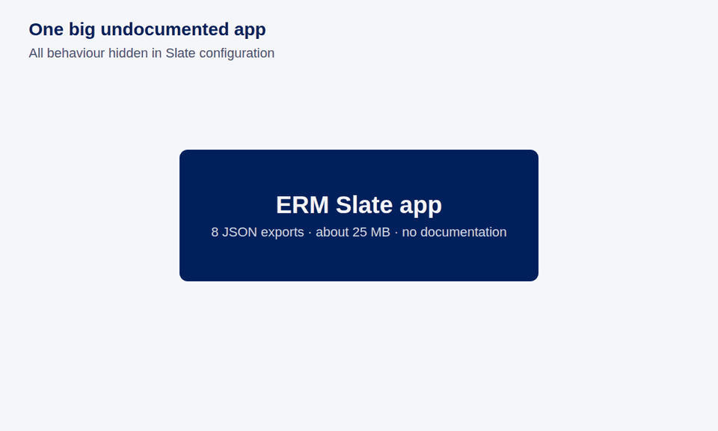
Why migrate: Slate had become the bottleneck
Tangled dependencies
One user action cascades through widgets, events, actions and variables
High regression risk
Changing one feature can break unrelated dashboard behaviour
Slow navigation
Variable trees are recalculated on every tab switch
No documentation
8 Slate exports, about 25 MB of configuration, no specs
The Airbus DevX solution: React + OSDK
Clean, modular TypeScript components: isolated modules, safe updates, instant navigation
Notes:
Why migrate at all. In Slate, even a simple action triggers a cascade of widgets, events, actions and variables, so one change can break unrelated features, and every tab switch recalculates large variable trees. On top of that, nothing was documented: 8 exports, about 25 MB of configuration. Let the animation play: we first broke the app into its shell and 7 modules, then had AI extract every feature, 105 in total. The target is Airbus DevX with React and OSDK: modular components that can change safely and navigate instantly.

Slide 6
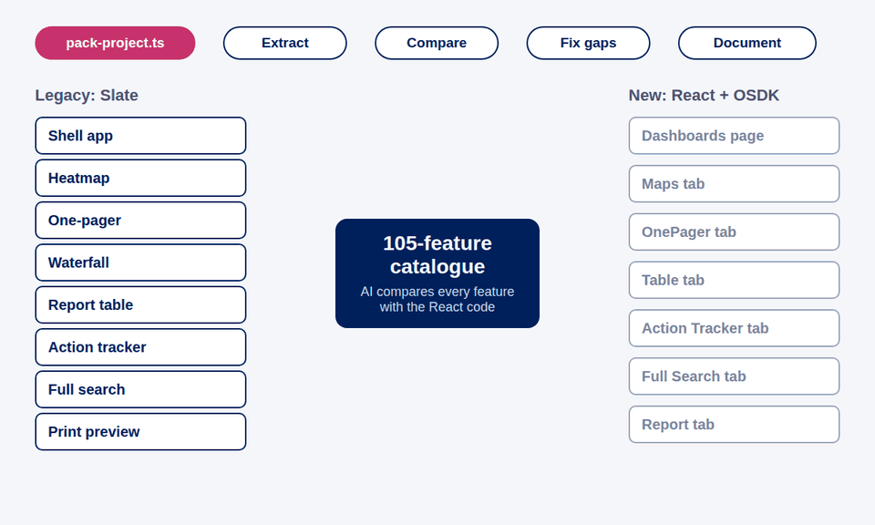
Our method: AI drafts, people check
pack-project.ts
Our script packs the whole React app, 75 files, into one dated file the AI reads in one go
Pack the context
Extract legacy features
Compare with the React code
Fix gaps, re-pack, re-check
Document the new app
Notes:
The key idea is context. AI only knows what you give it, so we wrote pack-project.ts: one command walks the React project and writes every source file, under its path, into a single dated dump. The AI sees components, hooks, OSDK calls and types together. The Slate side is already one JSON file per module. With both, the AI compares each of the 105 features to the React code. The animation shows each Slate module landing in its React tab. Gaps get fixed and reviewed, and the backend sharing fix is deployed; then we re-pack and re-check until nothing unplanned is left. Features we dropped on purpose, like the heatmap slider and report KPIs, are marked as choices, not gaps.

Slide 7
The process in numbers
1 PI
105
8
75→1
Whole migration built in one SAFe Program Increment
legacy features recovered, with no docs
Slate exports analysed, about 25 MB
React files packed into one AI context
31
7
11
0→10
gaps found and prioritised by AI review
security and data issues caught in review
new features beyond the old app
documents: 8 diagrams and 2 guides
Notes:
Walk the numbers left to right. One PI for the whole migration. 105 features recovered from an app with no documentation, out of 8 Slate exports totalling about 25 MB. pack-project.ts turned 75 React files into one context file. The AI review found and prioritised 31 gaps, 7 of them security or data-integrity issues such as unsanitised rich text and permission checks, all caught in review. The React app adds 11 features the old app did not have, from a searchable dashboard switcher and a web address per tab to a report slideshow; the next slides show them. Security and data-integrity findings caught in review: stored cross-site scripting from unsanitised rich HTML in 5 places; permission checks that matched e-mails by substring instead of exactly; sharing payload arrays misaligned with the wrong fields; settings JSON overwritten whole from a stale copy; reports printing shared risks the legacy app left out; no 100-risk print cap, a legacy cybersecurity limit; and children edits in the risk drawer silently discarded. Documentation went from nothing to 10 documents: 8 architecture and lifecycle diagrams, the feature comparison and the playbook.

Slide 8
Effort saved: about 76%, or ~$80K
~17
4
~$80K
Manual estimate
Actual with AI
Saved
sprints, ≈ 340 person-days ≈ $105K
sprints, ≈ 80 person-days ≈ $25K
about 76% less effort: (17 − 4) ÷ 17
Where the AI saved the most time
Discovery
Gap analysis
Documentation
105 features catalogued from the exports, with no docs to read
Every feature checked against the packed React code
8 architecture and lifecycle diagrams produced alongside the work
Generic estimate, not a measured baseline: 105 features × (0.5 day discovery + 2 days build + 0.5 day parity testing) + 25 days documentation ≈ 340 person-days. 2 developers, 2-week sprints = 20 person-days per sprint; 1 PI = 4 sprints; $38.50 per hour, 8 hours a day.
Notes:
These are generic industry-style estimates, not our measured baseline; say so if asked. A manual migration of 105 features typically needs about half a day per feature to reverse-engineer it, two days to rebuild it and half a day to test parity, plus about 25 days to document the app: roughly 340 person-days, or about 17 sprints for our team of 2 developers, more than 4 PIs. We did it in one PI, 4 development sprints, which is about 76% less effort. At $38.50 per developer hour, that is roughly $105,000 of manual effort against about $25,000 actual: around $80,000 saved. Then say where the time went: discovery was the biggest saving, because the AI catalogued 105 features straight from the Slate exports with no documentation to read; gap analysis, because every feature was checked against the packed React code; and documentation, because the diagrams were produced alongside the work instead of afterwards.

Slide 9
Faster to build, cheaper to run
11
11 files
−97%
~$10K
new features Slate never had, built in the same PI
one change added app-wide notifications and auto-refresh
25 MB of Slate configuration became 0.8 MB of typed code
less maintenance effort every year (estimate)
ADDING A FEATURE IN SLATE
Wire widgets, events, variables and functions across 8 exports
Any change can break unrelated dashboards
No documentation to know what depends on what
ADDING A FEATURE IN REACT + OSDK
One isolated, typed component plus one OSDK call
pack-project.ts gives AI the whole app as context
Architecture and lifecycle diagrams show the impact
Estimates at $38.50 per developer hour, 8 hours a day. Maintenance: rule of thumb of ~20% of build effort a year (340 person-days → 68 a year, ≈ $21K), assumed halved by modular, typed, documented code (≈ $10K a year saved).
Notes:
Building new features is now easy, and that keeps paying back. During the same PI we built 11 features Slate never had: permissions-only edit for locked versions, a web address per tab, a searchable dashboard switcher, a criticality-differs filter, category and impact-category filters, a fourth one-pager layout with custom slots, resizable columns saved per board, report classification and cover toggle, slideshow mode, one-pager selection shortcuts, and showing risks by ID or title. One change added app-wide notifications and automatic list refresh across 11 files. 25 MB of Slate configuration became about 0.8 MB of typed source in 75 files. In Slate, a feature meant wiring widgets, events, variables and functions across 8 exports, with no documentation; in React it is one typed component and one OSDK call, and pack-project.ts gives AI the whole app as context. On recurring cost: using a common rule of thumb that maintenance costs about 20% of build effort a year, a Slate-equivalent app would need about 68 person-days a year, around $21,000 at $38.50 an hour. Assuming modular, typed, documented code halves that, we save around $10,000 a year. Say clearly these are estimates.

Slide 10
What the business says
Feedback from ERM business stakeholders, September 2026
“
“
“
Thanks to a mix of regular teamwork with the business and strong IT skills, they have turned an idea into a user-friendly industrial [solution]… User interface and performance have significantly improved.
The Skywise ERM dashboard application is a tremendous addition to our ERM toolset… More and more users regularly prepare and facilitate risks & opportunities reviews with the application.
They built great new features that make navigation easier and give us a much clearer view of our R&O data. Whenever bugs or issues came up, they fixed them quickly and efficiently.
ERM Centre of Competence
Enterprise Risk Management
ERM stakeholder
[Role]
Risk and Opportunity Manager
Airbus Operations GmbH, Hamburg
Notes:
Let the business speak. These are testimonials sent by ERM stakeholders in September 2026 about the team and the ERM tool. A member of the ERM centre of competence: teamwork with the business and strong IT skills turned an idea into a user-friendly industrial solution, ERM reports are now generated in a much more automated way, and the user interface and performance have significantly improved. An ERM stakeholder: the ERM dashboard is a tremendous addition to the ERM toolset, and more and more users prepare and run their risk and opportunity reviews with it. A Risk and Opportunity Manager in Hamburg: new features made navigation easier and gave a much clearer view of R&O data, and issues were fixed quickly. Make clear these speak about the team and the tool overall.

Slide 11
Our contribution to the 2026 objectives
OUR PROJECT
EVIDENCE
2026 OBJECTIVE
AI read 8 Slate exports and the packed React code: 105 features recovered, 31 gaps found
Leverage AI to solve business problems
India TFO · Digital: democratise AI
AI-assisted migration of ERM
Slate to React + OSDK
2 developers · 1 PI
pack-project.ts
Delivered in 1 PI by 2 developers, about 76% less effort than a manual estimate
Deliver on time, on cost, on quality
Digital: optimise our digital resources
All 105 features tracked for parity; ERM rebuilt on a standard, maintainable stack, ready to leave Slate
Ensure our operational performance
Digital: availability of systems for operations
pack-project.ts and the playbook let any team repeat the method
Grow digital acumen and competencies
Digital: develop our people · India TFO
Notes:
This slide ties the project to four 2026 objectives; the flow builds one branch at a time. One: Leverage AI to solve business problems. The AI read all 8 Slate exports and the packed React code, recovered 105 features from an undocumented app and found 31 gaps. Two: Deliver on time, on cost, on quality. Two developers delivered it in one PI, about 76% less effort than a generic manual estimate. Three: Ensure our operational performance. ERM is a business system; every one of its 105 features was tracked for parity, and it is rebuilt on standard, maintainable React and OSDK code, ready to replace the legacy Slate configuration. Four: Grow digital acumen and competencies. pack-project.ts and the playbook mean other teams can repeat this, which builds AI-assisted engineering skills across the organisation.

Slide 12
A playbook any team can reuse
Built together
Ready to transfer
Business users confirmed the feature catalogue
Data and security owners kept restricted views intact
Backend and frontend fixes shipped together
Proposed at the architecture sync, aligned with [Architect], for functions beyond DMS
Other Slate apps in [business areas]
Any low-code tool with little documentation
Reusable as is: pack-project.ts, comparison template, diagrams
Pack. Extract. Compare. Fix. Document. Repeat for the next app.
Notes:
Close on reuse. This was a team effort across business, data and security, backend and frontend; name the teams. The method needs only the legacy export, the new codebase and an AI model, so it carries over to other Slate apps and to other legacy tools. The pieces are ready: pack-project.ts, the comparison document layout and the diagram formats. End with the five-word playbook and invite questions.

