Slide 1

QUARTERLY AWARDS · INNOVATION
Enterprise Risk Management (ERM)
2 developers rebuilt a business-critical, undocumented app for Airbus DevX in one PI, with an AI method any team can reuse
[Team name] · [Presenter names] · [Date]
Notes:
Give the answer first, in one breath: two developers rebuilt ERM, a business-critical Slate application with no documentation, for Airbus DevX with React and OSDK in a single PI, ready for go-live, using an AI-assisted method we designed and that any team can reuse. Then: let me show you why that was hard, what we did differently, and the proof.

Slide 2
ERM is business-critical for 892 risk managers
THE STAKES · IMPACT
LIFETIME UNIQUE USERS
MONTHLY ACTIVE PEAK
DASHBOARDS CREATED
UPDATED DAILY
892
320+
1,600+
10+
Across engineering, programmes and operations
Active risk managers per reporting month
Custom dashboards created to date
Maintained continuously by risk owners
MONTHLY UNIQUE USERS TREND
WHAT ERM DOES
One place to manage ARM risks and opportunities: custom dashboards, live editing, trend following, governed quarterly releases and cross-division sharing.
Every risk and opportunity review in ERM depends on it working.
Approximate monthly values, read from the ERM usage chart
Notes:
Set the stakes. ERM is where Airbus risk managers manage ARM risks and opportunities: custom dashboards, live editing, trend following, governed quarterly releases and sharing across divisions. 892 people have used it; more than 320 are active in a peak month; more than 1,600 dashboards exist and more than 10 are updated every day. Usage has grown steadily since launch. So whatever we did, we could not break it.

Slide 3
Used across Airbus organisations and sites
THE STAKES · IMPACT
More than half of ERM users work outside its largest organisation, across 6 countries
UNIQUE USERS BY ORGANISATION (SIGLUM 1)
LOCATION PROFILE
France
Blagnac Wings Campus 271, Saint-Martin 43 users
Germany
Hamburg Finkenwerder 205 users
United Kingdom
Broughton 32, Filton 26 users
Spain
Getafe 25 users
Canada
Mirabel 12 users
India
Bangalore 7 users
Plus about 12 smaller organisations (D, M, Z, Q, G, F, H, I, V, E, T…). Approximate values, read from the ERM usage chart
Notes:
ERM is not one team's tool. By organisation, the largest group, siglum B, has around 345 users, followed by O, P, A, L, S and K, and about a dozen smaller organisations. By site, Blagnac and Hamburg lead, with users in the UK, Spain, Canada and India too. The values on the organisation chart are read from the usage dashboard, so treat them as approximate. A migration that broke ERM would hit risk reporting across the company.

Slide 4
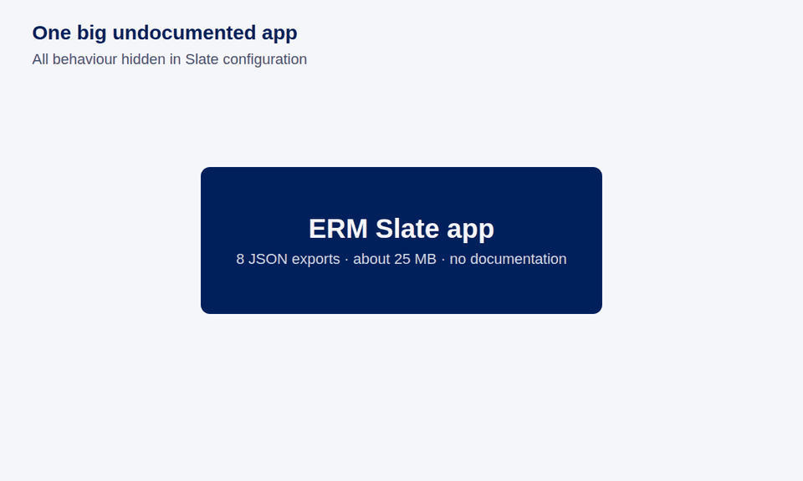
But Slate had become the bottleneck
THE COMPLICATION
Tangled dependencies
One user action cascades through widgets, events, actions and variables
High regression risk
Changing one feature can break unrelated dashboard behaviour
Slow navigation
Variable trees are recalculated on every tab switch
No documentation
8 Slate exports, about 25 MB of configuration, no specs
THE QUESTION
How do 2 developers move 105 hidden features in one PI, without breaking risk reporting?
Notes:
Here is the complication. In Slate, one simple action triggers a cascade of widgets, events, actions and variables, so any change risks breaking something unrelated, and every tab switch recalculates large variable trees. And nothing was documented: 8 exports, about 25 MB of configuration. Let the animation play: the app breaks into a shell and 7 modules, and 105 features come out of it. Then ask the question on screen: how do two developers move 105 hidden features in one PI without breaking risk reporting?

Slide 5
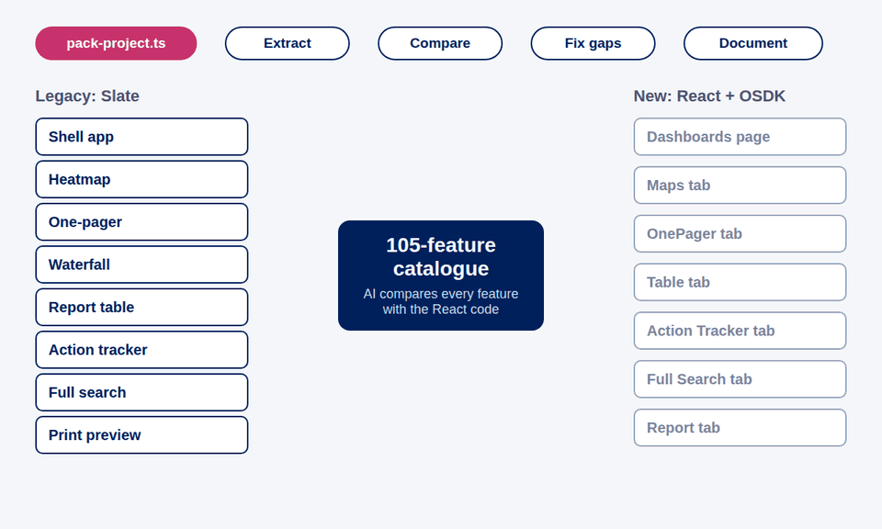
Our answer: AI reverse-engineers, people verify
THE INSIGHT · INNOVATION
USUAL MIGRATION
OUR METHOD
Discovery
Interviews and clicking through screens
Discovery
AI reads all 8 Slate exports: 105 features catalogued
Context
Code read in fragments
Context
pack-project.ts gives the AI the whole app at once
Parity check
Manual testing, gaps found late
Parity check
Every feature checked against the code: 31 gaps found
pack-project.ts
Our script packs the whole React app, 75 files, into one dated context the AI reads in one go. The 8 Slate exports complete the picture.
Documentation
Written afterwards, if at all
Documentation
8 architecture and lifecycle diagrams made alongside
Notes:
This is the innovation. A usual migration starts with interviews and clicking through screens, reads code in fragments, finds gaps late in testing and documents afterwards, if at all. We flipped it. The AI read all 8 Slate exports and catalogued 105 features. Our script, pack-project.ts, packs the whole React app into one dated file, so the AI sees every component and OSDK call at once. The AI then checked every feature against the code and found 31 gaps; people reviewed, fixed and deployed. The diagrams were produced alongside the work. AI drafts, people verify. If time allows, show the live app here for 60 seconds.

Slide 6
Same features, one PI, two developers
THE PROOF · IMPACT
1 PI
2
105
~$80K
saved: about 76% less effort than a manual migration
4 sprints (≈ $25K) actual vs ~17 sprints (≈ $105K) estimated for 2 developers
Generic estimate: 105 features × 3 days + 25 days docs ≈ 340 person-days, at $38.50/h
for the whole migration
developers
features carried over and checked
31
7
0 → 10
gaps found and prioritised by AI review
security and data-integrity issues caught in review
documents: 8 diagrams and 2 guides
READY FOR GO-LIVE · [planned date]
Ready now
All 105 features checked against the code; backend sharing fix deployed
Next
Go-live to 892 users across 6 countries, then retire the Slate app
We will measure
Users retained, page-switch time against Slate, incidents after release
Notes:
The proof, hard facts first. One PI. Two developers. All 105 features carried over and checked. The AI review found and prioritised 31 gaps, including 7 security and data-integrity issues such as unsanitised rich text and permission checks, all caught in review; the dashboard sharing-access fix is deployed. Documentation went from nothing to 10 documents. Against a generic estimate of about 340 person-days, roughly 17 sprints for two developers, we used 4 sprints: about 76% less effort. At $38.50 per developer hour that is roughly $105,000 against $25,000, around $80,000 saved. Say clearly that this is a generic estimate. Security and data-integrity findings caught in review: stored cross-site scripting from unsanitised rich HTML in 5 places; permission checks that matched e-mails by substring instead of exactly; sharing payload arrays misaligned with the wrong fields; settings JSON overwritten whole from a stale copy; reports printing shared risks the legacy app left out; no 100-risk print cap, a legacy cybersecurity limit; and children edits in the risk drawer silently discarded. Then the readiness row: be clear the app is not live yet. Everything is checked and the backend sharing fix is deployed; go-live is planned for [date], after which the Slate app is retired. Tell the jury what you will measure after go-live: users retained, page-switch time against Slate, and incidents after release.

Slide 7
Faster to build, cheaper to run
SUSTAINABILITY · IMPACT
11
11 files
−97%
~$10K
new features Slate never had, shipped in the same PI
one change added app-wide notifications and auto-refresh
25 MB of Slate configuration became 0.8 MB of typed code
less maintenance effort every year (estimate)
ADDING A FEATURE IN SLATE
Wire widgets, events, variables and functions across 8 exports
Any change can break unrelated dashboards
No documentation to know what depends on what
ADDING A FEATURE IN REACT + OSDK
One isolated, typed component plus one OSDK call
pack-project.ts gives AI the whole app as context
Architecture and lifecycle diagrams show the impact
Estimates at $38.50 per developer hour, 8 hours a day. Maintenance: rule of thumb of ~20% of build effort a year (340 person-days → 68 a year, ≈ $21K), assumed halved by modular, typed, documented code (≈ $10K a year saved).
Notes:
Building new features is now easy, and that keeps paying back. During the same PI we shipped 11 features Slate never had: permissions-only edit for locked versions, a web address per tab, a searchable dashboard switcher, a criticality-differs filter, category and impact-category filters, a fourth one-pager layout with custom slots, resizable columns saved per board, report classification and cover toggle, slideshow mode, one-pager selection shortcuts, and showing risks by ID or title. One change added app-wide notifications and automatic list refresh across 11 files. 25 MB of Slate configuration became about 0.8 MB of typed source in 75 files. In Slate, a feature meant wiring widgets, events, variables and functions across 8 exports, with no documentation; in React it is one typed component and one OSDK call, and pack-project.ts gives AI the whole app as context. On recurring cost: using a common rule of thumb that maintenance costs about 20% of build effort a year, a Slate-equivalent app would need about 68 person-days a year, around $21,000 at $38.50 an hour. Assuming modular, typed, documented code halves that, we save around $10,000 a year. Say clearly these are estimates.

Slide 8
What the business says
VOICE OF THE BUSINESS · IMPACT
Feedback from ERM business stakeholders, September 2026
“
“
“
Thanks to a mix of regular teamwork with the business and strong IT skills, they have turned an idea into a user-friendly industrial [solution]… User interface and performance have significantly improved.
The Skywise ERM dashboard application is a tremendous addition to our ERM toolset… More and more users regularly prepare and facilitate risks & opportunities reviews with the application.
They built great new features that make navigation easier and give us a much clearer view of our R&O data. Whenever bugs or issues came up, they fixed them quickly and efficiently.
ERM Centre of Competence
Enterprise Risk Management
ERM stakeholder
[Role]
Risk and Opportunity Manager
Airbus Operations GmbH, Hamburg
Notes:
Let the business speak. These are testimonials sent by ERM stakeholders in September 2026 about the team and the ERM tool. A member of the ERM centre of competence: teamwork with the business and strong IT skills turned an idea into a user-friendly industrial solution, ERM reports are now generated in a much more automated way, and the user interface and performance have significantly improved. An ERM stakeholder: the ERM dashboard is a tremendous addition to the ERM toolset, and more and more users prepare and run their risk and opportunity reviews with it. A Risk and Opportunity Manager in Hamburg: new features made navigation easier and gave a much clearer view of R&O data, and issues were fixed quickly. Make clear these speak about the team and the tool overall.

Slide 9
Four 2026 objectives, one team effort
STRATEGIC FIT · TEAMWORK
OUR PROJECT
EVIDENCE
2026 OBJECTIVE
AI read 8 Slate exports and the packed React code: 105 features recovered, 31 gaps found
Leverage AI to solve business problems
India TFO · Digital: democratise AI
AI-assisted migration of ERM
Slate to React + OSDK
2 developers · 1 PI
pack-project.ts
Delivered in 1 PI by 2 developers, about 76% less effort than a manual estimate
Deliver on time, on cost, on quality
Digital: optimise our digital resources
All 105 features tracked for parity; ERM rebuilt on a standard, maintainable stack, ready to leave Slate
Ensure our operational performance
Digital: availability of systems for operations
pack-project.ts and the playbook let any team repeat the method
Grow digital acumen and competencies
Digital: develop our people · India TFO
BUILT TOGETHER Business users confirmed the feature catalogue · Data and security owners kept restricted views intact · Backend and frontend fixes shipped together
Notes:
This slide shows strategic fit and teamwork; the flow builds one branch at a time. One: Leverage AI to solve business problems. The AI read all 8 Slate exports and the packed React code, recovered 105 features from an undocumented app and found 31 gaps. Two: Deliver on time, on cost, on quality. Two developers delivered it in one PI, about 76% less effort than a generic manual estimate. Three: Ensure our operational performance. ERM is a business system; every one of its 105 features was tracked for parity, and it is rebuilt on standard, maintainable React and OSDK code, ready to replace the legacy Slate configuration. Four: Grow digital acumen and competencies. pack-project.ts and the playbook mean other teams can repeat this, which builds AI-assisted engineering skills across the organisation. Finally the team strip: business users confirmed the feature catalogue, data and security owners kept the restricted-view access model intact, and backend and frontend fixes shipped together. Name the people and teams here.

Slide 10
A playbook any team can run next
SCALE · TRANSFERABILITY
Pack
Extract
Compare
Fix
Document
Ready to reuse
Where next
Our ask
Endorse the playbook as a DevX pattern. We have aligned with [Architect] to propose it at the architecture sync, so functions beyond DMS can use it.
[Next: a first team outside DMS]
pack-project.ts: whole-app context in one command
Feature comparison template
Architecture and lifecycle diagram formats
Functions beyond DMS, via the architecture sync
Other Slate apps in [business areas]
Any low-code tool with little documentation
Any team starting an AI-assisted migration
105 features, one PI, two developers. Ready for go-live, and for the next app.
Notes:
Close on scale and make an ask. The method is five steps: pack, extract, compare, fix, document. The pieces are ready to reuse: pack-project.ts, the comparison template and the diagram formats. It fits other Slate apps and any low-code tool with little documentation. Then the ask: endorse the playbook as a DevX pattern. We have already aligned with [Architect] to propose it at the architecture sync, so functions beyond DMS can use it; name the first team outside DMS if you have one. End on the line on screen and invite questions.

