Slide 1
Web Server &
App Server
Setup
What's Covered
🌐
Nginx — Web Server on Port 81
🔴
Apache — Web Server on Port 82
🐱
Apache Tomcat — App Server on Port 8082
Nginx • Apache • Tomcat • HAProxy
Tasks 8 — Completed
⚖️
Deploy sample index.html files
📄
Create tomcat.service (systemd)
Nithin Reddy Batch-20
🔀
Configure HAProxy Load Balancer

Slide 2
Architecture Overview
Tasks 8 | DevOps Engineering
Full stack: Client → Load Balancer → Web Servers → App Server
Client
Browser
HAProxy
Nginx
Apache
HTTP Request
Port 80 (LB)
Port 81
Port 82
▶
▶
▶
▼
Tomcat
Port 8082
(App Server)

Slide 3
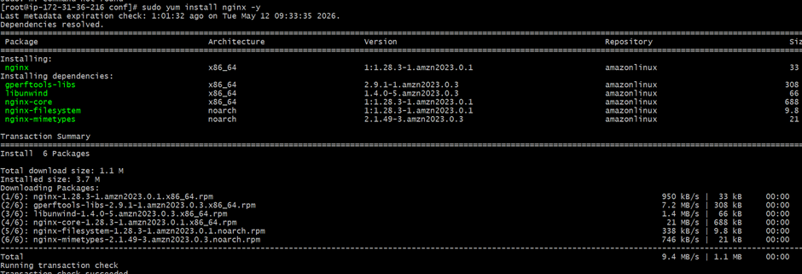
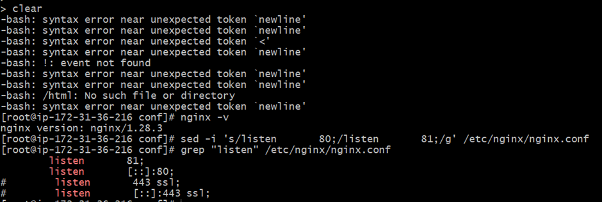
Task 1 — Install Nginx & Run on Port 81
Tasks 8 | DevOps Engineering
sudo apt-get install nginx | Configure port 81
1
Install Nginx
sudo apt-get update
sudo apt-get install nginx -y
2
Edit Config — Set Port 81
sudo nano /etc/nginx/sites-available/default
→ Change: listen 80 to listen 81
📷
3
Start & Enable Service
Add your Nginx screenshots here
sudo systemctl start nginx
sudo systemctl enable nginx
4
Verify Running
sudo systemctl status nginx
curl http://localhost:81

Slide 4
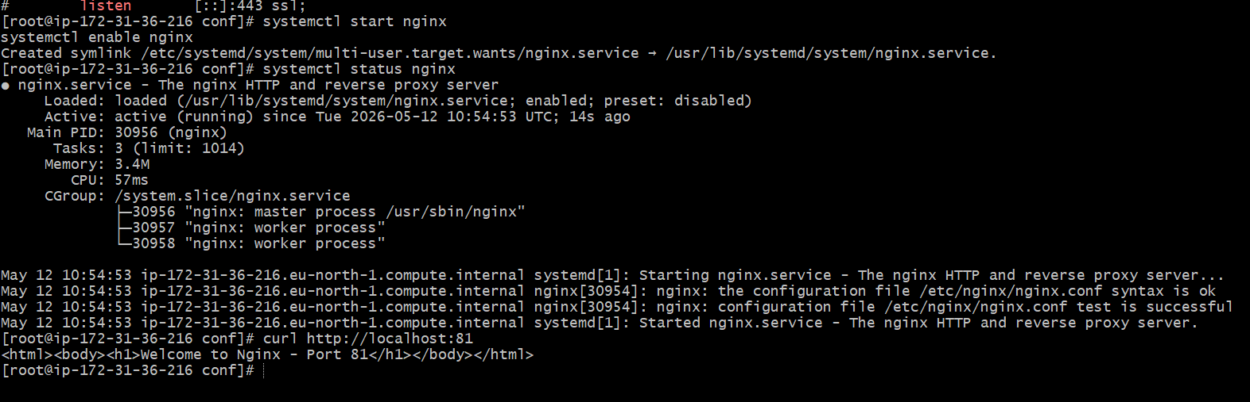
Task 2 — Deploy index.html on Nginx
Tasks 8 | DevOps Engineering
Create and deploy a sample HTML page on Nginx
1
Create index.html
sudo nano /var/www/html/index.html
2
Add Sample HTML Content
<html><body>
<h1>Welcome to Nginx!</h1>
</body></html>
📷
3
Set Permissions
Add your Nginx HTML screenshots here
sudo chown www-data:www-data
/var/www/html/index.html
4
Reload & Test
sudo nginx -t
sudo systemctl reload nginx
curl http://localhost:81

Slide 5
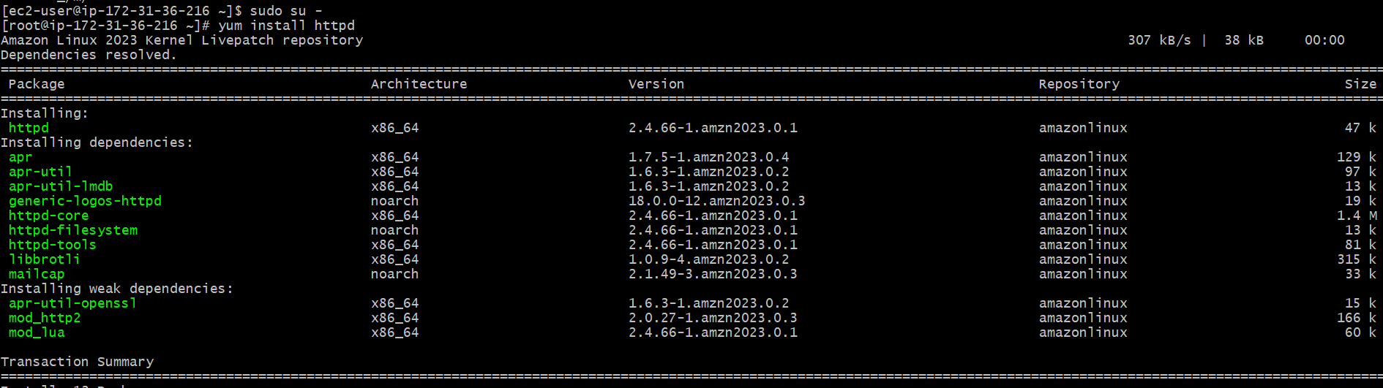

Task 3 — Install Apache & Run on Port 82
Tasks 8 | DevOps Engineering
sudo apt-get install apache2 | Configure port 82
1
Install Apache2
sudo apt-get update
sudo apt-get install apache2 -y
2
Edit Ports Config
sudo nano /etc/apache2/ports.conf
→ Change: Listen 80 to Listen 82
📷
3
Update VirtualHost
Add your Apache screenshots here
sudo nano /etc/apache2/sites-available
/000-default.conf
→ <VirtualHost *:82>
4
Start & Verify
sudo systemctl start apache2
sudo systemctl enable apache2
curl http://localhost:82

Slide 6
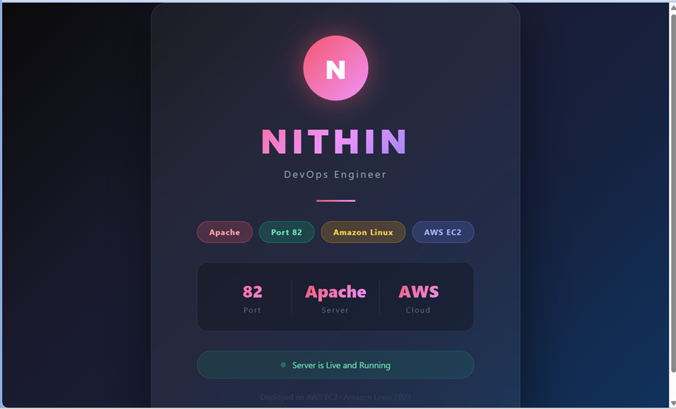
Task 4 — Deploy index.html on Apache
Tasks 8 | DevOps Engineering
Create and deploy a sample HTML page on Apache
1
Create index.html
sudo nano /var/www/html/index.html
2
Add Sample HTML Content
<html><body>
<h1>Welcome to Apache!</h1>
</body></html>
📷
3
Set Correct Permissions
Add your Apache HTML screenshots here
sudo chown www-data:www-data
/var/www/html/index.html
4
Restart & Test in Browser
sudo systemctl restart apache2
curl http://localhost:82

Slide 7
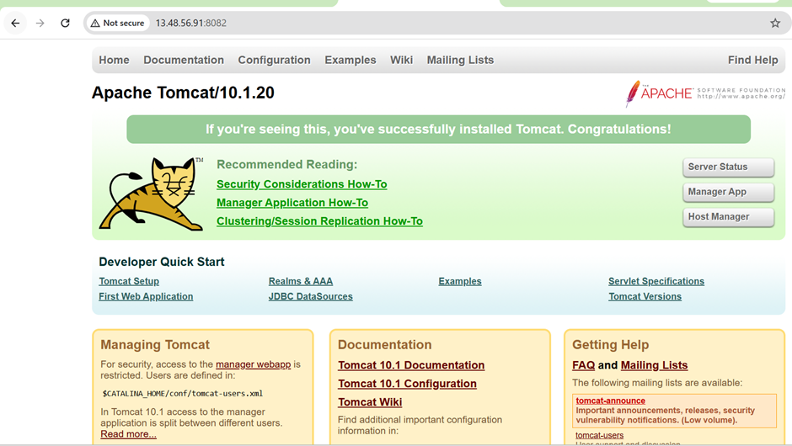
Task 5 — Install Apache Tomcat on Port 8082
Tasks 8 | DevOps Engineering
Java-based application server | Port 8082
1
Install Java & Download Tomcat
sudo apt install default-jdk -y
wget https://dlcdn.apache.org/tomcat/...
2
Extract & Move to /opt
sudo tar -xvf apache-tomcat-*.tar.gz
sudo mv apache-tomcat-* /opt/tomcat
📷
3
Configure Port 8082
Add your Tomcat screenshots here
sudo nano /opt/tomcat/conf/server.xml
→ Change: port="8080" to port="8082"
4
Start Tomcat
sudo /opt/tomcat/bin/startup.sh
curl http://localhost:8082

Slide 8


Task 6 — Deploy Sample App on Tomcat Webapps
Tasks 8 | DevOps Engineering
Deploy .war file to Tomcat's webapps directory
1
Create or Get Sample .war File
# Download sample war
wget https://tomcat.apache.org/
tomcat-7.0-doc/appdev/sample/sample.war
2
Copy to webapps Directory
sudo cp sample.war
/opt/tomcat/webapps/
📷
3
Tomcat Auto-Deploys
Add your app deploy screenshots here
# Tomcat auto-extracts .war
# Check webapps folder
ls /opt/tomcat/webapps/
4
Access in Browser
http://<server-ip>:8082/sample

Slide 9
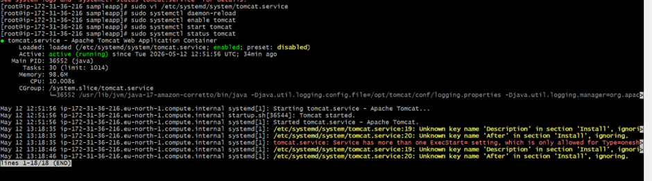
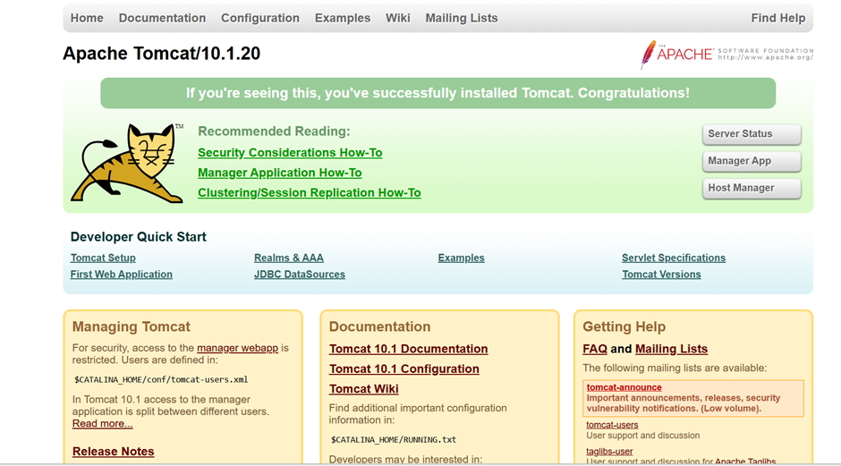
Task 7 — Create tomcat.service File
Tasks 8 | DevOps Engineering
Configure Tomcat as a systemd service for auto-start
1
Create Service File
sudo nano /etc/systemd/system/
tomcat.service
2
Enable & Start
sudo systemctl daemon-reload
sudo systemctl enable tomcat
sudo systemctl start tomcat
📷
Add your tomcat.service screenshots here
tomcat.service content
[Unit]
Description=Apache Tomcat
After=network.target
[Service]
Type=forking
User=tomcat
ExecStart=/opt/tomcat/bin/startup.sh
ExecStop=/opt/tomcat/bin/shutdown.sh
[Install]
WantedBy=multi-user.target

Slide 10
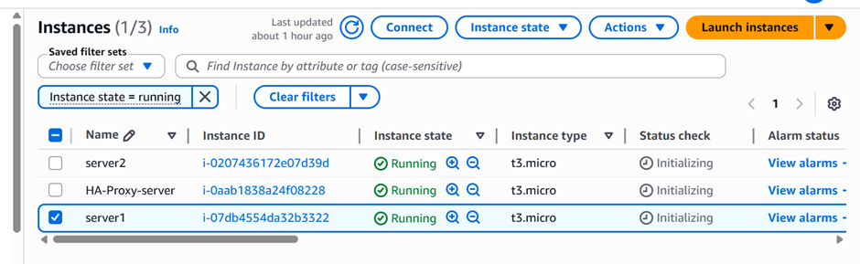
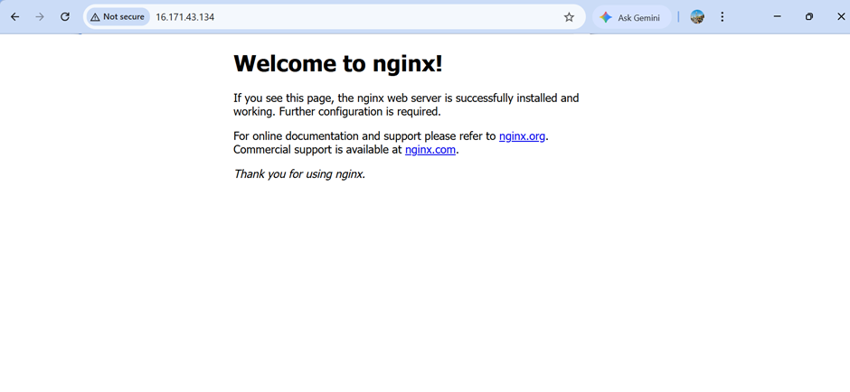
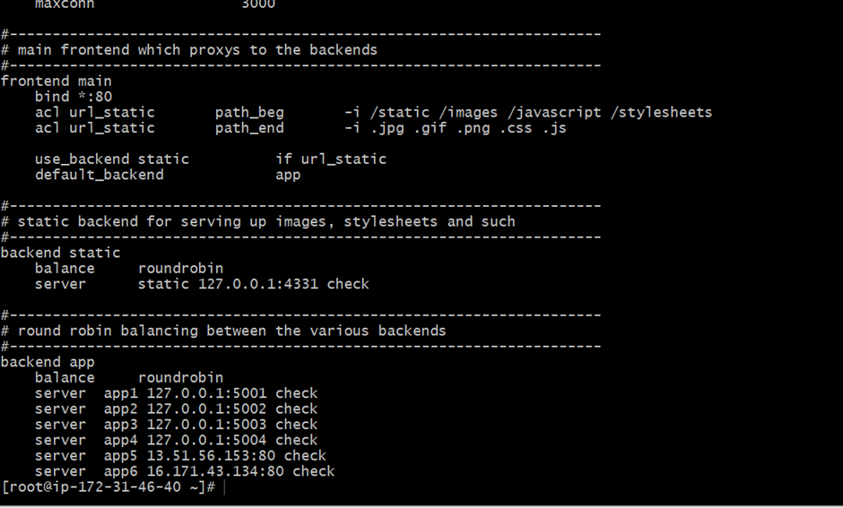
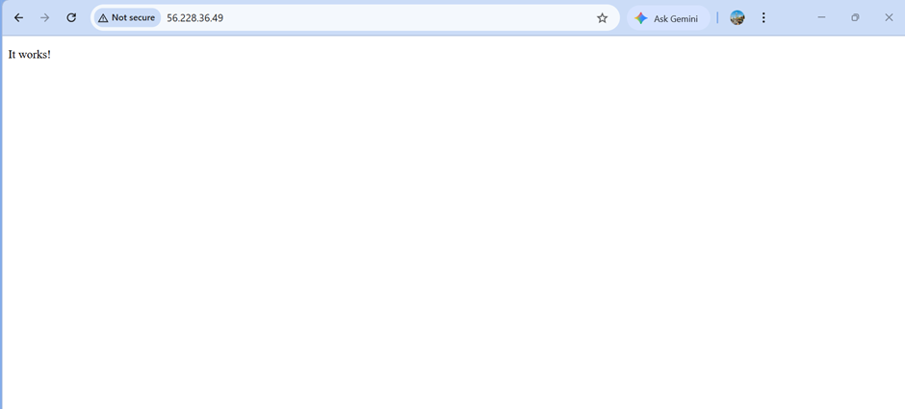
Task 8 — Configure HAProxy Load Balancer
Tasks 8 | DevOps Engineering
Server 1 (Nginx :81) + Server 2 (Apache :82)
1
Install HAProxy
sudo apt-get install haproxy -y
2
Edit haproxy.cfg
sudo nano /etc/haproxy/haproxy.cfg
📷
3
Add Backend Servers
Add your HAProxy screenshots here
backend servers
balance roundrobin
server s1 <IP>:81 check
server s2 <IP>:82 check
4
Restart & Verify
sudo systemctl restart haproxy
sudo systemctl status haproxy

Slide 11
Task Completion Summary
Tasks 8 | DevOps Engineering
All 8 tasks successfully completed
✔
Install Nginx on Port 81
✔
Install Apache Tomcat on Port 8082
Task 1
Task 5
✔
Deploy index.html on Nginx
✔
Deploy sample app on webapps
Task 2
Task 6
✔
Install Apache on Port 82
✔
Create tomcat.service file
Task 3
Task 7
✔
Deploy index.html on Apache
✔
Configure HAProxy Server
Task 4
Task 8

Slide 12
Thank you

