Slide 1
GRAD DIRECT PROJECT I Research Content Management Group - 1
Team Members
Nithin Reddy Kumbham – S545694
Saivivek Reddy Kusukuntla – S544900
Jawahar Reddy Nomula – S545267
Gopi Krishna Kandimalla – S545535
Abhinav Bellamkonda – S545039
Vamsidhar Reddy - S546964

Slide 2
Introduction
In this project we as a team developing a website where faculty and staff can save their all the research papers which they have worked on and search for the research paper using sorting functions.
We will have a signup and login page where user can register.
We further have a page where user can upload their saved files and notify what topic, year, and subtopics that the paper belongs to. Faculty can search their uploaded papers by using sorting functions like topic, year, and subtopics.
The desired research paper content is displayed after clicking on it in the pdf format. The format is editable, and author can review and add the comments or note the important information in it in a comment section text box.

Slide 3
Scope
The main objective of this project is to make user access his research papers with user friendly environment to make a note of his research work for referencing.
User can search and sort out easily from a bulk of research papers and can have an idea regarding the research paper by adding some comments and text highlighting functionality inside a PDF.
It is much helpful when referencing

Slide 4
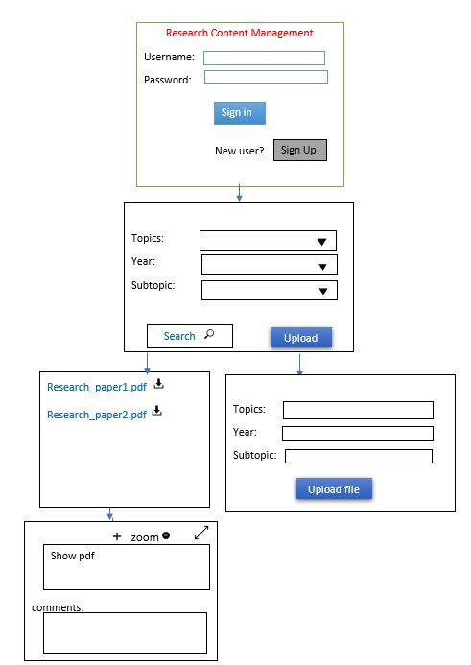
User Interface

Slide 5
Functionalities
This website consists of Authentication, where the registered users can only access this website
In search page user can search the desired paper by having sorting functions.
After searching user can view the PDF and highlight the key points to take a note.
User can also add some comments or key points in the website and can save the data
In Upload page user can upload the PDF and store PDF.

Slide 6
Technology used
HTML: Used in structuring web pages with tags and elements, we can define the headings, paragraphs, and other contents of a web page and ensure the proper formatting of text and images for our Internet browser.
CSS: we used CSS to control all design-related aspects of our website.
JavaScript: we used JavaScript to make web pages interactive.
React: It is a JavaScript library used to easily create fast user interfaces for websites and applications
Firebase: The Firebase Realtime Database is used to build rich, collaborative applications by allowing secure access to the database directly from client-side code.

Slide 7
Work Progress
We worked on the Authentication, designing login and sign-up pages
We integrated firebase to react to store the data
We used Firebase Authentication to access the data

Slide 8
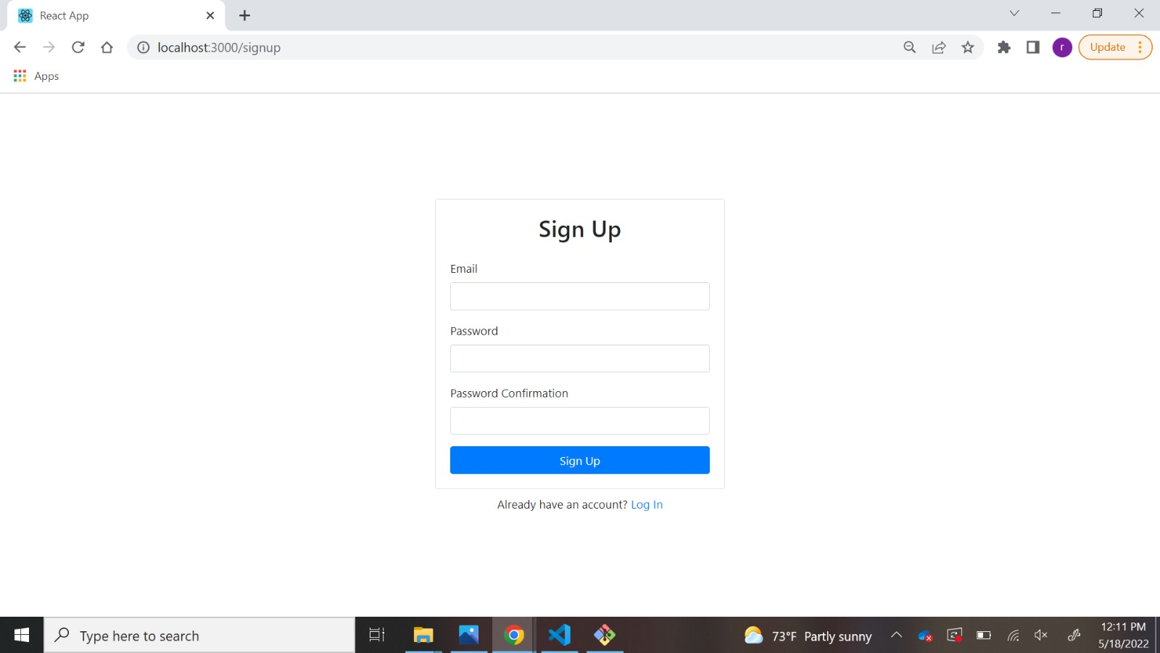
Sign up page:
Whenever a new user wants to register, he must sign up.
We provided email and password registration.
When the user sign up, the user’s email and password are stored in the firebase database, such that accordingly user can access the data.
An existing user cannot signup again using same credentials

Slide 9
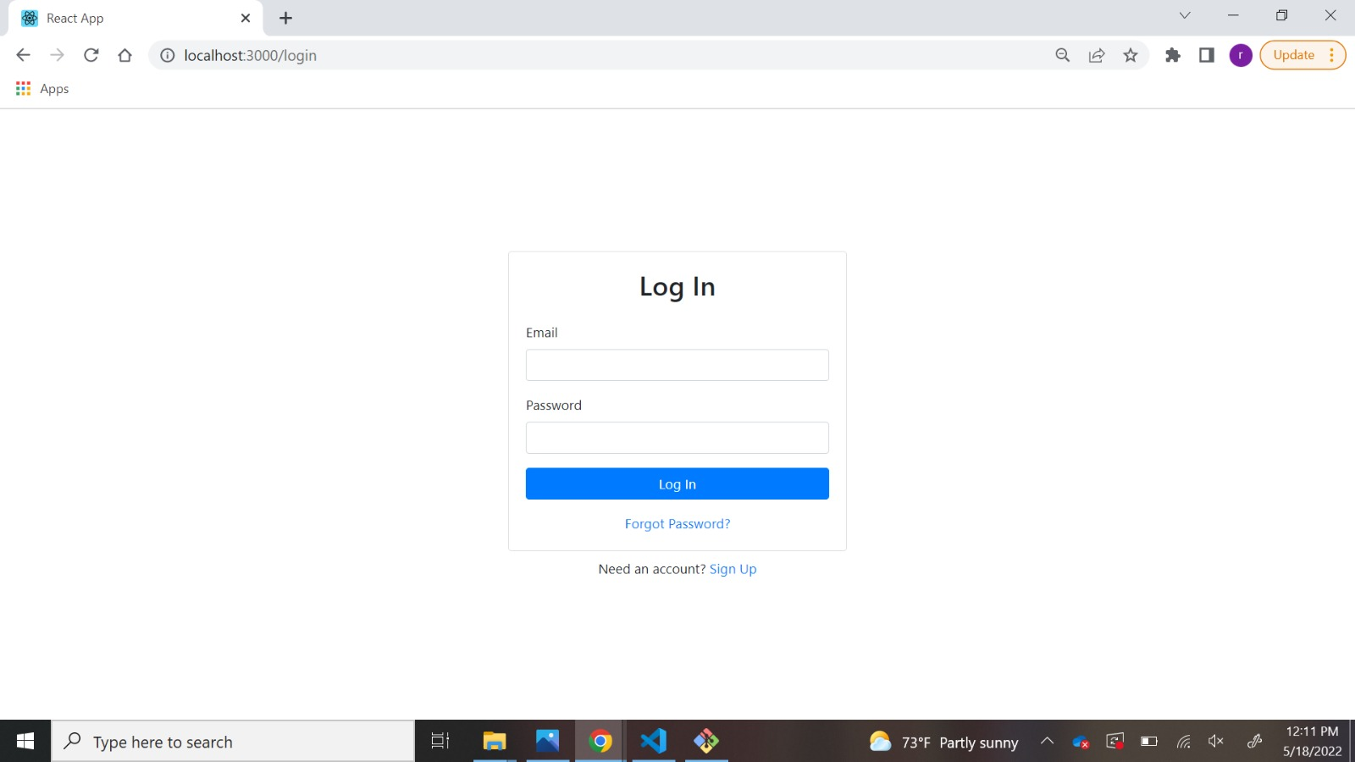
Login page
We worked on designing login page, where registered users can access the data.
We used React to design the UI part and firebase has the storage of the registered users.
After login user is redirected to uploading page.

Slide 10
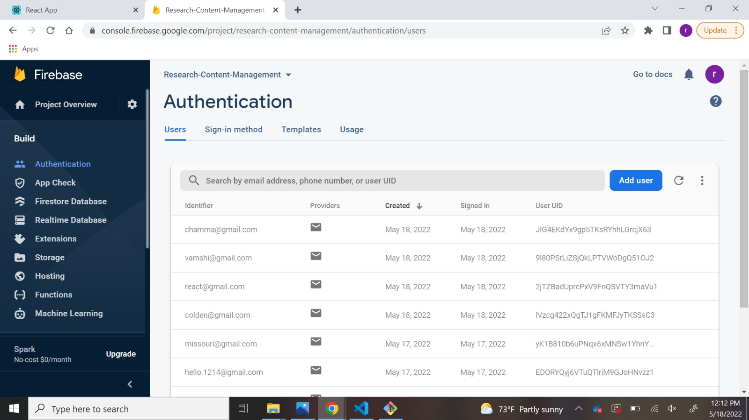
Firebase
We created a firebase account using our group email with the database named Research-Content-Management.
We used Email and password authentication in firebase.
As shown in figure, registered users are displayed in the firebase.

Slide 11
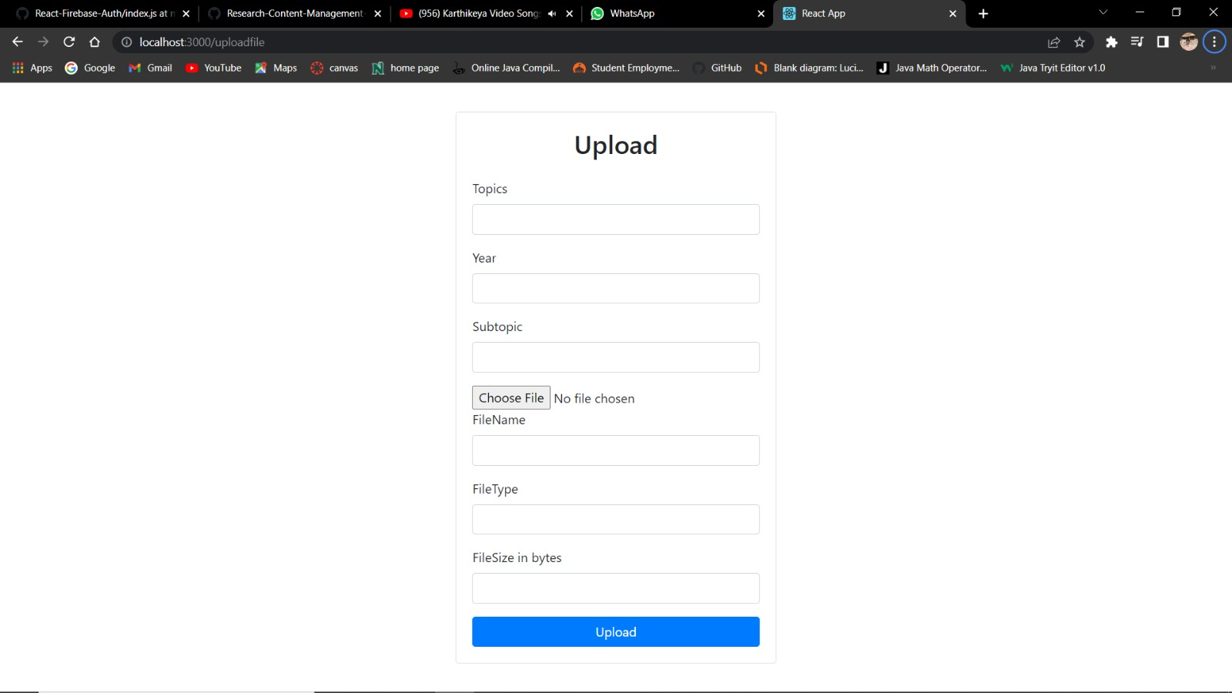
Upload Page
We have designed the UI part for upload page.
Currently working on uploading function of upload page

Slide 12
Future work
We are working on uploading the PDFs to database for the respective user and when we are done with uploading papers, we then move on to sorting functions where we sort papers according to the data provided by user during uploading of papers.
Our final work includes viewing the pdf file and adding comments to respective papers so that user can view the comments whenever he opens that paper.

Slide 13

Thank You

