Slide 1

Workshop-1
Research content management.
Team Members
Nithin Reddy Kumbham – S545694
Saivivek Reddy Kusukuntla – S544900
Jawahar Reddy Nomula – S545267
Gopi Krishna Kandimalla – S545535
Abhinav Bellamkonda – S545039
Vamsidhar Reddy - S546964

Slide 2
Roles and responsibilities
Front-end development
Vamsidhar reddy
Saivivek Reddy
Back-end development
Nithin reddy
Abhinav Bellamkonda
Database Management
Jawahar reddy
GopiKrishna Kandimalla

Slide 3
Technologies
Firebase is a platform developed by Google for creating mobile and web applications. It was originally an independent company founded in 2011. In 2014, Google acquired the platform, and it is now their flagship offering for app development.
React is a free and open-source JavaScript library for building user interfaces based on UI components. It is maintained by Meta and a community of individual developers and companies.
Bootstrap is a free and open-source CSS framework directed at responsive, mobile-first front-end web development. It contains HTML, CSS and JavaScript-based design templates for typography, forms, buttons, navigation, and other interface components.

Slide 4


An Google Development Platform

Slide 5
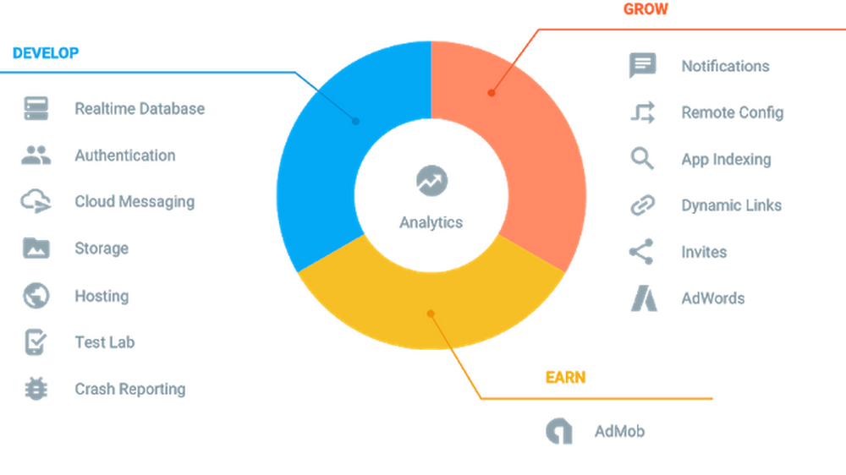
What Is Firebase ,Features Of Firebase?

Slide 6
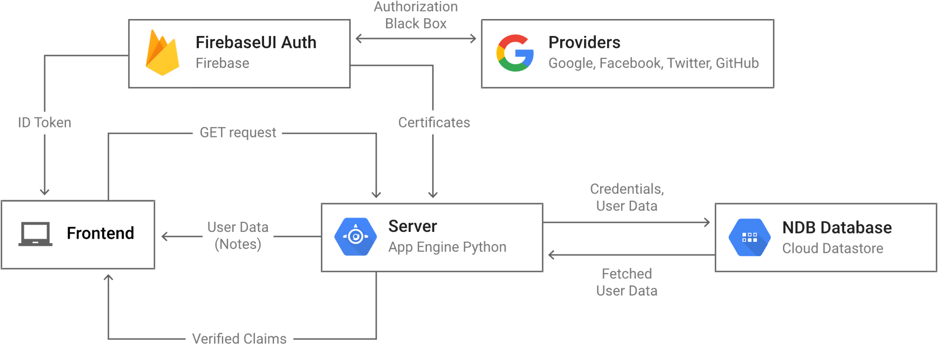
Firebase For RCM(Research Content Management)
We RCM team using firebase for: Authentication, Firestore Database and Storage.
Firebase Authentication:

Slide 7
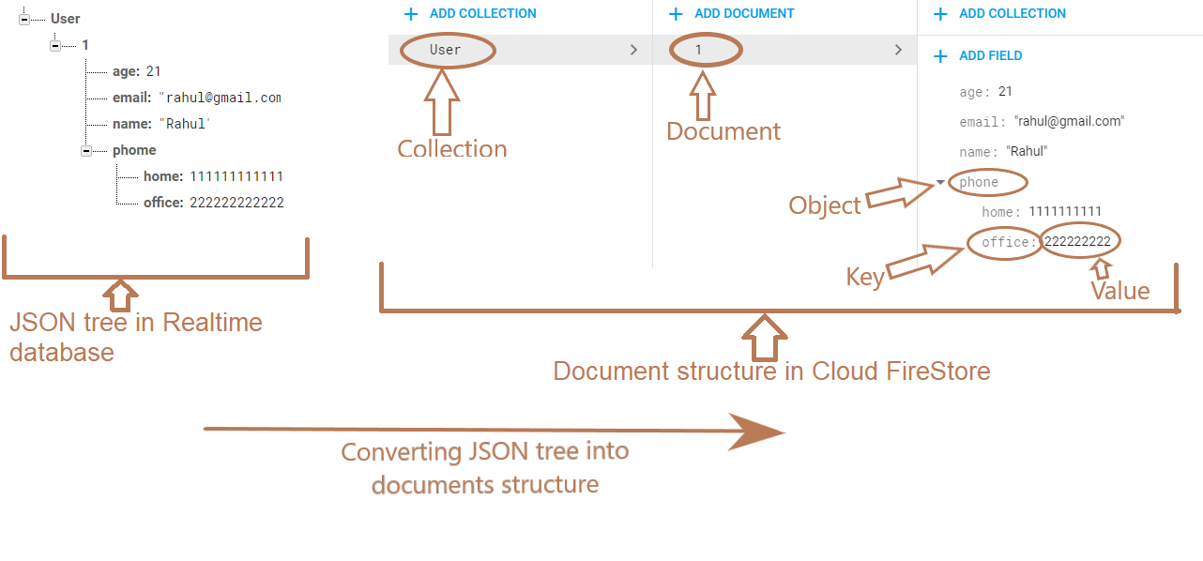
Firebase Firestore Database
Cloud Firestore is a flexible, scalable database for mobile, web, and server development from Firebase and Google Cloud.
Data stored in firestore is in JSON format.

Slide 8
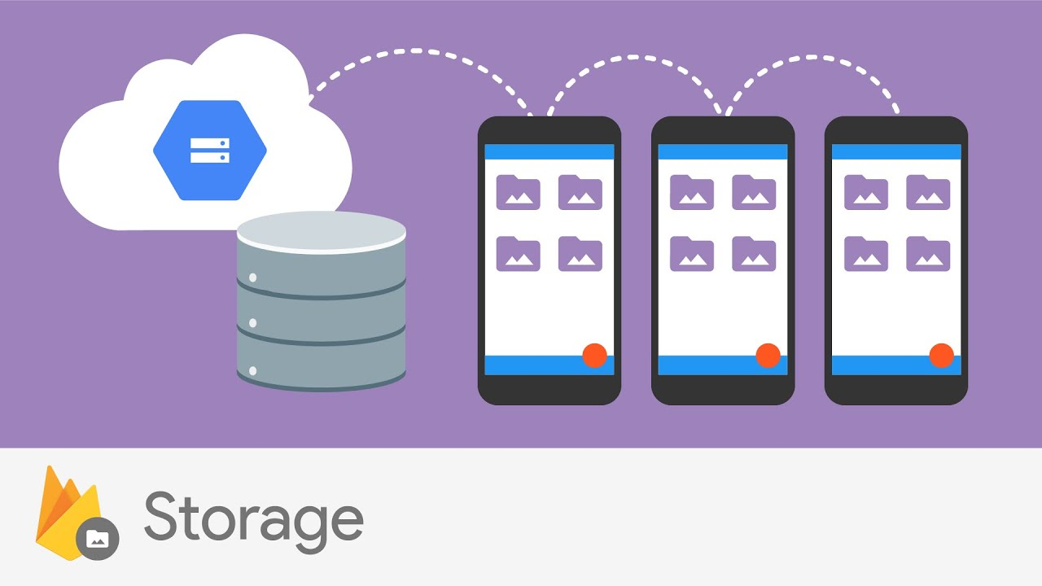
Firebase Storage
Firebase Cloud Storage is built with mobile connectivity in mind. Automatically pause and resume transfers as your app loses and regains connectivity.
You can use SDKs to store images, audio, video, or other user-generated content.
Cloud Storage is built for exabyte scale when your app goes viral. Effortlessly grow from prototype to production using the same infrastructure that powers Spotify and Google Photos.

Slide 9

Slide title 29
React JS
JavaScript library from Meta and community

Slide 10

React js
React is a library of JavaScript build by Facebook for building user interfaces for web application and mobile apps.
It’s an open source, reusable component-based front-end library
In Model View controller architecture, react is the view, which is responsible for how app looks like.
Pre-requisites:
JavaScript
HTML
CSS

Slide 11
Why React?
React is a library not a framework.
React is declarative, which doesn't interact with DOM directly and is in charge of taking declarative code and performing all the JavaScript operations.
High performance with less loading time.
It is Flexible and easy to maintain because react code is easy to update due to its virtual DOM feature.
For Complex UI’s react allows to reuse the components with similar UI’s, when we are dealing with lot of pages.

Slide 12
features
React application is composed of blocks of components.
Components are like functions that returns the HTML elements.
Hooks are the new added feature in react, available from version 16.
Hooks allow function components to have access to state and other React features. Because of this, class components are generally no longer needed.
React creates a VIRTUAL DOM in memory, thereby creating web applications faster.
Virtual DOM updates only those components in the real DOM which was edited, so the rest of the components remains stable, which defines faster performance.

Slide 13
Conclusion
React is an excellent tool with which to create interactive applications for mobile, web, and other platforms.
React’s benefits of being robust, advanced, responsive , non-risky, user-friendly increasing Usage of React gradually.
Firebase is very powerful and easy to use. It Basically makes Developer work easier, and he can focus less on data management logic because Firebase handles it with ease and with few lines of code.
The ability for the Firebase Realtime Database to sync with the Redux store without causing unexpected issues is a key benefit.

Slide 14
Thank You

