Slide 1

Workshop-2
Research content management.
Team Members
Nithin Reddy Kumbham – S545694
Saivivek Reddy Kusukuntla – S544900
Jawahar Reddy Nomula – S545267
Gopi Krishna Kandimalla – S545535
Abhinav Bellamkonda – S545039
Vamsidhar Reddy - S546964

Slide 2
Roles and responsibilities
Front-end development
Vamsidhar reddy
Saivivek Reddy
Back-end development
Nithin reddy
Abhinav Bellamkonda
Database Management
Jawahar reddy
GopiKrishna Kandimalla

Slide 3
Technologies
Firebase is a platform developed by Google for creating mobile and web applications. It was originally an independent company founded in 2011. In 2014, Google acquired the platform, and it is now their flagship offering for app development.
React is a free and open-source JavaScript library for building user interfaces based on UI components. It is maintained by Meta and a community of individual developers and companies.
Bootstrap is a free and open-source CSS framework directed at responsive, mobile-first front-end web development. It contains HTML, CSS and JavaScript-based design templates for typography, forms, buttons, navigation, and other interface components.

Slide 4


An Google Development Platform

Slide 5
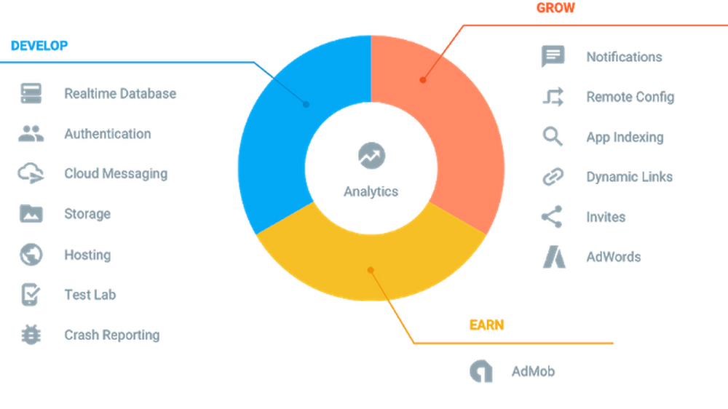
What Is Firebase ,Features Of Firebase?

Slide 6
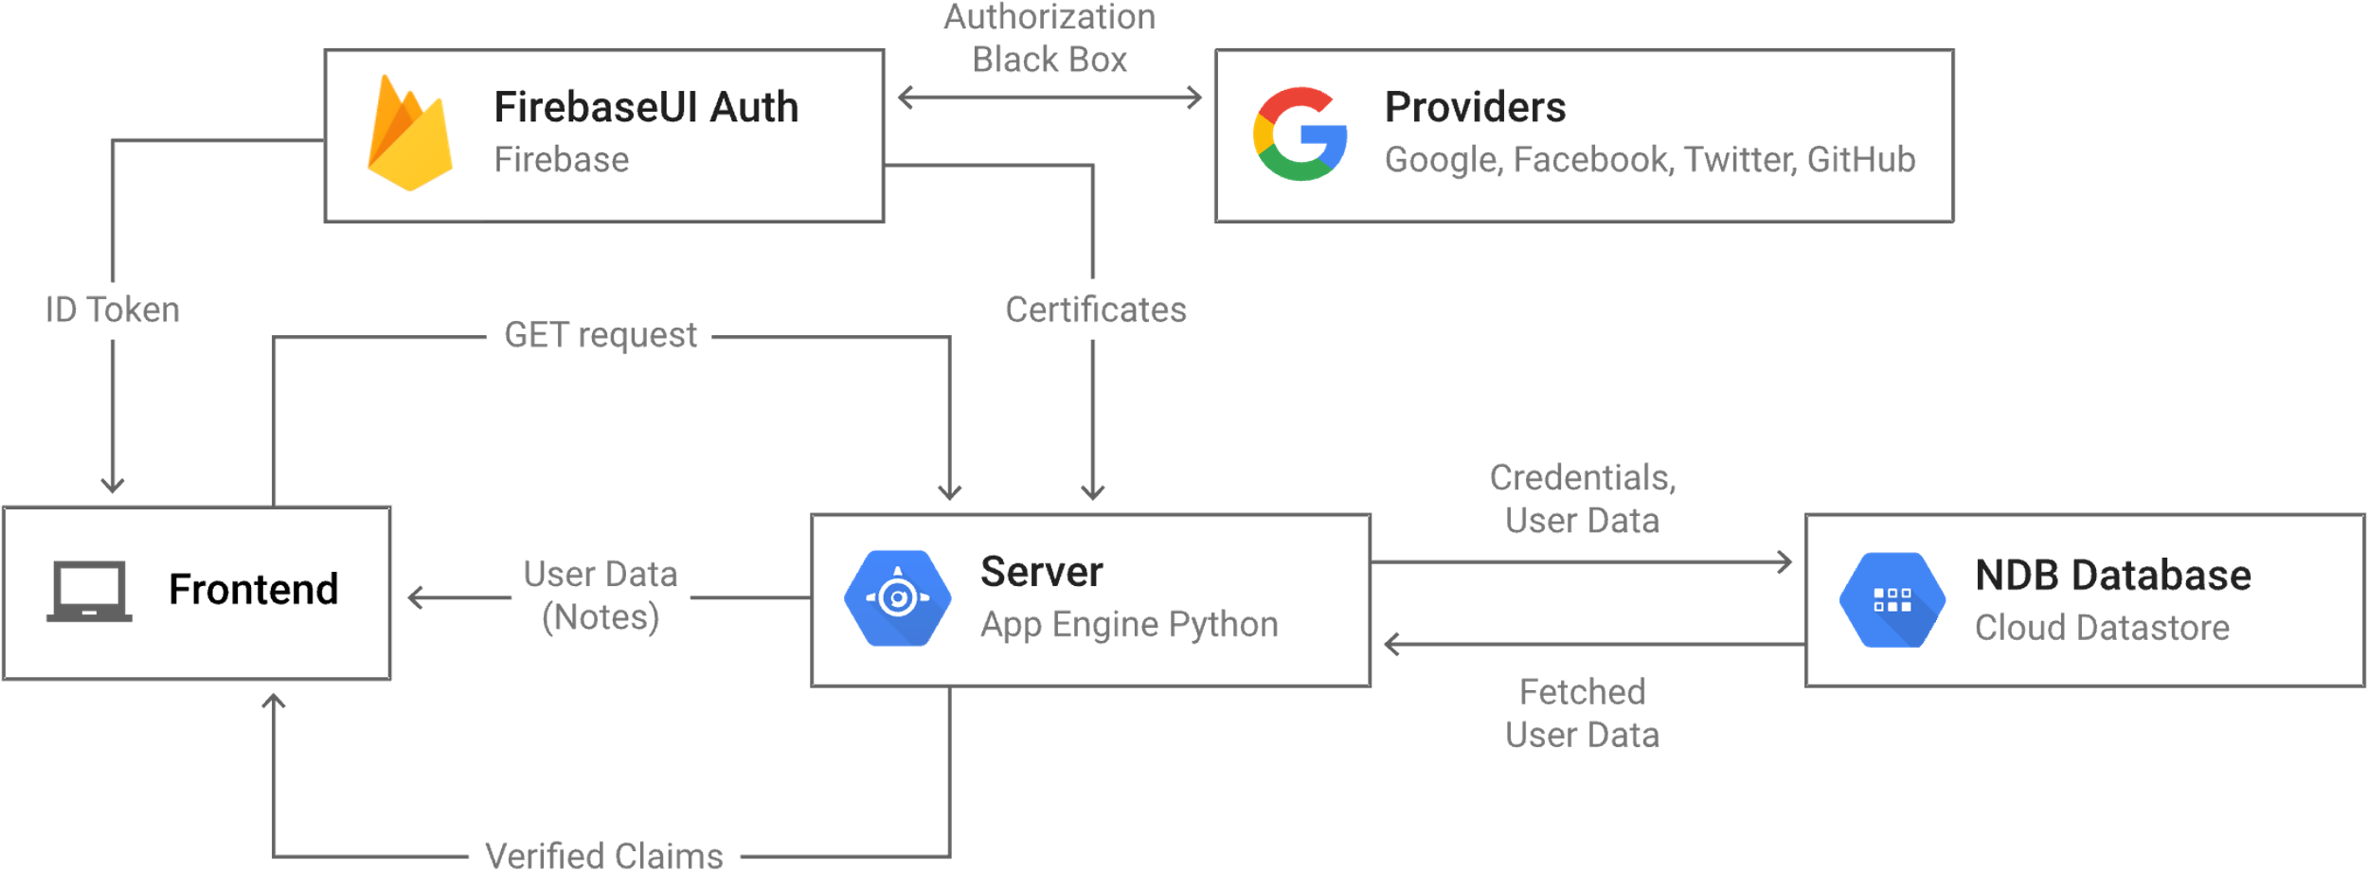
Firebase For RCM(Research Content Management)
We RCM team using firebase for: Authentication, Firestore Database and Storage.
Firebase Authentication:

Slide 7
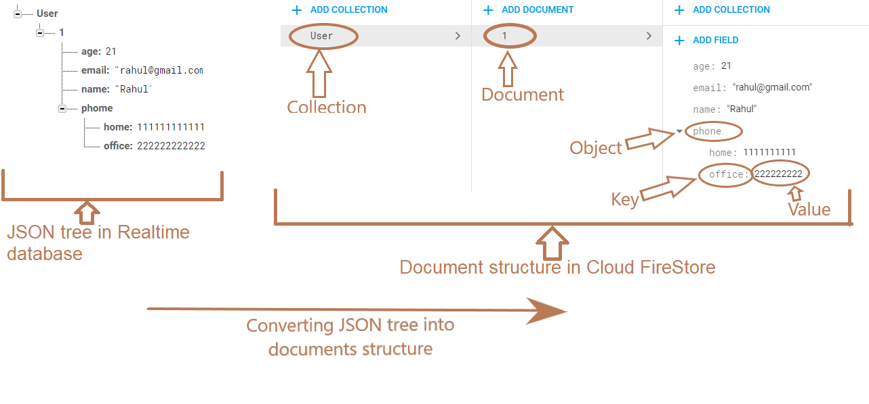
Firebase Firestore Database
Cloud Firestore is a flexible, scalable database for mobile, web, and server development from Firebase and Google Cloud.
Data stored in firestore is in JSON format.

Slide 8
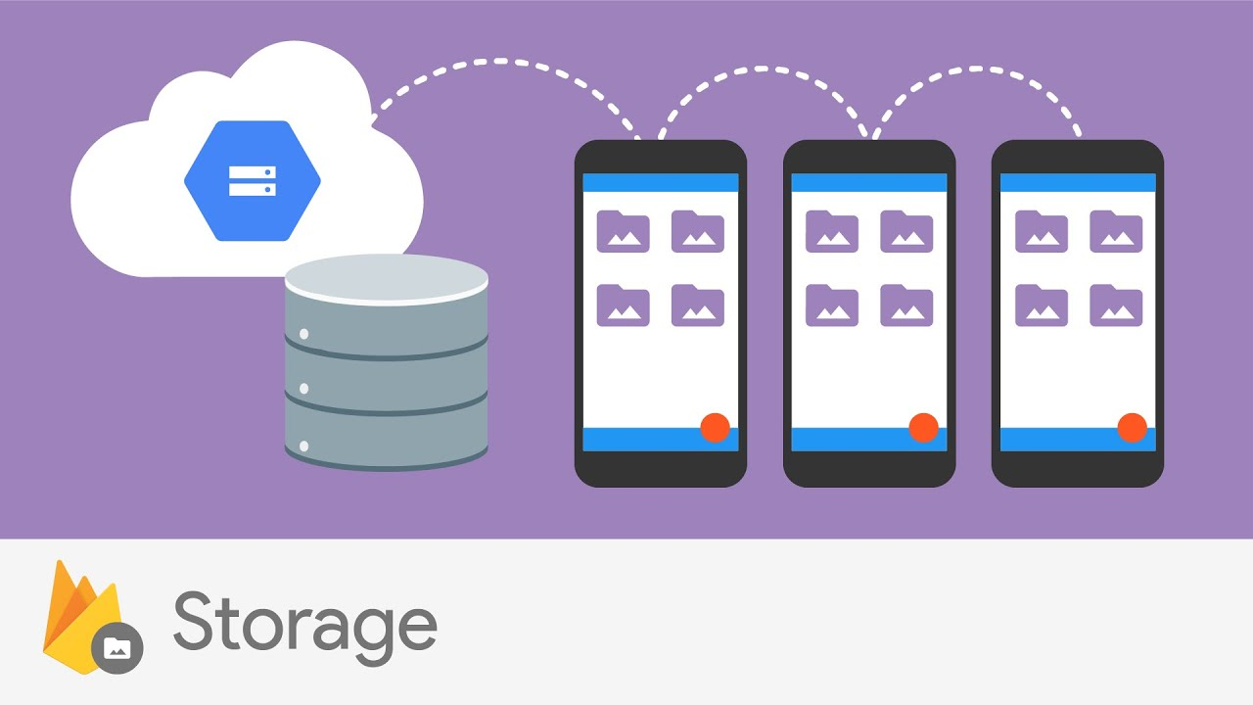
Firebase Storage
Firebase Cloud Storage is built with mobile connectivity in mind. Automatically pause and resume transfers as your app loses and regains connectivity.
You can use SDKs to store images, audio, video, or other user-generated content.
Cloud Storage is built for exabyte scale when your app goes viral. Effortlessly grow from prototype to production using the same infrastructure that powers Spotify and Google Photos.

Slide 9

Slide title 29
React JS
JavaScript library from Meta and community

Slide 10

React js
React is a library of JavaScript build by Facebook for building user interfaces for web application and mobile apps.
It’s an open source, reusable component-based front-end library
In Model View controller architecture, react is the view, which is responsible for how app looks like.
Pre-requisites:
JavaScript
HTML
CSS

Slide 11
Why React?
React is a library not a framework.
React is declarative, which doesn't interact with DOM directly and is in charge of taking declarative code and performing all the JavaScript operations.
High performance with less loading time.
It is Flexible and easy to maintain because react code is easy to update due to its virtual DOM feature.
For Complex UI’s react allows to reuse the components with similar UI’s, when we are dealing with lot of pages.

Slide 12
features
React application is composed of blocks of components.
Components are like functions that returns the HTML elements.
Hooks are the new added feature in react, available from version 16.
Hooks allow function components to have access to state and other React features. Because of this, class components are generally no longer needed.
React creates a VIRTUAL DOM in memory, thereby creating web applications faster.
Virtual DOM updates only those components in the real DOM which was edited, so the rest of the components remains stable, which defines faster performance.

Slide 13
Conclusion
React is an excellent tool with which to create interactive applications for mobile, web, and other platforms.
React’s benefits of being robust, advanced, responsive , non-risky, user-friendly increasing Usage of React gradually.
Firebase is very powerful and easy to use. It Basically makes Developer work easier, and he can focus less on data management logic because Firebase handles it with ease and with few lines of code.
The ability for the Firebase Realtime Database to sync with the Redux store without causing unexpected issues is a key benefit.

Slide 14
working example of React
npx create-react-app my-app
npx create-react-app my-app
We can create a react application by using
“npx create-react-app my-app” where my-app is your app name.
React application runs on server side i.e., whenever developer run’s the react application, you can see the app running in your web browser.
A basic react application has following important folders
1. node_modules which contains all the node packages that app requires.
2. public which contains static files such as index. html, JavaScript library files, images, and other assets, etc.
3. src which is the heart of React application as it contains JavaScript which needs to be processed by webpack.
4. Package.json file plays a very important role in the react application development and deployment. In short, we can say, Package.json = Metadata associated with project + All Dependencies with version + scripts.

Slide 15
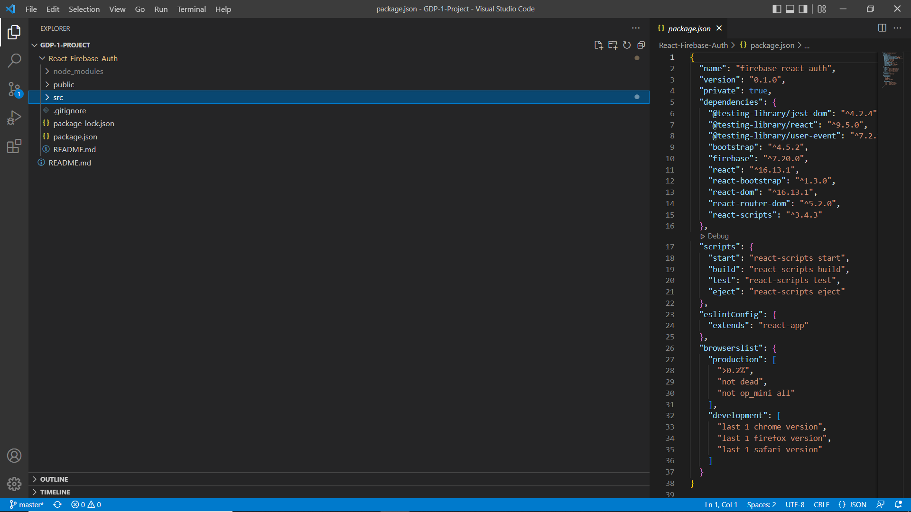
npx create-react-app my-app
Below is the image showing how a React application looks like

Slide 16
Components
In React, components plays an important role where the application is broken down into chunks and represented as components.
Consider an example where a web application consists of authentication for users like Register, Sign in, Logout, Forgot password and Update profile. Here each part acts as an individual component in React application where developers can write clean and efficient code and access them easily.
Each component is a file consisting of JavaScript code where code is rendered and returned to main App.js file. Components have html scripts and bootstrap to design the web page.
As mentioned earlier by using React-Hooks developers can change the state of the page.
For a component to be accessible in web application each component needs to be exported by using the keyword “export” and needs to be imported in App.js file using keyword “import”.
In React, Bootstrap and other libraries doesn’t come in handy to use instead one needs to install the dependencies and import the content which the developer needs to use.

Slide 17
Basic html code using functional component
import React from 'react';
import ReactDOM from 'react-dom';
// This is a functional component
const Welcome=()=>
{
return <h1>Hello World!</h1>
}
ReactDOM.render(
<Welcome />,
document.getElementById("root")
);
render() controls the contents of the container node you pass in.
ReactDOM.render(): will returns the contents to the real DOM.

Slide 18
Basic html code using class component
import React from 'react';
import ReactDOM from 'react-dom';
class Car extends React.Component {
render() {
return <h2>This is RCM!!h2>;
}
}
ReactDOM.render(<Car />, document.getElementById('root'));
A class component must include the extends React. Component statement. This statement creates an inheritance to React. Component, and gives your component access to React. Component's functions.

Slide 19
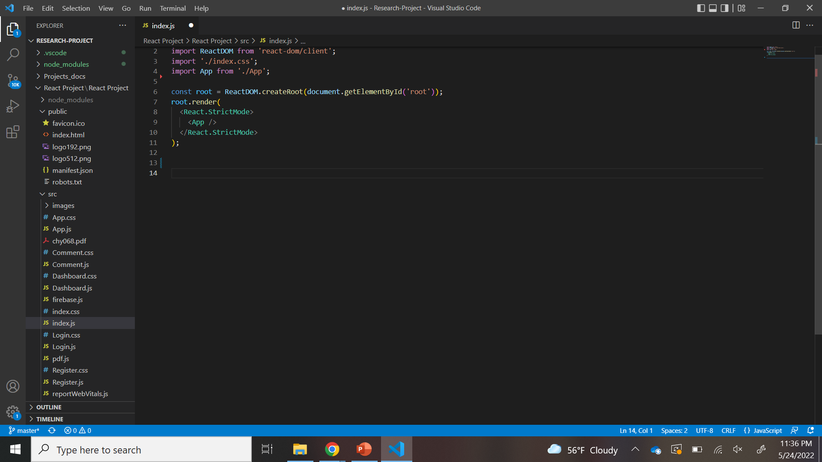
Index.js
StrictMode is a tool for highlighting potential problems in an application. StrictMode does not render any visible UI. It activates additional checks and warnings for its descendants.

Slide 20
App.js
Whenever React application is executed, ReactDOM renders App.js and starts displaying the structure or content which App.js holds.
App Component is the main component in React which acts as a container for all other components.
As already mentioned in previous slide we use export and import keywords to have a copy of components.
We use routers in React application to navigate between different components and the routers dependency need to be installed from "react-router-dom"

Slide 21
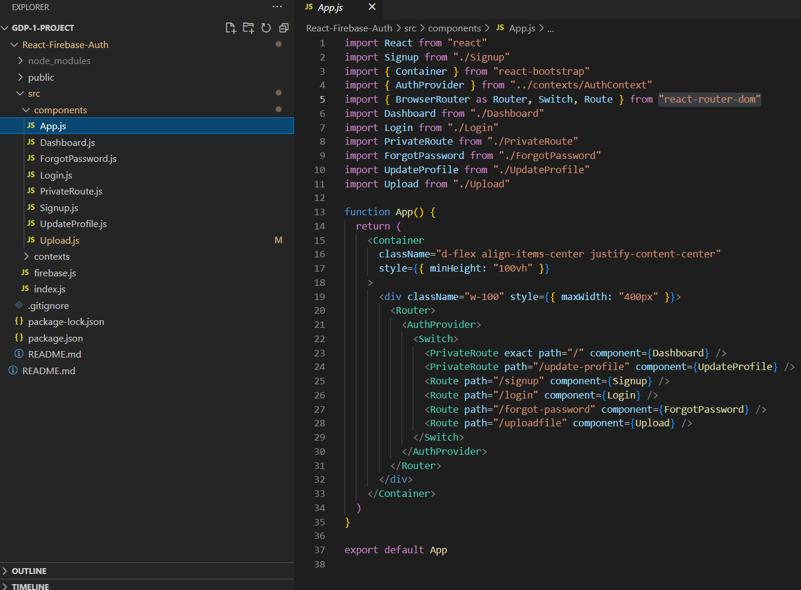
Below is the image showing how App.js look like

Slide 22
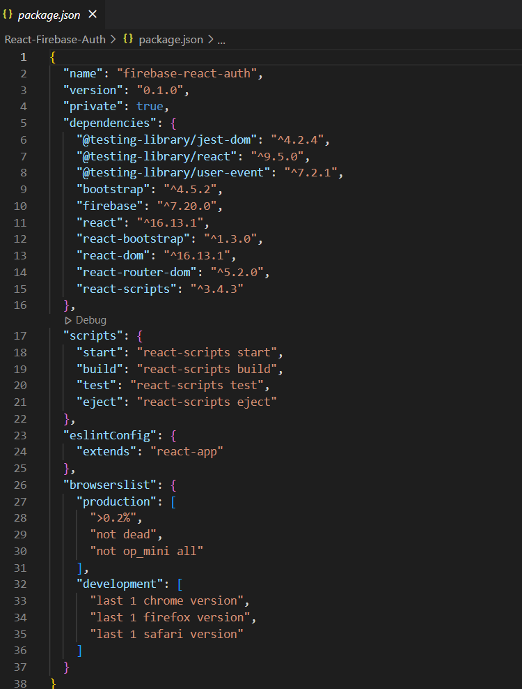
Package.json
Package.json plays a main role in defining which Metadata is associated with project, it also contains all Dependencies with version which are installed for the project and scripts.
Developers need to have a complete idea of how package.json is useful in a project as it is the file where all the information of project is depicted.
name is the name of your app, which you give while executing create-react-app<name-of-application>.
version is the current version of your app. By default, create-react-app initializes it as 0.1.0.
dependencies contains all the required node modules and versions required for the application in production.

Slide 23
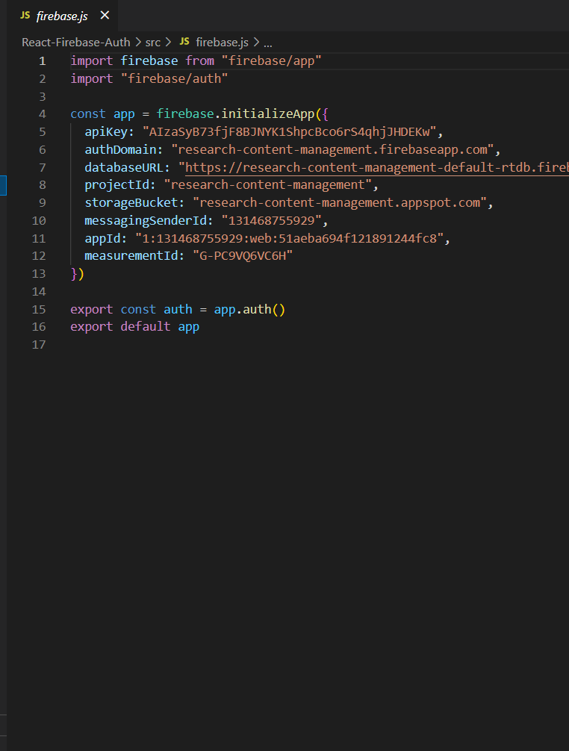
Connecting firebase to React Application
As our project deals with uploading research papers and adding comments for future reference. We used Firebase as our primary database to store user credentials, papers uploaded for respective user and comments added by user for respective paper.
Firebase provide a snippet for connecting database and React application for web, Android and IOS applications. As our project deals with web application, we use a web snippet provided by Firebase.
We create a file in React application and dump the snippet in the created file.
We export the firebase.js file and use the functionalities provided by firebase i.e., authentication, storage etc.

Slide 24
Thank You

