Slide 1
FINANCIAL RAG CHATBOT
Ingest
Q&A
Evaluate
Presented by,
Nithin Shetty M

Slide 2
Index
What this deck covers, in the order of a document's life
1
System architecture
Slide 3
3
Online Q&A architecture
Slide 8
4
Routing, input guardrails, planning and cache
Slide 9 – 10
5
Retrieval, reranking and generation
Slide 11 – 12
6
Output guardrails and grounding
Slide 13
7
Evaluation: architecture and RAGAS metrics
Slide 14 – 15
8
Serving, observability and tech stack
Slide 16
9
References and further reading
Slide 17

Slide 3
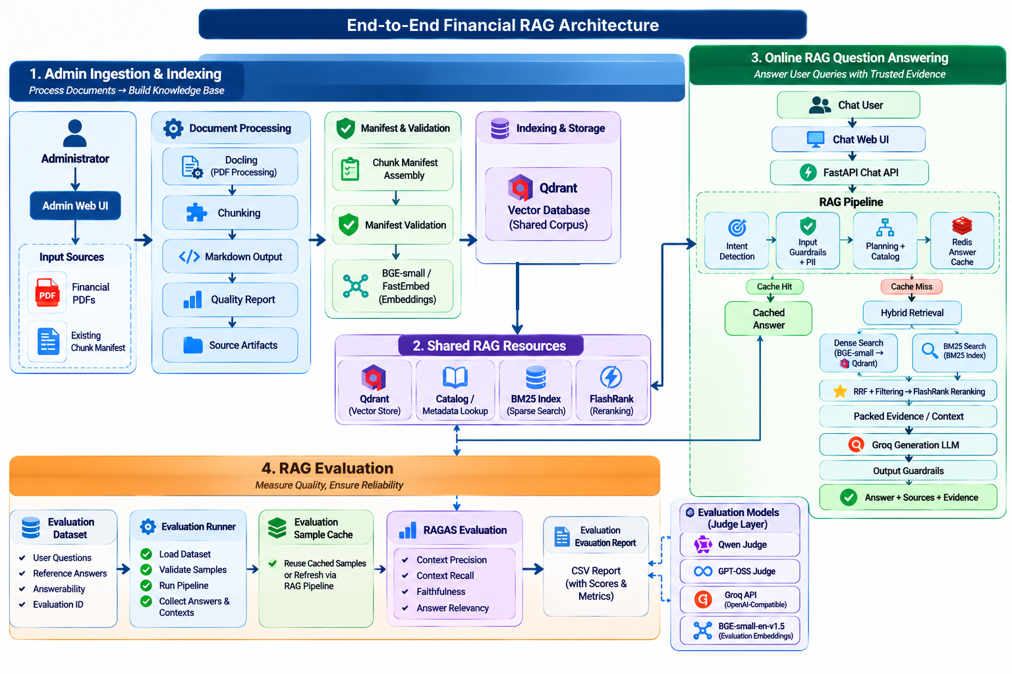
›

Slide 4
Parsing with Docling: structure first
parse_pdf.py: FastDoclingChunker turns a PDF into a structured DoclingDocument
ACCURATE
> 20%
4
0
TableFormer mode + PDF cell matching
pages without text triggers OCR fallback
artifacts saved per document
silent truncation of text
Layout and tables
Scanned PDFs
Cleanup and QA
Tables read from structured TableItem: cells, row/col spans, header flags
Cells expanded to a dense grid
Reading order from bounding boxes
No regex on flattened text
ocr_mode: auto, on or off
Auto: re-convert with OCR when over 20% of pages lack text
Falls back to the non-OCR result if OCR fails
Born-digital PDFs stay fast
Boilerplate and glyph-only noise removed
Fragments (under 35 chars or 6 words) are merged, not dropped
Quality report JSON per document

Slide 5
Chunking: three chunk types, loss-free
Docling HybridChunker, tokenized with the same bge-small tokenizer used for embedding
text
table
table_fact
HybridChunker, heading-contextualized
Budget: 500 tokens minus the Document / Page / Section prefix
merge_peers disabled
Whole table as a Markdown block
Caption, columns, row labels kept in metadata
Good for context and citation
Atomic multi-year row facts
Metadata: fiscal_years, row_group, financial_metric
Primary retrieval target for numeric questions
Loss-free splitting
Artifacts per document
Oversized text is split by lines, then sentences, then words, then raw token slices
Nothing is cut to fit
_manifest.json (chunks), _document.md
_quality.json, _docling.json (re-chunk without re-parsing)

Slide 6
Indexing into Qdrant
seed_qdrant.py + Streamlit admin UI (parse tab, upload-manifest tab)
Validate manifest
›
Embed (bge-small, batch 32)
›
Upsert points
›
Create payload indexes
›
Delete orphan points
Vector store
Idempotent writes
Filters and safety
Collection financial_rag_analytics
Named vector fastembed-BAAI/bge-small-en-v1.5
384 dimensions, cosine distance
Local path or remote QDRANT_URL
Point ID = uuid5(doc_id : chunk_id)
Re-indexing overwrites, never duplicates
Points of that document absent from the new manifest are deleted
Company and year inferred if missing
Payload indexes: document_id, chunk_type, company, fiscal_year, fiscal_years
Manifest file is kept on disk for the runtime BM25 search
Recreate-collection needs explicit confirmation in the UI

Slide 7
Architecture: online question answering
FastAPI request path; cache hit exits early, miss continues to retrieval
Chat user
asks a question
Chat Web UI
Streamlit, session state
FastAPI
POST /v1/chat, 40 s timeout
Intent router
embedding fast paths
Input rails + PII
NeMo, Presidio
Query planner
catalog, follow-ups, sub-queries
Output rails
numeric, leak, PII
Groq LLM
gpt-oss-20b, [S#] citations
Context builder
4,096-token budget
FlashRank
MiniLM-L-12 rerank
Hybrid retrieval
dense + BM25 + RRF
Redis cache
L1 exact, L2 semantic
Answer
text + sources + state
Cache HIT: Redis returns the stored answer directly.
Cache MISS: continue left through retrieval, rerank, generation and output rails.
Verified, complete answers are written to Redis asynchronously.
Qdrant + BM25
vectors; BM25 reads manifests
Request path
Cache
Shared stores

Slide 8
Intent routing and input guardrails
Fast, data-driven filters before any expensive call
Embedding intent router
NeMo Guardrails as a policy layer
Labelled examples (intent_examples.yml) embedded once at startup with bge-small
Cosine similarity to nearest example per class
Fast labels: smalltalk, elaboration, reference, summary, out_of_scope
Fires only if score 0.85 or more, margin 0.03 or more, and short (12 words; 40 for out-of-scope)
Otherwise falls through to the LLM router: a miss costs latency, not correctness
Text containing PII never takes a fast path
check_async() on input rails only; the RAG pipeline still owns generation
Injection heuristics + self_check_input LLM check (Groq)
PII masking via Presidio, regex fallback
8 s timeout; on NeMo failure, fail-open to deterministic rules (configurable)
Blocked requests get the Colang message or a scope refusal; raw PII is never logged

Slide 9
Query planning, catalog and two-tier cache
Cached answers are a pure function of (standalone question, scope, corpus)
Planner and catalog
Redis cache
Catalog = documents in Qdrant (TTL 300 s, manifest fallback)
LLM router sees known companies; outputs intent, entities, years, metrics, sub-queries, search_query
Resolves follow-ups: none, reference (rewrite to standalone), elaboration (needs previous answer)
SessionState (company, year, metric, document) carried across turns
Unknown company returns a clear not-found message
L1: exact match. L2: semantic, cosine distance 0.04 or less, then Jaccard word overlap 0.7 or more
Scope key = intent + entities + years + corpus_version (+ hash of previous answer for elaboration)
Elaboration uses L1 only
TTL: 24 h answers, 7 d greetings
Never cached: chat summary, general chat, incomplete answers; writes are fire-and-forget

Slide 10
Hybrid retrieval: dense + BM25 with RRF
hybrid_search_balanced(): per-entity quotas keep multi-company questions fair
Sub-queries per entity
›
Dense bge-small + BM25 (parallel)
›
Relax filters if under 5 hits
›
RRF fusion
›
Entity quota to 30 candidates
k = 60
30
8
5
RRF constant
rerank candidates
max concurrent searches
min strict hits before relaxing
Filtering
Fusion
Balance
Metadata filters: document_ids, company, fiscal years
If strict results are thin, retry with document filter only
Score = sum of 1 / (60 + rank) across rankings
Rank-based, so no score normalization between cosine and BM25
Quota = total / entities, spare slots filled by best leftovers
Failures in one retriever return empty, not an error

Slide 11
Reranking, context packing and generation
From 30 candidates to a small, cited, token-budgeted context
FlashRank rerank
Final-k policy
Context builder
ms-marco-MiniLM-L-12-v2, CPU only
rerank_balanced with entity-aware queries (company + metrics + years)
Default 5, cap 10
At least 3 chunks per company
+3 for elaboration follow-ups
Blocks tagged [S1], [S2]... with file, page, section
Stops at 4,096 tokens (token-counted)
source_map powers citations
System prompt + context
›
Groq gpt-oss-20b
›
Output guardrails
›
Strict re-prompt if figures ungrounded
Key rotation: a fallback Groq API key and chat_with_retry handle rate limits. Conversation history is sanitized and capped at 6 turns.

Slide 12
Output guardrails and grounding
Financial answers must be traceable to the retrieved evidence
Numeric grounding
Leak and PII checks
Completeness
Every figure in the answer must appear in the context
Ungrounded ratio over 0.5 blocks the answer in fallback mode
Numeric block triggers one strict retry
Prompt-leak detection
Masks email, card, SSN, IBAN, bank, Aadhaar, PAN
Phone numbers allowed in output: filings contain IR phones
Every requested company must be in the evidence
Missing company: prefix note, answer not cached
Blocked answers are never cached
Response contract (ChatResponse)
answer, retrieved_chunks (page, type, rrf_score, final_score), source_map, updated SessionState, intent, search_query

Slide 13
Architecture: offline RAGAS evaluation
Reuses the production pipeline in-process, so scores reflect the real system
Eval dataset
question, reference, answerability, id
Sample validation
invalid samples excluded
Sample cache
HIT reuses, MISS or refresh runs
RAG pipeline
run_rag_pipeline_async, in-process
Eval sample
answer + retrieved contexts
Shared corpus
Execution logs
failures, not scored
Per-sample scores
one row per question
Four metrics
precision, recall, faithfulness, relevancy
RAGAS evaluator
per-sample, robust retries
same Qdrant + BM25
Report CSV
evaluation report
Aggregate means
per-metric averages
Judge LLMs
Qwen + GPT-OSS via Groq, failover
Embeddings
bge-small for answer relevancy
Evaluation steps
Production pipeline
Evaluation-only model services

Slide 14
Offline evaluation with RAGAS
ragas4.py runs the real pipeline in-process and scores each sample
Dataset (question, reference, id)
›
Validate samples
›
Cache hit or fresh pipeline run
›
RAGAS scoring
›
Per-sample CSV + means
Metric | Question it answers
Context precision | Are the relevant chunks ranked high?
Context recall | Does the context cover the reference answer?
Faithfulness | Is every claim supported by the context?
Answer relevancy | Does the answer address the question?
Judge infrastructure
Two judge LLMs (Qwen, GPT-OSS) through Groq's OpenAI-compatible API
Custom httpx transport: dual keys, model failover, retry-after backoff
Up to 5 contexts of 1,500 chars per sample; pipeline concurrency 2
bge-small embeddings for answer relevancy
Sample cache avoids re-running generation; refresh flag forces it

Slide 15
Serving, observability and tech stack
Designed to fail soft and be debuggable in production
Serving (FastAPI)
Observability (Logfire)
/health, /health/ready (503 while models warm up), /v1/chat
Warmup preloads embeddings, BM25, reranker, router, guardrails, cache
40 s request timeout returns 504
Streamlit chat UI checks readiness, shows source chunks
FastAPI, httpx and pydantic instrumented
Spans per stage with intent, cache tier, tokens, guardrail events
Query PII-masked before logging
Docling
bge-small / FastEmbed
Qdrant
BM25
FlashRank
Groq gpt-oss-20b
NeMo Guardrails
Presidio
Redis
FastAPI
Streamlit
RAGAS
Logfire
Next: tune intent and cache thresholds from logs, grow the eval set, add more filings.

Slide 16
References and further reading
Docling Technical Report arXiv:2408.09869; github.com/docling-project/docling
TableFormer: table structure with transformers arXiv:2203.01017
RAG for knowledge-intensive NLP (Lewis et al.) arXiv:2005.11401
C-Pack / BGE embeddings arXiv:2309.07597; huggingface.co/BAAI/bge-small-en-v1.5
Reciprocal Rank Fusion (Cormack, Clarke, Buettcher) SIGIR 2009
BM25: The Probabilistic Relevance Framework Robertson and Zaragoza, 2009
RAGAS: automated evaluation of RAG arXiv:2309.15217; docs.ragas.io
NeMo Guardrails arXiv:2310.10501; github.com/NVIDIA/NeMo-Guardrails
Docs: Qdrant, FlashRank, Presidio, Logfire qdrant.tech/documentation; github.com/PrithivirajDamodaran/FlashRank; microsoft.github.io/presidio; logfire.pydantic.dev/docs
Video talks YouTube: search "Docling IBM Research", "hybrid search RRF Qdrant", "RAGAS evaluation tutorial"

