Slide 1
Wireshark Packet Analysis
Network Traffic Monitoring & Protocol Analysis
Presented By: Nithin

Slide 2
Objective
Understand network packet analysis using Wireshark
Capture and inspect live network traffic
Analyze protocols such as DHCP, ARP, MDNS, and ICMPv6
Observe packet flow and communication behavior
Gain practical knowledge of network monitoring

Slide 3
Tools Used
Kali Linux
Security testing platform
Wireshark
Network protocol analyzer
VMware Workstation
Virtualization environment

Slide 4
Step-by-Step Procedure
Open Kali Linux in VMware
Launch Wireshark
Select active network interface (eth0)
Start packet capture
Apply filters (dhcp, arp, mdns)
Analyze captured packets
Observe source IP, destination IP, and ports
Document findings and save screenshots

Slide 5
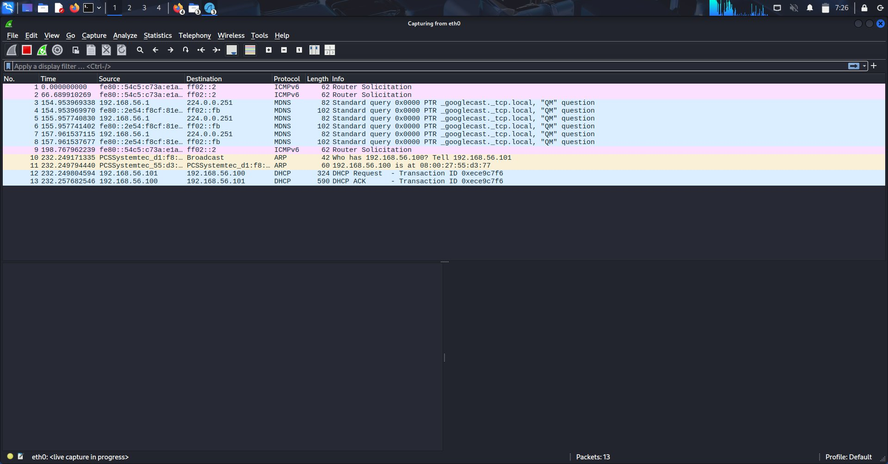
Wireshark Interface
Live packet capture showing DHCP, ARP, and MDNS traffic

Slide 6
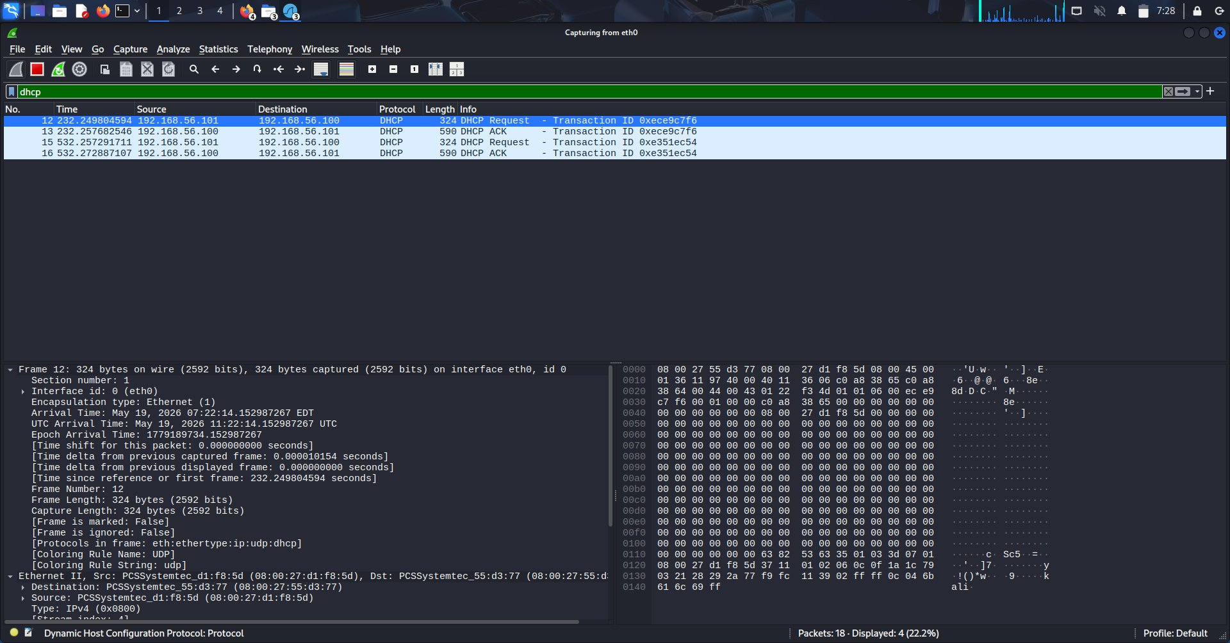
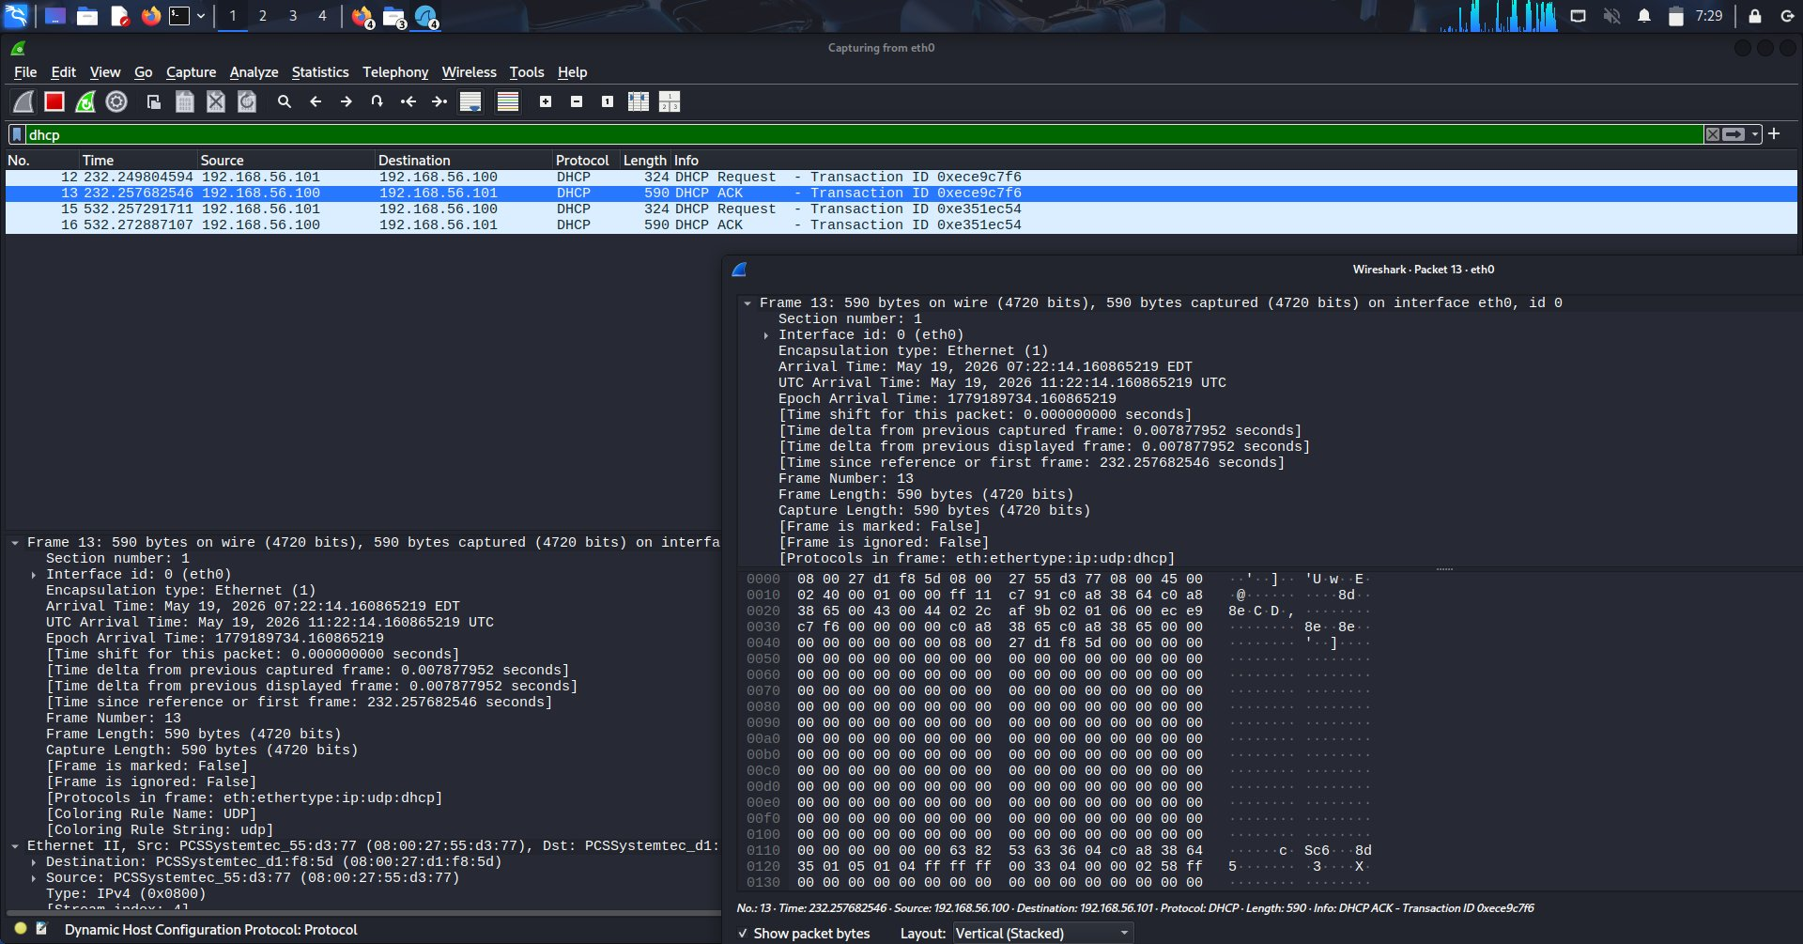
Packet Analysis – DHCP
Filter Used: dhcp
Observed DHCP Request and ACK packets
Identified IP address assignment
Analyzed client-server communication
Studied transaction IDs and flow

Slide 7
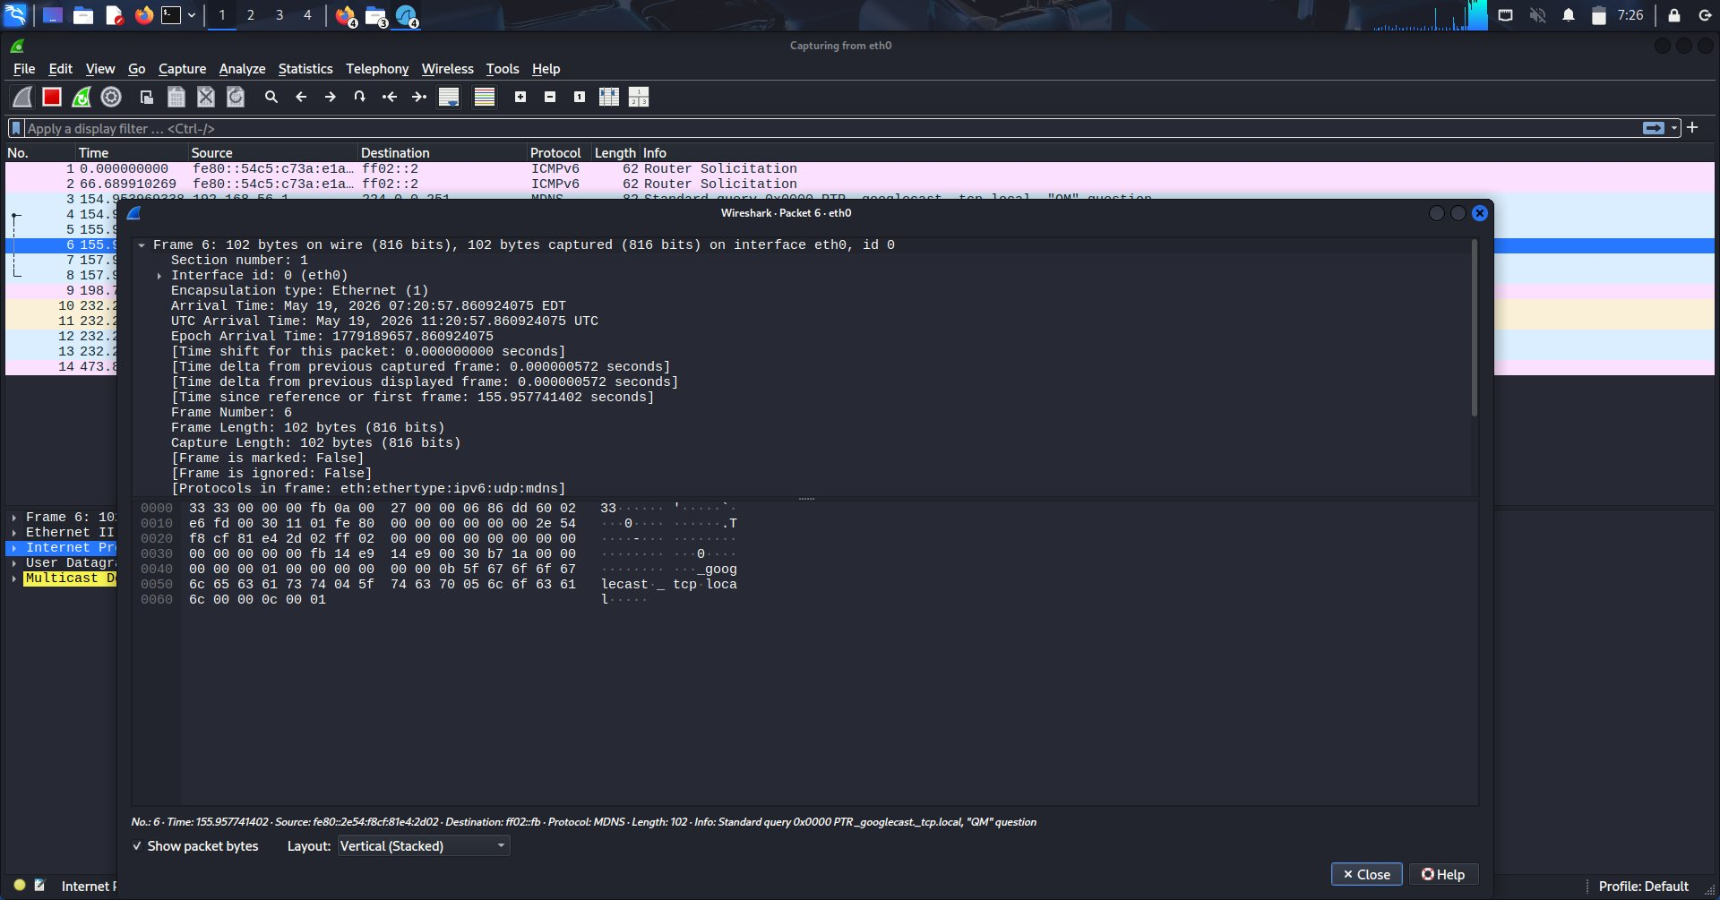
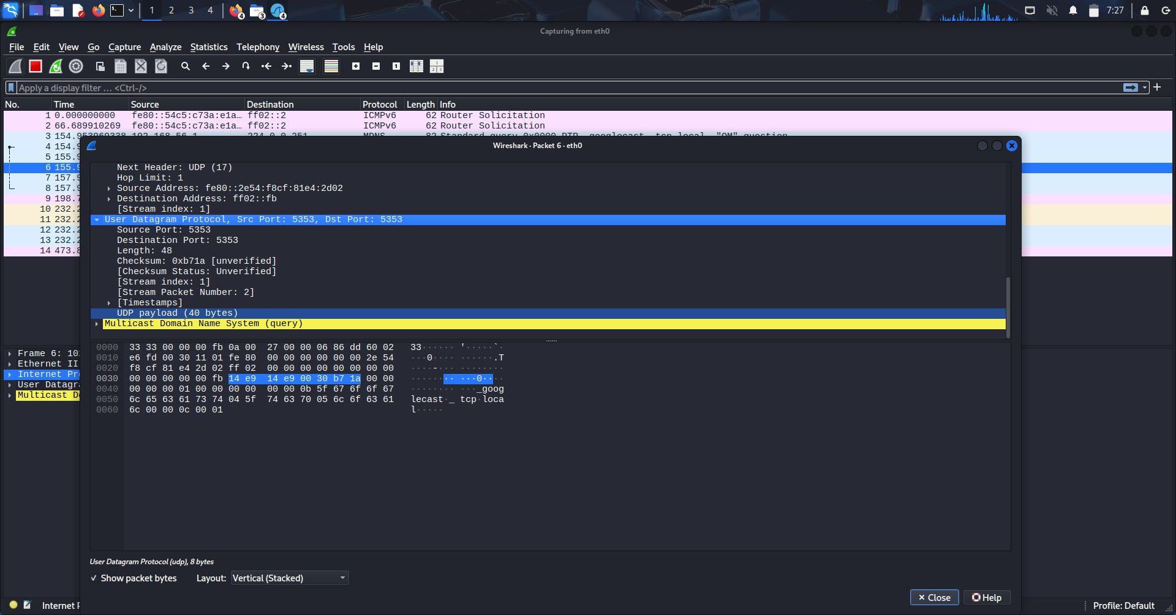
Packet Analysis – MDNS
Multicast DNS Protocol
Captured multicast query packets
Local network service discovery
UDP communication on port 5353
Analyzed packet structure

Slide 8
Packet Analysis – ARP
Analysis
Observed ARP requests and replies
Identified MAC address resolution process
Studied communication between devices on the local network
ARP resolves IP addresses to MAC addresses for local network communication

Slide 9
Key Findings
Successfully captured and analyzed live network traffic
Identified DHCP, ARP, MDNS, and ICMPv6 packets
Understood packet structure, headers, and communication flow
Improved practical knowledge of network protocols
Gained experience with traffic analysis techniques

Slide 10
Skills Gained
Packet Analysis
Traffic Monitoring
Protocol Inspection
Network Troubleshooting
Wireshark Filtering
Network Security Fundamentals

Slide 11
Conclusion
This project provided hands-on experience in capturing and analyzing network packets using Wireshark in a controlled lab environment. The activity improved understanding of network protocols, communication flow, and packet-level analysis techniques used in cybersecurity and network monitoring.

Slide 12
Thank You
Questions?

